Slide 1
ATTACHMENT
FACILITATOR CLASSROOM GUIDE
Modified January 2022
Notes:
ATTACHMENT
FACILITATOR CLASSROOM GUIDE
Modified January 2022

Slide 2
To prepare for the Class
See Notes view
Notes:
To prepare for this class, you should:
Review the facilitator preparation information included in this Guide along with the handouts.
Review the Resources for this theme found on CapLEARN (https://learn.childwelfare.gov/) or NTDC website (https://ntdcportal.org/).
Develop an agenda that includes this theme and any other themes you will be conducting along with it during the class.
Ensure that participants have a copy of the Participant Resource Manual and that it is accessible to them. This Manual will be used during all themes and will have handouts needed by participants. Facilitators should have copies of the handouts for the theme available in case participants do not bring their Manual to class. If the theme is being taught on a remote platform, facilitators should have the handouts available so that they can share in the chat and/or email to participants who do not have their Manual.
Bring any materials you need for the activities. .
Review any videos or other electronic media used in this theme, if any, and plan the mechanics of how you will present them. Media for this theme are listed in the Materials and Handouts slide. Review the instructions for each media clip (e.g., to pause or stop at a particular time stamp). The videos can be played in different ways, including:
Play them from a flash drive or the computer’s hard drive using a media player app
Link to them from CapLEARN or the NTDC website.
Practice playing the media for the theme. Ensure that you have the files and apps you need, that your links and connections work, and that you know when to pause or stop the media clip if appropriate.
If training on a remote platform, make sure all participants have the link available to access the class and that you have all videos, PPT’s and handouts ready for use.
If training in person, ensure that a room is available and set up, with the following:
Enough tables and chairs for all participants
Projector and screen (check that it works with the computer you will be using)
Classroom activities have been adapted so that they can be done on a remote platform. Adaptations will be marked as follows so that they can be easily spotted throughout the Facilitator Classroom Guide: Adaptation for Remote Platform
PREPARATION

Slide 3
MATERIALS AND HANDOUTS
See Notes view
Notes:
FACILITATOR'S NOTE
Participants are expected to have the Participant Resource Manual available for every session.
MATERIALS NEEDED
You will need the following if conducting the session in the classroom:
A screen and projector (test before the session with the computer and cables you will use)
A flipchart or whiteboard and markers for several of the activities. A flipchart with a sticky backing on each sheet may be useful and will allow you to post completed flipchart sheets on the wall for reference.
Name tent cards (use the name tent cards made during the Introduction and Welcome theme.)
Something to use as a grab bag for the Examples of Relationship Promoting Activities exercise e.g., a paper bag, a hat, a cardboard box, or a plastic bin.
Small sheets of paper for the Relationship Promoting Activities activity. A 3x5 card will work but smaller sizes are also OK. Bring at least two per participant; more is fine.
You will need the following if conducting the session via a remote platform:
Access to a strong internet connection
A back-up plan in the event your internet and/or computer do not work
A computer that has the ability to connect to a remote platform- Zoom is recommended
HANDOUTS
Have the following handouts accessible. Participants will have all handouts listed below in their Participant Resource Manual:
Handout #1: Cycles of Attachment
Handout #2: Examples of Relationship Promoting Activities
Handout #3: JAR Activity Worksheet
VIDEOS AND PODCASTS
Before the day when you will facilitate this class, decide how you will show/play the media items, review any specific instructions for the theme, and do a test drive. You may wish to set up the media to the start point. Unless indicated otherwise below, all videos and podcasts can be obtained on CapLEARN (https://learn.childwelfare.gov/) or NTDC website (https://ntdcportal.org/).
The following media will be used in this theme:
Jacob Ham video / Avoidant Attachment (4.12 minutes)
Jacob Ham video / Ambivalent Attachment (4:41 minutes)
The Dark Matter of Love Clip One (2:51 minutes)
The Dark Matter of Love 4 S’s (1:48 minutes)
NTDC video-Relationship Focused Discipline (9:04 minutes)
EVALUATION
There is a pre- and post-survey available for every theme. If the facilitator wants to use these evaluation tools, they will need to be downloaded from the NTDC website or CapLEARN and provided to participants. Participants will need to complete the pre-survey prior to the theme and the post-survey upon completion of the theme. If conducting the class on a remote platform, the facilitator will need to put the surveys into an online format such as survey monkey.
MATERIALS AND HANDOUTS

Slide 4
Theme and competencies
See Notes view
Notes:
FACILITATOR'S NOTE
Prior to the session, review the theme and competencies. You will not read these aloud to participants. Participants can access all competencies in their Participant Resource Manual.
THEME AND COMPETENCIES
4

Slide 5
Suggested agenda
See Notes view
Notes:
FACILITATOR'S NOTE
This notes page shows a suggested agenda and timing for this theme. Before the theme, please review this agenda and incorporate it into your overall agenda for this and any other themes you are conducting along with it.
AGENDA
This theme is divided into five sections. This content is based on 2 hours of classroom material, including a 10-minute break. (See agenda in notes view)
BEFORE YOU BEGIN THE CLASS
Before discussing the Color Wheel of Emotions and covering the content of this theme, you should do the following:
Make any announcements that are needed regarding the training, timing of training, or process to become a foster or adoptive parent.
Take out the Participant Resource Manual and direct participants to this theme in their Manual. Remind participants that the Competencies for today’s theme are in their Manual.
Review the agenda for the theme. Facilitators should add a slide to the PPT deck that includes the agenda so that they can review it with participants. Make sure to include start and end times and any breaks that will be taken during the session.
Encourage participants to be engaged and active learners.
Encourage participants to contact you in between classes with any questions and/or concerns. (Prior to class, list the name(s) of the facilitators on the board with contact information.)
Remind participants to put out their name tents (these can either be made by the participants during the first class or the agency can print out name tents and provide them to the participants at the first class). If conducting the class on a remote platform, remind participants to type their first and last names in their screen box.
SUGGESTED AGENDA

Slide 6
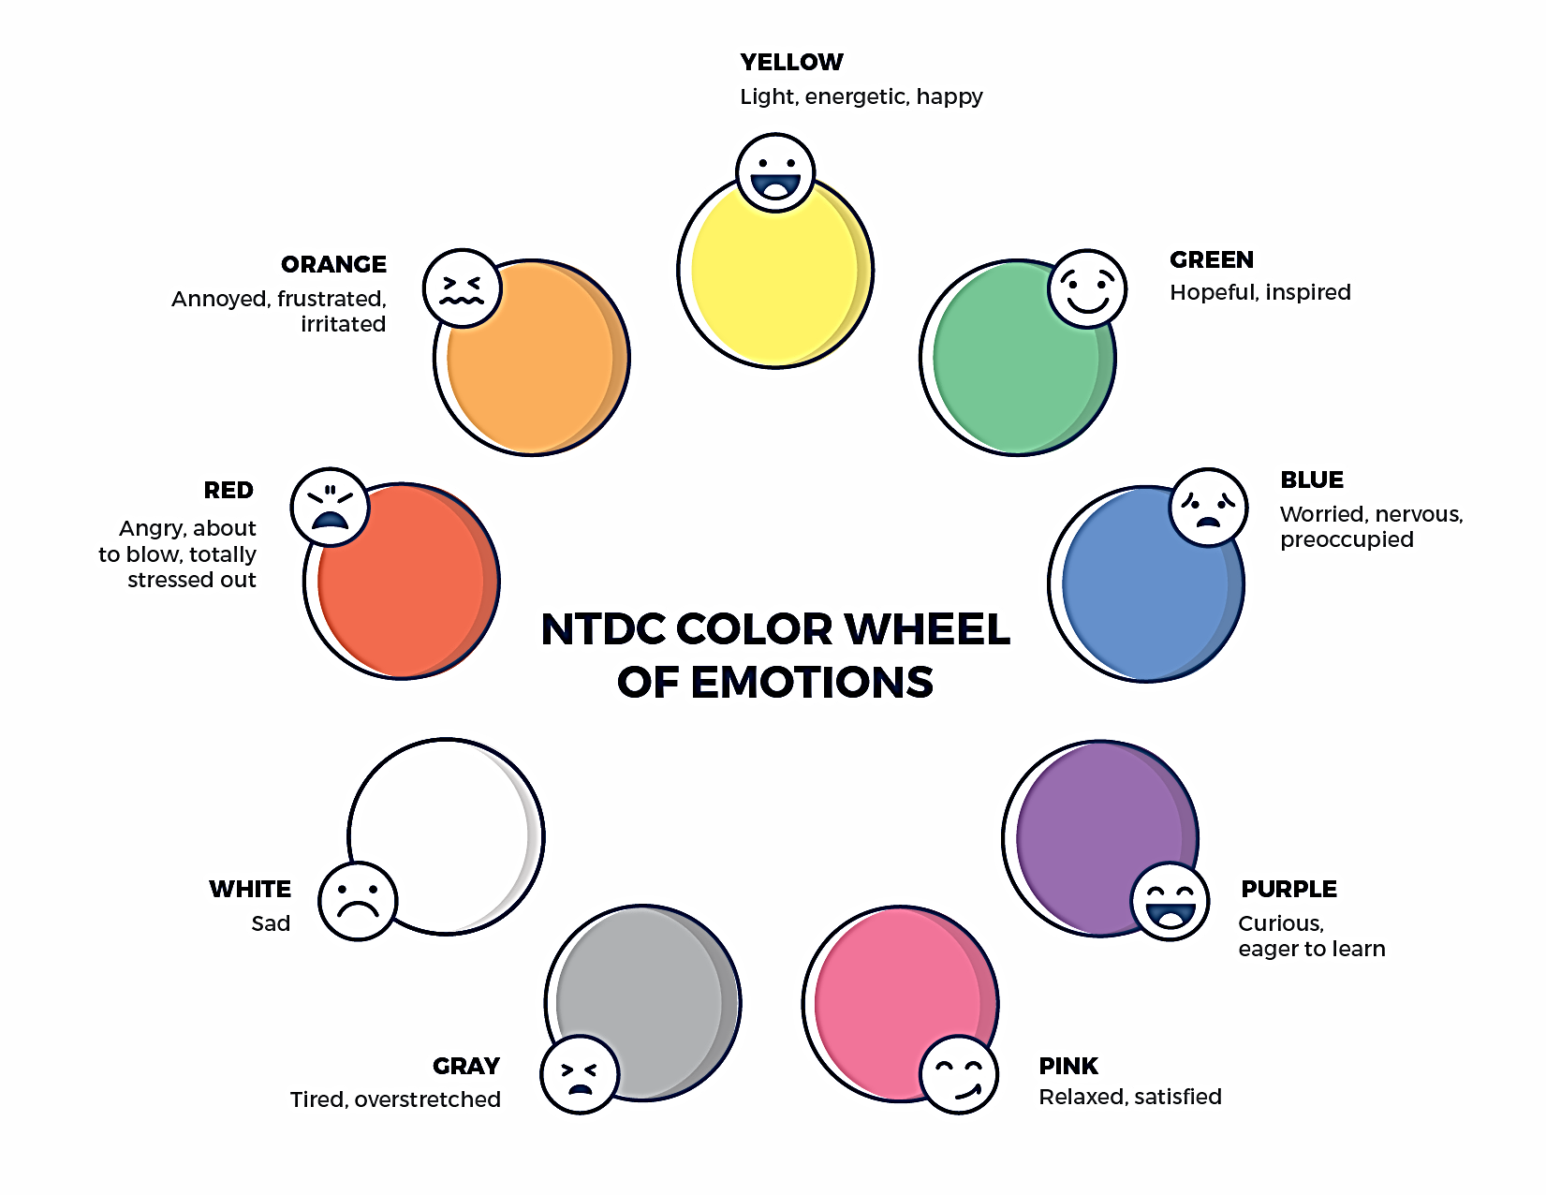
Welcome to the national training and Development Curriculum for foster and adoptive parents
Notes:
FACILITATOR'S NOTE
Have this slide showing onscreen as participants assemble for the first class of the day. As participants come in, welcome them back and ask them to take a few minutes to do a self-check using the Color Wheel. NOTE: The Color Wheel should only be done one time per day; before the first theme of the day. If combining several themes together on one day, facilitate the Color Wheel at the beginning of the first class of the day as participants are coming into the room.
SAY
Welcome back. We are so glad that you have taken time out of your day to join us for another exciting learning opportunity. As you recall, tuning in to how you’re doing on a daily basis may not be something everyone here is used to, but this type of regular self-check is critical for parents who are adopting or fostering children who may have experienced trauma, separation, or loss, as it will be helpful to become and stay aware of your own state of mind. It may seem like a simple exercise but be assured that knowing how we’re doing on any given day strengthens our ability to know when and how we need to get support and/or need a different balance. Doing this type of check in will also help us to teach and/or model this skill for children! Please take a moment to look at the color wheel and jot down on paper the color(s) that you are currently feeling.
DO
Wait a little while to give participants time to complete the Color Wheel.
SAY
Now that everybody has had the opportunity to do a quick check in, would someone like to share what color(s) they landed on today for the Color Wheel?
DO
Call on someone who volunteers to share their color(s). If a challenging emotion or feeling is shared, thank the person and acknowledge their courage in sharing, pause for a moment, encourage everyone to take a deep breath, and transition to beginning the theme.

Slide 7
ATTACHMENT
Modified January 2022
Notes:
FACILITATOR'S NOTE
Show this slide briefly just before you start the class.
SAY
Let’s get started! Welcome to the Attachment theme.
7

Slide 8
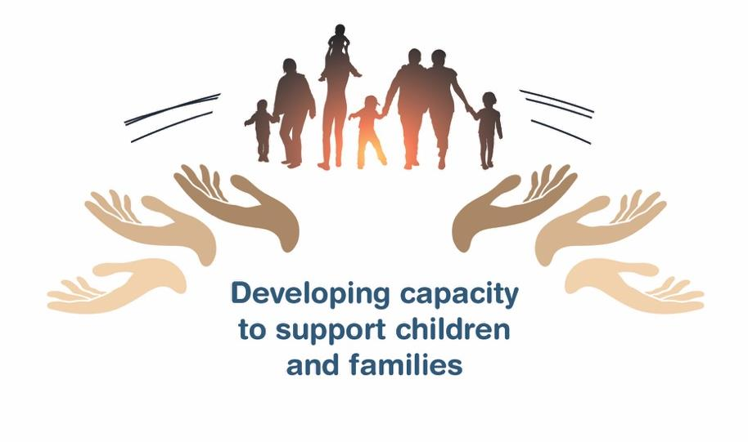
Place holder for slide with opening Quote
Notes:
FACILITATOR'S NOTE
The opening quote slide should only be used for the first theme of the day. If combining several themes together on one day, the opening quote slide would only be shown after the Color Wheel at the beginning of the first theme. It is important to always emphasize with this slide that this type of parenting involves lifelong learning and it will be critical for families to be invested in their own learning before and after a child is placed in their home.
PARAPHRASE
We are excited to share this lesson with all of you today. We are going to start with the Attachment theme. As the slide states, this information will help to develop your capacity to support children and families. This type of parenting will require continuous learning. So, let’s dive in and see what important information we have to share with you today.
8

Slide 9
SECTION 1:
INTRODUCTION: ATTACHMENT
Notes:
PARAPHRASE
For anyone who fosters or adopts a child, you will find that prioritizing the relationship with the child becomes the most important thing you can do. It can also be the most challenging part of parenting because that may not be as easy as it may sound. As we begin our conversation on attachment, some key things to know about relationships are:
Attachment is the foundation of all parent-child relationships.
Attachment is an emotional dance between two people-no two relationships are the same.
The way a child relates to their current caregiver is directly impacted by what they experienced with their earlier caregivers.
To really feel that the world is safe now, children who have experienced separations, loss, and trauma will need caregivers to show them this through their understanding and by consistently meeting their needs.
After we learn more about attachment, we can discuss strategies to help you build your toolkit to enhance your relationship with the child you foster or adopt.
This information is also relevant for children living with kinship caregivers who already have a pre-existing connection and relationship with the caregiver.

Slide 10
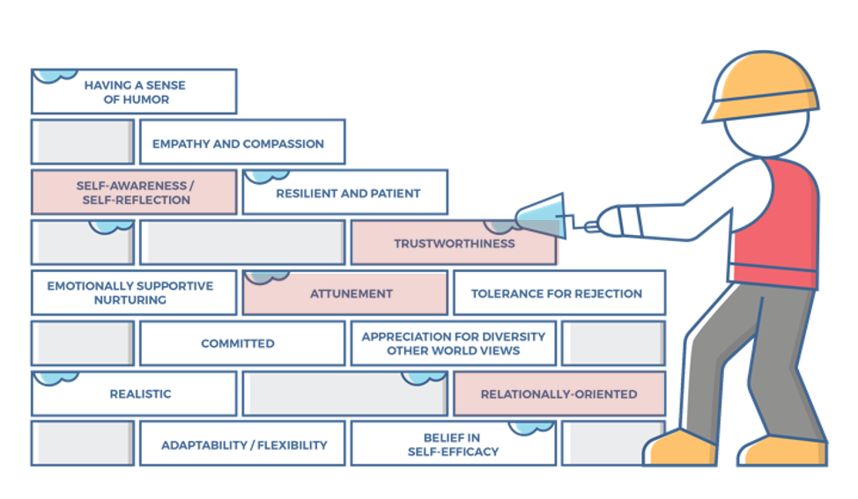
Characteristics of successful foster and adoptive parents
10
Notes:
FACILITATOR'S NOTE
This slide is shown at the start of each theme. Although the graphic will remain the same, the bricks that are colored in red will change based on the characteristics that will be touched upon in this theme. The characteristics were obtained from review of literature, stakeholder interviews, and review of existing curricula. We want families to become very acquainted with these characteristics throughout the training. It is important to note that in addition to the characteristics that are highlighted in red, there may be additional characteristics that are touched upon during the theme. Facilitators should try to connect these characteristics to the information they are sharing throughout the training. Remind participants that their Participant Resource Manual contains the definitions for these characteristics.
SAY
There are 14 characteristics of successful foster and adoptive parents. The Attachment theme will cover the following characteristics:
Self-Awareness/Self-Reflection
Trustworthiness
Attunement
Relationally-Oriented

Slide 11
Characteristics for attachment, 1 of 2
Self Awareness/Self Reflection
Parents can identify why they have responded to a child in a certain way.
Parents can identify what was good, bad, and different about the way they were raised, while adjusting their own parenting to meet a child’s needs.
Parents can identify and forgive themselves for having negative feelings towards a child, moving from disappointment to acceptance.
Parents are aware of their own history of experiencing loss and being hurt, and can identify how this history can negatively impact their parenting if they are not careful.
Trustworthiness:
Parents know that creating an environment of trust is the role of the parent.
Parents know that trust is based on understanding the importance of honesty, consistency, routines, and rituals, and they can implement these qualities/strategies in the home.
Parents are careful in what is promised to a child so that the parents can keep their word and meet the expectations they have set.
Notes:
FACILITATOR’S NOTE
Move to the next slide after reviewing this one, then ask the question after reading all 4 Characteristics.
SAY
The Attachment theme will cover the following characteristics:
Self-Awareness/Self-Reflection
Trustworthiness
Attunement
Relationally-Oriented
Take a moment to think back how you assessed yourself with these characteristics. It is important as you start this journey to assess your characteristics as they are qualities that can strengthen your ability to successfully parent a child who is in foster care or has been adopted.

Slide 12
Characteristics for attachment, 2 of 2
Relationally Oriented:
Parents recognize and value the relationships the child has with others including their family.
Parents show respect for the child’s family and previous relationships, and to the child.
Parents move beyond any anger or jealousy they may feel toward the child’s family in order to help the child resolve relationship issues with their family members and former foster families.
Parents are able to help a child grieve losses, maintain connections, and feel good about themselves.
Attunement:
Parents are aware of, understand, and sensitive to the responses and needs of a child, even when the child does not directly express needs.
Parents are in tune with child’s moods, rhythms and responses, needs for physical contact, affection, security, stimulation and movement.
Parents understand that they need to stay calm and regulated so that they can successfully help the child regulate their emotions.
Notes:
ASK
Now that we have reviewed the definitions, why do you think these specific characteristics are important to attachment?
Reinforce the following:
Self-Awareness/Self-Reflection
Understanding how the way we were parented affects how we are currently parenting is important.
Without self-reflection, our strong feelings may come out in reactions that could increase a child’s worry and self-blame as children tend to blame themselves when they see a parent be upset.
Trustworthiness
Children who have experienced separations, loss and trauma have had their trust broken; parents who foster or adopt will need to put their relationship with the child first to slowly earn their trust.
To create trust, parents will need to structure the child’s world in consistent and predictable ways, and follow through with what they say they will do.
Relationally-Oriented
It is important to value the relationships children have with others and it will help the child not feel they have to chose between people they care about.
Attunement
Being attuned to the child’s emotional needs (i.e., moods and feelings of security) and physical needs (i.e., hunger, levels of exhaustion) help a parent respond positively to those needs and gradually build the child’s trust and sense of safety.
Being attuned means paying attention to more than words, there are many subtle clues that can help adults learn when a child is in need.

Slide 13
SECTION 2:
ATTACHMENT PATTERNS
Notes:
FACILITATOR'S NOTE
This section will take approximately 45 minutes.
PARAPHRASE
Let’s now talk about how attachment is developed and spend some time talking about attachment styles and how they affect behaviors. Later in class, we’ll focus on ways to enhance your relationship with a child that you are fostering or have adopted.

Slide 14
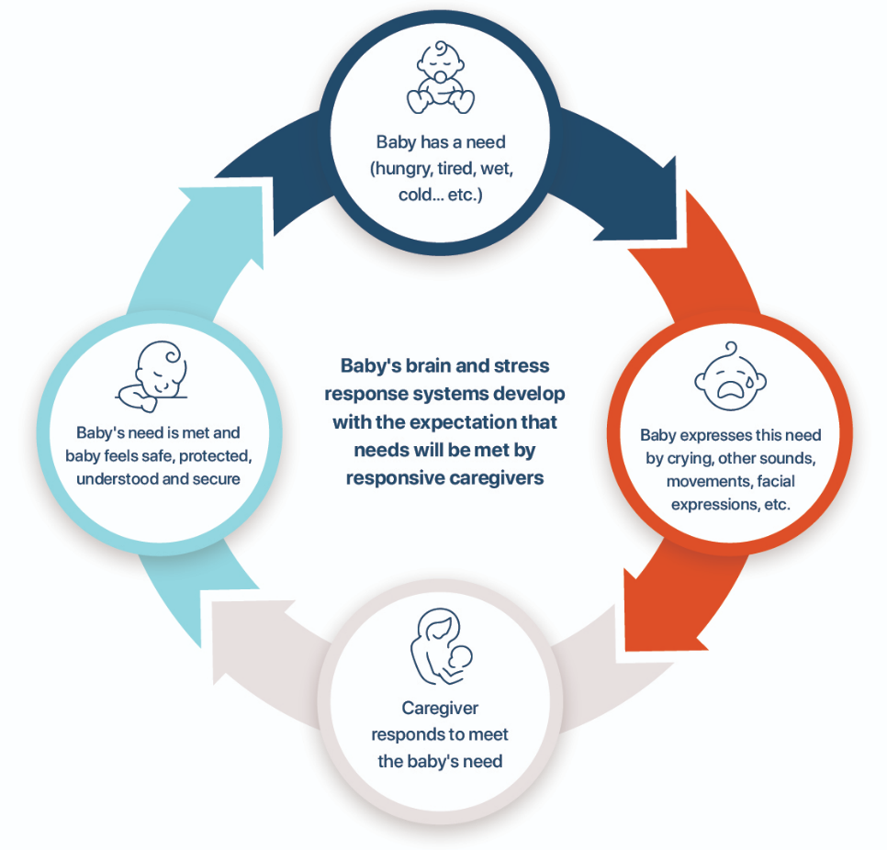
Healthy Cycle of Attachment
Healthy Cycle of Attachment
Notes:
FACILITATOR’S NOTE
It may be useful to point to the graphic as you move through this cycle of the child’s needs being met. This graphic is also Handout #1: Cycles of Attachment for this theme in the Participant Resource Manual if it is easier for participants to view on paper.
This content is meant to move quickly as the focus should be on the disrupted cycle of attachment, which comes next.
SAY
To understand attachment, we need to go back to the beginning. The building blocks for relationships begin in the earliest months between a child and the primary person(s) taking care of them. In a healthy relationship, when the baby expresses a need, the parent comes to meet that need.
ASK
What kinds of needs do babies express?
Reinforce:
Hunger
Sleepy
Too hot or cold
Dirty diaper needs changing
Lonely
How many times a day do babies express these needs?
Reinforce: Many!
How do parents and caregivers meet these needs?
Reinforce:
Picking them up/holding
Soothing
Rocking/walking/movement
Cooing/singing
Changing what they need-diapers, temperature, environments, etc.
SAY
That’s why caregivers of newborn babies are often so exhausted. But it is important to meet the baby’s needs because it teaches the child that their needs are understood, so they can relax because the world is predictable and, therefore, safe.

Slide 15
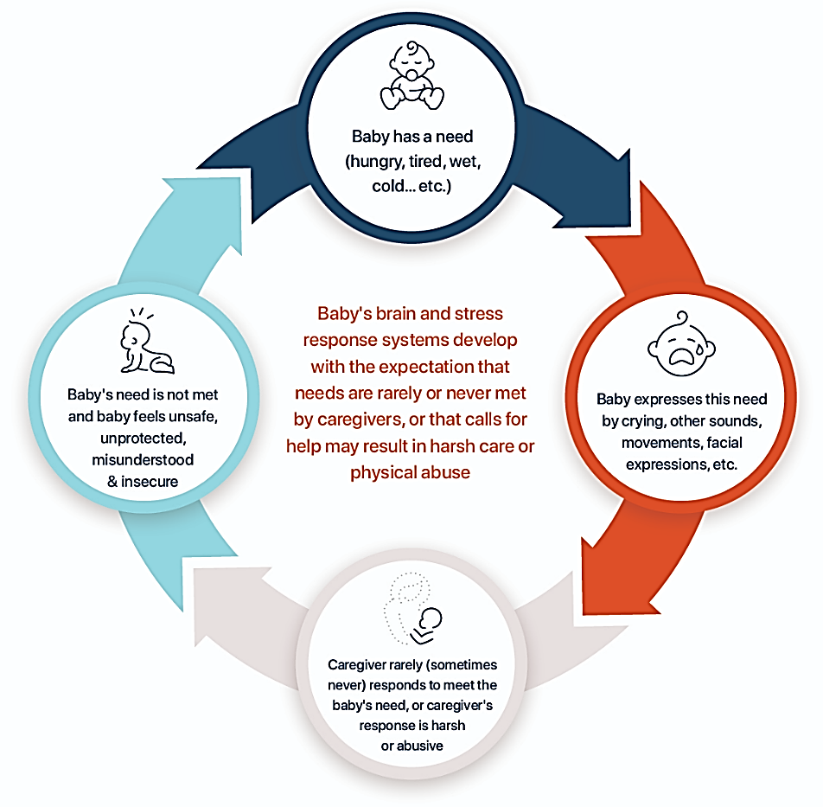
Disrupted Cycle of Attachment
Notes:
PARAPHRASE
When a parent does not come or does not reliably meet the child’s needs in an appropriate way, the cycle of healthy attachment gets disrupted. The child’s developing brain and body do not learn to relax or feel secure. Instead, they learn difficult messages about people and the world. The world may feel like an unsafe and scary place, and that people will not be there to meet their needs Unfortunately, this may be the early experience of most of the children that you will be fostering or adopting.
While we cannot actually recreate the attachment process with older children who have experienced disruptions, we can promote their relationships with stable, nurturing, and attentive caregivers that can provide the emotional support necessary for the child’s healing no matter what age they are when they come to you.
Relationships that focus on the child’s needs over and over again will help improve how the child feels about themselves and interacts with others. This is why parents who are fostering and adopting will become so important in the child’s life!

Slide 16
OVERVIEW: STYLES of attachment
Attachment is formed early in life and creates expectations and beliefs that will guide later relationships.
Styles of attachment are thought of in four categories for children and four styles for adults; however, many people have combinations of characteristics.
Attachment styles are not fixed patterns for life. They can be impacted by experiences in future relationships and with whom we are in a relationship at any given time.
Notes:
PARAPHRASE
Now that you have been learning about the impact of early attachments, let’s dig a little deeper into how it can play out in relationships later.
Research tells us that both children and adults relate to others with certain styles of attachment. As we discussed, these styles are formed early in life, through interactions with a child’s early caregivers. It is through these parent-child interactions that we develop our first ideas and feelings about ourselves, others, and the world. These ideas and feelings often end up guiding the way we interact with others in later relationships.
Attachment styles are generally thought of in four categories for children, with corresponding styles for adults. However, characteristics from the categories can overlap, and the styles are not fixed patterns for life as they can be impacted by other relationships along the way.

Slide 17
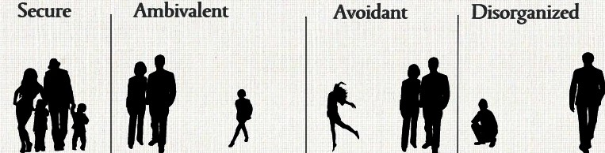

Children’s Styles of attachment
Secure | Ambivalent | Avoidant | Disorganized
Notes:
PARAPHRASE
Let’s talk for a few minutes about the children’s styles of attachment. Although many people have combinations of characteristics, the styles of attachment are generally viewed in four categories.
In children, the 4 styles are known as Secure, Avoidant*, Ambivalent*, and Disorganized.
*Sometimes referred to as Anxiously Avoidant and Anxiously Ambivalent.
FACILITATOR'S NOTE
It may be helpful to point to each style on the slide as you name them. The arrow is indicative of the potential for fluidity and change as they do not have to stay fixed patterns for life.

Slide 18

Rerouting to a different track
Notes:
PARAPHRASE
The styles of attachment are patterns that may guide how we interact with others, but it is important to remember that while these patterns are a tendency to act a particular way, that’s not always going to be true. Have you ever been moving along a certain path and then you spent time with someone that made such an impression on you that they actually changed your outlook or actions? Maybe it was conversations and time spent with a coach, a colleague, a mentor, a friend? That’s kind of how attachment styles work; they move in one direction like they’re on autopilot, but as you see in this slide, sometimes, enough powerful experiences with someone reroutes them onto a different track.

Slide 19

Secure attachments
My needs were met.
People are predictable + the world is safe.
I am free to trust others and the world.
I can thrive in this safe world and have healthy relationships.
19
Notes:
PARAPHRASE
All this theory might sound a little complicated. So let’s break it down a bit.
When a child has their needs met the majority of the time, they will likely develop what is known as a “secure” attachment. The securely attached person does not look or act perfectly, nor were they parented perfectly. But, securely attached children believe that their needs are generally understood and can be met, so they experience their world as mostly predicable and safe. This belief allows them to have healthy relationships with others and to individually thrive. Maybe some of you had this experience growing up, maybe not.
ASK
Why do you think children who are securely attached from having their needs met would be able to thrive in relationships later?
Reinforce the following points if not brought up by participants:
Experience has taught them how to trust.
They are not preoccupied with getting their basic needs met.
They know what love feels like and can return that love.
The person can relax and be open to learning and creating on their own.
They know that they can manage tough times because their needs will eventually be met and support will be there if they need it.
PARAPHRASE
Unfortunately, many of the children who have experienced separations, loss and trauma will not have secure attachment styles. We’re now going to take a look at some video clips on insecure attachment styles, which you will likely see more of when children first come to your home.

Slide 20
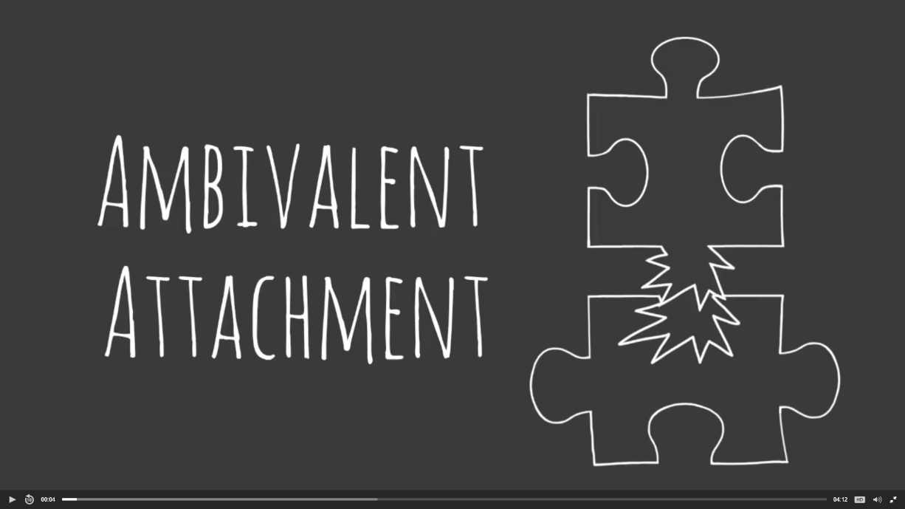

AVOIDANT Attachment Style
Show Jacob Ham Video / Avoidant Attachment
Notes:
FACILITATOR'S NOTE
For the discussion on attachment styles, focus on participants’ understanding of the importance of secure attachment and the range of how attachment concerns can present rather than the details in each individual attachment style.
SAY
These videos were created by Dr. Jacob Ham, a clinical psychologist who is the Director of the Center for Child Trauma and Resilience at Mt. Sinai Hospital in New York, to show what these styles look like in the behaviors of children. The first insecure style of attachment we’re going to look at is called Avoidant.
DO
Show the Jacob Ham video clip labeled Avoidant Attachment. It is located on CapLEARN (https://learn.childwelfare.gov/) or the NTDC website (https://ntdcportal.org/). The run time is approximately 4 minutes.
SAY
To help us think about how to parent this child, now let’s talk about an actual child with this attachment style.

Slide 21
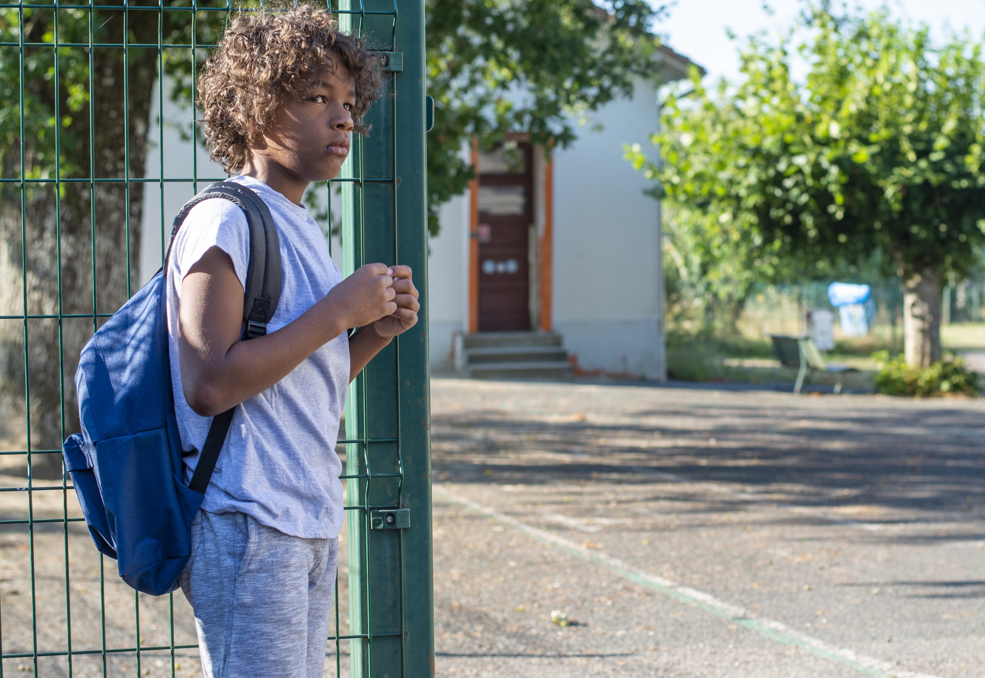
Case Study:
William
What do I need?
Came from a family with a lot of children.
Mom had problems with alcohol use and had difficulties caring for all the kids.
His needs were not met, so he did not think others’ needs were important either.
Notes:
DO
Read the case study below or ask your co-facilitator to read it:
William came from a family with a lot of children. His mom had a problem with alcohol use, and it was hard for her to take care of all the kids. William did not have his needs met and learned that his needs were not important. Therefore, he didn’t learn that other people’s needs were important either. He was a great artist, reader, and athlete and at times had a very sweet side, but at other times, when he hurt another child on the playground, he would either run away or make fun of the child’s pain. If he got a consequence, he would say things like, “It didn’t matter anyway,” or “Kids just have to learn nothing in life ever comes easy.”
Facilitate a discussion around what kind of parenting would be most helpful to children with an avoidant style of attachment like William. Encourage responses that are relationally-oriented (characteristic) like those below:
Slowing down and really getting to know the child and their needs.
Helping the child learn how to identify and express emotions.
Pointing out situations where needs are expressed and acknowledging that a person’s needs are important. This can be done anywhere and everywhere in daily life, movies, books, etc.

Slide 22
Ambivalent Attachment Style
Show Jacob Ham Video / Ambivalent Attachment
Notes:
SAY
Now we’re going to watch another video by Dr. Ham on another insecure, but quite different attachment style. This one is known as ambivalent attachment, also called anxious attachment.
DO
Show the Jacob Ham video clip labeled Ambivalent Attachment. It is located on CapLEARN (https://learn.childwelfare.gov/) or NTDC website (https://ntdcportal.org/). The run time is approximately 5 minutes.
SAY
To help us think about how to parent this child, now let’s talk about an actual child with this attachment style.

Slide 23

Case Study:
MARINA
What do I need?
Raised by her mother for first several years. Mother often homeless and had substance abuse problems.
Mother was verbally cruel when stressed.
By the time she came into foster care, Marina saw herself as ugly and worthless.
Notes:
DO
Read the case study below or ask your co-facilitator to read it:
Marina was raised by her mother for her first several years. Her mother was often homeless, and she had an addiction to methamphetamines. When they were able to live in shelters and motels, Marina’s mom was upbeat and better able to attend to her needs, but when she became stressed or was high or experiencing withdrawals, she would say very cruel things to Marina. By the time Marina came into foster care, she saw herself as ugly and worthless. No one could tell her otherwise, and when she was given new clothes, she would often lose or destroy them. Maurina had difficulty keeping friends, because once they started spending a lot of time together, she would become angry and jealous if the friend wanted to be with anyone else. As Marina is getting older, she is beginning to cut on her arms when stressed. She is also often staying out past curfew.
Facilitate a discussion around what kind of parenting would be most helpful to children with an ambivalent style of attachment like Marina. Encourage responses like those below:
Staying concrete, consistent, and clear about rules, roles, and boundaries.
Not just telling her she is great but setting her up with successful experiences to believe it herself.
Keeping everyone safe, while being understanding and validating, by using statements like, “We can see you are in pain. We are here to support you.”
Do not attempt to be a perfect parent; don’t set that expectation and be forgiving of yourself!
Consistency and predictability will be especially helpful for a child with this attachment style to thrive as it will help her to see the world has order, rather than the chaos she was used to. It will also allow her to feel safe and help the child see you as trustworthy (characteristic).
PARAPHRASE
Having mixed feelings is normal when parenting children with insecure attachment styles. Good self-awareness/self-reflection (characteristic) will help you to see where you might have the most challenges in being consistent or nurturing and when you may need extra support.

Slide 24

Disorganized Attachment Style, 1 of 2
Inconsistent, harmful, or even bizarre parenting
  Significantly affects the child’s view of the world
  Not uncommon in children who experienced severe forms of abuse and neglect
Behavior often makes little sense
Notes:
PARAPHRASE
What is not shown in the videos is the Disorganized Attachment style. This happens when children have received such inconsistent, harmful, or even bizarre parenting that it significantly impacts how they view the world. While this is not extremely common in the general population, it is not uncommon in children who have experienced severe forms of abuse and neglect.
Because the world is very confusing to a child in these circumstances, later the child’s behavior may make little sense to their caregivers. For example, they are often desperate to connect, but they do not go to their caregivers when they need help or if the caregiver offers help, they may push it away because it is scary to them. A child with this background may feel very confused when they first come into stable homes and sometimes their caregivers are unsure about how to best help them..

Slide 25

Disorganized Attachment Style, 2 of 2
True
emotional confusion
Needs were not met
Little help from caregivers
Too young to help themselves
Nothing to cling to
Notes:
PARAPHRASE
As children with disorganized attachment styles get older, they may not know where to turn or how to get their needs met. Their behaviors may seem inconsistent or illogical, such as the boy in the case study we’re about to read.
While you are listening, think about how you would respond as a parent to this child. If you feel an emotional reaction, such as concern, frustration or even fear, that is perfectly ok. It is natural to have a reaction. Noticing how we feel helps us to become self-aware and will help us be thoughtful about how to best respond to the child.
DO
Read the case study below or ask your co-facilitator to read it:
Paul is a 7-year-old boy. His mother was homeless the first year of his life and eventually left him near an orphanage, where he lived until he was three and half years old. He had different caregivers on different shifts and was given little attention. When he was first adopted, he would wander aimlessly through the house, pulling out and scattering the insides of all his toys. He did not seem to have any sense of family life and expected everyone to sleep in the same room, screaming until they did. He is now able to sleep in his own room, but he often throws his toys away. He often laughs when he gets in trouble, cries when others are laughing and takes whatever he likes from others without asking. When his parents have friends over, he is always sure to stay close and sit right in between them rather than playing with the other children. But, when they are home alone, he ignores them for long periods until nighttime when he does not let them leave his room.
SAY
It is clear this child has a hard start in life. It is important to remember all that we have learned about how attachment is formed in order to strategize how to parent a child with these behaviors.

Slide 26

STABILITY builds trust
Anchor the child by being available
Understand and meet the child’s needs
Parents should be:
  Structured
  Predictable
  Compassionate
Notes:
DO
Facilitate a discussion around what type of parenting would be most helpful to children with a disorganized attachment style like Paul. Encourage responses like those below:
The parent will need to be attuned (characteristic) to the child to gain their trust.
Children with disorganized attachment styles need a very predictable, structured, emotionally supportive parenting style to learn what safety and security looks and feels like (i.e.,“felt safety”).
Parents will need to balance predictability with compassion for the child.
Good self care and self compassion is essential for parents/caregivers.
Parents should be open to connecting with mental health professionals who have experience with helping parents effectively parent a child with this type of attachment style.
PARAPHRASE
If the parent can help reorganize the child’s emotional confusion by anchoring the child again and again in the safety of being available to them, the child will be able to experience their needs being understood and met in a way they never did before. Gradually, they can learn that the world is predictable and, therefore, safe.
Once a child’s outlook on the world starts to change, their behaviors will shift and start to make more sense, too. While parenting should be structured and predictable, we want to do this while being compassionate to their experiences. Balancing structure and predictability with compassion will help the child to see you as being trustworthy (characteristic).
PARAPHRASE
As we’ve been discussing, we learn to make meaning of the world through our relationships with others. This remains true in learning harmful, as well as healing messages. Once children’s brains and bodies learn their needs will get met and people can be experienced as trustworthy (characteristic), children can relax and turn their attention to growing in other ways. These experiences will need to happen over and over, many times a day, to be more powerful than the experiences where children learned their needs would not be met, that they were not worth it, and that people can’t be trusted.
So, let’s take a minute to make sure we know how to stay consistent while remaining compassionate, which an important balance!

Slide 27
What Is Compassionate Consistency?
True or False?
1. It is important to acknowledge children’s feelings even when they’ve done something wrong.
2. The parent should do what they said they would do, even when they’re upset.
3. Even though their behavior may be challenging, the child should be included in as many typical activities as possible.
4. The child should be sent away from activities and people because of misbehavior.
Notes:
FACILITATOR'S NOTE
Next, we will engage participants in a set of true/false questions that will help to clarify the concept of compassionate consistency. This is meant to move quickly to break up and reinforce content, only pause for misunderstandings/clarification.
SAY
As we just said, it’s important to be both compassionate and consistent.
What is compassionate consistency?
Let’s check in on what we mean with 4 true or false questions.
DO FOR EACH OF THE 4 STATEMENTS:
Read the statement aloud.
Wait a moment to allow participants to think about the statement. Ask for a show of hands for True, then False votes.
State the correct answer.
STATEMENT #1:
This statement is “TRUE.”
For children who have experienced separations, loss, and trauma, it is especially important to acknowledge their feelings during their mistakes to help with their low self worth.
STATEMENT #2:
This statement is “TRUE.”
For children who have experienced separations, loss, and trauma, it is important to build their trust by following through in daily things like picking up children on time or taking them somewhere when you said you would.
STATEMENT #3:
This statement is “TRUE.”
For children who have experienced separations, loss, and trauma, being included helps them feel part of the family and teaches them that children should be supported by their families, even in tough times.
STATEMENT #4:
This statement is “FALSE.”
Why is this false? Children who have experienced separations and trauma have experienced a tremendous amount of loss already. The goal now is to help them feel they are wanted and that they belong, even when they make mistakes.
Are there any exceptions? If necessary, give an example of exceptions, such as if the parent knows they need to take a break and a deep breath, in which case they can simply share that with the child and step away versus sending the child away.
Adaptation for Remote Platform
Use the poll or chat function to make this activity more interactive.

Slide 28
Attachment Styles in Adults
Autonomous
Comfortable in a warm, loving, and emotionally close relationship.
Preoccupied
Insecure in intimate relationships
Constantly worried about rejection and abandonment; preoccupied
with relationship
Dismissive
Emotionally distant and rejecting in an intimate relationship
Keeps partner/loved one at arm’s length
Unresolved
Unresolved mindset and emotions
Cannot tolerate emotional closeness in a relationship
Notes:
PARAPHRASE
As we saw when we discussed children’s attachment styles, how we interact with people later is directly linked to how we learned to be in relationships when we were young. These patterns in adulthood are called Adult Styles of Attachment. There is a resource on them if you would like to read more about the specific styles of adult attachment and how they play out in adult relationships, including parenting.
Remember, having awareness of how we were parented helps us to develop awareness about how we will parent children, which is why Self-awareness/Self- reflection is one of the characteristics of this theme!
Maybe you developed a very secure attachment style as the result of healthy parenting. Or some of you who experienced less healthy parenting may now function with more of a secure attachment style because you’ve done some work to build your self awareness and not repeat the old patterns you learned in childhood. While it takes work and spending time with stable people, it is possible for a person to learn how to interact with others in healthier ways!
Whether you started with a secure attachment style or learned it later, it is human nature to regress, or go backwards, under stress. Have you ever found yourself fussing at a loved one the way a caregiver fussed at you, even though you didn’t want to? Being human, we often return to old patterns our brain once knew, and these patterns are tapped during times of stress. Parenting can zap our resources, challenge our confidence, and add levels of stress we had not expected. It’s important to become aware of what patterns you have so that you can be conscious when any old, unwanted interaction styles get tapped into again. How you interact is key to helping create healthy attachment styles for children who have experienced separations, trauma, and loss.
FACILITATOR’S NOTE
Have a parent facilitator personalize this with an example of regressing under stress to make content more relatable with participants.

Slide 29
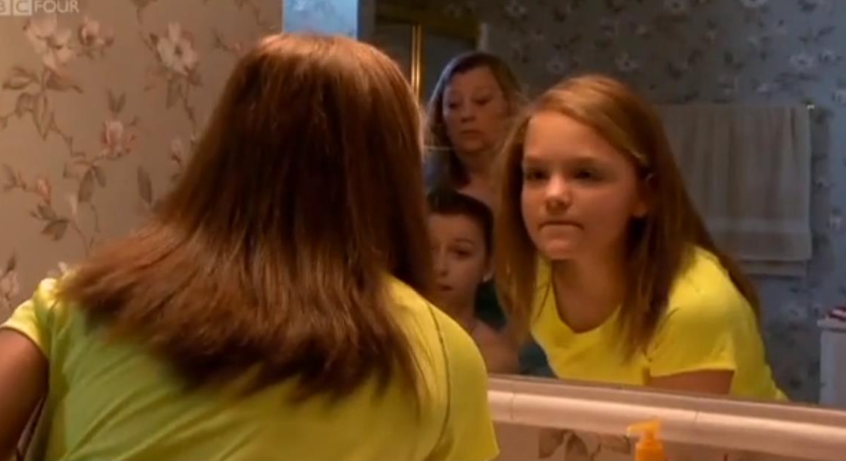
The Dark Matter of Love
Show The Dark Matter of Love Clip One
Notes:
PARAPHRASE
We are now going to watch a video clip to further understand how a parent’s history intersects with how they parent today. This video clip comes from the documentary, Dark Matter of Love, written and directed by Sarah McCarthy. It is the story of an American family who adopted three children from Russia- including a 12-year-old Masha, who you’ll meet in this clip. You will also see dad with one of the younger children in another clip later today.
In this clip, Mom is actively working on her relationship with Masha. Notice her commitment, and the support and partnership with professionals as she works through it all.
DO
Play the clip (The Dark Matter of Love Clip One) located on CapLEARN (https://learn.childwelfare.gov/) or the NTDC website (https://ntdcportal.org/). The clip will run approximately three minutes.
ASK
What could be making it hard for Mom to stay attuned to her daughter’s emotional needs?
DO
Facilitate a discussion. And reinforce responses about Mom’s own upbringing, such as her own mother not being there for her. Reinforce mom’s need for self-awareness to understand how this may impact her parenting.

Slide 30

Reflection/ relevance
Notes:
PARAPHRASE
As you’ve been learning today, all of us have a primary attachment style or ways that we tend to interact with others. As you saw in that last video, attachment styles we learned in childhood are connected to how we interact in adulthood. Therefore, our adult attachment style will impact the way we will now parent. When you have time at home, we’d like you to think about own attachment history for a moment so you can reflect on how that may impact your parenting.
Once you find a quiet moment, think about the way that your parent or earliest caregivers took care of you. Really consider how you were parented. After all you’ve heard today, think about how your parent’s attachment style felt for you as a child. After you have done that, think about the child you hope to be fostering or adopting. Think about how you might want to parent this child differently or similarly than your parents were with you?
Use your Participant Resource Manual to write any reflections down.
Being such a thoughtful and aware parent means taking good care of oneself. This allows everyone to keep stress to reasonable levels and regression to old or unhealthy relationship patterns to a minimum. Just like when children are infants and crying out for help, children with backgrounds of separations, loss, and trauma need consistent, present, attuned caregiving to meet their needs (characteristic). Learning new and effective patterns can be gratifying and, at the same time, exhausting for caregivers. You will need to give yourselves permission for rest, healthy nutrition, pleasurable experiences (with and without children), time away, and activities that rejuvenate.
We’ve created a whole theme on Building Your Parental Resilience in our Right Time series to talk more about this because it’s so important.
FACILITATOR’S NOTE
There is a classroom-based theme specific to kinship caregivers that focuses on caregivers building their resilience. You may choose to share material from it with your participants.
30

Slide 31
BREAK
10 minutes
Notes:
FACILITATOR'S NOTE
Allow for a 10-minute break. This may be a good point to pause and take the break.
31

Slide 32
SECTION 3:
ENHANCING RELATIONSHIPS
Notes:
FACILITATOR'S NOTE
Allow 25 minutes for this section.
SAY
Now, let’s focus in on how we can enhance our relationships with children.
32

Slide 33
The 4 S’s of Relationship focused Parenting
SEEN
Be tuned into the child’s needs, spoken and unspoken.
SAFE
Build safety with time at home/with family, protection, and predictability.
SOOTHED
Comfort by word and action.
SECURE
Connect physically and emotionally to build trust.
Notes:
PARAPHRASE
One of the primary jobs of a healing parent is to build and protect the relationship with children. For those of you who have parented before, this process likely occurred naturally. But, for children who have experienced separations, loss, and/or trauma, a basic fear they have is that the parent-child relationship will not last. And even worse for children, that anything that goes wrong with it will be their fault. In the early days of a new child living with you, when stressful things happen, building trust in the relationship will be critical to build attachment. This is key in making the relationship with you meaningful, but also in working to heal the child’s previous experiences that taught them that it’s not safe to trust. This healing will happen through many pleasurable experiences together, as well as finding teachable moments to modify or change their behavior.
Remember, opportunities to build your relationship will be happening all day long; every single day and every experience is a new opportunity for healing. While “big ticket” activities and splurges will be fun sometimes, the real relationship building will come through daily experiences, both positive and negative, that include creating a routine and structure, as well as following through with what you’ve said you will do. Just as we learned in the cycle of attachment, trust builds with predictability. Predictability builds patterns. Patterns create ways of being in relationships with others.
One easy way to think about the goals of relationship focused parenting are the 4 S’s of parenting developed by Dr. Daniel Siegel, a well-respected child psychiatrist. The 4 S’s help remind us of what children need to feel: Seen, Safe, Soothed and Secure. We’ll spend a few minutes exploring these. We will start with the first 2.
PARAPHRASE
The first S is Seen. Just like with infants, parents need to be tuned in or “attuned” to the needs of children, including those that are not spoken. Getting to know signals of a child’s emotional state, their signs of distress (which may be unpredictable), subtle body language cues, and triggers will be important to anticipate.
The second S is Safe. Because of their life experiences, feeling safe is particularly critical for children with backgrounds of separations, loss, and trauma. A situation that may seem safe to others, such as going to a movie, might be seen as threatening to a child with a background of trauma and loss. Perhaps the child’s history has left them afraid of the dark or worried that they will be lost in unfamiliar places.

Slide 34
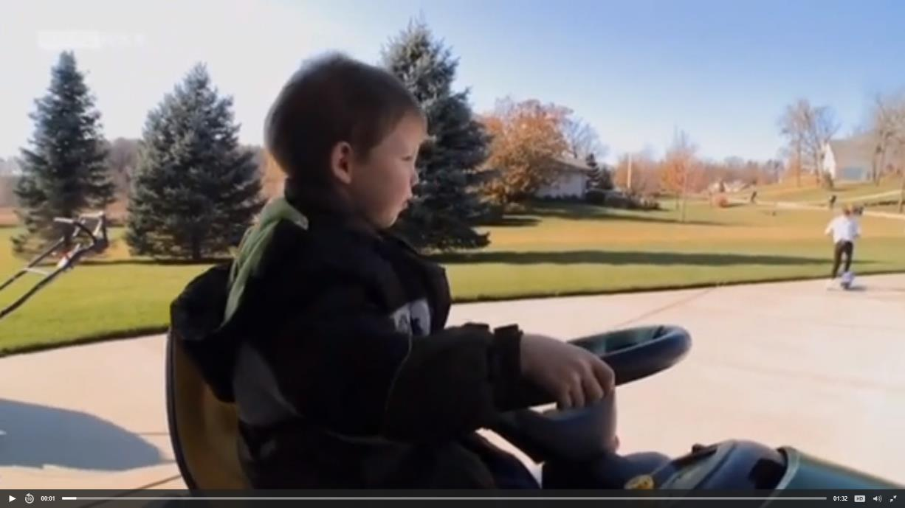
The Dark Matter of Love
The 4 S’s
Show Dark Matters Of Love - 4 S’s
Notes:
PARAPHRASE
Now, let’s watch one more video clip from the documentary Dark Matter of Love, where Dad notices that his son has experienced some scary or unpredictable things. Watch how he helps the child to feel seen and safe, which gives him a new sense of mastery over a trauma trigger.
DO
Play the clip (The Dark Matter of Love: “Dark Matters 4 S’s”) located on CapLEARN (https://learn.childwelfare.gov/) or the NTDC website (https://ntdcportal.org/). It will run approximately three minutes.

Slide 35
The 4 S’s of Parenting, 1 of 2
SEEN
Be tuned into the child’s needs, spoken and unspoken.
SAFE
Build safety with time at home/with family, protection, and predictability.
SOOTHED
Comfort by word and action.
SECURE
Connect physically and emotionally to build trust.
Notes:
FACILITATOR’S NOTE:
Do not take much time to process the video. Return to the 4 S’s slide to finish the discussion and segue to the activity which requires time.
PARAPHRASE
The third S is Soothed. Remember that a key job of parents who are fostering or adopting is to increase safety, security and positive experiences while decreasing distress. We just saw an example of this with the dad when he gave the child his earplugs and sat with him on the tractor. In the video clip, it was clear the boy felt seen and safe. Did you also notice how soothed he seemed riding along on the tractor with his father? Not unlike infants, children who have experienced loss and trauma will need great comforting, not just by words, but by actions.
Another time children may need soothing is when they are missing their families or other people they used to be close to. As with the boy on the tractor, the child may not be able to clearly communicate when they have this need for comfort. Having gentle conversations about missing loved ones will give you an opportunity to soothe a child, and also has the added benefit of bringing you closer to them. We’ll talk more about this and and how to have these conversations in future classes.

Slide 36
The 4 S’s of Parenting, 2 of 2
SEEN
Be tuned into the child’s needs, spoken and unspoken.
SAFE
Build safety with time at home/with family, protection, and predictability.
SOOTHED
Comfort by word and action.
SECURE
Connect physically and emotionally to build trust.
Notes:
PARAPHRASE
The last S stands for Secure. Spending time with children and connecting physically and emotionally will create a strong foundation of stability and trust. Experiences speak much louder than words, so activities that involve touch, movement, and use of our senses particularly help to cement positive patterns and loving messages into brains and bodies.

Slide 37
Relationship-PROMOTING Activities
What makes an experience relationship-promoting?
Is interactive
Maximizes the senses
Involves movement
Notes:
FACILITATOR'S NOTE
Now, we will move to an interactive activity to allow participants practice thinking about activities that focus on their relationship with the children. The emphasis should be on activities that are interactive, maximize the senses, and involve movement as they solidify patterns in children’s brains and bodies.
Allow about 15 minutes for the activity.
PARAPHRASE
Now, let’s take some time to brainstorm together about parenting skills that promote parent-child relationships. In a moment, I’m going to pass out some papers and ask each of you to write an activity you think would be relationship-promoting on the paper.
To really solidify a positive memory and create new patterns for the child, the activities you choose should be interactive, maximize the senses, and/or involve movement.
DO
Distribute the small papers for the activity.
PARAPHRASE
Now, please think about activities that would be relationship-promoting.
Write one activity on the paper.
Please just write one per sheet. If you think of more than one, use extra sheets.
I’ll collect them in two minutes.
DO
Circulate as participants work to answer questions and provide advice.
Keep track of time.
At 2 minutes, collect the papers, and put them in a grab bag.
ASK
Can I have two volunteers? I need someone to pull papers out of the grab bag and read them, and someone else to write activities on the flipchart.
DO
After the volunteers come up, ask the first volunteer to pull a paper from the grab bag at random, and to read the activity on it.
The second volunteer writes the activity on the white board.
After all activities are written, ask the group to choose the 5 they think are the most relationship-promoting (interactive/maximizing senses/involving movement).
Facilitate a brief discussion around their answers. Some questions that may stimulate conversation:
Why do you feel this activity is good for promoting the relationship between a parent and child?
How could the activity be used or changed for different children (e.g., toddlers, school-aged, or teens)?
What are the exceptions - situations where the activity might not be relationship-promoting? (For example, an activity that soothes some children might be too stimulating for others.)
After you have finished:
Post the flipchart(s) listing relationship-promoting activities to solidify them for participants
Invite participants to add to the lists anytime they get an idea for a good activity.
Refer to Handout #2 :Examples of Relationship Promoting Activities
You can also refer participants to a resource for this theme titled Attachment Through the Senses for more ideas and to understand the concept.
Adaptation for Remote Platform
Invite participants to brainstorm their ideas on their own, and place ideas into the chat. Have a volunteer reader call out the ideas. The facilitator can randomly choose one or more activity in the chat box to discuss with the group. The discussion questions can be posed by randomly unmuting participants or volunteers who raise their hand. Use the white board function or google Jamboard to reinforce responses. To make this activity more interactive, invite participants to use the reactions buttons. The list from the white board can be sent to participants after class.
FACILITATOR'S NOTE
Reinforce responses that are sensory rich and action oriented, such as:
Going for a walk, hike or run together
Cooking or baking together
Games with eye contact like patty cake, peek-a-boo
Find a swing or trampoline, and swing or jump the time away. Try different speeds or mimicking each others’ moves
Brushing hair
Playing sports where you have time alone and fun together like basketball, tennis, ping pong, etc.
Eating together as a family, anywhere, everywhere
Sharing all forms of music, especially singing, dancing, or drumming together
Creating messy art together, like finger-painting and clay or playdoh
Scream loudly in jubilation together, such as at a concert, a sporting event, or on a roller coaster
Swimming, water fights, jumping into a wave or a lake together
Reading snuggled up or rocking together
Draw attention to how and why activities like the ones below can still build the parent-child relationship and/or why they may feel more comfortable for children.
Going for a car ride together
Biking side by side together
Side-by-side activities with no eye contact, like doing artwork
Draw out why examples such as those below are not really relationship-promoting because they are focused on talking, punishment, and/or spending time away from the parent. If these come up on the lists, comment or ask how any can be done in a way that promotes the relationship. Reinforce ways to have parents present, give encouragements, and being sure to check in frequently.
Lecturing
Time-outs
Changing siblings’ diapers
Buying the coolest new high-tops
Watching TV
Playing Video Games

Slide 38
SECTION 4:
KEEPING THE RELATIONSHIP FIRST
Notes:
FACILITATOR'S NOTE
Be sure you have a minimum of 25 minutes for this section.
PARAPHRASE
We’ve been talking about experiencing joy and playful moments with children. Now, let’s talk about more challenging times.
One of the primary roles of parents is to guide children in correcting their behavior when they are off track. What makes this incredibly fulfilling, but also stressful, is that parents are not aiming just to discipline, but to shape lifelong decision-making abilities.
Children who have experienced loss and trauma also need discipline, yet generally benefit most from non-traditional approaches. Typical strategies that “take away” privileges, experiences, or people from children who have a history of loss and trauma can be experienced as more loss, loneliness, or shame. So, these methods are not only ineffective because they put the child into survival mode, they might also be experienced as very painful for the child.
Regardless of the child’s age, parents who are fostering or adopting can view these moments as opportunities for children to continue on their healing journey by correcting behavior while simultaneously protecting or even enhancing their relationship.
38

Slide 39

Relationship-focused discipline
Notes:
SAY
Now we’re going to watch a video to learn effective techniques for disciplining children who have experienced loss and trauma with Laura Ornelas. Laura is a licensed clinical social worker with 30 years experience working with children and families in foster care and adoption.
The discipline strategies you’ll hear about might be new to you since they are not the typical ways people discipline a child when they’ve done something wrong! In this video, you’re going to be introduced to JAR-Joining, Amends Making and Re-do’s. As you watch, listen for why these might work particularly well for children who have experienced loss and trauma.
DO
Play the NTDC video Relationship Focused Discipline. This video will play for approximately 9 minutes. It can be found in CapLEARN (https://learn.childwelfare.gov/) or on the NTDC website (https://ntdcportal.org/).
If time permits, allow for a few brief reactions.
SAY
Even though these kind of strategies might not be what you’re used to using when a child has done something wrong, using the JAR brings children closer to parents and is very effective at teaching responsibility through consequences. But, when something is new, it can feel confusing. So, now let’s take some time to practice using JAR!

Slide 40
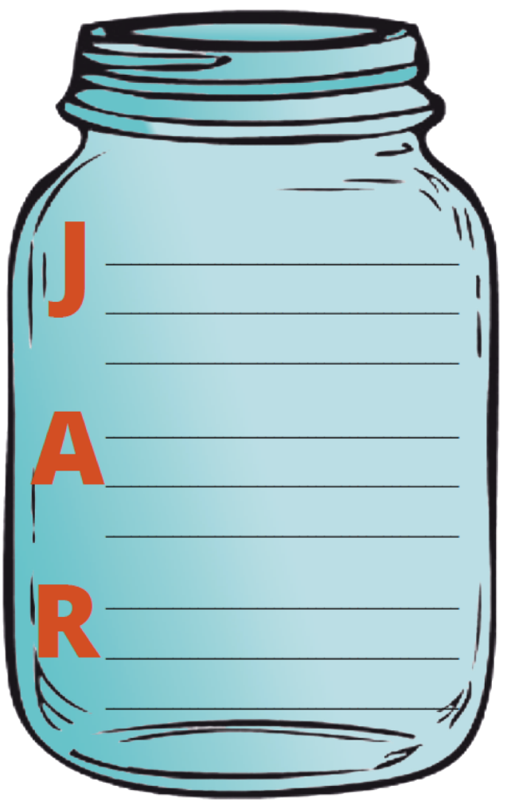
Practicing
JAR
Notes:
FACILITATOR'S NOTE
Allow about 15 minutes for this activity.
PARAPHRASE
I’m going to hand out a short story of a child who has just done something that needs correcting. Feel free to use Handout #3: JAR Activity Worksheet in your Participant Resource Manual to take notes as I’m reading.
DO
Read the short story aloud to the group:
A neighbor knocks on your door and says he saw your 13-year-old break their window yesterday while playing ball. The child has not told you anything about this, but you did notice that the child came straight home from school today and went to her room, which is not typical. The neighbor says there is no mistaking it was her, because he watched her run into your house after she broke his window. The neighbor seems sincere and believes it was an accident.
ASK
To give us a head start on your worksheet, what might be some examples for the A/Amends Making in this scenario?
Reinforce or give any of the following examples of A’s:
Doing yard work or housework for the person ‘wronged’ (in this example, the neighbor)
Bringing the neighbor a goodie, flowers or a gift, like art work or a baked good.
Writing an apology song or rap or poem or story for the neighbor (less direct way of kid expressing themselves in writing)
Creating a talking circle where the person acknowledges their wrong publicly and the community decides restitution
PARAPHRASE
Remembering all that we have learned today about the importance of parent-child relationships, discuss what ideas you have about how to use the JAR in this situation. Turn to the folks around you to think of some examples of the J/Joining and the R/Re-do’s. Take about 5 minutes in your small group.
DO
Circulate during the discussion to provide advice and answer questions.
Keep participants especially focused on generating concrete ideas for the R (as the J was discussed in the video and A was just discussed in class.)
Keep track of time.
At about 4 minutes, give the group a 1-minute warning
At 5 minutes, bring everyone back to a large group discussion.
Adaptation for Remote Platform
Use break out rooms with the desired number of participants. Facilitators can feel free to circulate amongst the breakout rooms to be sure participants are understanding the activity.
PARAPHRASE
Now, let’s discuss your ideas about how you would use J.A.R. with the child in this story.
We already heard a lot about J/Joining in the video, and we discussed the A/Amends-Making a few minutes ago, so let’s focus our discussion on ideas for using the R/Re-do’s in this situation.
ASK
What examples would you like to share of some good R’s/Re-do’s?
Are there any other J’s (Joining) or A’s (Amends) to add to what we’ve already discussed?
DO
Allow a short while to see what ideas participants have. If you’d like to move this discussion quickly, have them simply shout out responses.
As anyone shares, facilitate a brief discussion about why that is a good example of J, A, or R.
If necessary, reframe/restate participant responses to make it a more accurate description of Joining, Amends-Making or Re-Do’.
You may need to give examples to get participants on track. For instance:
Re-Do example: taking the ball to a safer place and practicing there instead
40

Slide 41


Practice
Practice
Practice
Notes:
SAY
Hopefully, the activity helped you get a better sense of how to use JAR strategies. But it will take practice to get it down, so be thinking about Joining, Amends-Making, and Re-Do’s as discipline situations come up with children and be sure to try out these strategies when children are in your home.

Slide 42
SECTION 5:
WRAP-UP
Notes:
FACILITATOR'S NOTE
Allow about 5 minutes to wrap-up.
SAY
Now, it’s time to wrap up. Before we do, I want to briefly highlight the key points from this theme:
A child’s experience with previous caregivers will impact the way the way they relate to their current caregiver(s).
For kinship caregivers raising your grandchild or another family member’s child, the child’s emotional needs and behaviors are still impacted by early life parenting experiences even if you have been a safe and stable force in their life. These parenting techniques will help reinforce the child’s relationship with you and their ability to regain trust with adults and others.”
Children with a history of loss and trauma often find it hard to get close in relationships, and they show this through their behavior.
When adults understand a child’s attachment style and history, they can better understand what the behaviors of the child represent and how the child can now be more effectively parented.
Parenting a child with breaks in their attachment can be challenging because the parent will need to adjust their parenting and to stay consistent and compassionate. This will require the parent to have awareness of their own attachment history so that they can focus on the child’s needs rather than their own.
Discipline is a necessary component of parenting - methods that bring the child closer to the parent will be essential to provide a healing environment.
Talking will not be enough to help children understand the world is now safe. The child experiencing repeated, sensory rich interactions with their parent will be key.
We’ll be talking more about helping children to get and stay calm, maybe even avoiding even some behavioral concerns in the Trauma Behaviors and Trauma-Informed Parenting themes.
42

Slide 43

LIFELONG Learning
Notes:
SAY
It is critical that as you go through this journey, you continue to enhance your knowledge and skills. It is important that you continue your own learning by taking advantage of resources that are available to you. This theme has many resources that will help you continue to learn more about this important topic. For example, there is a good podcast in your resources with Laura Ornelas on this theme.
You can find the resources on the NTDC website or in CapLEARN.

Slide 44
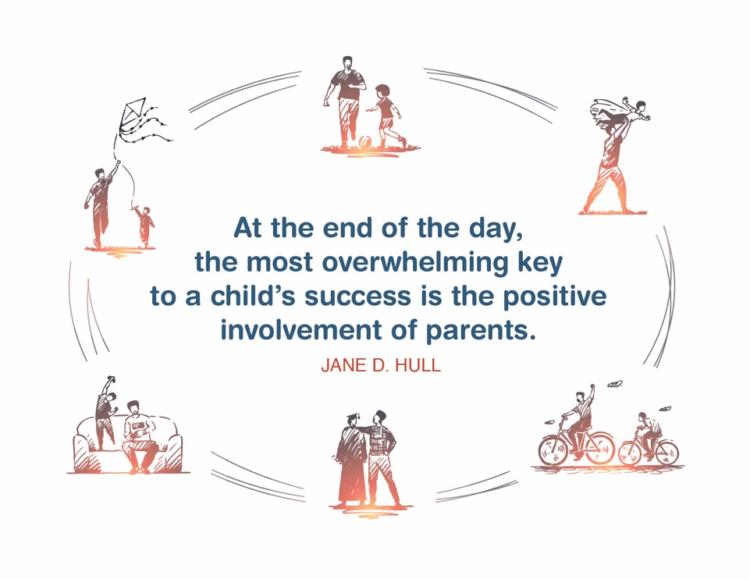
Place holder for slide with Closing Quote
Notes:
FACILITATOR'S NOTE
The closing quote above and the paraphrase section below will be done only once per day, after the last theme presented. If you are moving on to another theme, invite them to take a break, stretch, or breathe, before moving on to the next theme.
If closing for the day:
Thank everyone for attending and for their thoughtful participation and attention. Remind the participants that although this training may seem long, it is critical for them to gather the knowledge, attitude, and skills that are needed as they embark on this journey because they ultimately will play a huge role in the lives of children and families.
If in person, collect the name tents or have them tuck them into their Participant Resource Manual to bring back to the next class.
PARAPHRASE
Close out the day by covering the below topics:
Remind participants of the date/time for the next class and let participants know if there are any changes to the location.
Encourage participants to contact you (or other facilitators) if they have any questions or concerns.
Review the themes that will be covered during the next class.
If in person, remind participants to take their Participant Resource Manual with them and to bring them to the next session. If using a remote platform, remind participants to have the Participant Resource Manual available for the next class.
44

Slide 45
For more information, visit:
45
Notes:
45

Slide 46
This curriculum was funded by the Children’s Bureau, Administration on Children, Youth, and Families, Administration for Children and Families, US Department of Health and Human Services, under grant #90CO1132. The contents of this curriculum are solely the responsibility of the authors and do not necessarily represent the official views of the Children’s Bureau.

