Slide 1
Child Development
FACILITATOR CLASSROOM GUIDE
Modified January 2022
Notes:
CHILD DEVELOPMENT
FACILITATOR CLASSROOM GUIDE
Modified January 2022

Slide 2
To prepare for the session
See Notes view
Notes:
To prepare for this class, you should:
Review the facilitator preparation information included in this Guide along with the handouts.
Review the Resources for this theme found on CapLEARN (https://learn.childwelfare.gov/) or NTDC website (https://ntdcportal.org/).
Develop an agenda that includes this theme and any other themes you will be conducting along with it during the class.
Ensure that participants have a copy of the Participant Resource Manual. This Manual will be used during all themes and will include the handouts needed by participants. Facilitators should have copies of the handouts for the theme available in case participants do not bring their Manual to class. If the theme is being taught on a remote platform, facilitators should have the handouts available so that they can share in the chat and/or email to participants who do not have their Manual.
Bring any materials you need for the activities.
Review any videos or other electronic media used in this theme, if any, and plan the mechanics of how you will present them. Media for this theme are listed in the Materials and Handouts slide. Review the instructions for each media clip (e.g., to pause or stop at a particular time stamp). The videos can be played in different ways, including:
Play them from a flash drive or the computer’s hard drive using a media player app
Link to them from CapLEARN or the NTDC website.
Please note that all clips from Instant Family movie must be played directly from the Instant Family DVD or the movie can be streamed using the code provided in the DVD case. It is also available on some TV and Video streaming services (i.e., Prime Video- Amazon.com)
Practice playing the media for the theme. Ensure that you have the files and apps you need, that your links and connections work, and that you know when to pause or stop the media clip if appropriate.
If training on a remote platform, make sure all participants have the link available to access the class and that you have all videos, PPT’s and handouts ready for use.
If training in person, ensure that a room is available and set up, with the following:
Enough tables and chairs for all participants
Projector and screen (check that it works with the computer you will be using)
Many classroom activities have been adapted so that they can be done on a remote platform. Adaptations will be marked as follows so that they can be easily spotted throughout the Facilitator Classroom Guide: Adaptation for Remote Platform
PREPARATION

Slide 3
MATERIALS AND HANDOUTS
See Notes view
Notes:
FACILITATOR'S NOTE
Participants are expected to have the Participant Resource Manual available for every session.
MATERIALS NEEDED
You will need the following if conducting the session in the classroom:
A screen and projector (test before the session with the computer and cables you will use.)
A flipchart or whiteboard and markers for several of the activities A flipchart with a sticky backing on each sheet may be useful and will allow you to post completed flipchart sheets on the wall for reference.
Name tent cards (use the name tent cards made during the Introduction and Welcome theme.)
You will need the following if conducting the session via a remote platform:
Access to a strong internet connection
A back-up plan in the event your internet and/or computer do not work
A computer that has the ability to connect to a remote platform- Zoom is recommended
HANDOUTS
Have the following handouts accessible. Participants will have all handouts listed below in their Participant Resource Manual:
Handout #1: Glossary: Child Development Podcast
Handout #2: Broad Developmental Themes from Birth to Age 21 Years
Handout #3: Sexual Development
US Centers for Disease Control Positive Parenting Tips
Handout #4: CDC Tip Sheet infants 0-1
Handout #5: CDC Tip Sheet toddlers 1-2
Handout #6: CDC Tip Sheet toddlers 2-3
Handout #7: CDC Tip Sheet preschoolers 3-5
Handout #8: CDC Tip Sheet middle-childhood 6-8
Handout #9: CDC Tip Sheet middle-childhood 9-11
Handout #10: CDC Tip Sheet young-teen 12-14
Handout #11: CDC Tip Sheet teen 15-17
VIDEOS AND PODCASTS
Before the day you facilitate this class, decide how you will show/play the media items, review any specific instructions for the theme, and do a test drive. You may wish to set up the media to the start point. Unless indicated otherwise below, all videos and podcasts can be obtained on CapLEARN (https://learn.childwelfare.gov/) or NTDC website (https://ntdcportal.org/).
The following media is used in this theme:
Podcast: Bruce Perry
EVALUATION
There is a pre- and post-survey available for every theme. If the facilitator wants to use these evaluation tools, they will need to be downloaded from the NTDC website or CapLEARN and provided to participants. Participants will need to complete the pre-survey prior to the theme and the post-survey upon completion of the theme. If conducting the class on a remote platform, the facilitator will need to put the surveys into an online format such as survey monkey.
MATERIALS AND HANDOUTS

Slide 4
Theme and competencies
See Notes view
Notes:
FACILITATOR'S NOTE
Prior to the session, review the theme and competencies. You will not read these aloud to participants. Participants can access the competencies in in their Participant Resource Manual.
THEME AND COMPETENCIES

Slide 5
Suggested Theme agenda
See Notes view
Notes:
FACILITATOR'S NOTE
This slide shows a suggested agenda and timing for this theme. Before the session, please review this agenda and incorporate it into your overall agenda for this and any other themes you are conducting along with it.
AGENDA
This theme is divided into four sections. This content is based on 1.5 hours of classroom material.
BEFORE YOU BEGIN CLASS
Before discussing the Color Wheel of Emotions and covering the content of this theme, you should do the following:
Make any announcements that are needed regarding the training, timing of training, or process to become a foster or adoptive parent.
Take out the Participant Resource Manual and direct participants to this theme in their Manual. Remind participants that the Competencies for today’s theme are in their Manual.
Review the agenda for the theme. Facilitators should add a slide to the PPT deck that includes the agenda so that they can review it with participants. Make sure to include start and end times and any breaks that will be taken during the session.
Encourage participants to be engaged and active learners.
Encourage participants to contact you in between classes with any questions and/or concerns. (Prior to class, list the name(s) of the facilitators on the board with contact information.)
Remind participants to put out their name tents (these can either be made by the participants during the first class or the agency can print out name tents and provide them to the participants at the first class). If conducting the class on a remote platform, remind participants to type their first and last names in their screen box.
SUGGESTED THEME AGENDA

Slide 6
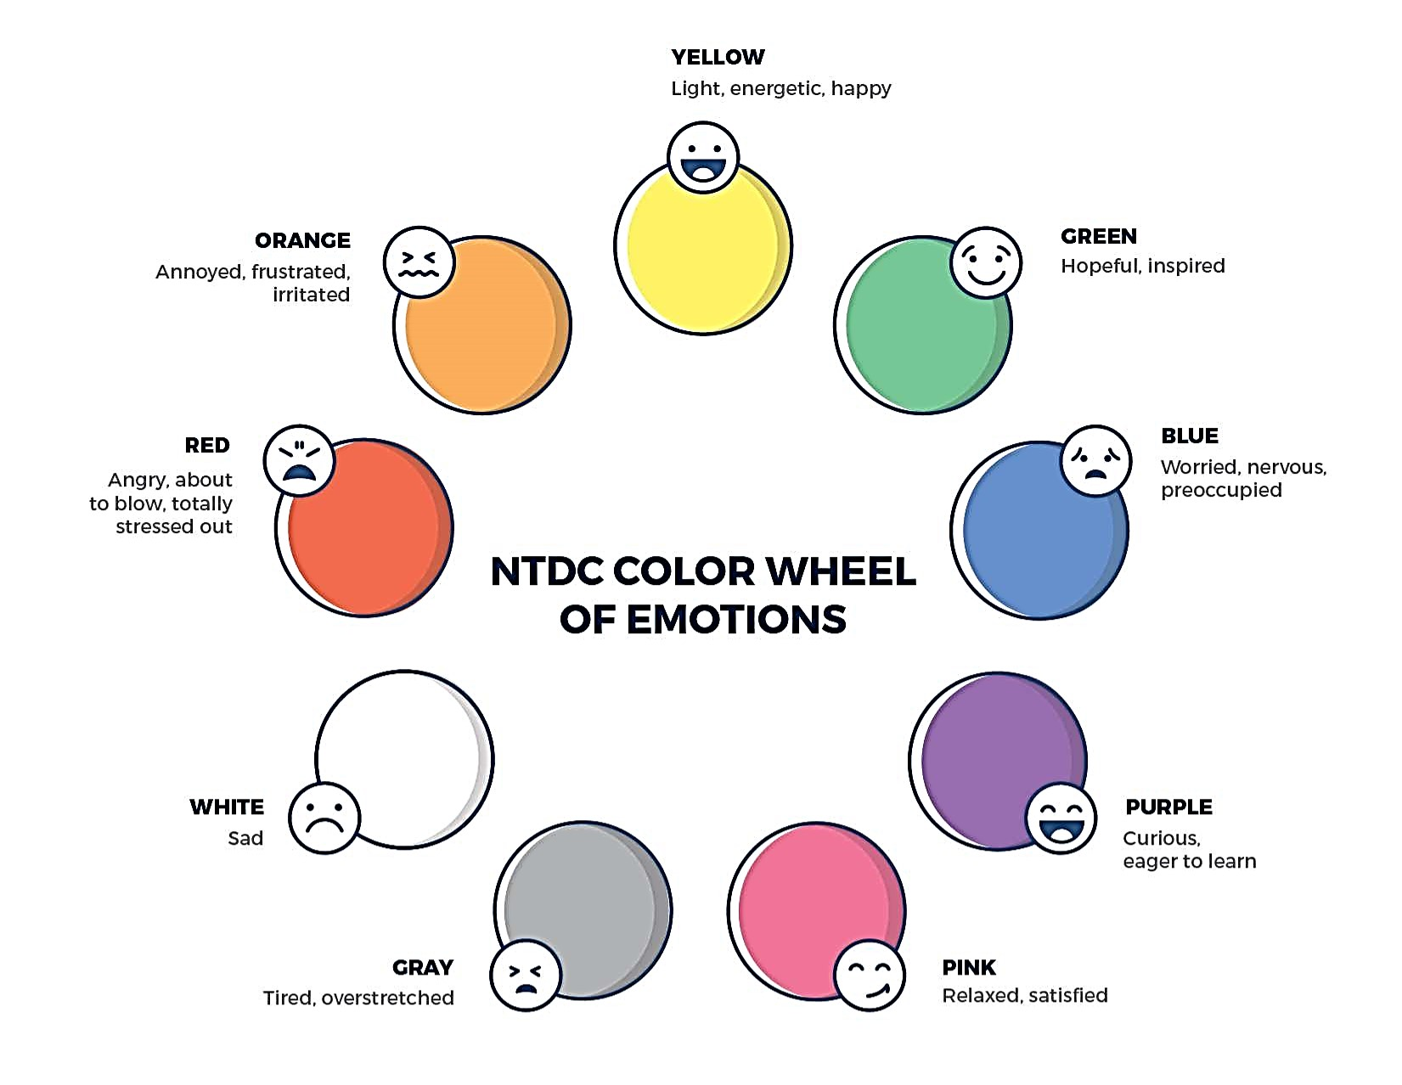
Welcome to the national training and Development Curriculum for foster and adoptive parents
Welcome to the national training and Development Curriculum for foster and adoptive parents
Notes:
FACILITATOR'S NOTE
Have this slide showing onscreen as participants assemble for the first class of the day. As participants come in, welcome them back and ask them to take a few minutes to do a self-check using the Color Wheel. NOTE: The Color Wheel should only be done one time per day; before the first theme of the day. If combining several themes together on one day, facilitate the Color Wheel at the beginning of the first class of the day as participants are coming into the room.
SAY
Welcome back. We are so glad that you have taken time out of your day to join us for another exciting learning opportunity. As you recall, tuning in to how you’re doing on a daily basis may not be something everyone here is used to, but this type of regular self-check is critical for parents who are adopting or fostering children who may have experienced trauma, separation, or loss, as it will be helpful to become and stay aware of your own state of mind. It may seem like a simple exercise but be assured that knowing how we’re doing on any given day strengthens our ability to know when and how we need to get support and/or need a different balance. Doing this type of check in will also help us to teach and/or model this skill for children! Please take a moment to look at the color wheel and jot down on paper the color(s) that you are currently feeling.
DO
Wait a little while to give participants time to complete the Color Wheel.
SAY
Now that everybody has had the opportunity to do a quick check in, would someone like to share what color(s) they landed on today for the Color Wheel?
DO
Call on someone who volunteers to share their color(s). If a challenging emotion or feeling is shared, thank the person and acknowledge their courage in sharing, pause for a moment, encourage everyone to take a deep breath, and transition to beginning the theme.

Slide 7
Child Development
Modified January 2022
Notes:
FACILITATOR'S NOTE
Show this slide briefly just before you start the session.
SAY
Let’s get started! Welcome to the Child Development theme.

Slide 8
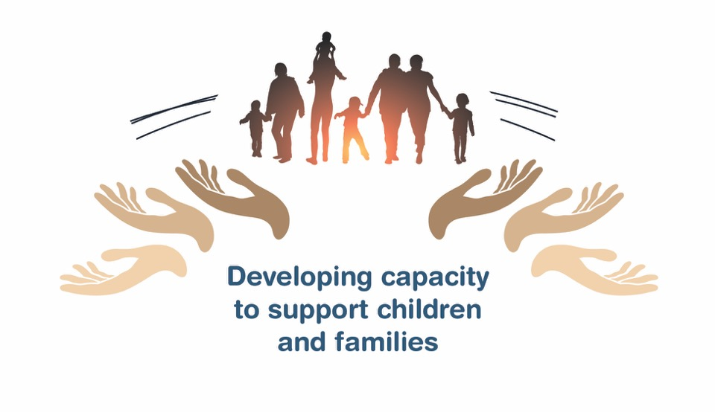
Place holder for slide with opening Quote
Notes:
FACILITATOR'S NOTE
The opening quote slide should only be used for the first theme of the day. If combining several themes together on one day, the opening quote slide would only be shown after the Color Wheel at the beginning of the first theme. It is important to always emphasize with this slide that this type of parenting involves lifelong learning and it will be critical for families to be invested in their own learning before and after a child is placed in their home.
PARAPHRASE
We are excited to share this lesson with all of you today. We are going to start with Child Development. As the slide states, this information will help to develop your capacity to support children and families. This type of parenting will require continuous learning. So, let’s dive in and see what important information we have to share with you today.

Slide 9
SECTION 1:
INTRODUCTION: CHILD DEVELOPMENT
Notes:
PARAPHRASE
Listed below are the main topics that we will cover during this theme:
Children grow and develop in different ways.
A child’s development can be disrupted if the child experiences trauma and many children who have been fostered or adopted have experienced trauma. It is important to build a basic foundation for understanding child development, so you can better understand and meet the child’s needs.
This theme will help you build your understanding of child development.

Slide 10
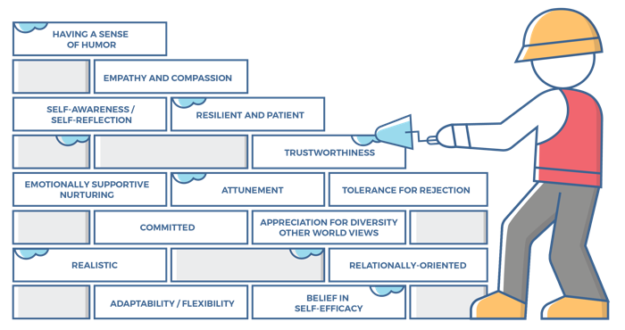
Characteristics of successful foster and adoptive parents
10
Notes:
FACILITATOR'S NOTE
This slide is shown at the start of each theme. Although the graphic will remain the same, the bricks that are colored in red will change based on the characteristics that will be touched upon in this theme. The characteristics were obtained from a review of literature, stakeholder interviews, and review of existing curricula. We want families to become very acquainted with these characteristics throughout the training. It is important to note that in addition to the characteristics that are highlighted in red, there may be additional characteristics that are touched upon during the theme. Facilitators should try to connect these characteristics to the content they are sharing throughout the training. Remind participants that their Participant Resource Manual contains the definitions for these characteristics.
SAY
Before we get into the content let’s look at the 14 characteristics of successful foster and adoptive parents. When you took your self-assessment, you were asked about these characteristics.

Slide 11
Characteristics for child development, 1 of 2
Emotionally Supportive/Nurturing:
Parents can create an emotionally supportive environment that gives the child a safe space to verbalize and process their emotions, including the positive ones.
Parents know that the child needs a supportive space to share and a calming guide who will listen and empathize which can include listening more than speaking so that the child finds a solution for their problem.
Attunement:
Parents are aware of, understand, and are sensitive to the specific responses and needs of a child at any given time (despite the degree to which the child expresses or does not express these needs directly).
Parents are in tune with the child’s moods, levels of exhaustion, hunger, rhythms, responses, need for physical contact, affection, security, and stimulation, and are able to use this understanding to build a trusting environment with the child.
Parents understand that they need to stay calm and regulated so that they can successfully help the child regulate their emotions.
Notes:
SAY
The Child Development theme will cover the following characteristics:
Emotionally supportive/Nurturing
Attunement
Realistic
Take a moment to think back to how you assessed yourself with these characteristics. It is important as you start this journey to assess your characteristics as they are qualities that can strengthen your ability to successfully parent a child who is in foster care or has been adopted.

Slide 12
Characteristics for child development, 2 of 2
Realistic:
Parents understand that there will be varying degrees of success with different situations with each child.
Parents understand that the efforts that they provide may not result in a change in a child’s understanding or behavior until much later.
Parents know that when mistakes are made, adjustments and allowances can be made as they re-evaluate expectations.
Parents know what their expectations are and can identify when those expectations are not being met and need to change.
Notes:
ASK
Now that we have reviewed the definitions, why do you think these specific characteristics are important to a child’s development?
Reinforce the following:
Emotionally supportive/Nurturing
Children who have experienced trauma, loss and grief often need someone who can help them feel calm and more secure. The emotionally supportive parent knows that by staying calm, and being a good listener, they can help the child feel more calm and secure.
Attunement
Children who have experienced trauma and loss are at increased risk for developmental delays. Attuned, emotionally supportive caregiving can create an environment that helps a child make progress toward developmental milestones
The attuned parent will be a good partner for the professionals who may also be involved with the child. A basic understanding of child development will help the attuned caregiver give good feedback on the child needs, challenges, and positive gains.
Realistic
The realistic parent accepts the child for who they are and makes adjustments to their parenting as needed to best meet the needs of the child.
The realistic parent knows that change and progress take time.

Slide 13


PODCAST: CHILD DEVELOPMENT
Guest: Bruce Perry, M.D.
Host: April Dinwoodie
Notes:
FACILITATOR'S NOTE
Listen to NTDC Podcast on Child Development which can be obtained from the NTDC website or CapLEARN. (Approximately 16 minutes)
Refer participants to Handout #1: Glossary: Child Development Podcast
ASK
What did you hear Dr. Perry explain about the difference in developmental versus chronological age for a child, and why is it important to parent to their developmental versus chronological age?
If you are learning something new, what kind of support is helpful to you or what environment is best for you to learn in?
PARAPHRASE
Reinforce the following points:
Healthy child development depends on supportive and nurturing parenting, building a foundation of safety and trust.
When very young children face different types of trauma or neglect, their brains grow and develop differently from children who have not experienced hardship.
A child’s brain grows and works best when they have parents and other caregivers who provide nurturing and responsive parenting, leading to a sense of safety. When children feel safe with their primary caregivers, they can reach beyond that foundation, learn new skills, and begin to heal and recover from hardships they may have faced.
Children who have experienced early childhood trauma often experience delays in their development in some or all areas, as trauma affects the brain’s development. Developmental milestones may be delayed or lost as a result of the trauma.
Some children simply develop more slowly than other children of the same age, even in the absence of trauma. This is called a developmental delay, which may be noticed from birth or at an older age. Other children may develop as expected, but at some point, can no longer do the things that they could do before. This is called a developmental regression. It will be important that you partner with the professionals involved in the child’s life who can help you understand how to provide what the child needs to help them make progress in their growth and development. This may include early intervention services, such as additional help in the preschool setting, speech, or occupational therapy.

Slide 14
SECTION 2:
TYPICAL CHILD DEVELOPMENT
Notes:
FACILITATOR'S NOTE
This section will take approximately 25 minutes.
Point out to participants that being aware of the child’s development stages will help parents who are fostering or adopting be attuned to the child’s needs (characteristic) so they are better able to know how to best parent the child.
PARAPHRASE
It is important for parents who foster and adopt to have a basic understanding of typical child development, as well as disrupted child development when it occurs. By understanding a child’s developmental delays, parents will more fully understand how to meet the child's developmental needs and how to be a partner with the child’s caseworker, doctors, nurses, teachers, and other professionals to help that child reach their potential.

Slide 15

Development Domains
Cognitive
Social-Emotional
Language/Communication
Physical
Notes:
SAY
There are many domains of development, including physical, language/communication, social-emotional, relationship, cognitive, problem solving, gross motor, fine motor, spiritual, moral, and sexual. It is important to note that development is sequential, and as with building blocks, each skill is built on the foundation of the ones that come before. We will initially focus on these four main domains of development listed on the slide:
Cognitive
Social-Emotional
Language/Communication
Physical
There are many steps in the developmental process, and each child moves along at their own unique pace.

Slide 16
Developmental Stages and Milestones, 1 of 7
Age Range | Physical | Language | Social-Emotional | Cognitive
Infancy (0-12 months)
Early Toddler (12-24 mos / 1-2 yrs)
Late Toddler (24-36 mos / 2-3 yrs)
Early Childhood (36-48 mos / 3-4 yrs)
Middle Childhood (48-60 mos / 4-5 yrs)
Late Childhood (60-72 mos / 5-6 yrs)
Early Latency (6-7 years)
Late Latency (8-10 years)
Early Adolescence (11-14 years)
Middle Adolescence (15-17 years)
Late Adolescence (18-21 years)
Notes:
FACILITATOR’S NOTE
The next several slides walk participants through Handout #2: Broad Developmental Themes from Birth to Age 21 Years. The intent is to show participants how to use this handout for future use. Facilitators do not need to read each slide but instead show participants how to use the chart and to point out that the skills for each developmental phase build on each other.
DO
Have participants refer to the Handout #2: Broad Developmental Themes from Birth to Age 21 Years.

Slide 17
Developmental Stages and Milestones, 2 of 7
Age Range | Physical | Language | Social-Emotional | Cognitive
Infancy (0-12 months)
Early Toddler (12-24 months)
Late Toddler (24-36 months)
Early Childhood (36-48 months)
Middle Childhood (48-60 months)
Late Childhood (60-72 months)
Early Latency (6-7 years)
Late Latency (8-10 years)
Early Adolescence (11-14 years)
Middle Adolescence (15-17 years)
Late Adolescence (18-21 years)
Notes:
SAY
Look at this chart in your handout and follow along as we walk through the developmental boxes from left to right for middle childhood-age 48 to 60 months (4 to 5 years).

Slide 18
Developmental Stages and Milestones, 3 of 7
Age Range | Physical | Language | Social-Emotional | Cognitive
Infancy (0-12 months)
Early Toddler (12-24 months)
Late Toddler (24-36 months)
Early Childhood (36-48 months)
Middle Childhood (48-60 months)
Late Childhood (60-72 months)
Early Latency (6-7 years)
Late Latency (8-10 years)
Early Adolescence (11-14 years)
Middle Adolescence (15-17 years)
Late Adolescence (18-21 years)
Able to climb, hop on one foot, kick, throw & catch
Can stand on one foot for 3-5 seconds
Walks up and down stairs without help
Fine motor skills advance- can button, draw, use a zipper
Increased height & muscle mass change body shape
Day & night bladder/bowel control achieved
Notes:
FACILITATOR'S NOTE
It is not necessary to go through every milestone in detail; the goal is to ensure participants realize there are different developmental domains and to give them an impression of what the different domains are.
DO
Briefly discuss the Physical developmental milestones for middle childhood shown on the slide.

Slide 19
Developmental Stages and Milestones, 4 of 7
Age Range | Physical | Language | Social-Emotional | Cognitive
Infancy (0-12 months)
Early Toddler (12-24 months)
Late Toddler (24-36 months)
Early Childhood (36-48 months)
Middle Childhood (48-60 months)
Late Childhood (60-72 months)
Early Latency (6-7 years)
Late Latency (8-10 years)
Early Adolescence (11-14 years)
Middle Adolescence (15-17 years)
Late Adolescence (18-21 years)
Vocabulary is 2,000+ words
Can speak in full sentences & be understood easily
Able to follow 2 or 3-part directions (“Take this book to your room, get your jacket and meet me in the kitchen.”)
Recognizes familiar word signs (like “stop)
Recognizes & can print some letters, words, & numbers
Notes:
FACILITATOR'S NOTE
It is not necessary to go through every milestone in detail; the goal is to ensure participants realize there are different developmental domains and to give them an impression of what the different domains are.
DO
Briefly discuss the Language developmental milestones for middle childhood shown on the slide.

Slide 20
Developmental Stages and Milestones, 5 of 7
Age Range | Physical | Language | Social-Emotional | Cognitive
Infancy (0-12 months)
Early Toddler (12-24 months)
Late Toddler (24-36 months)
Early Childhood (36-48 months)
Middle Childhood (48-60 months)
Late Childhood (60-72 months)
Early Latency (6-7 years)
Late Latency (8-10 years)
Early Adolescence (11-14 years)
Middle Adolescence (15-17 years)
Late Adolescence (18-21 years)
Can dress/undress & brush teeth
Can ask for help before becoming frustrated
Better at expressing anger verbally over physically
Engages in extended associative play with other children
Enjoys imaginative play and dress-up
Likes playing games, but rules may be changed often
Notes:
FACILITATOR'S NOTE
It is not necessary to go through every milestone in detail; the goal is to ensure participants realize there are different developmental domains and to give them an impression of what the different domains are.
DO
Briefly discuss the Social-Emotional developmental milestones for middle childhood shown on the slide.
Note: If a parent asks about “associative” play, perhaps they have heard the term parallel play instead.

Slide 21
Developmental Stages and Milestones, 6 of 7
Age Range | Physical | Language | Social-Emotional | Cognitive
Infancy (0-12 months)
Early Toddler (12-24 months)
Late Toddler (24-36 months)
Early Childhood (36-48 months)
Middle Childhood (48-60 months)
Late Childhood (60-72 months)
Early Latency (6-7 years)
Late Latency (8-10 years)
Early Adolescence (11-14 years)
Middle Adolescence (15-17 years)
Late Adolescence (18-21 years)
Understands the order of daily activities (breakfast, lunch, dinner, bedtime, etc.)
Can count ten or more objects
Correctly names at least four colors & three shapes
Able to draw a person with a body & limbs
Can copy a circle, square, or other simple shapes
Notes:
FACILITATOR'S NOTE
It is not necessary to go through every milestone in detail; the goal is to ensure participants realize there are different developmental domains and to give them an impression of what the different domains are.
DO
Briefly discuss the Cognitive developmental milestones for middle childhood shown on the slide.
PARAPHRASE
Notice that this handout contains only a few major developmental domains (Physical, Language, Social-Emotional and Cognitive) for each age, but they are enough for us to see the progression from one stage to the next.
DO
Give participants a chance to ask questions or comment.
Refer participants to Handout #2 Broad Developmental Themes.

Slide 22
Developmental Stages and Milestones, 7 of 7
Age Range | Physical | Language | Social-Emotional | Cognitive
Infancy (0-12 months)
Early Toddler (12-24 months)
Late Toddler (24-36 months)
Early Childhood (36-48 months)
Middle Childhood (48-60 months)
Late Childhood (60-72 months)
Early Latency (6-7 years)
Late Latency (8-10 years)
Early Adolescence (11-14 years)
Middle Adolescence (15-17 years)
Late Adolescence (18-21 years)
Notes:
PARAPHRASE
Next, follow Language Development down from age 0-12 months to Middle childhood. Notice that the developmental process builds on early (or foundational) abilities and gradually moves toward more advanced or mature levels. We will not walk through all of the age ranges but instead our purpose with this activity is to show you how to use the chart for future reference.

Slide 23
Developmental Stages and Milestones
Language, 1 of 5
Age Range | Language
Infancy (0-12 months)
Early Toddler (12-24 months)
Late Toddler (24-36 months)
Early Childhood (36-48 months)
Middle Childhood (48-60 months)
Late Childhood (60-72 months)
Early Latency (6-7 years)
Late Latency (8-10 years)
Early Adolescence (11-14 years)
Middle Adolescence (15-17 years)
Late Adolescence (18-21 years)
Early vocalizations (cooing, babbling)
Back-and-forth vocal exchanges
Can mimic adult conversations with vocalizations
May sign simple words at 1 year, if taught
Single words may come late in this range, or may have special sounds for caregiver(s), food, pets, etc.
Notes:
FACILITATOR'S NOTE
It is not necessary to go through every milestone in detail.
The goal is to ensure participants realize there are clear developmental stages and to give them an impression of different stages and how they build on one another.
DO
Read a few of the Language developmental milestones for infancy shown on the slide.

Slide 24
Developmental Stages and Milestones
Language, 2 of 5
Age Range | Language
Infancy (0-12 months)
Early Toddler (12-24 months)
Late Toddler (24-36 months)
Early Childhood (36-48 months)
Middle Childhood (48-60 months)
Late Childhood (60-72 months)
Early Latency (6-7 years)
Late Latency (8-10 years)
Early Adolescence (11-14 years)
Middle Adolescence (15-17 years)
Late Adolescence (18-21 years)
Typically, 50 words by 18 months
200 words by 24 months
Looks at caregiver as a means for communicating with caregiver in times of ambiguity or stress
Can understand and respond to words
Notes:
FACILITATOR'S NOTE
It is not necessary to go through every milestone in detail.
The goal is to ensure participants realize there are clear developmental stages and to give them an impression of different stages and how they build on one another.
DO
Read a few of the Language developmental milestones for infancy shown on the slide.

Slide 25
Developmental Stages and Milestones
Language, 3 of 5
Age Range | Language
Infancy (0-12 months)
Early Toddler (12-24 months)
Late Toddler (24-36 months)
Early Childhood (36-48 months)
Middle Childhood (48-60 months)
Late Childhood (60-72 months)
Early Latency (6-7 years)
Late Latency (8-10 years)
Early Adolescence (11-14 years)
Middle Adolescence (15-17 years)
Late Adolescence (18-21 years)
Says 200+ words & can answer simple questions
Points to things when they are named
Knows names of familiar people, says sentences with two to four words
Can follow 1 or 2 step instructions
Knows names of body parts
Notes:
FACILITATOR'S NOTE
It is not necessary to go through every milestone in detail.
The goal is to ensure participants realize there are clear developmental stages and to give them an impression of different stages and how they build on one another.
DO
Read a few of the Language developmental milestones for infancy shown on the slide.

Slide 26
Developmental Stages and Milestones
Language, 4 of 5
Age Range | Language
Infancy (0-12 months)
Early Toddler (12-24 months)
Late Toddler (24-36 months)
Early Childhood (36-48 months)
Middle Childhood (48-60 months)
Late Childhood (60-72 months)
Early Latency (6-7 years)
Late Latency (8-10 years)
Early Adolescence (11-14 years)
Middle Adolescence (15-17 years)
Late Adolescence (18-21 years)
500-1,000 words
Able to say name and age
Can answer simple questions
Speaks with 5-6-word sentences
Speaks clearly & can be understood by caregivers
Understands “on”, “in,” & “under”
Notes:
FACILITATOR'S NOTE
It is not necessary to go through every milestone in detail.
The goal is to ensure participants realize there are clear developmental stages and to give them an impression of different stages and how they build on one another.
DO
Read a few of the Language developmental milestones for infancy shown on the slide.

Slide 27
Developmental Stages and Milestones
Language, 5 of 5
Age Range | Language
Infancy (0-12 months)
Early Toddler (12-24 months)
Late Toddler (24-36 months)
Early Childhood (36-48 months)
Middle Childhood (48-60 months)
Late Childhood (60-72 months)
Early Latency (6-7 years)
Late Latency (8-10 years)
Early Adolescence (11-14 years)
Middle Adolescence (15-17 years)
Late Adolescence (18-21 years)
Vocabulary is 2,000+ words
Can speak in full sentences & be easily understood
Able to follow 2 or 3 part directions (“Take this book to your room, get your jacket ,and meet me in the kitchen.”)
Recognizes familiar word signs (like “stop”)
Recognizes & can print some letters words & numbers
Notes:
FACILITATOR'S NOTE
It is not necessary to go through every milestone in detail.
The goal is to ensure participants realize there are clear developmental stages and to give them an impression of different stages and how they build on one another.
DO
Read a few of the Language developmental milestones for infancy shown on the slide.

Slide 28

Another Developmental Domain: Sexual development
Notes:
SAY
Let’s talk briefly about another domain- sexual development. Perhaps many of us grew up in homes that avoided talking about sex, and it is not always a comfortable topic to discuss in public. It is important that we review this domain for the same reasons that we talk about the other domains—to better understand the children in our homes, and to seek consultation from a professional if there is a concern. Refer to the right-time training Sexual Development and Identity to learn more about sexual development. Let’s review Handout #3: Sexual Development. In our theme on Sexual Trauma, we will have more discussion on the impact of sexual trauma on sexual development.
DO
Refer participants to Handout #3: Sexual Development and review a couple of the age categories.

Slide 29

Traumatic Childhood Events
Physical Abuse
Displace-ment
Neglect
Family Violence
Abandon-ment
Emotional Abuse
Notes:
PARAPHRASE
While it is typical for there to be differences in the achievement of developmental milestones, trauma can result in loss of developmental milestones, or the interruption of progression to the next developmental level.
A child might experience trauma such as chronic neglect, emotional or physical abuse, witnessing family violence, separation from caregivers, or something as unintended as displacement as a result of a natural disaster. Each of these traumatic experiences can cause interruption and delay of developmental milestones.

Slide 30
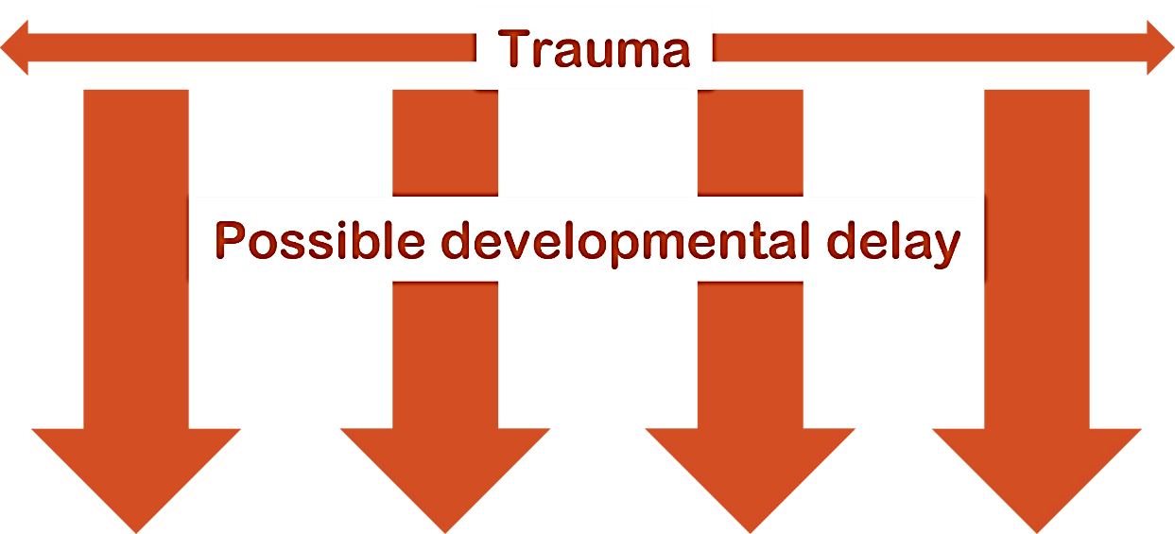
Trauma and Development
Age Range | Physical | Language | Social-Emotional | Cognitive
Infancy (0-12 months)
Early Toddler (12-24 months)
Late Toddler (24-36 months)
Early Childhood (36-48 months)
Middle Childhood (48-60 months)
Late Childhood (60-72 months)
Early Latency (6-7 years)
Late Latency (8-10 years)
Early Adolescence (11-14 years)
Middle Adolescence (15-17 years)
Late Adolescence (18-21 years)
Notes:
PARAPHRASE
Consider what it would look like if a traumatic event occurred during the Early Childhood phase; let’s say for a 3-year-old child. If the child experienced delays in development at age 3 due to trauma, then it will also affect the child’s achievement of developmental milestones at age 4 and 5, the middle childhood stage, because skills build upon one another. On the slide you see how this trauma occurring at age 3 can result in developmental delays in all the domains as the child ages.
We also need to remember, that for a child who has experienced trauma, there may be delays observed in some areas and not in others. For example, the 3-year-old who was impacted by trauma might achieve the Physical milestones but have delays in the Social-Emotional or Cognitive domains. If there is no intervention and the child is not able to catch up for a long time, you can see how it would affect the child’s overall developmental picture and behavior.
Again, these delays might happen in only one area or may occur across many developmental areas. Another example might be that a child may be developing at their age level in large motor skills like walking and running, but have delays in their speech development, and may need some help in this area. Another child may be ahead in their cognitive abilities; let’s say showing signs that they will be an early reader; but be less developed in social skills, such as having difficulty getting along with peers in preschool.
These delays call upon the parent to change and/or modify parenting to better support the child’s growth and learning. Parents must recognize that due to these delays, a child’s inability to “act their age” is not because they don’t want to, it is because they often cannot. It is important to engage with professionals who can help to develop strategies that will assist the child in overcoming these gaps in development. It is also essential that parents who are fostering or adopting take extra care to provide the child with a sense of safety, predictability, and protection. You will also want to provide rich developmental experiences to help the child make progress toward developmental milestones.

Slide 31








Parenting Tips
Infants
(0-1)
Toddlers
(1-2)
Toddlers
(2-3)
Preschoolers
(3-5)
Middle Childhood
(6-8)
Middle Childhood
(9-11)
Young Teens
(12-14)
Teenager
(15-17)
Notes:
FACILITATOR NOTES
You will not review these handouts in class. You will share information about them so participants can be aware of this resource for further use.
DO
Refer participants to Handouts #4 - #11 in their Participant Resource Manual. The Centers for Disease Control (CDC) have developed a series of Positive Parenting Tips for different age ranges. You may notice that these tip sheets use slightly different age ranges than the ones used in Handout #2: Broad Developmental Themes. There are a total of eight tip sheets, one for each age range shown on the slide. These tip sheets can be useful to you understanding the developmental stages of children as they move into your home:
Handout #4: Infants (0-1 year of age)
Handout #5: Toddlers (1-2 years of age)
Handout #6: Toddlers (2-3 years of age)
Handout #7: Preschoolers (3-5 years of age)
Handout #8: Middle Childhood (6-8 years of age)
Handout #9: Middle Childhood (9-11 years of age)
Handout #10: Young Teens (12-14 years of age)
Handout #11: Teenagers (15-17 years of age)

Slide 32

Supporting Development
Notes:
PARAPHRASE
Remember that each new developmental step takes time to master. New developmental steps are linked to changes in the brain. This means that there is growth of new brain cells, brain connections, and other changes that allow for each new ability to be developed, practiced, and mastered. This makes way for the next developmental step. This will take time, so it is important to be patient and supportive, and to keep expectations realistic.
As children experience positive feedback and pleasure in their successes, they will be encouraged to achieve more. They feel rewarded, not only within themselves, but also when someone like a parent or teacher notices the achievement and gives them that positive feedback-a smile or praise, it encourages the child. Think of the praise a baby gets when they take their first step, and how they keep working at walking more and more. This is a part of the feedback loop that helps to promote developmental progress.
Remember, when you are concerned that a child may be experiencing developmental delays or regression, it is important to ask for help from a professional skilled in understanding child development (caseworker, physician, psychiatrist, nurse, psychologist, teacher, etc.).
Children with a developmental delay are likely to have a developmental age that’s different from their chronological age. The next section takes a closer look at this concept.

Slide 33
SECTION 3:
CHRONOLOGICAL Age VS. DEVELOPMENTAL AGE
Notes:
FACILITATOR'S NOTE
This section will take approximately 30 minutes.
SAY
Many children who are in, or who have experienced out-of-home care, have had life experiences that may have impacted their development. This may cause them to be at different stages within different domains. This concept is important for parents who are fostering or adopting to understand.
For example, you may have a 15-year-old child move into your home who physically looks 15; however, emotionally the child may be behaving like a 9-year-old; act like a 7- year- old child socially; cognitively the child may be 8; and sexual development of the child may be 15. Recognizing that the chronological age does not always match where the child is developmentally is crucial. Once this recognition is made and accepted, parents who foster or adopt can adapt their demands/expectations and parenting approach to meet the child at their actual developmental age. By doing this, parents are being emotionally supportive and nurturing of the child (characteristic) and reducing the tendency to have unrealistic expectations of the child.
We’ll introduce the idea of differences between chronological and developmental age with an activity.

Slide 34







Developmental Domains
Notes:
FACILITATOR'S NOTE
In this activity, you will read descriptions of a child’s behavior in seven different developmental domains, ask participants to estimate the child’s age from the descriptions, reveal the child’s actual age, and facilitate a whole-group discussion around the difficulties and challenges for the child and the parents that might result from the differences in developmental and chronological age.
Before the session, draw a simple figure of a child on a flipchart or white board- The flipchart page or white board should be large enough that you can add in different ages guessed by the participants. After each domain is read and discussed, add the guessed age next to the child you drew on the flipchart or white board.
Don’t reveal the child’s actual age or that this is the same child until all of the domains have been discussed. At that point, you will reveal that all of the descriptions were about the same child, “Randy” and his age is 13.
Adaptation for Remote Platform: You can either add a new blank slide and then use Zoom annotate feature (text) to reflect participant responses regarding age OR you can use the white board feature. If not using Zoom, you can use Jamboard. You need a Google account to access Jamboard. (Sign into your google account and then do a search for Jamboard.) In all of these scenarios you will need a co-facilitator to read the slides with the developmental domains, as you will not be showing them on the PPT.
SAY
For this activity, we are going to read descriptions of a child’s different developmental domains. After we read each domain, I will ask you to estimate the child’s age based on each domain on the slide. Let’s get started.

Slide 35
Developmental Domain 1
The parent found advertisements of women in lingerie stuffed behind the child’s bed.
Notes:
DO
Read the developmental domain or ask a volunteer to read it. If doing this remotely, have your co-facilitator read the domain aloud.
Ask the group or a specific volunteer what they think the child’s age is.
Write the estimated age on the simple drawing of the child.
FACILITATOR'S NOTE
It does not matter exactly what age is guessed.

Slide 36
Developmental Domain 2
The child has difficulty completing basic hygiene skills, going for days without brushing his teeth or showering. The parent repeatedly tells him to take a shower and more specifically to use soap.
Notes:
DO
Read the developmental domain or ask a volunteer to read it. If doing this remotely, have your co-facilitator read the domain aloud.
Ask the group or a specific volunteer what they think the child’s age is.
Write the estimated age next to the simple drawing of the child.
FACILITATOR'S NOTE
It does not matter exactly what age is guessed.

Slide 37
Developmental Domain 3
The child had a friend over to play with but continued to leave the friend and go off and do his own activity. The parent had to repeatedly tell him to go back and play with his friend.
Notes:
DO
Read the developmental domain or ask a volunteer to read it. If doing this remotely, have your co-facilitator read the domain aloud.
Ask the group or a specific volunteer what they think the child’s age is.
Write the estimated age next to the simple drawing of the child.
FACILITATOR'S NOTE
It does not matter exactly what age is guessed.

Slide 38
Developmental Domain 4
The child got very upset about his homework tonight. He said he was tired and could not do any work. He slammed down his book and ran into his bed and refused to get up the rest of the night.
Notes:
DO
Read the developmental domain or ask a volunteer to read it. If doing this remotely, have your co-facilitator read the domain aloud.
Ask the group or a specific volunteer what they think the child’s age is.
Write the estimated age next to the simple drawing of the child.
FACILITATOR'S NOTE
It does not matter exactly what age is guessed.

Slide 39
Developmental Domain 5
The parent found the child’s homework in the trash after he left for school. When he got home from school, the parent ask him why. The child repeatedly said that he did not throw his homework in the trash even after being shown the crumpled-up piece of homework.
Notes:
DO
Read the developmental domain or ask a volunteer to read it. If doing this remotely, have your co-facilitator read the domain aloud.
Ask the group or a specific volunteer what they think the child’s age is.
Write the estimated age next to the simple drawing of the child.
FACILITATOR'S NOTE
It does not matter exactly what age is guessed.

Slide 40
Developmental Domain 6
The child was completely focused on food. Every morning the only thing that he could think about was breakfast. He would get up in the middle of night and eat, and even then, he could not complete his morning routine until he ate breakfast. When hungry, he could not do anything other than focus on getting food.
Notes:
DO
Read the developmental domain or ask a volunteer to read it. If doing this remotely, have your co-facilitator read the domain aloud.
Ask the group or a specific volunteer what they think the child’s age is.
Write the estimated age next to the simple drawing of the child.
FACILITATOR'S NOTE
It does not matter exactly what age is guessed.

Slide 41
Developmental Domain 7
The child had 3 chores that he was expected to do every weekend. Although they had been explained to him with step-by-step directions, he would rush through the chores, only partially completing them. Each weekend he would run to the parent 5 minutes after starting his chores to say that he was done. Every week the parent had to provide specific directions for each chore; however, the child continued to not complete them.
Notes:
DO
Read the developmental domain or ask a volunteer to read it. If doing this remotely, have your co-facilitator read the domain aloud.
Ask the group or a specific volunteer what they think the child’s age is.
Write the estimated age next to the simple drawing of the child.
FACILITATOR'S NOTE
It does not matter exactly what age is guessed.

Slide 42

Developmental Domains
RANDY
13 years old
7th grade
Much bigger than most of the kids in his class (5’7”, 130 lbs.)
Notes:
SAY
The child we are talking about is Randy. Now that we have identified his developmental stages, let’s look at Randy’s description:
Randy is 13 years old. At 5”7, he is taller than his foster mother and weighs 130 pounds. As one of the oldest in his seventh-grade class, since he was held back one year, he is much bigger than most of the kids in his class. He is often mistaken for being in high school, based upon his appearance. Randy moved into this home at the age of 8 after being in seven placements.
FACILITATOR’S NOTE
Now that participants know that these 7 domains all belong to one child, ask participants what they notice about Randy and his developmental stages?

Slide 43
43
Developmental Domains
Discussion Questions
Randy is 13 years old. Does this match the ages you guessed?
What difficulties could Randy encounter based upon his mixed developmental ages?
What challenges might the mixed developmental ages cause for the parent?
Notes:
DO
Facilitate a large group discussion around the questions on the slide.
PARAPHRASE
As Dr. Perry discussed in the podcast, it is important to parent to the child’s developmental age, rather than making assumptions based on the child’s chronological age. Understanding that typical development can vary in different domains, parents should consider what the child’s behavior tells them about the child’s developmental stage in relation to that behavior, and what building blocks they may have missed. Parents who foster and adopt may need to adjust their expectations of the child. For example, consequences for behavior should be at the appropriate developmental level and focused on helping the child add those missing building blocks. This will help the child progress to the developmental level and behavior that is more appropriate for their chronological age. By parenting to a child’s developmental age, the parent will be more realistic in understanding and meeting the child’s needs (characteristic). This can be confusing and challenging because often a child may act a certain age in some areas and act totally different in other areas, just like Randy.
DO
If the facilitator has a real-life example of a child they knew and/or cared for whose developmental domains did not match their chronological age, this would be a good time to share it. The facilitator can also ask the participants if they have a real-life example to share. Focus the sharing on the challenges associated with caring for a child with different developmental ages and any tips on how to do this well.

Slide 44

Reflection/
RElevance
Notes:
FACILITATOR'S NOTE
If time permits do this reflection in class. If time is short, ask participants to do on their own at home. This activity should take approximately 5 minutes.
SAY
Now, we’ll take a few minutes to reflect on what we’ve learned in this theme.
Please open your Participant Resource Manual for this theme. Think about “Randy” from our activity today. What do you think would be most challenging for you if you were caring for him, as a child with such a mixture in developmental stages? What support might you need? Please write your thoughts in your Participant Resource Manual.
44

Slide 45
SECTION 4:
WRAP-UP
Notes:
SAY
Now, it’s time to wrap up. Before we do, I want to briefly highlight the key points from this theme:
Each child has a unique developmental path.
Developmental milestones are like building blocks—each step builds upon the one before it.
Trauma and other factors may cause developmental delays or regressions. These delays should be assessed by a professional skilled in understanding child development.
Parents who are fostering or adopting should be prepared to adjust their expectations about children’s developmental capabilities.
Parenting should be focused on the child’s developmental stage, rather than the chronological age.
You will need to be attuned, realistic, and emotionally supportive and nurturing to successfully parent a child whose developmental age is different from their chronological age.

Slide 46

LIFELONG Learning
Notes:
SAY
It is critical that as you go through this journey, you continue to enhance your knowledge and skills. It is important that you continue your own learning by taking advantage of resources that are available to you. This theme has numerous resources that will help you continue to learn more about this topic. For example, there is a handout on Connecting with your Teen that provides practical steps on how to engage with teens. There is another handout that provides practical tips on how to parent and engage with children who are school age (6-12). You can find the resources on the NTDC website or in CapLEARN.

Slide 47
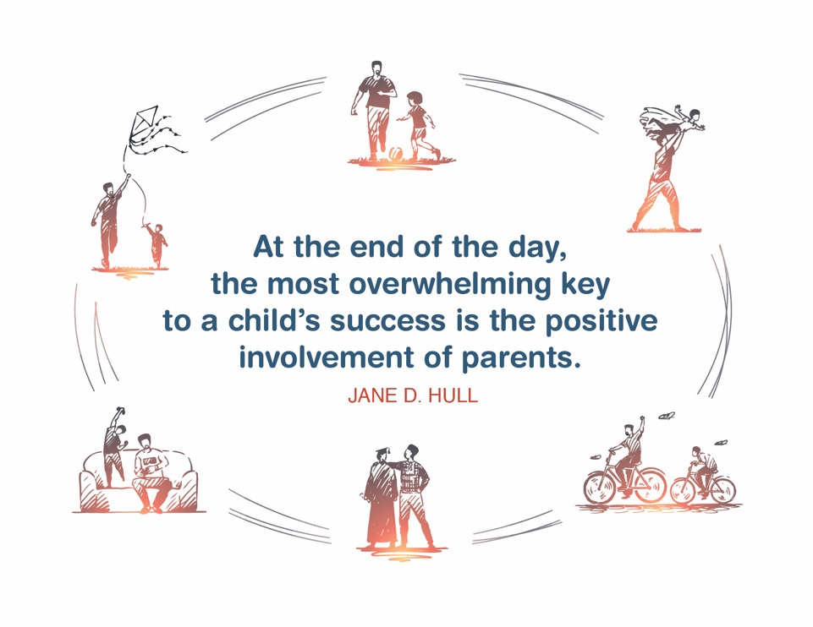
Place holder for slide with Closing Quote
Notes:
FACILITATOR'S NOTE
The closing quote above and the paraphrase section below will be done only once per day, after the last theme presented for the day. If you are moving on to another theme invite them to take a break, stretch, or breathe before moving on to the next theme.
If closing for the day:
Thank everyone for attending and for their thoughtful participation and attention. Remind the participants that although this training may seem long, it is critical for them to gather the knowledge, attitude, and skills that are needed as they embark on this journey because they ultimately will play a huge role in the lives of children and families.
If in person, collect the name tents or have them tuck them into their Participant Resource Manual to bring back to the next class.
PARAPHRASE
Close out the day by covering the below topics:
Remind participants of the date/time for the next class and let participants know if there are any changes to the location.
Encourage participants to contact you (or other facilitators) if they have any questions or concerns.
Review the themes that will be covered during the next class.
If in person, remind participants to take their Participant Resource Manual with them and to bring them to the next session. If using a remote platform, remind participants to have the Participant Resource Manual available for the next class.

Slide 48
For more information, visit:
Notes:
48

Slide 49
This curriculum was funded by the Children’s Bureau, Administration on Children, Youth, and Families, Administration for Children and Families, US Department of Health and Human Services, under grant #90CO1132. The contents of this curriculum are solely the responsibility of the authors and do not necessarily represent the official views of the Children’s Bureau.

