Slide 1
IMPACT OF SUBSTANCE USE
FACILITATOR CLASSROOM GUIDE
Modified January 2022
Notes:
Impact of Substance Use
FACILITATOR CLASSROOM GUIDE Modified January 2022

Slide 2
To Prepare for the Class
See Notes view
Notes:
To prepare for this class, you should:
Review the facilitator preparation information included in this Guide along with the handouts.
Review the Resources for this theme found on CapLEARN (https://learn.childwelfare.gov/) or NTDC website (https://ntdcportal.org/).
Develop an agenda that includes this theme and any other themes you will be conducting along with it during the class.
Ensure that participants have a copy of the Participant Resource Manual and that it is accessible to them. This Manual will be used during all themes and will have handouts needed by participants. Facilitators should have copies of the handouts for the theme available in case participants do not bring their Manual to class. If the theme is being taught on a remote platform, facilitators should have the handouts available so that they can share in the chat and/or email to participants who do not have their Manual
Bring any materials you need for the activities.
Review any videos or other electronic media used in this theme, if any, and plan the mechanics of how you will present them. Media for this theme are listed in the Materials and Handouts slide. Review the instructions for each media clip (e.g., to pause or stop at a particular time stamp). The videos can be played in different ways, including:
Play them from a flash drive or the computer’s hard drive using a media player app
Link to them from CapLEARN or the NTDC website.
Practice playing the media for the theme. Ensure that you have the files and apps you need, that your links and connections work, and that you know when to pause or stop the media clip if appropriate.
If training on a remote platform, make sure all participants have the link available to access the class and that you have all videos, PPT’s and handouts ready for use.
If training in person, ensure that a room is available and set up, with the following:
Enough tables and chairs for all participants
Projector and screen (check that it works with the computer you will be using)
Many classroom activities have been adapted so they can be done on a remote platform. Adaptations will be marked as follows so they can be easily spotted throughout the Facilitator Classroom Guide: Adaptation for Remote Platform
PREPARATION

Slide 3
MATERIALS AND HANDOUTS
See Notes view
Notes:
FACILITATOR'S NOTE
Participants are expected to have the Participant Resource Manual available for every session.
MATERIALS NEEDED
You will need the following if conducting the session in the classroom:
A screen and projector (test before the session with the computer and cables you will use)
A flipchart or whiteboard and markers for several of the activities. A flipchart with a sticky backing on each sheet may be useful and will allow you to post completed flipchart sheets on the wall for reference.
Name tent cards (use the name tent cards made during the Introduction and Welcome theme)
You will need the following if conducting the session via a remote platform:
Access to a strong internet connection
A back-up plan in the event your internet and/or computer do not work
A computer that has the ability to connect to a remote platform- Zoom is recommended
HANDOUTS
Have the following handouts accessible. Participants will have all handouts listed below in their Participant Resource Manual:
Handout #1: Understanding Complicated Children: The Impact of Prenatal Exposure
Handout #2: Developmental Quadrant
VIDEOS AND PODCASTS
There are no videos or podcasts in the classroom content for this theme.
EVALUATION
There is a pre- and post-survey available for every theme. If the facilitator wants to use these evaluation tools, they will need to be downloaded from the NTDC website or CapLEARN and provided to participants. Participants will need to complete the pre-survey prior to the theme and the post-survey upon completion of the theme. If conducting the class on a remote platform, the facilitator will need to put the surveys into an online format such as survey monkey.
MATERIALS AND HANDOUTS

Slide 4
Theme and competencies
See Notes view
Notes:
FACILITATOR'S NOTE
Prior to the session, review the theme and competencies. You will not read these aloud to participants. Participants can access the competencies in in their Participant Resource Manual.
*FASD = fetal alcohol spectrum disorders
*FAS=fetal alcohol syndrome
THEME AND COMPETENCIES
4

Slide 5
Suggested agenda
See Notes view
Notes:
FACILITATOR'S NOTE
This slide shows a suggested agenda and timing for this theme. Before the session, please review this agenda and incorporate it into your overall agenda for this and any other themes you are conducting along with it.
AGENDA
This theme is divided into five sections. This content is based on 1.5 hours of classroom material.
BEFORE YOU BEGIN THE CLASS
Before discussing the Color Wheel of Emotions and covering the content of this theme, you should do the following:
Make any announcements that are needed regarding the training, timing of training, or process to become a foster or adoptive parent.
Take out the Participant Resource Manual and direct participants to this theme in their Manual. Remind participants that the Competencies for today’s theme are in their Manual.
Review the agenda for the theme. Facilitators should add a slide to the PPT deck that includes the agenda so that they can review it with participants. Make sure to include start and end times and any breaks that will be taken during the session.
Encourage participants to be engaged and active learners.
Encourage participants to contact you in between classes with any questions and/or concerns. (Prior to class, list the name(s) of the facilitators on the board with contact information.)
Remind participants to put out their name tents (these can either be made by the participants during the first class or the agency can print out name tents and provide them to the participants at the first class). If conducting the class on a remote platform, remind participants to type their first and last names in their screen box.
SUGGESTED AGENDA

Slide 6
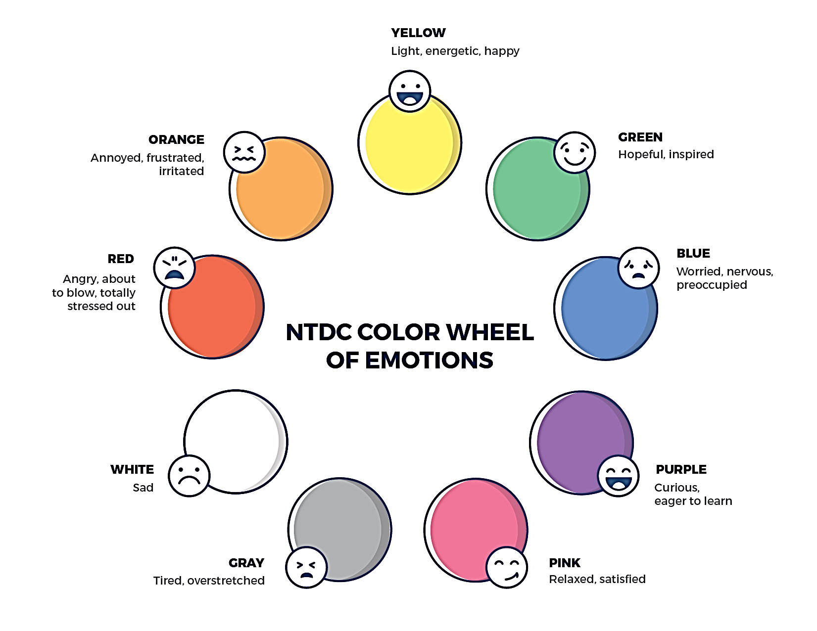
Welcome to the national training and Development Curriculum for foster and adoptive parents
Notes:
FACILITATOR'S NOTE
Have this slide showing onscreen as participants assemble for the first class of the day. As participants come in, welcome them back and ask them to take a few minutes to do a self-check using the Color Wheel. NOTE: The Color Wheel should only be done one time per day; before the first theme of the day. If combining several themes together on one day, facilitate the Color Wheel at the beginning of the first class of the day as participants are coming into the room.
SAY
Welcome back. We are so glad that you have taken time out of your day to join us for another exciting learning opportunity. As you recall, tuning in to how you’re doing on a daily basis may not be something everyone here is used to, but this type of regular self-check is critical for parents who are adopting or fostering children who may have experienced trauma, separation, or loss, as it will be helpful to become and stay aware of your own state of mind. It may seem like a simple exercise but be assured that knowing how we’re doing on any given day strengthens our ability to know when and how we need to get support and/or need a different balance. Doing this type of check in will also help us to teach and/or model this skill for children! Please take a moment to look at the color wheel and jot down on paper the color(s) that you are currently feeling.
DO
Wait a little while to give participants time to complete the Color Wheel.
SAY
Now that everybody has had the opportunity to do a quick check in, would someone like to share what color(s) they landed on today for the Color Wheel?
DO
Call on someone who volunteers to share their color(s). If a challenging emotion or feeling is shared, thank the person and acknowledge their courage in sharing, pause for a moment, encourage everyone to take a deep breath, and transition to beginning the theme.

Slide 7
IMPACT OF SUBSTANCE USE
Modified January 2022
Notes:
FACILITATOR'S NOTE
Show this slide briefly just before you start the class.
SAY
Let’s get started! Welcome to the Impact of Substance Use theme.
7

Slide 8
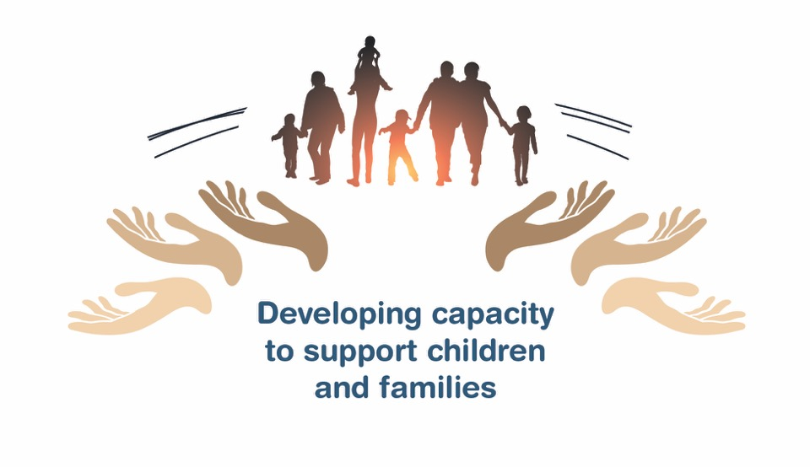
Place holder for slide with opening Quote
Notes:
FACILITATOR'S NOTE
The opening quote slide should only be used for the first theme of the day. If combining several themes together on one day, the opening quote slide would only be shown after the Color Wheel at the beginning of the first theme. It is important to always emphasize with this slide that this type of parenting involves lifelong learning and it will be critical for families to be invested in their own learning before and after a child is placed in their home.
PARAPHRASE
We are excited to share this lesson with all of you today. We are going to start with Impact of Substance Use, focusing primarily on the impact of prenatal alcohol exposure, as current research has shown this to have the potential for the greatest impact. As the slide states, this information will help to develop your capacity to support children and families. This type of parenting will require continuous learning. So, let’s dive in and see what important information we have to share with you today.
8

Slide 9
SECTION 1: INTRODUCTION: Impact of Substance USE
Notes:
PARAPHRASE
The following topics will be covered in today’s theme:
Neither drugs nor alcohol are safe for a developing fetus.
Prenatal exposure to drugs and alcohol can impact various areas of fetal development, but the brain is where we see the most impact.
Some children who are in the child welfare system or have been adopted were exposed to drugs and alcohol before they were born. These exposures can affect a baby’s development while they are still in utero. To date, the research on alcohol exposure tells us that alcohol has been shown to have the most serious long-term implications because it can cause permanent brain injury and fetal alcohol spectrum disorders (FASDs).
One of the most important concepts that parents who are fostering and adopting need to understand about children with a FASD is that it is a permanent brain injury. FASD is most often an invisible disability, even though some of the children might have the physical features of Fetal Alcohol Syndrome (FAS).
Children with a FASD often look like they are being willfully disobedient, when in fact, they are exhibiting symptoms of a brain injury that play out in a behavioral way.
Learning to reframe behaviors with the perspective that a child with a FASD lives with a brain injury can help parents have more patience and empathy, even in the difficult times.
In this theme, we’ll focus on FASD and ways to reframe the challenging behaviors that it may cause.

Slide 10
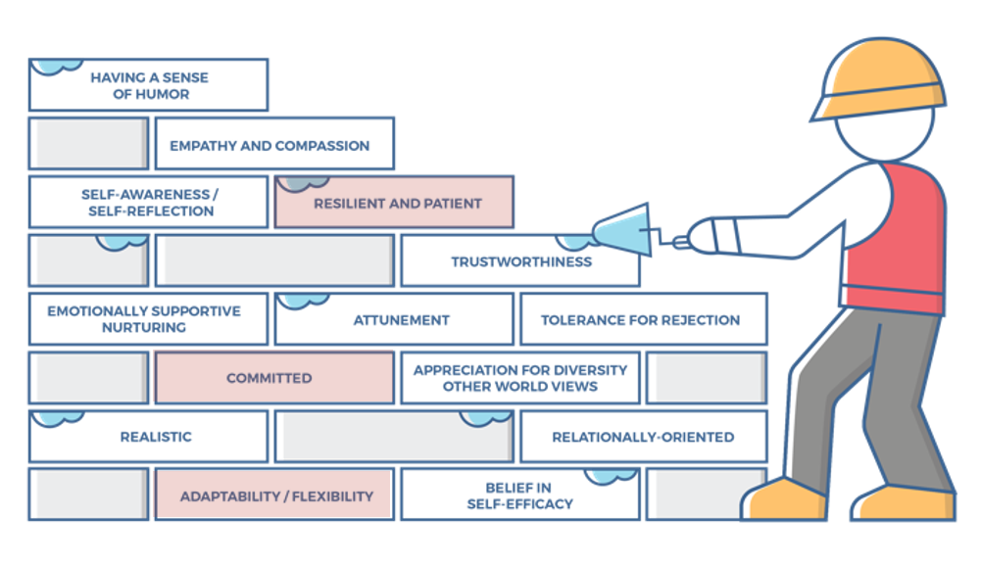
Characteristics of successful foster and adoptive parents
10
Notes:
FACILITATOR'S NOTE
This slide is shown at the start of each theme. Although the graphic will remain the same, the bricks that are colored in red will change based on the characteristics that will be touched upon in this theme. The characteristics were obtained from a review of literature, stakeholder interviews, and review of existing curricula. We want families to become very acquainted with these characteristics throughout the training. It is important to note that in addition to the characteristics that are highlighted in red, there may be additional characteristics that are touched upon during the theme. Facilitators should try to connect these characteristics to the content they are sharing throughout the training. Remind participants that their Participant Resource Manual contains the definitions for these characteristics.
SAY
Before we get into the content let’s look at the 14 characteristics of successful foster and adoptive parents. When you took your self-assessment, you were asked about these characteristics.

Slide 11
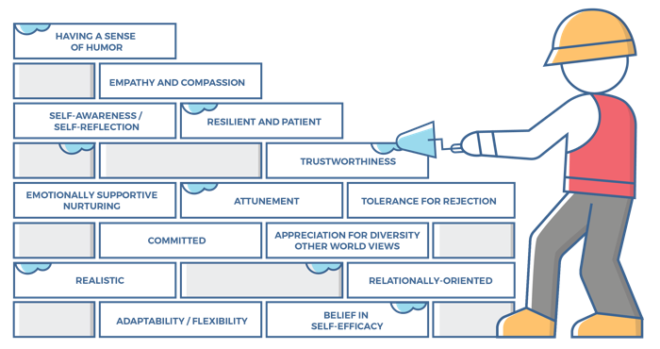
Characteristics for Impact of Substance USE, 1 of 2
Adaptability/Flexibility:
Parents are willing and able to make changes in their parenting style/responses in order to be accommodating, encouraging, and supportive to the physical, emotional, and cognitive needs of the child.
Parents share the responsibility of caring for the child and are not restricted by stereotypical or societal roles/expectations.
Parents can acknowledge when something is not working and are able to try a different approach or modify their expectations for the child.
Committed:
Parents are dedicated to a child, sticking with them no matter how difficult the journey.
Parents carefully and consciously consider the requirements of parenting a child and understand that it is not about fulfilling their own parental needs.
Parents recognize the role may not offer much validation or reinforcement of their skills and talents but are willing to commit to the long-term work of unconditional parenting and promoting the child’s well-being.
Parents believe in commitment and can persevere in the face of adversity.
Parents are secure in their commitment to the child and know they are doing the right thing.
Notes:
SAY
The Impact of Substance Abuse theme will cover the following characteristics:
Adaptability/Flexibility
Committed
Resilient and Patient
Take a moment to think back to the report that you received after taking the self-assessment and how you assessed yourself with these characteristics. It is important as you start this journey to assess your characteristics as they are qualities that can strengthen your ability to successfully parent a child who is in foster care or has been adopted.

Slide 12
Characteristics for Impact of Substance USE, 2 of 2
Resilient and Patient:
Parents see their role as helping a child achieve success in small steps, beginning with measurable, daily tasks.
Parents do not dwell on past mistakes or focus on the future in ways that pressure themselves or the child.
Parents celebrate small successes, teaching the child to appreciate the accumulative effect of each effort.
Parents have an ability to wait for answers /solutions without giving up.
Parents can withstand the child’s “testing” behaviors including hurtful, angry, or rejecting comments and actions.
Notes:
ASK
Now that we have reviewed the definitions, why do you think these specific characteristics are important to a for parents to know for this theme?
Reinforce the following:
Adaptability/Flexibility
A child exposed to substances may need different types of parenting skills and strategies.
Parents who recognize when certain parenting strategies are not working and who are willing to be adaptable and flexible in learning how to best parent the child will be more able to meet the unique needs of the child
Committed
Children who were exposed to substances prenatally, like all children, need a safe, nurturing home environment with parents who are committed to meeting their needs.
Children with a Fetal Alcohol Spectrum Disorder need parents who understand the challenges that may arise and are 100 percent committed be parenting the child.
Resilient and Patient.
Successful parents understand that a child impacted by prenatal substance use will need caring, patient caregivers who have realistic expectations.
Children with a Fetal Alcohol Spectrum Disorder need parents who can celebrate the small steps understanding that each small step is progress.

Slide 13
SECTION 2: Understanding Potential Developmental impact
Notes:
FACILITATOR’S NOTE
This section should take approximately 35 minutes.
PARAPHRASE
In this section, we will discuss the possible impact of prenatal exposure to substances on a children’s development. Given what we know from current research, we will spend the most of our time discussing the possible developmental impact on children who have had prenatal exposure to alcohol.
However, first we will begin with a quick general overview of the impact of prenatal exposure to drugs and alcohol using Handout #1: Understanding Complicated Children: The Impact of Prenatal Exposure developed for us by Dr. Julia Bledsoe, a pediatrician at the University of Washington Medical Center and Seattle Children's Hospital.

Slide 14
Handout 1: Understanding Complicated Children: The Impact of Prenatal Exposure
Legal is not better.
Drug and alcohol use during pregnancy causes a wide range of problems.
Even with heavy exposure, some children seem unaffected.
There are individual factors of mother and baby that influence outcome.
Nature AND nurture are important.
Problems can be due to something other than alcohol and drug exposure.
The need for lifelong support from a team.
Julia Bledsoe, MD
Notes:
FACILITATOR'S NOTE
The points on the slide come from Handout #1: Understanding Complicated Children: The Impact of Prenatal Exposure. Review the points and encourage participants to read the handout to learn more.
SAY
Dr. Bledsoe’s article can be found in your Participant Resource Manual, and I would encourage you to read the full article later. Dr. Bledsoe gives us an overview of the impact of prenatal exposure, highlighting this is a big problem, affecting many children in foster care and children who are available for adoption through private agencies, both in domestic and intercountry adoptions. The article covers the impact of the legal substances, nicotine and alcohol, as well as the illegal substances, such as cocaine, methamphetamines, opiates, and marijuana. For example, the research shows that pre-natal exposure to opiates can cause babies to be born with newborn withdrawal symptoms such as tremors, fussiness, diarrhea, and difficulties with feeding. Opiate exposure has been associated with smaller birth weight.
Marijuana exposure may lead to an increase in learning problems for exposed children.
For all substances additional research is needed, but let’s review the list of those things that Dr. Bledsoe described as what we know for sure:
Legal is not better. More children are exposed prenatally to alcohol and nicotine than to other drugs and they tend to cause the most damage to the developing baby – especially alcohol. This is not to say that the illegal drugs don’t cause harm, but alcohol and nicotine products have been shown to cause the most severe short and long-term effects on a child.
Drugs and alcohol use during pregnancy causes a wide range of problems. Babies exposed to substances in the womb can have degrees of severity of problems; some mild, some more severe.
Even with heavy exposure, some children seem unaffected. Although some babies prenatally exposed to alcohol and substances can show short and/or long- term effects of this exposure, many are born healthy without any identifiable problems.
There are individual factors of mother and baby that influence outcome. The metabolism of drugs and alcohol of both the baby and the birth mother can influence the severity of problems from exposure to substances in the womb.
Nature AND nurture are important. Research shows that both nature (the baby’s genetic or biological make-up) and nurture (the environment in which a baby lives and grows) are important influences on childhood health and development.
Problems can be due to something other than alcohol and drug exposure. Baby and childhood developmental behaviors and problems that cause concern for caregivers may or may not be related to substance exposure.
The need for lifelong support from a team. Children who are exposed to alcohol and drugs in the womb benefit from early identification and care over time from a coordinated group of parents/caregivers, families, teachers, and medical professionals.

Slide 15

Additional impacts of substance use
Prenatal exposure to substances is associated with a higher risk of addiction problems later in life.
Children who have been exposed are often born to parents who struggle with addiction—and the problems that are often associated with addiction.
Parent’s substance use may have affected their ability to meet their child’s physical and emotional needs.
Addiction is a disease, and the child will need to see and hear your empathy for their parent.
Julia Bledsoe, MD
Notes:
PARAPHRASE
Dr. Bledsoe also talks about several additional risk factors that children who have been prenatally exposed to substances may face:
These children may also face increased risk of addiction problems later in life. Knowing this, parents and the growing child can learn steps to prevent these problems from developing. Knowledge can be power in this situation.
Children who have been exposed are often born to parents who are struggling with addiction, and this problem is associated with other risk factors for the family and child such poverty, exposure to trauma, and lack of good medical care
Parent’s substance use may have affected their ability to meet the child’s physical and emotional needs.
These problems may have led to the child’s removal from the parents to ensure the child’s safety and well-being.
It is important to remember that:
Even when the problems associated with substance use and addiction led to the child being removed from the parent’s care, the child still cares for their parents.
Addiction is a disease, and it is important that the child sees and hears your empathy for the parents and their struggles.

Slide 16
WHAT ARE FETAL ALCOHOL SPECTRUM DISORDERS (FASDS)?
Fetal alcohol syndrome (FAS)
Partial fetal alcohol syndrome (pFAS)
Alcohol-related birth defects (ARBDs)
Alcohol-related neurodevelopmental disorder (ARND)
Neurobehavioral disorder associated with prenatal alcohol exposure (ND-PAE)
Notes:
SAY
As Dr. Bledsoe indicated, when it comes it comes to impact of substances on the developing baby during pregnancy, alcohol exposure is associated with the most serious impact.
Alcohol exposure can lead to the development of a fetal alcohol spectrum disorder.
Before discussing how FASDs affect children’s development, let’s define what we mean by FASDs.
PARAPHRASE
What are Fetal Alcohol Spectrum Disorders?
Alcohol usage during pregnancy can lead to a number of diagnoses under the umbrella of fetal alcohol spectrum disorders, or FASDs. One FASD is Fetal Alcohol Syndrome or FAS, which involves poor growth (at birth or since), a subtle set of facial features, and evidence of brain damage.
It’s important to remember children affected by prenatal alcohol often don’t have all the possible symptoms and issues, and they may have partial FAS or pFAS (where they’re missing some of the physical features but have equivalent brain dysfunction) or may just have neurodevelopmental impacts that range from mild to severe.
Other conditions that reflect cognitive and behavioral impairments with a history of prenatal alcohol exposure include diagnostic terms you might hear about such as: Neurobehavioral disorder associated with prenatal alcohol exposure (or ND-PAE), static encephalopathy/ alcohol-exposed, or alcohol-related neurodevelopmental disorder (ARND). The bottom line is that alcohol can damage almost every part of the developing brain, and have lifelong impacts.

Slide 17
Typical Stages of Impact on Development for Children with A FASD*
Infants | Toddlers | School-Age | Teenagers
Low birth weight Sensitivity to light, noise, and touch Irritability Unable to suck effectively Slow to develop Ear infections Trouble sleeping | Poor memory Hyperactivity Seems to have no fear Speech and language delays | Poor social skills Easily distracted, short attention span Poor coordination Trouble with large and fine motor skills Difficulty in school | Low self-esteem Poor impulse control Must be reminded of concepts on a daily basis
*FASD = fetal alcohol spectrum disorders
Notes:
PARAPHRASE
As discussed in the Child Development theme, children’s chronological and developmental ages can be different.
DO
Facilitate a quick review of slide and then let participant know that you will be talking more about each stage in upcoming slides.

Slide 18

FASD AT DIFFERENT AGES, 1 of 2
Infant, Toddler, Early School
Pre-adolescent, Adolescent
Young adult
Many children do OK
Notes:
PARAPHRASE
It is important to note that many children with a FASD have no apparent difficulties in the toddler and early school years. Children with FASD are typically very concrete thinkers and do not process abstract concepts well. Preschool and early elementary curriculum are very concrete. Children at this stage are not expected to use a lot of the higher-level parts of their brain for problem solving, abstract thinking, and decision-making. They are not given many tests.

Slide 19

FASD AT DIFFERENT AGES, 2 of 2
Infant, Toddler, Early School
Pre-adolescent, Adolescent
Young adult
Increasing challenges:
Difficulty with abstract thinking
Lagging social skills
Hormonal changes
Notes:
PARAPHRASE
When they are entering into upper elementary and middle school, we start to see many children struggle in school and at home. There are several reasons for this:
Around fourth grade, many students with a FASD start to struggle as the curriculum becomes more abstract and tests are given frequently. This can increase their anxiety levels, causing behaviors in school and school refusal. This anxiety can trickle into their home life where they feel more comfortable to express their frustrations.
Most children with a FASD do not function at their chronological age, even if they have average or high IQs. Their social skills, in particular, lag behind their peers. In early years, this social gap is not as obvious, but as the children get older, these differences become obvious to peers, and they start to become socially isolated as children are self-selecting their friend groups.
This is also the age when bullying in schools increases and these children are easy targets for bullies. Many young children with a FASD are invited to birthday parties and sleepovers, but these invitations may generally decrease or disappear as children get older, leading them to feel isolated and lonely.
This is also the age when their bodies are starting the pre-hormonal changes of puberty, which is a difficult time for all pre-adolescents, and is generally even more challenging for those with neurobehavioral issues.
These three factors listed on the bottom of the slide can lead to multiple challenges for children with a FASD. By the end of elementary/beginning of middle school, many start to have significant struggles with challenging behaviors. Parents and caregivers are often unclear about the cause of these behaviors. It can look like a child is out of control, when instead it is a child who is struggling significantly academically, socially, and emotionally.
It is crucial that children’s parents, caregivers, educators, and other adult supporters are aware of these factors as soon as some of these struggles begin, so supports can be implemented to potentially avoid issues with truancy, self-harm, and falling self-esteem. Parenting children with FASD will take a great deal of commitment (characteristic).

Slide 20

FASD AT DIFFERENT AGES
Infant, Toddler, Early School
Pre-adolescent, Adolescent
Young adult
Increasing social and emotional maturity
Notes:
PARAPHRASE
We start to see many young adults with a FASD begin to show more developed social and emotional maturing, improved life skills and decreased difficulties in life between the ages of 25 and 30. This is partially due to the fact that the frontal lobe of their brain continues developing up to the age of 25 and they are catching up to same-age peers. While this is often the case, many children with a FASD continue to struggle in their adult years.
Two considerations that seem to factor into which children are able to function better in life are:
Being able to stay away from addiction
Maintaining a positive relationship with their parents and families
Let’s illustrate some of the concepts we’ve been discussing with a case study example.

Slide 21

CASE STUDY: Amira
Notes:
FACILITATOR’S NOTE
In this activity, you will:
Review the case study of Amira
Describe the Developmental Quadrants diagram
Facilitate the group in estimating Amira’s developmental age in each quadrant
Discuss the parenting and other strategies based on the child’s developmental age in each quadrant.
READ the case study:
Amira is a 16-year-old girl who has a FASD. She is in a special education school with lots of support for her challenging behaviors and learning needs. She gets frustrated very easily and has a hard time controlling her emotions. She reads at a fourth-grade level and does third-grade level math. She is obsessed with boys and has had many boyfriends already at age 16. She enjoys wearing makeup, buying clothes, shopping, and talking on the phone. She doesn’t have any same-age friends, although she talks to teenage boys on the phone regularly. For her birthday, she is asking for a doll and a Barbie movie. She recently rented an Arthur video from the library, and she enjoys playing with her neighbor’s kids who are 5 and 6 years old.
PARAPHRASE
Let’s talk about Amira and her developmental mixture. It is very common for children with a FASD to have very mixed development.
One common strength for children with a FASD is strong verbal expressive skills. This often confuses adults and makes them think that the child is capable of things they may not be, or that they understand things that they don’t.

Slide 22
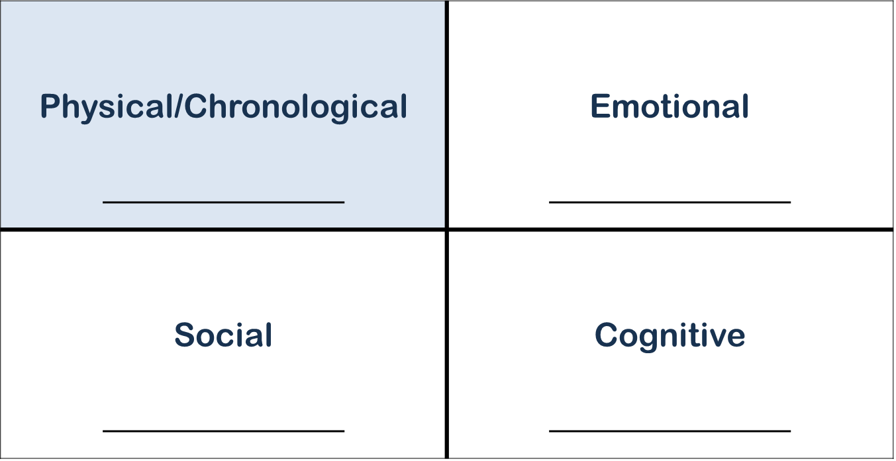
Developmental Quadrant, 1 of 5
Notes:
PARAPHRASE
Let’s look at the Developmental Quadrant. In the top left quadrant, we put the child’s chronological age. As we continue to discuss this child in the following slides, we’ll put their emotional age in the top right quadrant, their social age in the bottom left quadrant, and their cognitive age in the bottom right quadrant.
DO
Draw a Developmental Quadrant on a flipchart or whiteboard.
Distribute the Developmental Quadrant handout.
Adaptation for Remote Platform: This activity can be easily adapted. Each time the participants suggest ages, you can add it on the actual slide as you move through the slides. You will need to leave “slide show” view to be able to write on the slides and you will need to remember to erase the numbers prior to your next training. You could also choose to use the whiteboard feature or Jamboard (if you have a google account) and draw the quadrant there.
PARAPHRASE
Let’s decide as a group what ages we think we should fill in the quadrants for Amira.
DO
Facilitate a discussion to fill in the Developmental Quadrant diagram.
Start with the physical/chronological age.
Explain that this is the child’s actual age.
Ask participants Amira’s actual age.
Allow one participant to answer. (The correct answer is 16, as stated in the case study)
Write it in the Physical/Chronological quadrant.
Discuss the other quadrants using the suggestions on the following three slides. Feel free to change the order based on how the discussion flows.

Slide 23
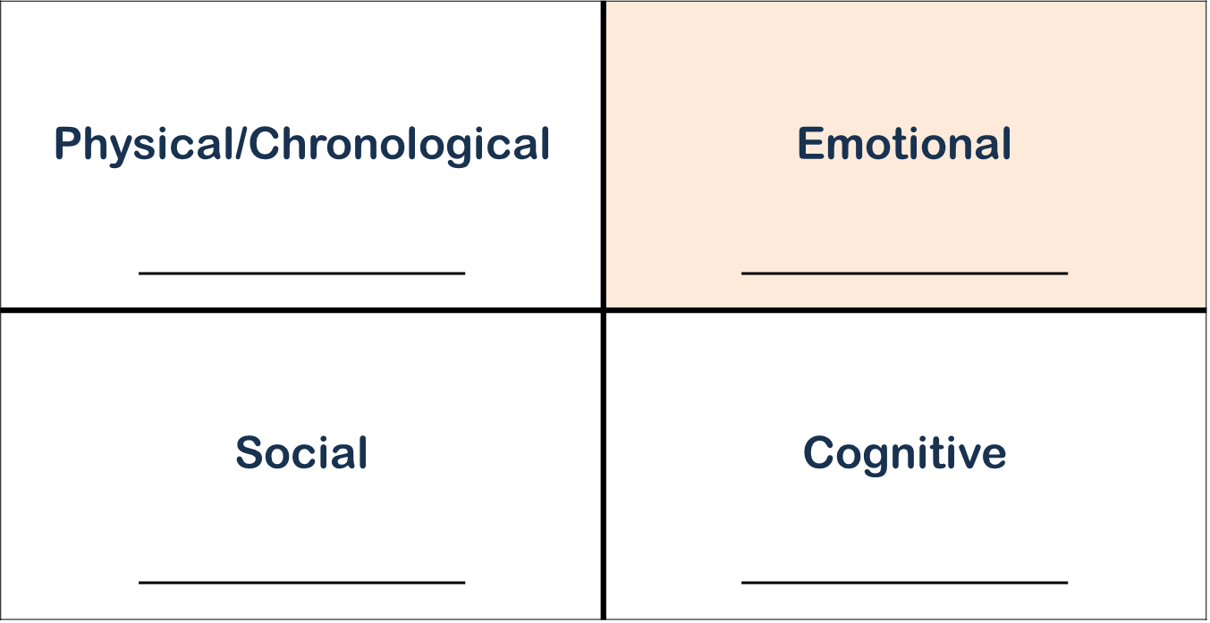
Developmental Quadrant, 2 of 5
Notes:
DO
Facilitate a discussion to estimate Amira’s emotional age
Explain that emotional age is estimated by looking how they respond and react to situations/frustrations.
Ask participants to estimate Amira’s emotional age.
Facilitate a discussion. Try to arrive at a consensus regarding the emotional age. It should be approximately 9 years, based on how she responds to situations. (She is easily frustrated and has a hard time managing her emotions and needs help with challenging behaviors at school; she has no friends who are her same age). It’s OK if the consensus is a few years off; the key is that Amira’s emotional age is much younger than her Physical/Chronological age.
Write the consensus emotional age in the Emotional quadrant.

Slide 24
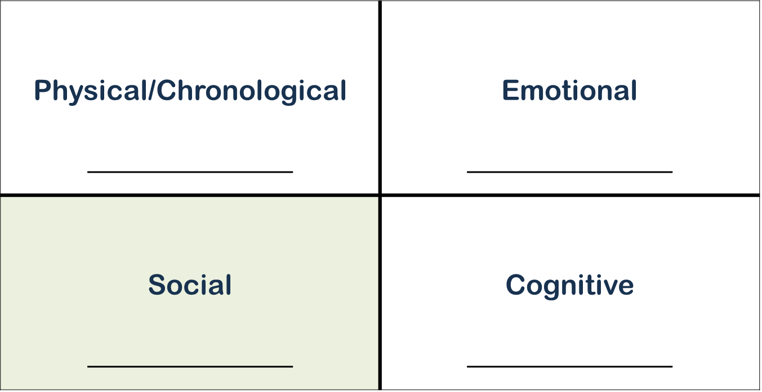
Developmental Quadrant, 3 of 5
Notes:
DO
Facilitate a discussion to estimate Amira’s social age
Explain that social age is estimated by looking at the ages of children they play with, what kinds of things they play with, what they watch, etc.
Ask participants to estimate Amira’s social age.
Facilitate a discussion. Try to arrive at a consensus. It should be approximately 5 years, based on who she plays with and what she watches. (She plays with neighborhood kids who are 5 and 6 years old; she may feel socially comfortable with younger children, while also liking dolls, Barbie movies, Arthur videos.) It’s OK if the consensus is a few years off; the key is that Amira’s social age is much younger than her physical/chronological age.
Write the consensus social age in the Social quadrant. While we know we are giving only estimates, it’s clear from her behavior that she is closer to 5 than 16 based on her behaviors.
We also know that Amira is obsessed with boys and has had boyfriends, but given her social and emotional age, she will need additional structure and guidance to keep her safe.

Slide 25
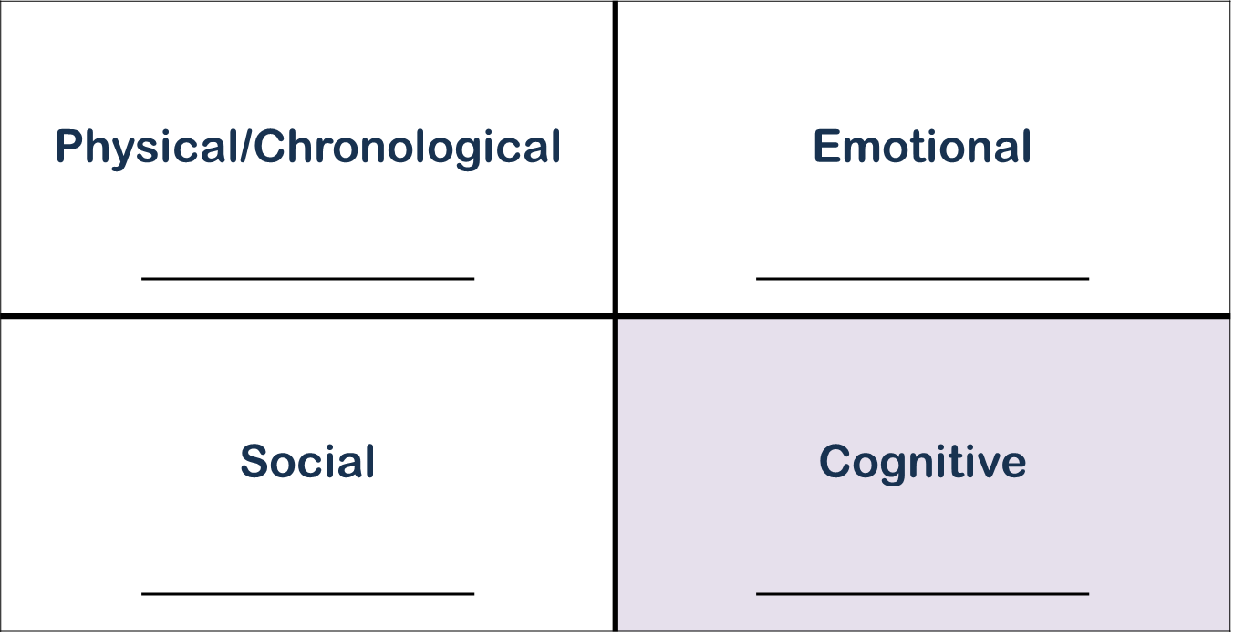
Developmental Quadrant, 4 of 5
Notes:
DO
Facilitate a discussion to estimate Amira’s cognitive age.
Explain that cognitive age is estimated by looking at their academic testing, or what levels of math or reading they are working on.
Ask participants to estimate Amira’s cognitive age.
Facilitate a discussion. Try to arrive at a consensus. It should be approximately 9 years, based on Amira’s level in school (fourth-grade reading, third-grade math). It’s OK if the consensus is a few years off; the key is that Amira’s cognitive age is much younger than her physical/chronological age.
Write the consensus cognitive age in the Cognitive quadrant.

Slide 26
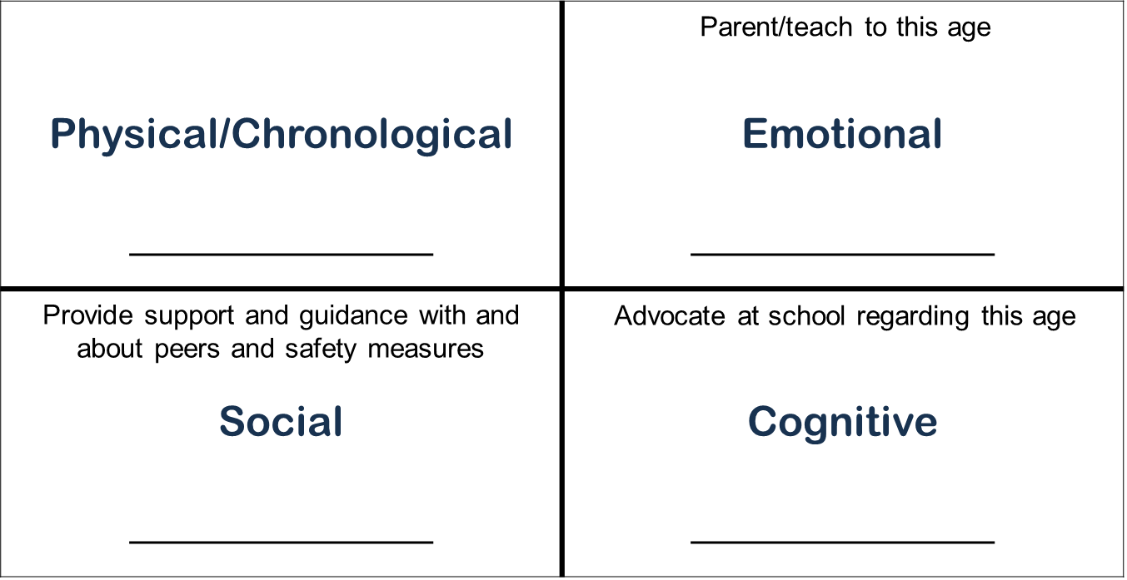
Developmental Quadrant, 5 of 5
Notes:
DO
After writing all four ages on the flipchart, write the following:
Parent/teach to this age (below the Emotional Age)
Provide support and guidance with and about peers and safety measures (below the Social Age)
Advocate at school regarding this age (below the Cognitive Age)
Facilitate a discussion of the flipchart. Highlight the following points:
The most important aspect of this chart is for the parent who is fostering or adopting to realize they should parent to the emotional age.
It can be exhausting to parent to the emotional age as it can vary minute to minute, leaving caregivers confused and frustrated. One minute you might be dealing with a child who has the emotional maturity that matches their chronological age, and the next minute their emotional maturity is cut in half. This is common and is a part of their brain injury. This will require parents to have a great deal of flexibility and adaptability and patience (characteristics).
It is recommended that parents who are fostering or adopting a child with a FASD take the child’s actual age, cut it in half, and frame your parenting strategies around that age. So, if you are parenting a child with a FASD who is 12 years old, he is likely closer to that of a 6-year-old. We should stop saying phrases like “act your age” or “12-year-olds don’t do that.” It is unfair to expect the child to act their age when developmentally they are not that age.
Remember: Children with a FASD often look like they are being willfully disobedient or naughty, when in fact, they are exhibiting symptoms of a brain injury that play out in a very behavioral way.
PARAPHRASE
Now that we’ve seen how FASD can affect development, let’s look at its impact on the brain.

Slide 27
SECTION 3: UNDERSTANDING THE BRAIN IMPACT
Notes:
FACILITATOR’S NOTE
This section should take approximately 15 minutes.
PARAPHRASE
As you know, prenatal exposure to alcohol can result in brain injury. Let’s review FASD (Fetal Alcohol Syndrome Disorders) and FAS (Fetal Alcohol Syndrome) In this section we are going to take a closer look at the brain injury and its effects.

Slide 28
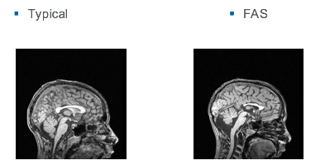
BRAIN SCANS
13-year-old boy
No FAS
13-year-old boy
With FAS
Corpus
callosum
Images courtesy Jeffrey R. Wozniak, PhD Used with permission.
Notes:
PARAPHRASE
This screen shows Magnetic Resonance Imaging (MRI) scans of the developing brains of two 13-year-old boys. The one on the left shows the brain of a typical boy with no FAS. The one on the right show the brain of a boy with FAS.
Look at the corpus callosum - the white structure in the center of the brain. Neuroscientists explain that the corpus callosum is a thick bundle of fibers in the center of the brain that separates the left and right hemisphere. It helps the two hemispheres to communicate with each other. Notice the difference in length and width of the corpus callosum between these two boys
Often, children with a FASD have retained information in one hemisphere and are not able to access the information when they need it if the Corpus Callosum is not firing properly in the moment, especially during times when the child is stressed or anxious. This damage is the cause of INCONSISTENTCY in children with FASD.
One day they might know how much toothpaste to put on a toothbrush, and not the next day. One day they might know what 3 x 2 is, and the next day they might not. These inconsistencies can even change minute to minute. This is one of the reasons it is so important to understand the brain injury perspective of children with a FASD. Otherwise, it is easy for parents and caregivers to assume the child is lazy, or not trying hard enough, or even trying to act incompetent.
Note that many of the structural abnormalities that can be caused by FAS do not show up on a regular MRI, yet many of the children still have brain functional impairments. For some children, it may be difficult to get a clear diagnosis, however, when history and developmental functioning suggest the symptoms consistent with a FASD, parents may need to adjust their parenting style to better meet the emotional and behavioral needs of the child.

Slide 29
Other Common Challenges For CHILDREN With a FASD
Inconsistency
Impulse control
Difficulty sensing the passage of time
Difficulty with generalizing
Sensory Integration issues
Difficulty with judgment
Working memory struggles
Poor comprehension
Notes:
PARAPHRASE
In addition to inconsistency, which we just discussed, other common challenges for children with a FASD include:
Impulse control
Difficulty sensing the passage of time (leading to challenging behaviors during times of transition)
Difficulty with generalizing (ability to use a skill and to transfer it to similar but not identical situations)
Sensory Integration issues (being over or under sensitive to things like noise, smells, texture, or touch)
Difficulty with judgment
Working memory struggles (example - difficulty remembering and being able to put memory into action, such as remembering the steps of a recipe the child is currently using, or not retaining or being able to carry out simple multi-step directions)
Poor comprehension
PARAPHRASE
Now, let’s do a quick activity designed to help you understand how children with a FASD might manage in school. I need a volunteer to read the next slide.
DO
Select a volunteer.

Slide 30
Last serny, Fingledobe and Pribin were in the nerd-link treppering gloopy caples and cleaming burly greps.
Suddently a ditty strezzle boofed into Fingledobe’s tresk. Pribin glaped and glaped.
“Oh Fingledobe!” He Chifed, “That ditty strezzle is tunning in your grep!”
Notes:
DO
Ask the volunteer to read the slide.
After the volunteer reads, thank them.
PARAPHRASE
Now, I’m going to ask the group some easy questions about what [our volunteer] just read. Please just shout out the answers as soon as you know them.
FACILITATOR’S NOTE
Keep this fast-paced.
ASK
Who were the main characters?
DO
Wait for the group to shout out the answer. [The answer should be: Fingledobe and Pribin]
ASK
When did the story take place?
DO
Wait for the group to shout out the answer. [The answer should be: Last serny]
ASK
What happened to Fingledobe’s tresk
DO
Wait for the group to shout out the answer. [The answer should be: A ditty strezzle boofed into it]
ASK
What did Pribin do?
DO
Wait for the group to shout out the answer. [The answer should be: He glaped and glaped]
ASK
What does this story mean?
DO
Wait for the group to shout out the answer. [Nobody should have a clue]
PARAPHRASE
This is an example of what happens when a child doesn’t comprehend something but comes off as if they do. The group was able to read the story and answer the questions, without knowing what they meant. Most children with a FASD are smart enough to figure out what answers the teachers, parents, case managers want to hear, but it doesn’t always mean that they comprehend or understand what they are saying.
This comprehension challenge leads to many misunderstandings between the adults and the child. It is important for parents who are fostering or adopting to take time to break it down, and see if the child truly understands a task, or a rule, or a request. And remember that this will change frequently, due to their Corpus Callosum damage.
We all want to seem smart and competent, and it is no different for our children. Imagine living with their body/brain - not understanding things regularly, knowing that people are often frustrated with you, and dealing with feelings of hopelessness and frustration. It makes sense that these children want to sound like they understand things.
PARAPHRASE
The brain injury caused by a FASD can lead to challenging behaviors. In the next section, we’ll use two case studies to discuss ways we can address challenging behaviors.

Slide 31
SECTION 4: ADDRESSING CHALLENGES - REFRAMING BEHAVIORS
Notes:
FACILITATOR’S NOTE
This section should take approximately 25 minutes.
PARAPHRASE
Let’s start this section with a case study about a child who steals things repeatedly.

Slide 32

CASE STUDY: The Cell Phone Story
Notes:
FACILITATOR’S NOTE
In this activity, you will read the Cell Phone story case study aloud and facilitate a discussion of why the parents’ new approach was successful.
Allow approximately 10 minutes for the activity.
READ the case study that follows:
Martin has a FASD and has struggled with stealing since his toddler years. No amount of consequences or sticker charts have had an impact on the stealing, leading to huge issues in the family. The parents were constantly disappointed and frustrated because Martin’s stealing was taking place on a regular basis, and the issue was starting to impact their relationship with him.
When Martin was 11 years old, the parents received some training to better understand that Martin’s disability was brain based, and they changed their approach. They sat down with Martin and told him they would not give him a consequence any longer for stealing. They discussed that it still was not acceptable, but that they wanted to work with him to keep giving him the skills to not take things that were not his; they had tried years of therapy with various therapists with no impact.
At age 11, he had already stolen dozens of cell phones. One day, Martin’s parent found a cell phone in his backpack that did not belong to him. The parent approached their son and said, “Who do I need to get this back to?” Phrasing the question this way took the blame and shame away and did not put Martin on the defense immediately. Martin told her who the phone belonged to immediately, which was rarely the case in previous situations. The parent asked Martin where the phone was when he stole it. The son shared that he felt excitement as he had always wanted a cell phone. Martin’s parent asked him what happened next, and he said that he took the phone. Martin’s parent asked him how he felt when he took it, and the son replied, “It felt so good. I want a cell phone so bad and I got really happy.” Martins’ parent then asked other questions about how the person who owned the phone likely felt when they realized it was missing, how much time they spent looking for it, etc. The final question the parent asked Martin was, “How do you feel now about having taken the phone?” Martin replied that he did not feel good about it, and they had a conversation about stealing and the reasons why it isn’t OK.
After about a year of this new approach, Martin stopped stealing.

Slide 33

CASE STUDY: The Cell Phone Story
Why was this new approach successful?
Notes:
ASK
Why do you think this new approach was successful?
PARAPHRASE
This approach was a way of keeping Martin’s anxiety down. Whenever a child is in trouble, or thinks they are in trouble, or were caught doing something they should not have done, their anxiety rises instantly. When they are anxious, it is very difficult for them to get to the truth in their own brain which often leads to confabulating, an unintentional type of lying that is common for people with compromised brains. In these moments, parents are often “lecturing” or trying to give learning points to the child, but the child’s brain is not in a place where it can process and retain the information. Children with a FASD need repetitive lessons given when not stressed or anxious.
This parent is reflecting the characteristic patience.
ASK
How do you think this case study would have turned out if the parents had not received training and learned to have more patience with his behaviors’?

Slide 34

Reframing Responses to Challenging Situations: What are Your IDEAS?
Challenge
Child refuses to shower or bathe and is starting to have strong body odor.
Ideas
Go swimming at the local community pool.
Wash the car together and have a water fight.
Notes:
FACILITATOR’S NOTE
In this activity, you facilitate brainstorming about ways to reframe behaviors for three different challenges, recording key ideas on a flipchart.
Allow approximately 12 minutes for the activity (4 minutes for each challenge). Stick to this time frame in order to have participants experience the challenge of having to think creatively and quickly in the moment!
PARAPHRASE
Here’s the first challenge - a child who refuses to shower or bathe and is starting to have strong body odor.
DO
Facilitate a discussion. Encourage participants to share their ideas.
Write the ideas on a flipchart.
The slide shows a few examples you can use if needed to kick-start the discussion.
Allow approximately 4 minutes for this challenge, so that the entire activity will run about 12 minutes.

Slide 35
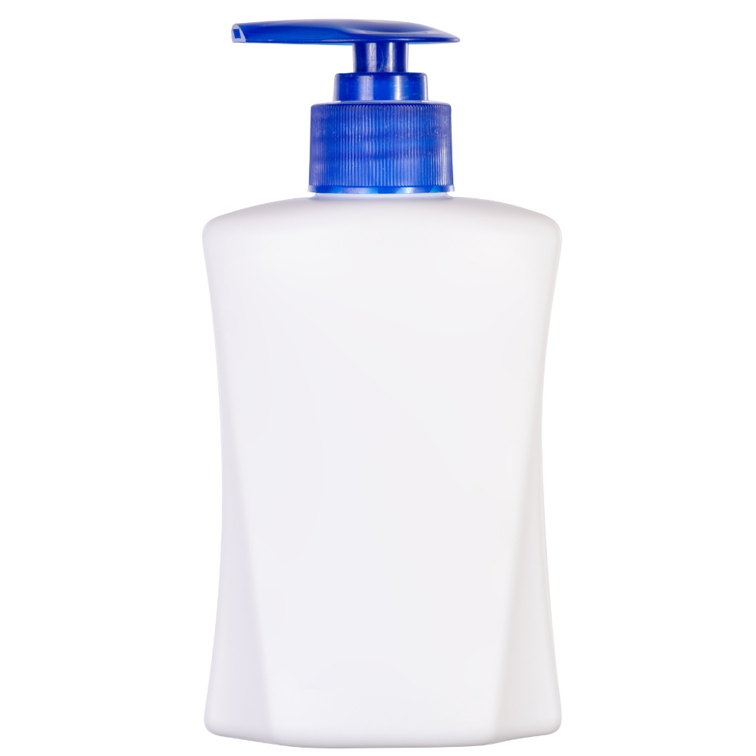
Reframing Responses to Challenging Situations: What are Your IDEAS?, 1 of 2
Challenge
Child refuses to use lotion on their very dry skin. (The child won’t apply it or let you apply it.)
Ideas
Try spray lotion.
Put glitter in the lotion or purchase glitter lotion.
Notes:
PARAPHRASE
Here’s another challenge - a child who refuses to use lotion on their very dry skin. (The child won’t apply it or let you apply it.)
DO
Facilitate a discussion. Encourage participants to share their ideas.
Write the ideas on a flipchart.
The slide shows a few examples you can use if needed to kick-start the discussion.
Allow approximately 4 minutes for this challenge.

Slide 36

Reframing Responses to Challenging Situations: What are Your IDEAS?, 2 of 2
Challenge
Teen keeps taking food while everyone is sleeping.
Ideas
Give the teen a basket of healthy snacks to keep in their room.
Have a healthy snack with the teen right before bedtime.
Notes:
PARAPHRASE
What about a child who keeps taking food while everyone is sleeping?
DO
Facilitate a discussion. Encourage participants to share their ideas.
Write the ideas on a flipchart.
The slide shows an example you can use if needed to kick-start the discussion.
Allow approximately 4 minutes for this challenge.

Slide 37

Reflection/ Relevance
Notes:
FACILITATOR'S NOTE
Ask participants to do on their own at home.
Note: There are additional questions for kinship caregivers for this activity in the addendum section.
SAY
We have covered a lot today.
There are three questions to think about for this exercise for you to do at home. Please think about how they might apply to you and record your thoughts in your Participant Resource Manual.
How hard do you think that it will be to remember and respond to the child’s developmental age, as opposed to their chronological age?
What are some behaviors that might easily be misinterpreted by adults that are more likely symptoms of a brain injury?
What supports and resources in your community do you think would be helpful to support a child with a FASD, and how could you find these supports and resources?
37

Slide 38
SECTION 5: WRAP-UP
Notes:
SAY
Now, it’s time to wrap up. Before we do, I want to briefly highlight the key points from this theme:
Impacts:
Alcohol and drug exposure can have a negative impact on the developing fetus.
Challenges may occur from infancy to adolescence/adulthood.
FASDs are considered a brain injury and a lifelong disability.
Many people with a FASD will need additional support and guidance throughout their lives.
Interventions:
We cannot erase the brain damage from prenatal substance use, but we can:
Identify challenges in an early and ongoing fashion.
Promote resilience.
Reframe challenging behaviors.
Support children at their developmental and cognitive level.
Parent with patience, commitment, and flexibility.

Slide 39

LIFELONG Learning
Notes:
SAY
It is critical that as you go through this journey, you continue to enhance your knowledge and skills. It is important that you continue your own learning by taking advantage of resources that are available to you. This theme has numerous resources that will help you continue to learn more about this topic that can be found on the NTDC website or in CapLEARN.
Three excellent resources for this theme are:
1. The NTDC Podcast, The Impact of Substance Use with Julian Davies, M.D.
2. FASD Parent Tip Sheet (NACAC)
3. Children and Adolescent Prenatal Alcohol and Drug Exposure Intervention Table by Julia Bledsoe, MD

Slide 40
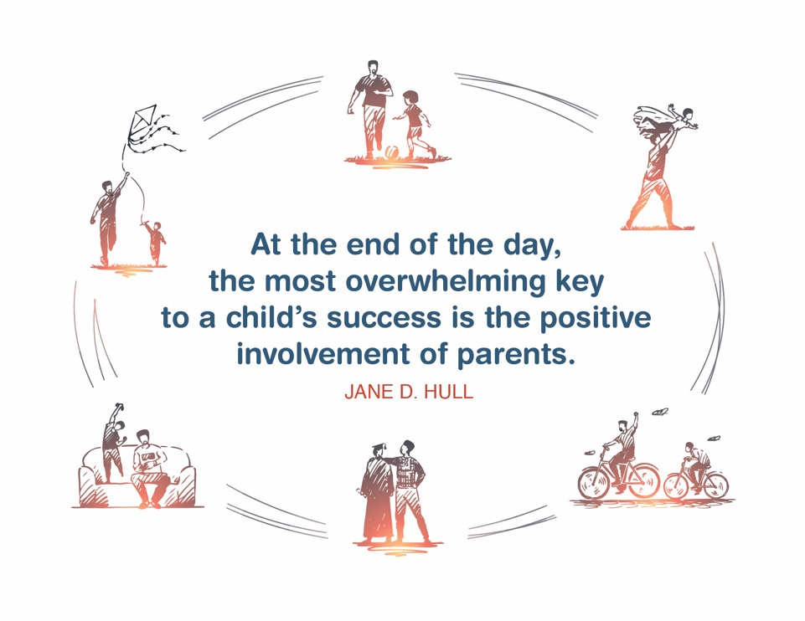
Place holder for slide with Closing Quote
Notes:
FACILITATOR'S NOTE
The closing quote above and the paraphrase section below will be done only once per day, after the last theme presented. If you are moving on to another theme, invite them to take a break, stretch, or breathe before moving on to the next theme.
If closing for the day:
Thank everyone for attending and for their thoughtful participation and attention. Remind the participants that although this training may seem long, it is critical for them to gather the knowledge, attitude, and skills that are needed as they embark on this journey because they ultimately will play a huge role in the lives of children and families.
If in person, collect the name tents or have them tuck them into their Participant Resource Manual to bring back to the next class.
PARAPHRASE
Close out the day by covering the below topics:
Remind participants of the date/time for the next class and let participants know if there are any changes to the location.
Encourage participants to contact you (or other facilitators) if they have any questions or concerns.
Review the themes that will be covered during the next class.
If in person, remind participants to take their Participant Resource Manual with them and to bring them to the next session. If using a remote platform, remind participants to have the Participant Resource Manual available for the next class.
40

Slide 41
For more information, visit:
Notes:
41

Slide 42
.
This curriculum was funded by the Children’s Bureau, Administration on Children, Youth, and Families, Administration for Children and Families, US Department of Health & Human Services, under grant #90CO1132. The contents of this curriculum are solely the responsibility of the authors and do not necessarily represent the official views of the Children’s Bureau.

Slide 43
All facilitators must take the following survey following each session:
www.surveymonkey.com/share/1ebe00ec-c5d0-4332-85dc-a5dbdb3e1733

Slide 44
Addendum:
inclusion materials for target populations

Slide 45
Addendum for kinship caregivers for the Reflections/relevance Activity
Facilitators should add the following information for kinship caregivers:
If you are raising a grandchild or other family member’s child, there are many common issues and dynamics in families with a substance abusing adult child or other family member. You may feel strong feelings of guilt, anger or resentment. You may have co-dependent behaviors and have trouble setting limits or taking care of the needs of both the child and the child’s parent. You may not want to acknowledge or accept the permanent brain injury to the child that was caused by your family member.
Notes:
For Reflection/Relevance (slide 37) there are additional questions that are added in the Participant Resource Manual that are specific to kinship caregivers. These questions are in addition to the questions that are listed for all other participants.
The questions are listed below:
How are you dealing with your feelings about your family member (child’s birth parent) whose substance abuse injured the child?
Has this negatively impacted your relationship with your family member or others in the family?
How likely is it that your extended family members will support these new parenting approaches and how can you help them understand?
What support do you have or need to help you deal with the common dynamics in families with a substance abusing adult child or other family member?

