Slide 1
INTRODUCTION AND WELCOME to the National training and Development curriculum for foster and adoptive parents
FACILITATOR CLASSROOM GUIDE
Modified January 2022
Notes:
INTRODUCTION AND WELCOME
FACILITATOR CLASSROOM GUIDE Modified January 2022

Slide 2
To prepare for the class
See Notes view
Notes:
This is designed to be the first theme for the NTDC classroom curriculum. It provides participants with an overview of some of the common elements found in all NTDC themes, sets the stage for what participants should expect in the training, and provides an opportunity for participants to get to know each other. Facilitators are encouraged to add in specific information about their agency so that participants receive an overview of this as well. Please note that there are some slides in this deck that will need to be adapted for your agency.
It is essential prior to training this theme that facilitators orient themselves to the Participant Resource Manual and review the NTDC Implementation Manual. Both documents can be found on CapLEARN (https://learn.childwelfare.gov/) or NTDC website (https://ntdcportal.org/). Additionally, facilitators will need to review this NTDC Facilitator Classroom Guide which provides essential information for facilitating this theme including tips and instructions for facilitating activities and discussions. These three documents will help you to familiarize yourself with the curriculum overall and prepare you to train this theme. Please note, that there is a separate NTDC Facilitator Classroom Guide for each theme.
To prepare for this class, you should:
Review the facilitator preparation information included in this NTDC Facilitator Classroom Guide along with the handouts.
Develop an agenda that includes this theme and any other themes you will be conducting along with it on the day of the class.
Ensure that participants have a copy of the Participant Resource Manual and that it is accessible to them. The Manual will be used during all themes and includes handouts needed by participants for each theme. Facilitators should have copies of the handouts for the theme available in case participants do not bring their Manual to class. If the theme is being on a facilitated on a remote platform, facilitators should have the handouts available to share in the chat and/or an email for participants who do not have their Manual.
Bring any materials you need for the activities.
Review any videos or other electronic media used in this theme, if any, and plan the mechanics of how you will present them. Media for this theme will be listed in the Materials and Handouts slide. Review the instructions for each media clip (e.g., to pause or stop at a particular time stamp). The videos can be played in different ways, including:
Play them from a flash drive or the computer’s hard drive using a media player app
Link to them from CapLEARN or the NTDC website.
Practice playing the media for the theme. Ensure that you have the files and apps you need, that your links and connections work, and that you know when to pause or stop the media clip if appropriate.
If training on a remote platform, make sure all participants have the link available to access the class and that you have all videos, PPT’s and handouts ready for use.
If training in person, ensure that a room is available and set up, with the following:
Enough tables and chairs for all participants
Projector and screen (check that it works with the computer you will be using)
Classroom-based activities have been adapted so that they can be done on a remote platform. Adaptations will be marked as follows so that they can be easily spotted throughout the Facilitator Classroom Guide: Adaptation for Remote Platform
PREPARATION

Slide 3
MATERIALS AND HANDOUTS
See Notes view
Notes:
FACILITATOR'S NOTE
Participants are expected to have the Participant Resource Manual available for every session.
MATERIALS NEEDED
You will need the following if conducting the session in the classroom:
A screen and projector (test before the session with the computer and cables you will use)
A flipchart or whiteboard and markers for several of the activities. A flipchart with a sticky backing on each sheet may be useful and will allow you to post completed flipchart sheets on the wall for reference.
Materials to make name tent cards (paper and something to draw with)
You will need the following if conducting the session via a remote platform:
Access to a strong internet connection
A back-up plan in the event your internet and/or computer do not work
A computer that has the ability to connect to a remote platform- Zoom is recommended
HANDOUTS
Have the following handouts accessible. Participants will have all handouts listed
below in their Participant Resource Manual:
Handout #1: Characteristics of Successful Foster and Adoptive Parents
VIDEOS and PODCASTS
Before the day you facilitate this class, decide how you will show/play the media items, review any specific instructions for the theme, and do a test drive. You may wish to set up the media to the start point. Unless indicated otherwise below, all videos and podcasts can be obtained on CapLEARN (https://learn.childwelfare.gov/) or NTDC website (https://ntdcportal.org/).
The following media will be used in this theme:
Expanding Your Parenting Paradigm (show the narrator’s introduction-approximately 8 minutes)
Note: Facilitators will choose which narrator to show, based on participants attending the class:
General Child Welfare (for those fostering/adopting from the child welfare system)
Kinship Families
American Indian/ Alaska Native Families
Intercountry and Private Domestic
EVALUATION
There is no pre- and post-survey available for this theme. Pre- and post-surveys are available for all other themes.
MATERIALS AND HANDOUTS

Slide 4
Suggested agenda
See Notes view
Notes:
FACILITATOR'S NOTE
This notes page shows a suggested agenda and timing for this theme. Before the day of class, please review this agenda and incorporate it into your overall agenda for this and any other themes you are conducting along with it.
AGENDA
This theme is divided into four sections. The content is based on 70 minutes of classroom time, with 20 minutes added for agencies to add in information about their process and/or paperwork and to address any general questions families have about becoming a foster or adoptive or kinship caregiver. With the 20 minutes added, this theme would be 1.5 hours.
BEFORE YOU BEGIN THE CLASS
Make any announcements that are needed regarding the training, timing of training, or process to become a foster or adoptive parent.
Take out the Participant Resource Manual.
Review the agenda for the theme. Facilitators should add a slide to the PPT deck that includes the agenda so that they can review it with participants. Make sure to include start and end times and any breaks that will be taken during the session.
Encourage participants to be engaged and active learners.
Encourage participants to contact you in between classes with any questions and/or concerns.
Prior to class, list the name(s) of the facilitators on the board or chat box with contact information.
SUGGESTED AGENDA

Slide 5
WELCOME!
Notes:
FACILITATOR'S NOTE
Have this slide showing onscreen as you welcome participants as they come into the class.
The purpose of this class is to:
Make all feel welcome, leaving with the feeling that “I feel comfortable here.”
Engage interest, leaving with the thought that “This is worth my time.”
Set a stage of inclusivity, leaving with the sense that “I belong here.”
The tone should be warm, light, positive, and authentic. The goal is that people return, if not now, at some point in the future.
DO
Welcome participants as they come in:
Give them a name tent and ask them to:
Write their name on it in large letters
Draw a stick or simple figure sketch of the people they consider to be in their immediate family, try to draw the figures so people can tell children from adults
Write the age of child near the child’s stick figure
Pets can also be included
Adaptation for Remote Platform: Have participants write their first and last name in their screen box. Ask them to draw the people they consider to be in their immediate family on a sheet of paper using stick or simple figures. Ask participants to draw the figures so that you can tell children from adults, with the ages of children on or around the figure. Pets can also be included. Couples can draw their family together or separately.
5

Slide 6
SECTION 1:
INTRODUCTION AND WELCOME
Modified January, 2022
Notes:
FACILITATOR'S NOTE
Allow 15 minutes for the Introduction and Welcome section.
SAY
Welcome to the National Training and Development Curriculum for Foster and Adoptive Parents! Let me introduce myself and the other facilitators.
DO
Introduce yourself by stating:
Your name
Your role at your agency and in this class
Any other facilitators should also introduce themselves (Facilitators will share more about themselves during the next activity)
FACILITATOR’S NOTE
Introduce yourself as a “facilitator” rather than a trainer because you will be facilitating the NTDC experience for prospective foster and adoptive parents, rather than teaching a course to them. The more they actively participate in the classes and invest in their own learning, the more they will gain from the curriculum.
6

Slide 7

About Me
Introduce yourself and your family on your tent/paper.
Do you already have a connection to fostering, adopting or kinship care?
Are you attending this class because you are interested in fostering, adopting, or providing kinship care?
Notes:
FACILITATOR’S NOTE
This activity is intended for participants to get to know each other. Taking the time to do this activity is an important part of building rapport among the class members. Facilitators should have their name tent or drawing completed in advance so that they can be the first people to do this activity, modeling the type of information that should be shared.
PARAPHRASE
We hope you’re all excited to be here today, although maybe a bit nervous too. Since we are all embarking on this journey together, we want to take some time to learn a little bit about each other. Take a minute to read the questions on the slide so that you are ready to introduce yourself to the group.
DO
Facilitators will introduce themselves first, answering the questions on the slide.
Have each participant introduce themselves. If facilitating the classroom remotely, identify the participant you want to go first and then ask each participant to name the participant who should go after them.
PARAPHRASE
It’s so wonderful to get to know a little about all of you, and I’m sure we’ll be learning a lot more about each other through our time together. So that you get your bearings, let’s take a moment to talk about logistics.

Slide 8
Logistics
Key site-specific logistic information to be added by facilitator as appropriate. Examples of the types of information that might be included:
Where participants should park
Location of restrooms
What to expect about food served/eaten at the classes
Expectations for breaks
Request to turn off/silence cell phones
Start and end time for the sessions
Expectations about being on time to sessions
Missing sessions/making up sessions
Whether the same people will be doing the training each session
Who to contact in between classes if there are questions
Classroom etiquette
Notes:
FACILITATOR’S NOTE
This slide should be prepared in advance of the class with appropriate information for your site. The logistical information can be shown on the slide or in a handout created by the agency.
DO
Review the information and make sure you answer any questions participants have about class.

Slide 9
SECTION 2:
Laying The Foundation
Notes:
FACILITATOR’S NOTE
Allow 20 minutes for this section.
PARAPHRASE
Now that we’ve introduced ourselves and covered all the logistical details, let me tell you more about this class.

Slide 10

Place holder for slide with opening Quote
Notes:
PARAPHRASE
You may be wondering what this class is all about. This class provides an educational framework to build a strong foundation for parenting children who have been separated from their families for all sorts of reasons. Regardless of the reason, it is important to realize that this separation is a loss that both the children and the families that are caring for them will need to recognize and address. As the slide states, the training overall will focus on developing your capacity to support children and families.
We will come back to this slide at the start of each class to keep us grounded in the purpose of why we are all here. We invite you to see where this journey takes you.
10

Slide 11
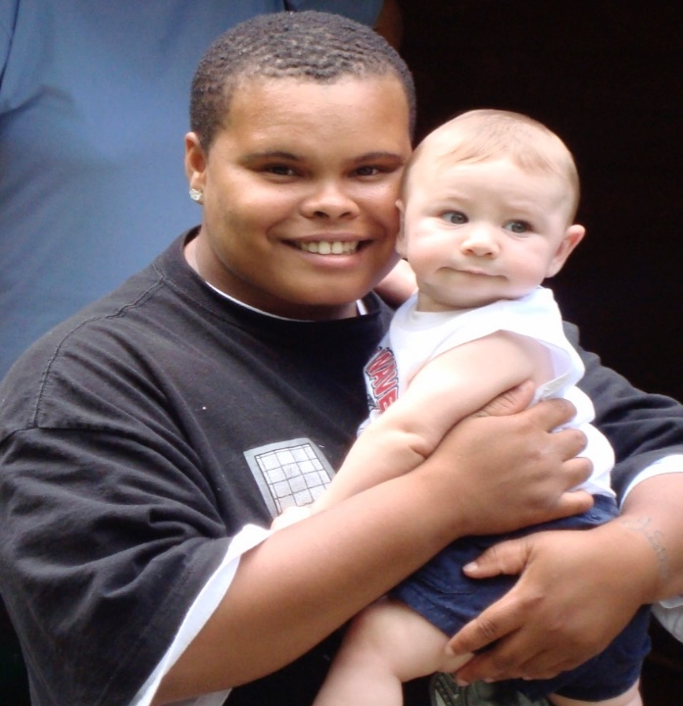




Photos
Notes:
PARAPHRASE
Most of you are probably here because you love children. You may be parenting for the first time, or you may be a parent who wants to expand your family by parenting another child or parenting a family member. This curriculum was developed to provide you with the knowledge and skills that you will need to provide a nurturing environment for children you take into your home through foster care, adoption, or kinship care.
11

Slide 12
Enhancing Your Toolbox
Notes:
PARAPHRASE
Because the children we’re talking about have life experiences that have not been easy, we’re going to need some extra tools in our parenting toolbox to help us provide a nurturing and safe environment for them.
Of course, all of us come to this training with different skills and experiences already in our parenting toolboxes. So, we’ll be building on those. And some tools will be new and specific to children who have experienced separation, loss, or trauma.
The NTDC Curriculum will help provide you with what you will need to effectively parent children who have experienced separation, trauma, and/or loss.

Slide 13

Expanding your Parenting paradigm
Notes:
FACILITATOR’S NOTE
You will show the narrator introduction of the Expanding Your Parenting Paradigm online video (approximately 8 minutes). You will then lead a discussion on this part of the video. Depending on your class population, choose one of the 4 versions that that have been created for the following populations:
General Child Welfare (for those fostering/adopting from the child welfare system)
Kinship Families
American Indian/ Alaska Native
Intercountry and Private Domestic
You will need to determine how you want participants to watch the remainder of this online theme. This online video has several segments which can be broken up and shown during the classroom time or they can be assigned to participants to watch on their own outside of the classroom. This video includes foundational information that is critical to the overall curriculum, so it is important that participants watch all of the video at some point.
SAY
We will now watch the introduction to the Expanding Your Parenting Paradigm online theme which is part of the NTDC curriculum. This portion of the video provides an overview of how one parent started this journey and her need to expand her parenting tools and knowledge to meet the needs of the child she was caring for.
DO
Show the introduction to the Expanding Your Parenting Paradigm video.
Facilitate a discussion using the following questions:
What did you think of the narrator’s example of the need to “have the right tool for the right job” and how this could apply to parenting a child with a history of loss and trauma?
What were some ways the narrator needed to expand her parenting paradigm?
Reinforce answers like:
She learned that while traditional parenting skills are good, when parenting a child with a history of separation, loss, and trauma, it’s not unusual to need to add additional skills to the parenting toolbox.
She learned that while traditional parenting is based on trust that has been built over time, children who have experienced separation, loss, and trauma have lost trust in caretakers, so a different types of parenting tools and skills are needed.

Slide 14

Enhancing Your Toolbox: Finding Support
Supportive people and places that help keep us afloat.
Notes:
PARAPHRASE
We will all have times when we will need to reach out for additional support to help us to stay afloat. Call out people and places you think might be helpful or supportive to you during those times?
DO
Facilitate a discussion by encouraging participants to call out people/places who might be helpful or supportive. Reinforce responses like the ones below. If participants don’t call them out, bring them up yourself:
Extended family
Friends
Places of worship
Workplace/colleagues
Caseworkers
PARAPHRASE
All parents face challenges. Parents who foster or adopt are likely to encounter additional challenges as a result of the children’s experiences before coming to the parent’s home. It’s important to think through where your support will come from before you are actually in need of that support.

Slide 15
SECTION 3:
Developing capacity to support children and families
Notes:
FACILITATOR’S NOTE
Allow 25 minutes for this section.
PARAPHRASE
As we just mentioned, parents who foster or adopt will likely face some challenges during this journey. As a parent, you will need to build your resilience so that you can manage these challenges successfully - and come back to manage tomorrow’s challenges when they arise.

Slide 16




Providing Tools for Parenting!
Classroom-Based & Online Training
Includes a combination of online and in-person content
Self-Assessment Before Classroom-Based Training
Self-Assessment
After
Classroom-Based Training
“Right-Time” Training
Access to online content anytime-when you need it the most.
16
Notes:
FACILITATOR’S NOTE
Facilitators will need to explain to participants when and how to access the Self-Assessment. [Choose one of these to PARAPHRASE as appropriate for your site.]
You have already been introduced to the Self-Assessment. [Add when they were introduced to it.]
You are soon to be introduced to the Self-Assessment. [Add when they will be introduced to it.]
This also may be the first time the Participant Resource Manual is mentioned. It will be described in more detail for participants on the next slide.
PARAPHRASE
The curriculum is broken down into three main components:
Component 1: Self-Assessment
The Self-Assessment is designed to be completed before and after the classroom-based training. This 20-30-minute online tool includes questions that will help you discover more about your characteristics and abilities. It is designed to be self-administered; allowing you to identify your areas of strength, those areas where you would benefit from additional support and information, and those areas that may be the most challenging for you when parenting children or teens. The self-assessment characteristics and competencies are highlighted throughout the curriculum.
After you complete the Self-Assessment, you will receive a report that provides feedback on your strengths and areas for growth. The report will only come to you. Understanding your parenting strengths and areas for growth will be a powerful tool in your parenting toolbox. More information about the Self-Assessment can be found in your Participant Resource Manual. We will discuss the Participant Resource Manual in a few minutes.
Component 2: Classroom-Based & Online Training
The Classroom-Based Training started today! We will be covering numerous themes that have been found to be essential for preparing parents who are wanting to foster, adopt or be a kinship care provider. Each theme runs from 1 to 2 hours and will follow a similar format. Two of these themes are online themes that are designed to be done outside the classroom. We saw a portion of one of themes (Expanding Your Parenting Paradigm) just a few minutes ago. For all classroom themes, you will need to have your Participant Resource Manual handy, as it will have the handouts and materials that you will need for each theme.
Component 3: Right-Time Training
The Right-Time Training includes additional topics that are not covered in the classroom-based training that will provide you with tools and information you will likely need along the journey. As stated in the graphic, this component is designed to provide you with access to online content that you can access anytime you need it. The Right-Time training includes 15 themes, each including podcasts, videos, and answers to frequently asked questions. The themes and how you can access them are listed in your Participant Resource Manual.
Now we are going to look at some elements that are important in every classroom-based theme.

Slide 17
Participant Resource Manual
Notes:
FACILITATOR'S NOTE
Ensure that participants are given the Participant Resource Manual either during or prior to this class. The Participant Resource Manual can be printed and distributed to participants, or it can be sent to them electronically.
PARAPHRASE
We have developed a Participant Resource Manual for people taking this class. Please feel free to look at your Manual as I talk about it. When you return to our next class, please bring your Participant Resource Manual. You should bring this to every class as it contains information that is needed for every session.
The Participant Resource Manual includes information on the different parts of the curriculum, including:
Self-Assessment
On-Line Classroom Themes
Classroom-Based Themes
Right-Time Themes
For the classroom-based themes, the Manual will include a brief overview of each theme, including competencies we are trying to achieve; handouts for the themes that will be used in class; and space to complete Reflections/Relevance activities. The Manual will be a crucial tool throughout the course. It will also be helpful to keep as a resource to refer to later in your parenting journey.

Slide 18
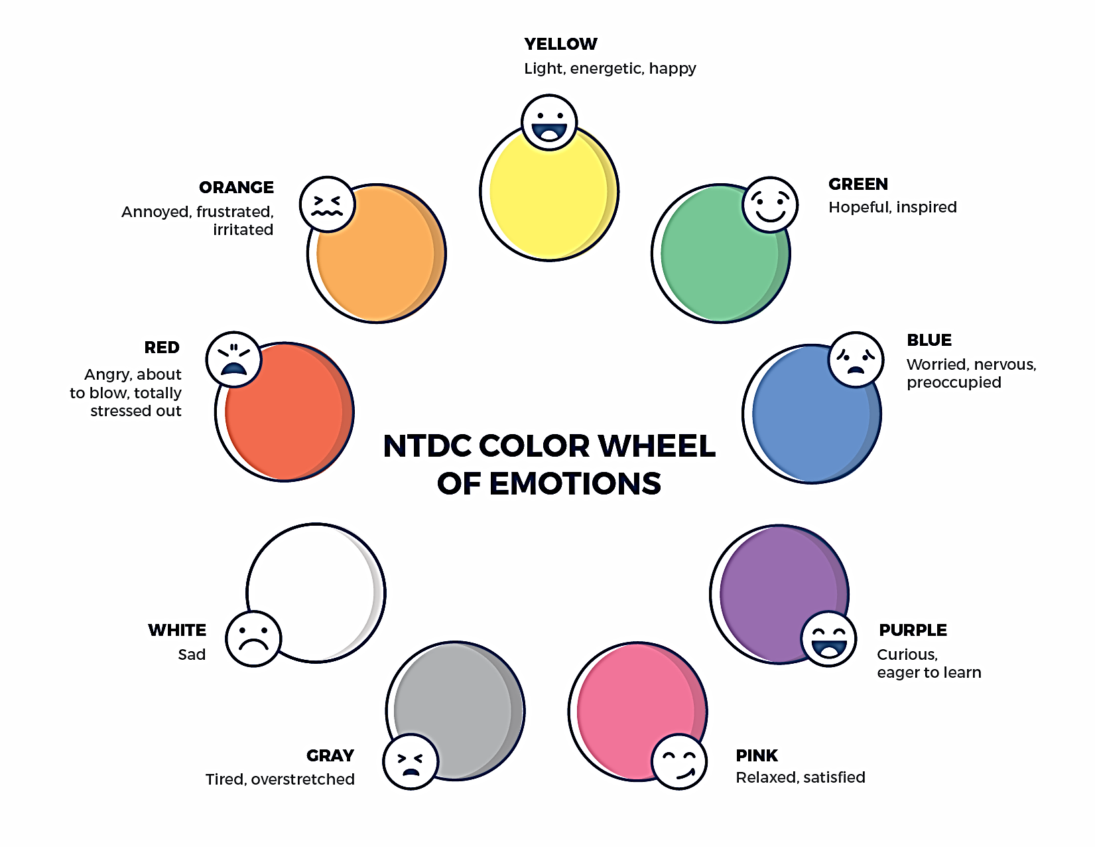
NTDC Color WHEEL
Notes:
FACILITATOR'S NOTE
On this slide, you introduce the Color Wheel graphic that will be used to open the first class of each day. Participants are not completing the Color Wheel during this theme, but it should be done starting with the next theme and continue to be used throughout the training. Before the class, check which page the Color Wheel is on in the Participant Resource Manual and make a note of it so you can inform the participants.
PARAPHRASE
Self-awareness is an important parenting tool. In your Participant Resource Manual there is a Color Wheel. This Color Wheel will give you the opportunity to take a moment to do a self-check. We will begin each class with a check-in using the Color Wheel. The Color Wheel will help us focus on our current emotional state at that particular moment. Most of us agree that when we are feeling worried, sad, or angry, it might interfere with our ability to take in new information, like what we will be covering in the class. Whereas, when we’re feeling relaxed, light or inspired, we are more interested and able to learn new things. The different colors and feelings they represent will help us to tune in to how we’re doing.
Tuning in to how you’re doing on a daily basis may not be something everyone here is used to, but this type of regular self-check is critical for parents who are adopting or fostering children who may have experienced trauma, separation, or loss, as it will be helpful to become and stay aware of your own state of mind. It may seem like a simple exercise but be assured that knowing how we’re doing on any given day strengthens our ability to know when and how we need to get support and/or need a different balance. Doing this type of check in will also help us to teach and/or model this skill for children! So be ready to do the Color Wheel during our next class.

Slide 19
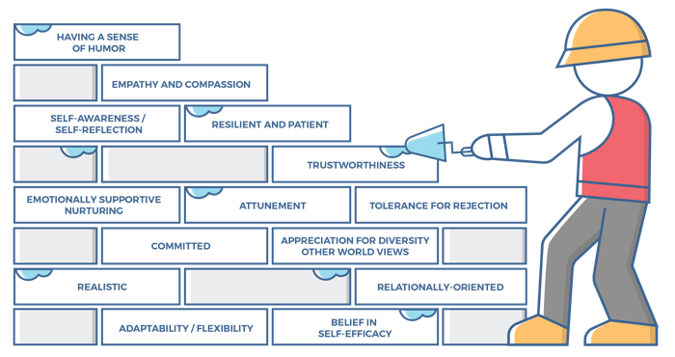
Characteristics of successful foster and adoptive parents
19
Notes:
FACILITATOR'S NOTE
This slide introduces the Characteristics of Successful Foster and Adoptive Parents, which are woven throughout the curriculum. The characteristics were featured in the Self-Assessment and are also brought into every theme. Each theme will highlight several characteristics. Before class, check the page number of the Characteristics of Successful Foster and Adoptive Parents in the Participant Resource Manual so that you can refer participants to this page.
PARAPHRASE
This graphic illustrates characteristics of parents who effectively foster or adopt. The characteristics may seem familiar to you as they were featured in the Self-Assessment. These characteristics are based on parent interviews, focus groups from different sources around the country, as well as a review of the literature. Several of the characteristics seen on the brick wall graphic will be highlighted in each theme. As you think about these characteristics, think about how you can use them to help build a strong foundation for your home to be as nurturing as possible for children who have experienced separation, loss, and/or trauma.
Your Participant Resource Manual lists the definitions for all 14 characteristics. For right now, we will use Handout #1 in your Participant Resource Manual to think about the characteristics as we go to the next slide for our Reflection/Relevance activity.

Slide 20

Reflection/ relevance
Using Handout #1, identify one strength and one challenge
Notes:
PARAPHRASE
Each theme includes a Reflection/Relevance activity.
Today, we’ll use Handout #1: Characteristics of Successful Foster and Adoptive Parents to think about the characteristics. I will give you a few minutes to look over the characteristics. You can spend more time with the characteristics at home, but for now, look them over and identify 1 characteristic that you consider a strength and 1 that is a challenge for you.
DO
Pause to allow participants to look over definitions and identify a strength and a challenge.
PARAPHRASE
Let’s focus on our strengths. Which of these characteristics do you already have as a strong part of your parenting foundation? Let’s go around and everyone name one strength. Don’t worry if it’s the same as somebody else’s. Who would like to start?
DO
Go around the room and have each participant name one of the characteristics.
When everyone in the group has named theirs, continue:
PARAPHRASE
Look at all the characteristics of successful parents who foster and adopt that you all already have. There is already such a strong foundation in this group to build on!
20

Slide 21

Lifelong Learning
Notes:
PARAPHRASE
Each of the upcoming classroom themes will highlight 1 or 2 resources that participants can access on their own to continue learning more about the topic of the theme. It is important that you continue your own learning by taking advantage of resources that are available to you. The suggested resources for each theme can be found on the NTDC website or in CapLEARN.
FACILITATOR’S NOTE
There are no designated additional resources for this theme, however, you may choose to recommend that they continue to watch the Expanding Your Parenting Paradigm video at home.

Slide 22
Class-Schedule
Notes:
FACILITATOR NOTES:
Create a slide to show the class schedule for this cohort. It is important for participants to know the date, time and themes that will be covered for every session.
PARAPHRASE
Here is the schedule of all classroom themes and classes for this cohort.
DO
Give the class schedule for your site. Go over any logistics that families need to remember (change in time, dates, etc.).
Review the specific themes that will be covered during the next class and any administrative paperwork they will need to complete.

Slide 23
SECTION 4:
WRAP-UP
Notes:
FACILITATOR’S NOTE
Allow 10 minutes for this section.
PARAPHRASE
We all bring knowledge and skills, but when parenting a child with a history of separation, loss, and trauma, it’s not unusual to need additional skills added to the parenting toolbox and to expand our parenting paradigm.
Traditional parenting is based on trust that has been built over time, but children who have experienced separation, loss and trauma have often lost trust in caretakers, so different types of parenting tools and skills are needed.
Parenting is challenging, we must identify sources of support to keep us afloat during challenging times
It is important to know our strengths and areas where we need to grow as we think about the characteristics associated with successful foster, adoptive and kinship parenting.

Slide 24

Place holder for slide with Closing Quote
Notes:
DO
Ask for a volunteer to read the quote on the slide.
PARAPHRASE
The last class of the day always ends with this quote. What are your thoughts on why this quote was chosen? (Allow for a few responses.)
We hope you enjoyed the class today and that you are interested in learning more about what the NTDC curriculum has to offer to build knowledge, skills, and tools for successful foster, adoptive, and kinship parenting.
If closing for the day:
Thank everyone for attending and for their thoughtful participation and attention.
If in person, collect the name tents or have them tuck them into their Participant Resource Manual to bring back to the next class.
PARAPHRASE
Close out the day by covering the below topics:
Remind participants of the date/time for the next class and let participants know if there are any changes to the location.
Encourage participants to contact you (or other facilitators) if they have any questions or concerns.
Review the themes that will be covered during the next class.
If in person, remind participants to take their Participant Resource Manual with them and to bring them to the next session. If using a remote platform, remind participants to have the Participant Resource Manual available for the next class.
24

Slide 25
For more information, visit:
Notes:
25

Slide 26
.
This curriculum was funded by the Children’s Bureau, Administration on Children, Youth, and Families, Administration for Children and Families, US Department of Health & Human Services, under grant #90CO1132. The contents of this curriculum are solely the responsibility of the authors and do not necessarily represent the official views of the Children’s Bureau.

