Slide 1
MAINTAINING CHILDREN’S CONNECTIONS WITH SIBLINGS, EXTENDED FAMILY MEMBERS, AND THEIR COMMUNITY
FACILITATOR CLASSROOM GUIDE
Modified January 2022
Notes:
MAINTAINING CHILDREN’S CONNECTIONS WITH SIBLINGS, EXTENDED FAMILY MEMBERS, AND THEIR COMMUNITY
FACILITATOR CLASSROOM GUIDE
Modified January 2022

Slide 2
To Prepare for the Class
See Notes view
Notes:
To prepare for this class, you should:
Review the facilitator preparation information included in this Guide along with the handouts.
Review the Resources for this theme found on CapLEARN (https://learn.childwelfare.gov/) or NTDC website (https://ntdcportal.org/).
Develop an agenda that includes this theme and any other themes you will be conducting along with it during the class.
Ensure that participants have a copy of the Participant Resource Manual. This Manual will be used during all themes and will include the handouts needed by participants. Facilitators should have copies of the handouts for the theme available in case participants do not bring their Manual to class. If the theme is being taught on a remote platform, facilitators should have the handouts available so that they can share in the chat and/or email to participants who do not have their Manual.
Bring any materials you need for the activities.
Review any videos or other electronic media used in this theme, if any, and plan the mechanics of how you will present them. Media for this theme are listed in the Materials and Handouts slide. Review the instructions for each media clip (e.g., to pause or stop at a particular time stamp). The videos can be played in different ways, including:
Play them from a flash drive or the computer’s hard drive using a media player app
Link to them from CapLEARN or the NTDC website.
Practice playing the media for the theme. Ensure that you have the files and apps you need, that your links and connections work, and that you know when to pause or stop the media clip if appropriate.
If training on a remote platform, make sure all participants have the link available to access the class and that you have all videos, PPT’s and handouts ready for use.
If training in person, ensure that a room is available and set up, with the following:
Enough tables and chairs for all participants
Projector and screen (check that it works with the computer you will be using)
Classroom activities have been adapted so that they can be done on a remote platform. Adaptations will be marked as follows so that they can be easily spotted throughout the Facilitator Classroom Guide: Adaptation for Remote Platform
PREPARATION

Slide 3
MATERIALS AND HANDOUTS
See Notes view
Notes:
FACILITATOR’S NOTE
Participants are expected to have the Participant Resource Manual available for every session.
MATERIALS NEEDED
You will need the following if conducting the session in the classroom:
A screen and projector (test before the session with the computer and cables you will use)
A flipchart or whiteboard and markers for several of the activities. A flipchart with a sticky backing on each sheet may be useful and will allow you to post completed flipchart sheets on the wall for reference.
Name tent cards (use the name tent cards made during the Introduction and Welcome theme)
You will need the following if conducting the session via a remote platform:
Access to a strong internet connection
A back-up plan in the event your internet and/or computer do not work
A computer that has the ability to connect to a remote platform- Zoom is recommended
HANDOUTS
Have the following handouts accessible. Participants will have all handouts listed below in their Participant Resource Manual.
Handout #1: Overcoming Barriers to Connection with the Child’s Family
VIDEOS and PODCASTS
Before the day you facilitate this class, decide how you will show/play the media items, review any specific instructions for the theme, and do a test drive. You may wish to set up the media to the start point. Videos can be found on the NTDC website or CapLEARN. (https://learn.childwelfare.gov/) or NTDC website (https://ntdcportal.org/).
The following media will be used in this theme:
Clip from documentary FOSTER- featuring Mary (1 minute)
Re-establishing Family Connections (12:30 minutes)
EVALUATION
There is a pre- and post-survey available for every theme. If the facilitator wants to use these evaluation tools, they will need to be downloaded from the NTDC website or CapLEARN and provided to participants. Participants will need to complete the pre-survey prior to the theme and the post-survey upon completion of the theme. If conducting the class on a remote platform, the facilitator will need to put the surveys into an online format such as survey monkey.
MATERIALS AND HANDOUTS

Slide 4
Theme and competencies
See Notes view
Notes:
FACILITATOR'S NOTE
Before beginning, review the theme and competencies. You will not read these aloud to participants. Participants can access all competencies in their Participant Resource Manual.
THEME AND COMPETENCIES
4

Slide 5
Suggested agenda
See Notes view
Notes:
FACILITATOR'S NOTE
This notes page shows a suggested agenda and timing for this theme. Before the day of class, please review this agenda and incorporate it into your overall agenda for this and any other themes you are conducting along with it.
AGENDA
This theme is divided into three sections. This content is based on 1 hour of classroom material.
BEFORE YOU BEGIN THE CLASS
Before discussing the Color Wheel of Emotions and covering the content of this theme, you should do the following:
Make any announcements that are needed regarding the training, timing of training, or process to become a foster or adoptive parent.
Take out the Participant Resource Manual and direct participants to this theme in their Manual. Remind participants that the Competencies for today’s theme are in their Manual.
Review the agenda for the theme. Facilitators should add a slide to the PPT deck that includes the agenda so that they can review it with participants. Make sure to include start and end times and any breaks that will be taken during the session.
Encourage participants to be engaged and active learners.
Encourage participants to contact you in between classes with any questions and/or concerns. (Prior to class, list the name(s) of the facilitators on the board with contact information.)
Remind participants to put out their name tents (these can either be made by the participants during the first class or the agency can print out name tents and provide them to the participants at the first class). If conducting the class on a remote platform, remind participants to type their first and last names in their screen box.
SUGGESTED AGENDA

Slide 6
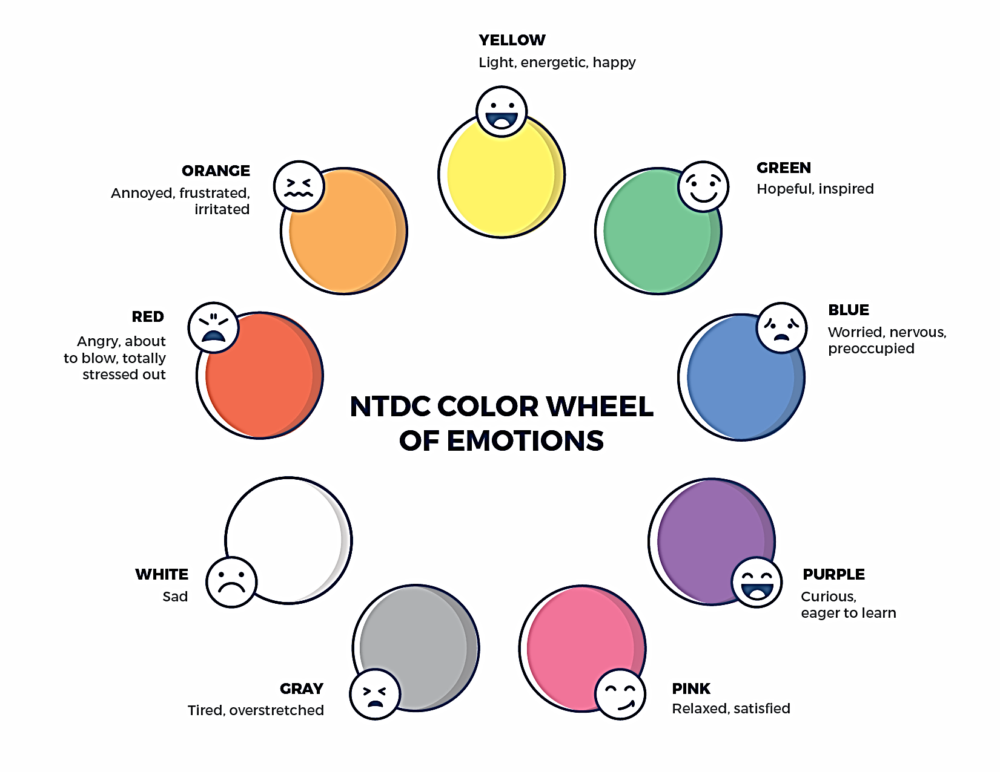
Welcome to the national training and Development Curriculum for foster and adoptive parents
Notes:
FACILITATOR'S NOTE
Have this slide showing onscreen as participants assemble for the first class of the day. As participants come in, welcome them back and ask them to take a few minutes to do a self-check using the Color Wheel. NOTE: The Color Wheel should only be done one time per day; before the first theme of the day. If combining several themes together on one day, facilitate the Color Wheel at the beginning of the first class of the day as participants are coming into the room.
SAY
Welcome back. We are so glad that you have taken time out of your day to join us for another exciting learning opportunity. As you recall, tuning in to how you’re doing on a daily basis may not be something everyone here is used to, but this type of regular self-check is critical for parents who are adopting or fostering children who may have experienced trauma, separation, or loss, as it will be helpful to become and stay aware of your own state of mind. It may seem like a simple exercise but be assured that knowing how we’re doing on any given day strengthens our ability to know when and how we need to get support and/or need a different balance. Doing this type of check in will also help us to teach and/or model this skill for children! Please take a moment to look at the color wheel and jot down on paper the color(s) that you are currently feeling.
DO
Wait a little while to give participants time to complete the Color Wheel.
SAY
Now that everybody has had the opportunity to do a quick check in, would someone like to share what color(s) they landed on today for the Color Wheel?
DO
Call on someone who volunteers to share their color(s). If a challenging emotion or feeling is shared, thank the person and acknowledge their courage in sharing, pause for a moment, encourage everyone to take a deep breath, and transition to beginning the theme.

Slide 7
MAINTAINING CHILDREN’S CONNECTIONS WITH SIBLINGS, EXTENDED FAMILY MEMBERS, AND THEIR COMMUNITY
Modified January 2022
Notes:
FACILITATOR'S NOTE
Show this slide briefly just before you start the class.
SAY
Let’s get started! Welcome to the Maintaining Children’s Connections with Siblings, Extended Family Members, and Their Community theme.
7

Slide 8
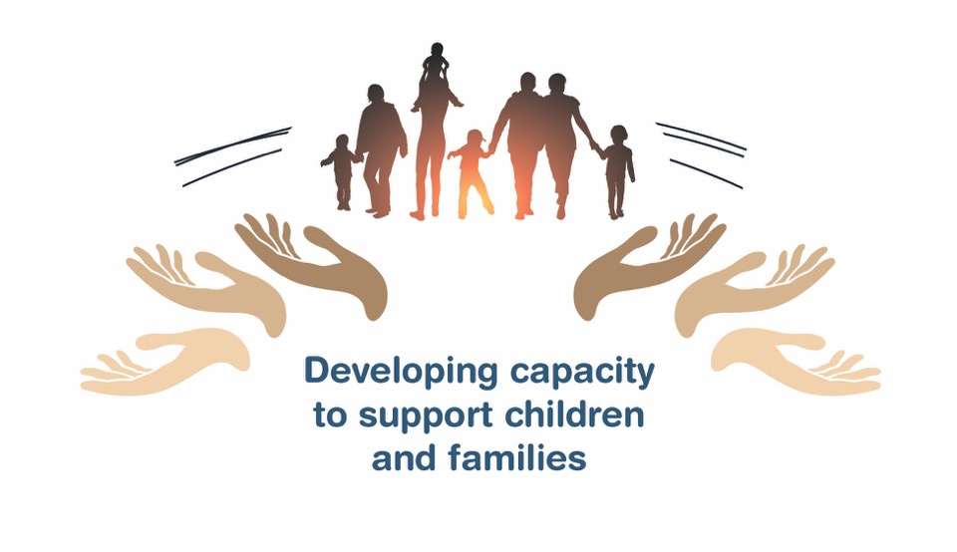
Place holder for slide with opening Quote
Notes:
FACILITATOR'S NOTE
The opening quote slide should be used only for the first theme of the day. If combining several themes together on one day, the opening quote slide would be shown only after the Color Wheel at the beginning of the first theme. It is important to always emphasize with this slide that this type of parenting involves lifelong learning and it will be critical for families to be invested in their own learning before and after a child is placed in their home.
PARAPHRASE
We are excited to share this lesson with all of you today. We are going to start with Maintaining Children’s Connections with Siblings, Extended Family Members, and their Community. As the slide states, this information will help to develop your capacity to support children and families. This type of parenting will require continuous learning. So, let’s dive in and see what important information we have to share with you today.
8

Slide 9
SECTION 1:
Introduction: Maintaining Children’s Connections
Notes:
FACILTATOR’S NOTE
Allow 40 minutes for this section.
PARAPHRASE
It’s important for children in foster care or adoption to maintain connections not only with their parents, but also with their siblings, extended family members and their community.
Parents who are fostering or adopting need to support these connections and to overcome barriers to maintaining those connections.
We will look at the barriers that can make the connections hard to maintain, and finally look for strategies we can use to overcome the barriers.

Slide 10
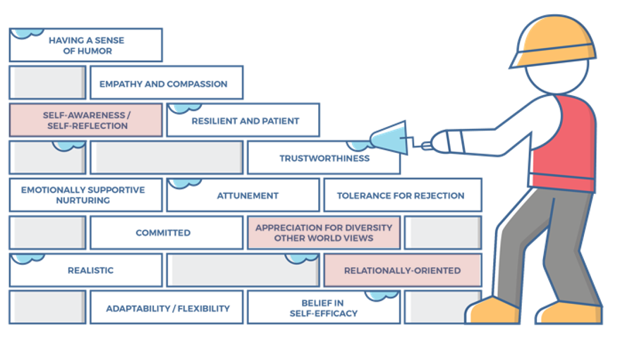
Characteristics of successful foster and adoptive parents
10
Notes:
FACILITATOR'S NOTE
This slide is shown at the start of each theme. Although the graphic will remain the same, the bricks that are colored in red will change based on the characteristics that will be touched upon in this theme. The characteristics were obtained from review of literature, stakeholder interviews, and review of existing curricula. We want families to become very acquainted with these characteristics throughout the training. It is important to note that in addition to the characteristics that are highlighted in red, there may be additional characteristics that are touched upon during the theme. Facilitators should try to connect these characteristics to the information they are sharing throughout the training. Remind participants that their Participant Resource Manual contains the definitions for these characteristics.
SAY
Before we get into the content let’s look at the 14 characteristics of successful foster and adoptive parents. When you took your self-assessment, you were asked about these characteristics.

Slide 11
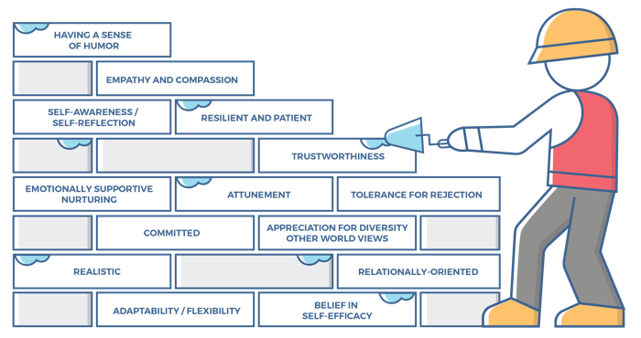
Characteristics for maintaining Children’s Connections, 1 of 2
Self-awareness/Self-reflection:
Parents can identify why they have responded to a child in a certain way.
Parents can identify what was good, bad, and different about the way they were raised, while adjusting their own parenting to meet a child’s needs.
Parents can identify and forgive themselves for having negative feelings towards a child, moving from disappointment to acceptance.
Parents are aware of their own history of experiencing loss and being hurt and can identify how this history can negatively impact their parenting if they are not careful.
Appreciation for Diversity / Other World Views:
Parents understand and have a sense of respect for a child who brings a different set of values with them.
Parents can reconcile that the child’s behaviors and values may not align with their personal values and that this will feel uncomfortable and at times, feel wrong. Parents know that if not resolved/accepted, this can be a real source of discontent, tension, and conflict in the parenting of the child.
Notes:
SAY
The Maintaining Children’s Connections theme will cover the following characteristics:
Self-awareness/Self-reflection
Appreciation for Diversity and other World Views
Relationally-Oriented
Take a moment to think back to how you assessed yourself with these characteristics. It is important as you start this journey to assess your characteristics as they are qualities that can strengthen your ability to successfully parent a child who is in foster care or has been adopted.

Slide 12
Characteristics for Maintaining children’s Connections, 2 of 2
Relationally-Oriented:
Parents recognize and value the relationships the child has with others including their family.
Parents show respect for the child’s family and previous relationships, and to the child.
Parents move beyond any anger or jealousy they may feel toward the child’s family to help the child resolve relationship issues with their family members and former foster families.
Parents can help a child grieve losses, maintain connections, and feel good about themselves.
Notes:
ASK
Now that we have reviewed the definitions, why do you think these specific characteristics are important to a Maintaining Connections theme?
Reinforce:
Self-awareness/Self-reflection
Being separated from family members they care about is hard for child. As you support the child, feelings of loss can also be stirred up for you and self-awareness about this will be important.
Being aware of and willing to challenge our stereotypes and pre-judgements is important as you support a child’s connections with siblings, extended family members, and the child’s community.
Appreciation for Diversity and other World Views
Not only must we be self-aware regarding biases, we must go a step farther by showing respect for and a willingness to learn more about the child’s culture and community to best know how to support the child in maintaining connections within that culture and community.
Relationally-Oriented
By valuing the child’s relationships with siblings, extended family, and community, you are helping a child feel good about themselves and all of who they are.
Your willingness to help a child maintain these important connections will go a long way in building your relationship with the child.

Slide 13

Connections are Important
Notes:
PARAPHRASE
In the theme Reunification – The Primary Permanency Planning Goal, we discussed the importance of a positive relationship between the child’s parent and the parent who is fostering and how helpful it can be for the child to see them working together. Connection with siblings, extended family members, and community is also critical for the child’s overall well-being.
Maintaining the child’s connections with siblings, extended family and other important people in their life recognizes and validates the importance of people who have played a key role in the child’s life. It is important that parents who are fostering or adopting maintain a respectful and supportive attitude toward the child’s family.
Parents who are fostering will have to establish healthy boundaries with the child’s family that are within the parameters set by the Court and the visitation plan. Parents who have adopted will decide how to maintain these connections.
It is important to include the family in the child’s life when possible. Making sure that family members are aware of and feel welcomed to celebrations, school events, medical appointments, sports, and other activities, will go a long way in keeping the family connected and informed about what is going on in the child’s life. This will also assure the child that you and the child’s family members are working as a team for the benefit of the child.

Slide 14
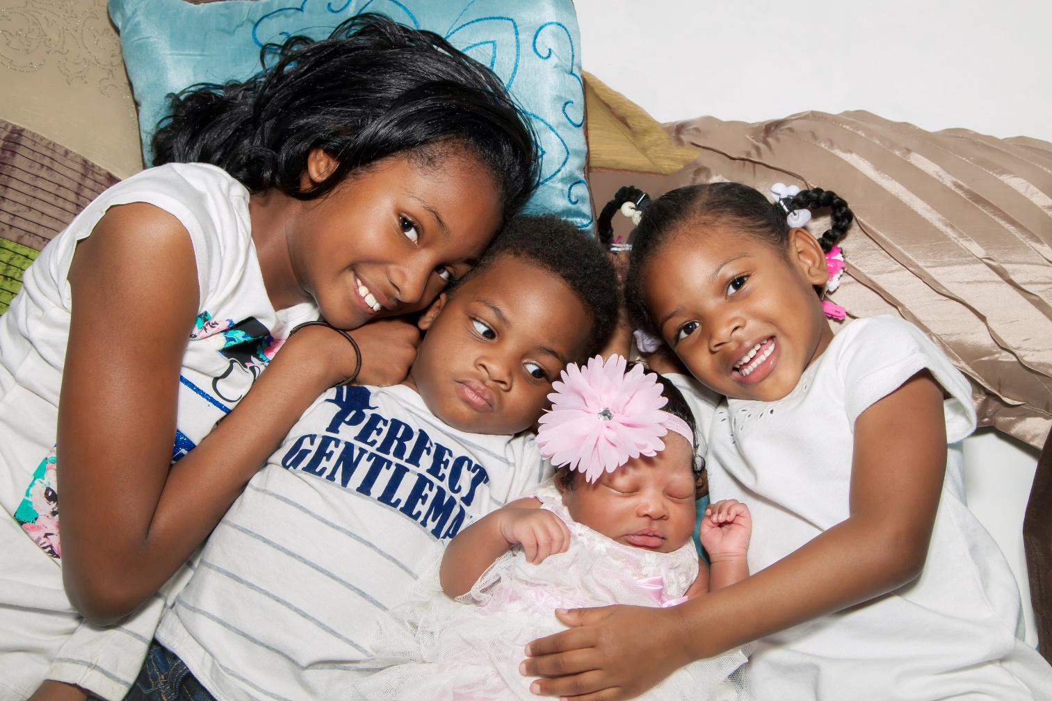
Connections with Siblings
Notes:
PARAPHRASE
The sibling bond is often the most important and long-standing relationship we have. Connections with siblings can serve as a protective factor for children who have been removed from their family. Sibling relationships can provide a source of continuity throughout a child’s lifetime. These relationships can also provide children with emotional support, companionship, and comfort in times of change. Sibling relationships play a crucial role in the development of one’s identity and self-esteem.
Children in foster care and those in adoptive families have some unique challenges when it comes to siblings. It is likely that they have siblings from whom they were separated. Sometimes they know about these siblings and sometimes they only wonder if they might exist. Parents who are fostering or adopting need to understand how children feel about the siblings that they cannot live with and when possible, find ways to help these connections be maintained.
According to research (C. Jones 2016), approximately 2/3 of children in foster care have a sibling in care and it is estimated that more than 70% of siblings are separated. As a result, many children are separated from their siblings through adoption.

Slide 15

FOSTER: Grief and Loss in Children
This video includes a clip of the documentary FOSTER.
Foster footage courtesy of Participant Media, LLC. © 2018 Sabine Films, Inc. All rights reserved.
Notes:
PARAPHRASE
We are now going to watch a brief video clip taken from a 2018 documentary, FOSTER, written and directed by Deborah Oppenheimer and Mark Jonathan Harris. It was filmed in Los Angeles County about the child welfare system and the true stories of people in it. We will watch Mary, a young adult aging out of foster care as she talks about the importance of her connection to her sister in her life.
DO
Show the video clip which can be found on the NTDC website or CapLEARN. (Approximately 1 minute.)
ASK
While the clip is short, what do you hear from Mary about the importance of her connection to her sister? Why do you think this relationship is so important to Mary?
Reinforce:
She says that she really wants to “close to somebody in my family”.
She has valued what her sister has tried to do in the past for her.
It seems comforting as she moves into an apartment to share it with someone she knows and cares about.

Slide 16
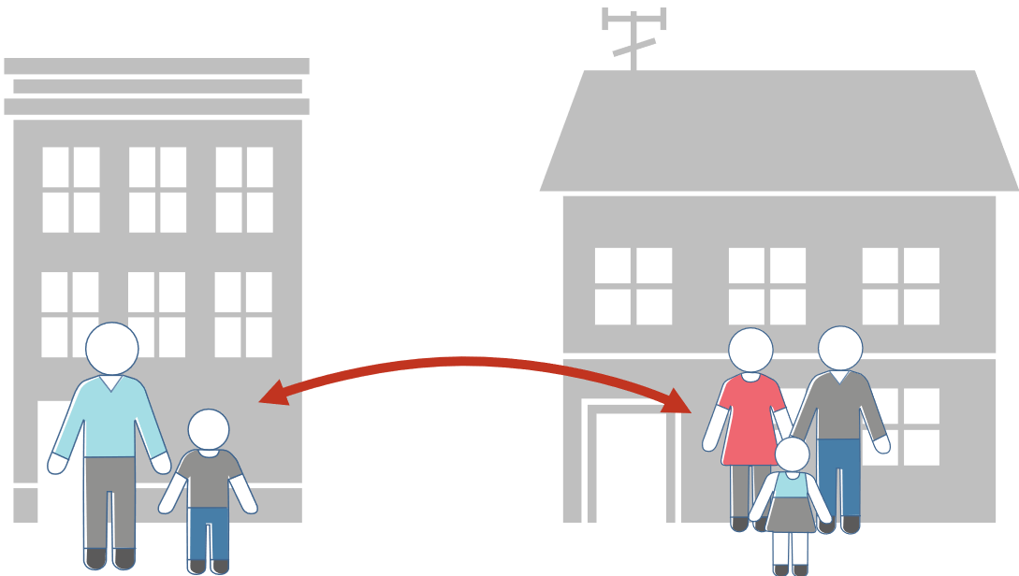
When Siblings Remain with the Parents
Notes:
PARAPHRASE
In some cases, a sibling will remain with the family while other siblings are removed. In other cases, children may be born into the family after the child left the family. Not having contact with their siblings can deepen their feelings of rejection and impact their self-worth and overall loss.
In the first situation children may have strong feelings about why they were removed while other siblings stayed in the home. This may cause a child to ask why this sibling has remained with the parent when they could not. If there is regular contact with the parent, the parent may need help in explaining why that child remains with them, when the child in foster care or who has been adopted could not. If there is not regular contact with the parent, an extended family member or professional may be able to help the child understand and work through these feelings and concerns.
A more common occurrence is when the child’s parents have additional children after the child is out of the home. It is important for the adults in the child’s life to share that information with them and evaluate how the relationships with the new siblings will unfold. It is important to note that even if the siblings did not live together, there is a bond that should be recognized and honored.

Slide 17
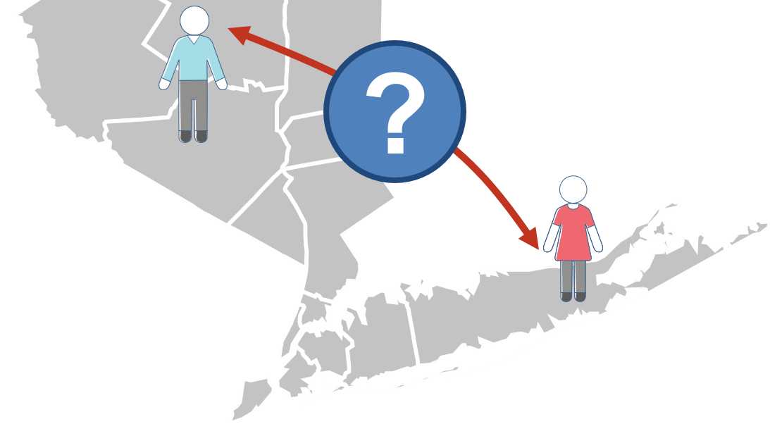
Fostering connections between siblings
Notes:
PARAPHRASE
As we think about maintaining sibling connections, let’s consider some effective strategies for maintaining these connections when siblings are separated. Let’s take a few minutes to share some ideas about how that might be accomplished. Call out your ideas and I’ll write them here.
DO
Facilitate a brainstorming discussion on ways to facilitate communication between siblings who are placed in separate, distant homes.
Write participants’ ideas on the flipchart or white board.
Adaptation for Remote Platform: Have participants use the chat function to record their suggestions. You will read them aloud as suggestions come in. Add in what is below if not mentioned.
Be sure to include the following strategies if participants don’t bring it up on their own:
Texting or calling,
FaceTime, Instagram
Writing letters and sending pictures
Planning consistent times to meet in the middle and do some type of activity
Visits at the other sibling’s home that are more extended
Working with the child welfare agency to determine if the other parent could be used as respite so the child can stay overnight or for a weekend.

Slide 18
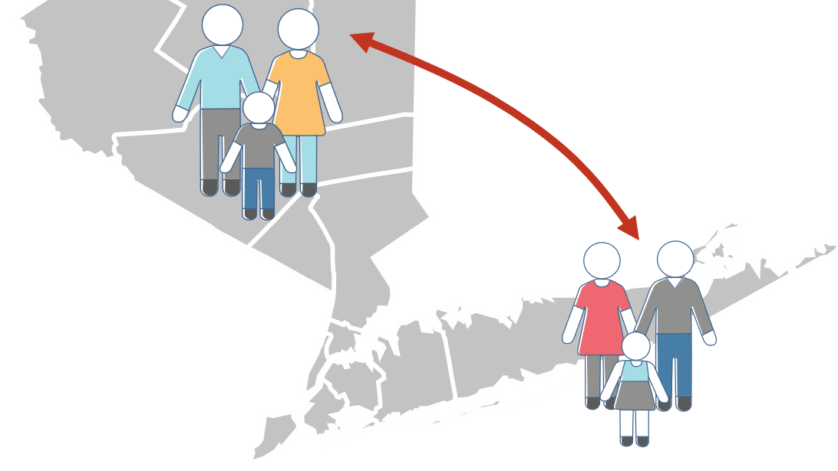
Parents who are fostering or adopting Must Collaborate to Support communications
Notes:
PARAPHRASE
Parents who are fostering or adopting siblings that are separated must collaborate to be sure that efforts are coordinated, boundaries for contact are clear, every effort is made to make the contact positive, and feedback from the contact is reported with clarity. It is helpful to communicate ahead of time with the child’s family members to establish an understanding and agreement about how contact will occur.
When sibling contact needs to be supervised or monitored for safety reasons, communication can be limited to those that can be monitored and joined by a supervising adult. When in-person visits need to be monitored, parents who are fostering, caseworkers, or other adults can be present in the room or can observe from an adjoining observation room. Even in these circumstances, these relationships are important and should be maintained.
It is important to remember that siblings who have been separated may not always seem to get along. They may seem awkward in their contact, may ignore each other and may even squabble. This does not mean that the contact is not valuable and meaningful to the child. Visitations should continue unless they are deemed to be harmful to the child by a professional.

Slide 19
Two Questions
About Maintaining Meaningful Connections
Notes:
FACILITATOR’S NOTE
In this activity, participants will break up into two groups. Each group will be given one of the questions to discuss. After the groups break out, they will come back and report out to the larger group.
Allow 10 minutes for this activity.
DO
Break the class into two groups.
Encourage participants to write out their suggestions and appoint one person to be the spokesperson for the group.
Facilitate as needed by giving advice and answering questions.
Adaptation for Remote Platform: Use the break-out rooms feature in zoom. Assign each group a question prior to participants joining their break-out room.
PARAPHRASE
Now, let’s talk about how to maintain connections with important people and practices in the child’s life. The next slide has two important questions that I want to discuss in break out groups. I will break you in two groups and tell you which question to discuss. We will then reconvene as a large group and report out the ideas your groups ideas for maintaining these connections. We’ll have about 10 minutes.
For reference, the two questions are:
Question 1: How can a parent who is fostering or adopting maintain meaningful connections with the child’s community and culture?
Question 2: How can a parent who is fostering or adopting encourage connection between the child and extended family members?

Slide 20

Two Questions About Maintaining Meaningful Connections
How can a parent who is fostering or adopting maintain meaningful connections with the child’s community and culture?
How can a parent who is fostering or adopting encourage connection between the child and extended family members?
Notes:
DO
Add the following if participants do not mention them in their report out:
Question 1:
Keep the child in the same school, church, activities, and community when geography permits.
Maintain authentic connections to the child’s community and culture by participating with them in connections and activities in that culture/community, especially when the child is of a different culture than the parent who is fostering or adopting. Examples include:
Ongoing participation in cultural music, art, or dance classes.
Prepare and add ethnic foods in family meal planning.
Attending holidays and community celebrations.
Find an extended family member who is willing and able to help the child connect with the community.
Visit familiar communities, shop at a familiar store, or eat at culturally connected restaurants.
Incorporate some of the child’s cultural practices and customs into the family that is fostering or has adopted - including learning about food, celebrations, rituals.
Question 2:
Ask the child who was important to them and which family members they would like have contact with.
Help the child remember and honor the important events in different family members lives with cards, phone calls or visits.
Include family members in special occasions, school events, holidays.
If approved by the case manager, schedule ongoing visits with the child’s extended family members (i.e., aunt, grandmother, grandfather, cousin)
Try to obtain pictures and/or information about the child’s extended family so that it is available for the child.
PARAPHRASE
It is important for us to remember that these types of connections are important for children, especially if they don’t have contact with their parents.

Slide 21

Video: Re-establishing Family Connections
Notes:
FACILITATOR NOTE
The class will first watch the video, and then you will facilitate a discussion of participants’ reactions and what participants have learned.
SAY
Let’s watch Vanessa and Debbie Schugg talk about reconnecting with family when continuous contact was not possible. As you will see, it is important to remember that people can change over time.
DO
Show Video Re-establishing Family Connections with Vanessa and Debbie Schugg (12:30 minutes) found on CapLEARN or the NTDC website under this theme.
Facilitate a discussion based on the questions below:
If connections to family are not successful, what can you do to be sure that information will be available if the family is able to reconnect?
How comfortable would you be if the family of the child you are fostering or adopting reconnected with the child over social media?
What are the advantages of supporting reconnection with family and understanding reasons for the initial disconnect?
What are the advantages for Vanessa in reconnecting to her family?
PARAPHRASE
Maintaining these connections is not always easy. You will encounter barriers that will make it difficult. We’ll talk about these in the next section. Despite the barriers, finding ways to maintain these connections is important to the child’s well-being.

Slide 22
SECTION 2:
BARRIERS TO
MAINTAINING CONNECTIONS
Notes:
FACILITATOR’S NOTE
Allow 15 minutes for this section.
PARAPHRASE
We’ll work together to identify possible barriers to maintaining successful connections with siblings and extended family members, and then look for ways to solve problems and overcome barriers.

Slide 23
Identifying Barriers
Notes:
FACILITATOR’S NOTE
In this activity, participants will work in a large group to identify barriers to maintaining connections. Allow 5 minutes for the activity.
Adaptation for Remote Platform: Use the zoom whiteboard and the annotation feature to record participant responses or set up a blank slide to record responses. Unmute participants to allow them to share responses or ask them to write answers into the chat.
PARAPHRASE
We’ll start by working to identify barriers that can make it difficult to maintain connections between a child who is in foster care or has been adopted and their siblings and extended family members.
DO
Provide a few examples from the list below.
Encourage participants to think of barriers and record the answers on the flip chart.
Some barriers to add if they are not mentioned, or to use to prompt:
Safety issues or concerns
Inappropriate family behavior
Worries of parents who foster or adopt regarding issues like substance use
Not having accurate or full information about family members or siblings
Possible conflict between sides of the family that get in the way of establishing healthy communication and relationships (maternal and paternal family conflicts)
Difficulty in planning and coordinating schedules with extended family members and siblings
Living long distances from extended family and/or siblings
Child not wanting to maintain the connections
Extended family does not make themselves available to the child
DO
After people have wrapped up, briefly go over/reinforce the barriers you put up, along with any of barriers listed above that were not discussed.
PARAPHRASE
We’ve identified a lot of possible barriers to maintaining a connection. Of course, we don’t want to leave those barriers in the way, so, we’ll look at ways to overcome, break through, or work around these barriers.

Slide 24
Summary: Overcoming Barriers
Communicate Before the Visit
Set Boundaries and Maintain an Empathetic Stance
Communication with the Child’s Family
Keep the Child’s Family Informed
Prepare the Child for the Visit
Use Alternate Ways to Communicate
Get Help From the Child’s Family and Community
Notes:
PARAPHRASE
Handout #1 Overcoming Barriers to Connections with the Child’s Family provides an overview of ways to reduce barriers. This slide highlights some points from the handout. Please turn to the Handout in your Participant Resource Manual.
To overcome these barriers and ensure the child maintains these connections, the parent who is fostering or adopting will need to have a good sense of self-awareness (characteristic) and an appreciation for diversity and other world views (characteristic).
DO
Review of Handout with participants.
ASK
Does anyone have questions or comments? Are there any additional ways to overcome barriers that you don’t see on the handout?

Slide 25

Reflection/ Relevance
List three people who are important in your life:
What is their role?
When did you last connect with them?
What would you miss if you lost contact?
What would you do to maintain the connection?
Notes:
FACILITATOR’S NOTE
If time is running short, the exercise can be completed at home.
For this reflection exercise, participants will list three people who are important in their life and answer questions about their connections with them.
PARAPHRASE
For this reflection exercise, you’ll go to your Participant Resource Manual. Start by writing down the names of three people who are important in your life, including at least one sibling if you have one. For each of the three people you list, answer these questions:
What role do they play in your life?
When was the last time you talked with them or saw them?
What would be missing if you no longer had contact with them?
What efforts would you do or make to be sure to maintain contact with them?
The slide shows short versions of these queries as reminders.
PARAPHRASE
Hopefully, this reflection will give you some insight into how important connections are from the child’s viewpoint. Please complete this at home.
25

Slide 26
SECTION 3:
WRAP-UP
Notes:
FACILITATOR’S NOTE
Allow 5 minutes for this section.
PARAPHRASE
It’s time to wrap up. Before we do, I want to briefly highlight some key points from this theme:
Sibling relationships are important and lifelong.
Maintaining connections between separated siblings is very important.
Maintaining connections for children with their family, community, and culture is an important part of fostering or adopting. Parents who are fostering or adopting need to be aware of this importance and work to maintain connections, even if the child has been adopted.
Maintaining open communication with parents and extended family is essential to successful fostering, and healthy for adoptive families.

Slide 27

LIFELONG Learning
Notes:
SAY
It is critical that as you go through this journey, you continue to enhance your knowledge and skills. It is important that you continue your own learning by taking advantage of resources that are available to you. This theme has numerous resources that will help you continue to learn more about this topic. For example, there is a podcast developed for this theme featuring Sharon Kaplan Roszia, an internationally known educator, presenter, and author who has devoted fifty years of her professional career to the field of foster care and adoption. The title of the podcast is The Importance of Maintaining Children’s Connections to Family, Community, and Culture.
You can find this and other resources on the NTDC website or in CapLEARN.

Slide 28
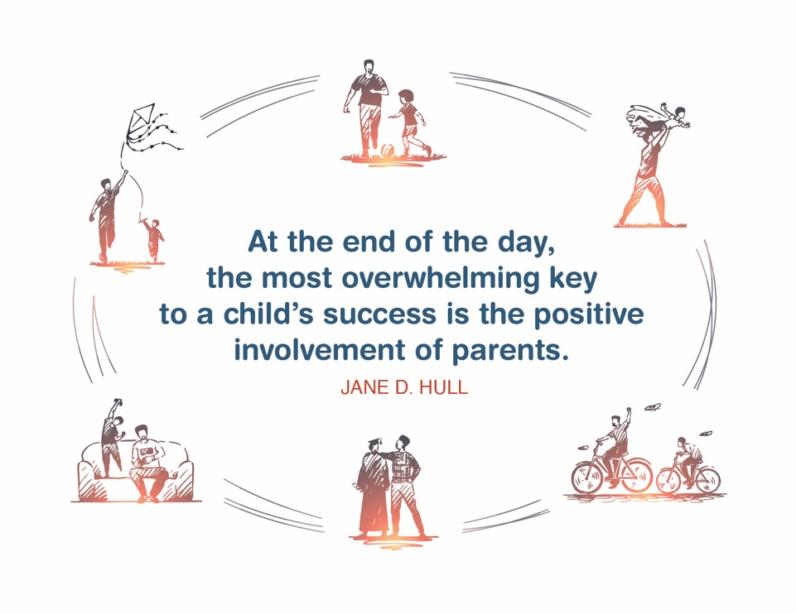
Place holder for slide with Closing Quote
Notes:
FACILITATOR'S NOTE
The closing quote above and the paraphrase section below will be done only once per day, after the last theme presented for the day. If you are moving on to another theme invite them to take a break, stretch, or breathe before moving on to the next theme.
If closing for the day:
Thank everyone for attending and for their thoughtful participation and attention. Remind the participants that although this training may seem long, it is critical for them to gather the knowledge, attitude, and skills that are needed as they embark on this journey because they ultimately will play a huge role in the lives of children and families.
If in person, collect the name tents or have them tuck them into their Participant Resource Manual to bring back to the next class.
PARAPHRASE
Close out the day by covering the below topics:
Remind participants of the date/time for the next class and let participants know if there are any changes to the location.
Encourage participants to contact you (or other facilitators) if they have any questions or concerns.
Review the themes that will be covered during the next class.
If in person, remind participants to take their Participant Resource Manual with them and to bring them to the next session. If using a remote platform, remind participants to have the Participant Resource Manual available for the next class.
28

Slide 29
For more information, visit:
Notes:
29

Slide 30
.
This curriculum was funded by the Children’s Bureau, Administration on Children, Youth, and Families, Administration for Children and Families, US Department of Health & Human Services, under grant #90CO1132. The contents of this curriculum are solely the responsibility of the authors and do not necessarily represent the official views of the Children’s Bureau.

