Slide 1
Parenting a child with a history of sexual Trauma
FACILITATOR CLASSROOM GUIDE
Modified January 2022
Notes:
PARENTNG A CHILD WITH A HISTORY OF SEXUAL TRAUMA
FACILITATOR CLASSROOM GUIDE
JANUARY 2022

Slide 2
preparation
See Notes view
Notes:
To prepare for this class, you should:
Review the facilitator preparation information included in this Guide along with the handouts.
Review the Resources for this theme found on CapLEARN (https://learn.childwelfare.gov/) or NTDC website (https://ntdcportal.org/).
Develop an agenda that includes this theme and any other themes you will be conducting along with it during the class.
Ensure that participants have a copy of the Participant Resource Manual. This Manual will be used during all themes and will include the handouts needed by participants. Facilitators should have copies of the handouts for the theme available in case participants do not bring their Manual to class. If the theme is being taught on a remote platform, facilitators should have the handouts available so that they can share in the chat and/or email to participants who do not have their Manual.
Bring any materials you need for the activities.
Review any videos or other electronic media used in this theme, if any, and plan the mechanics of how you will present them. Media for this theme are listed in the Materials and Handouts slide. Review the instructions for each media clip (e.g., to pause or stop at a particular time stamp). The videos can be played in different ways, including:
Play them from a flash drive or the computer’s hard drive using a media player app
Link to them from CapLEARN or the NTDC website.
Practice playing the media for the theme. Ensure that you have the files and apps you need, that your links and connections work, and that you know when to pause or stop the media clip if appropriate.
If training on a remote platform, make sure all participants have the link available to access the class and that you have all videos, PPT’s and handouts ready for use.
If training in person, ensure that a room is available and set up, with the following:
Enough tables and chairs for all participants
Projector and screen (check that it works with the computer you will be using)
Classroom activities have been adapted so that they can be done on a remote platform. Adaptations will be marked as follows so that they can be easily spotted throughout the Facilitator Classroom Guide: Adaptation for Remote Platform
PREPARATION

Slide 3
MATERIALS AND HANDOUTS
See Notes view
Notes:
FACILITATOR’S NOTE
Participants are expected to have the Participant Resource Manual available for every session.
MATERIALS NEEDED
You will need the following if conducting the session in the classroom:
A screen and projector (test before the session with the computer and cables you will use)
A flipchart or whiteboard and markers for several of the activities. A flipchart with a sticky backing on each sheet may be useful and will allow you to post completed flipchart sheets on the wall for reference.
Name tent cards (use the name tent cards made during the Introduction and Welcome theme)
You will need the following if conducting the session via a remote platform:
Access to a strong internet connection
A back-up plan in the event your internet and/or computer do not work
A computer that has the ability to connect to a remote platform- Zoom is recommended
HANDOUTS
Have the following handouts accessible. Participants will have all handouts listed below in their Participant Resource Manual.
Handout #1: Key Points: Right-Time Video on Sexual Trauma
Handout #2: Abuse Reports and False Allegations: How to Protect Yourself and Respond
Handout #3: House Rules for Sexual Safety
Handout #4: Interrupted Sexual Development
VIDEOS and PODCASTS
Before the day you facilitate this class, decide how you will show/play the media items, review any specific instructions for the theme, and do a test drive. You may wish to set up the media to the start point. Videos can be found on the NTDC website or CapLEARN. (https://learn.childwelfare.gov/) or NTDC website (https://ntdcportal.org/).
The following media will be used for this theme:
NTDC Right-Time Video on Sexual Trauma (17 minutes)
EVALUATION
There is a pre- and post-survey available for every theme. If the facilitator wants to use these evaluation tools, they will need to be downloaded from the NTDC website or CapLEARN and provided to participants. Participants will need to complete the pre-survey prior to the theme and the post-survey upon completion of the theme. If conducting the class on a remote platform, the facilitator will need to put the surveys into an online format such as survey monkey.
MATERIALS AND HANDOUTS

Slide 4
Theme and competencies
See Notes view
Theme: Parenting the Child Who Has Experienced Sexual Trauma
Competencies:
  Participants will be able to recognize indicators of sexual trauma
  Participants will be able to create an environment that is emotionally and physically safe for children who have experienced sexual abuse
  Participants will learn strategies to prevent further abuse
  Participants will learn how to promote healthy sexual development
Notes:
FACILITATOR'S NOTE
Before beginning, review the theme and competencies. You will not read these aloud to participants. Participants can access all competencies in their Participant Resource Manual.
THEME AND COMPETENCIES
4

Slide 5
Suggested agenda
Notes:
FACILITATOR'S NOTE
This notes page shows a suggested agenda and timing for this theme. Before the day of class, please review this agenda and incorporate it into your overall agenda for this and any other themes you are conducting along with it.
AGENDA
This theme is divided into seven sections. This content is based on 1.5 hours of classroom material.
BEFORE YOU BEGIN THE CLASS
Before discussing the Color Wheel of Emotions and covering the content of this theme, you should do the following:
Make any announcements that are needed regarding the training, timing of training, or process to become a foster or adoptive parent.
Take out the Participant Resource Manual and direct participants to this theme in their Manual. Remind participants that Competencies for today’s theme are in their Manual.
Review the agenda for the theme. Facilitators should add a slide to the PPT deck that includes the agenda so that they can review it with participants. Make sure to include start and end times and any breaks that will be taken during the session.
Encourage participants to be engaged and active learners.
Encourage participants to contact you in between classes with questions and/or concerns. (List the name(s) of the facilitators on the board with contact information.)
Remind participants to put out their name tents. If conducting class on a remote platform, remind participants to type their first and last names in their screen box.
SUGGESTED AGENDA

Slide 6
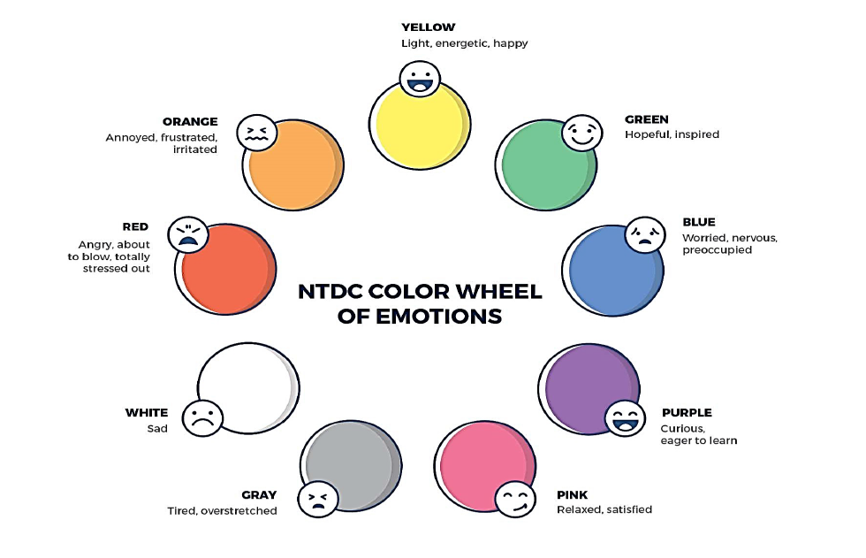
Welcome to the national training and Development Curriculum for foster and adoptive parents
Notes:
FACILITATOR'S NOTE
Have this slide showing onscreen as participants assemble for the first class of the day. As participants come in, welcome them back and ask them to take a few minutes to do a self-check using the Color Wheel. NOTE: The Color Wheel should only be done one time per day; before the first theme of the day. If combining several themes together on one day, facilitate the Color Wheel at the beginning of the first class of the day as participants are coming into the room.
SAY
Welcome back. We are so glad that you have taken time out of your day to join us for another exciting learning opportunity. As you recall, tuning in to how you’re doing on a daily basis may not be something everyone here is used to, but this type of regular self-check is critical for parents who are adopting or fostering children who may have experienced trauma, separation, or loss, as it will be helpful to become and stay aware of your own state of mind. It may seem like a simple exercise but be assured that knowing how we’re doing on any given day strengthens our ability to know when and how we need to get support and/or need a different balance. Doing this type of check in will also help us to teach and/or model this skill for children! Please take a moment to look at the color wheel and jot down on paper the color(s) that you are currently feeling.
DO
Wait a little while to give participants time to complete the Color Wheel.
SAY
Now that everybody has had the opportunity to do a quick check in, would someone like to share what color(s) they landed on today for the Color Wheel?
DO
Call on someone who volunteers to share their color(s). If a challenging emotion or feeling is shared, thank the person and acknowledge their courage in sharing, pause for a moment, encourage everyone to take a deep breath, and transition to beginning the theme.

Slide 7
Parenting a child with a history of sexual trauma
January 2022
Notes:
FACILITATOR'S NOTE
Show this slide briefly just before you start the class.
SAY
Let’s get started! Welcome to the Parenting a Child with Sexual Trauma theme.
7

Slide 8
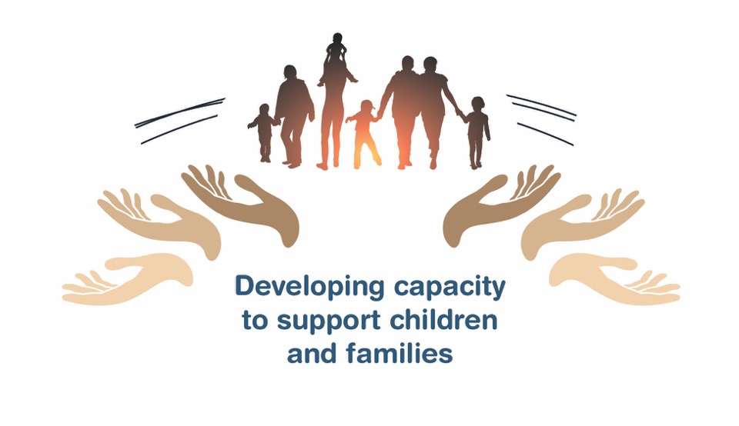
Place holder for slide with opening Quote
Notes:
FACILITATOR'S NOTE
The opening quote slide should be used only for the first theme of the day. If combining several themes together on one day, the opening quote slide would be shown only after the Color Wheel at the beginning of the first theme. It is important to always emphasize with this slide that this type of parenting involves lifelong learning and it will be critical for families to be invested in their own learning before and after a child is placed in their home.
PARAPHRASE
Now we are going to start the Parenting a Child with Sexual Trauma theme. As the slide states, this information will help to develop your capacity to support children and families. This type of parenting will require continuous learning. So, let’s dive in and see what important information we have to share with you today.
8

Slide 9
SECTION 1:
INTRODUCTION: PARENTING A CHILD WITH A HISTORY OF SEXUAL TRAUMA
Notes:
FACILITATOR’S NOTE
Allow 10 minutes for this section.
PARAPHRASE
Today we will be talking about some of the information and strategies that parents who foster or adopt need to effectively parent a child with a history of sexual trauma.
There are several reasons that those who want to foster or adopt need to build their understanding and skill in this area:
Children and teens who are in foster care and those who are available for adoption most often have experienced different types of trauma. For some, this includes sexual trauma.
Though caseworkers and other professionals try to give parents who foster and adopt an accurate view of the child’s history, including their trauma history, there is no guarantee that a child’s history of sexual trauma will be known.
Many children do not disclose sexual abuse for a number of reasons.
Children with a history of sexual trauma, like other children in need of fostering or adoptive homes, need to be in safe and caring homes that can help them heal from past traumas, including sexual trauma.

Slide 10

Concerns
Notes:
FACILITATOR’S NOTE
In this activity, you will acknowledge that many parents who foster or adopt have concerns related to parenting a child with a history of sexual abuse. You will ask members to identify some of the possible concerns.
DO
Facilitate a discussion on identifying some of the concerns that participants may have about parenting a child with a history of sexual trauma, and record some of the responses on a flipchart or white board.
Adaptation for Remote Platform:
Have participants write their responses into the chat or add a blank slide to the PPT and record answers as they share.
SAY
Let’s acknowledge what some of the possible concerns may be?
Reinforce some of the common worries, such as:
Afraid the child will sexually abuse other children
Worries about the child making a false allegation against them
Not knowing how to talk about uncomfortable behaviors or topics with the child
Not feeling like you know what the child needs so that they and others will be safe
Unsure about how to express affection with the child….are hugs bad?
PARAPHRASE
Nice job in acknowledging some of your concerns. By bringing our concerns out into the open, we can address them. One good way to do this is to educate ourselves on this topic. We will be addressing many of these concerns throughout this theme.

Slide 11
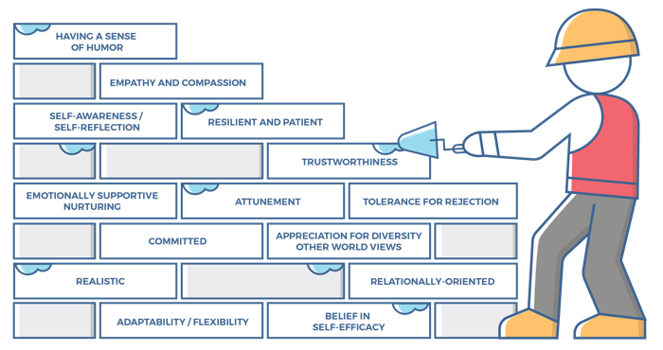
Characteristics of successful foster and adoptive parents
11
Notes:
FACILITATOR'S NOTE
This slide is shown at the start of each theme. Although the graphic will remain the same, the bricks that are colored in red will change based on the characteristics that will be touched upon in this theme. The characteristics were obtained from review of literature, stakeholder interviews, and review of existing curricula. We want families to become very acquainted with these characteristics throughout the training. It is important to note that in addition to the characteristics that are highlighted in red, there may be additional characteristics that are touched upon during the theme. Facilitators should try to connect these characteristics to the information they are sharing throughout the training. Remind participants that their Participant Resource Manual contains the definitions for these characteristics.
SAY
Let’s look at the 14 characteristics of successful foster and adoptive parents. When you took your self-assessment, you were asked about these characteristics.

Slide 12
Characteristics for Parenting a child with sexual trauma
Self-awareness/Self-reflection:
Parents can identify why they have responded to a child in a certain way.
Parents can identify what was good, bad, and different about the way they were raised, while adjusting their own parenting to meet a child’s needs.
Parents can identify and forgive themselves for having negative feelings towards a child, moving from disappointment to acceptance.
Parents are aware of their own history of experiencing loss and being hurt and can identify how this history can negatively impact their parenting if not careful.
Empathy and Compassion:
Parents can perceive/feel others’ emotions, particularly others disappointment or sadness.
Parents can look past the current behavior and find the core distress related to the child’s response.
Parents know they cannot shield the child from pain but must allow the child to experience and express pain and grief.
Notes:
SAY
The Parenting a Child with Sexual Trauma theme will cover the following characteristics:
Self-awareness/Self-reflection
Empathy and Compassion
Attunement
Take a moment to think back how you assessed yourself with these characteristics. It is important as you start this journey to assess your characteristics as they are qualities that can strengthen your ability to successfully parent a child who is in foster care or has been adopted, and who has experienced sexual trauma.

Slide 13
Characteristics for Parenting a child with sexual trauma
Attunement:
Parents are aware of, understand, and are sensitive to the specific responses and needs of a child at any given time (despite the degree to which the child expresses or does not express these needs directly).
Parents are in tune with the child’s moods, levels of exhaustion, hunger, rhythms, responses, need for physical contact, affection, security, and stimulation, and use this understanding to build a trusting environment with the child.
Parents understand that they need to stay calm and regulated so that they can successfully help the child regulate their emotions.
Notes:
ASK
Now that we have reviewed the definitions, why do you think these specific characteristics are important to a child’s development?
Reinforce the following:
Self-awareness/Self-reflection:
Talking about and handling issues around sexuality in general can be difficult in our society. Being able to talk about this topic will be essential to helping a child develop a healthy sexual identity.
It’s not unusual for the topic of sexual abuse of children to evoke strong feeling reactions. Without self-reflection it will be difficult to avoid letting our strong feelings come out in ways that might increase a child’s worry and self-blame as children often blame themselves for the abuse.
Empathy and Compassion:
It is important to know that the child will need to work through their feelings of loss, grief, and pain related to their trauma, and the parent will need to offer support without trying to shield the child from this work.
Parents are aware that the child’s current behaviors have an underlying reason that may be connected to the child’s past trauma. The parent can be empathic and compassionate as part of helping a child heal.
Attunement:
Children who have experienced trauma, including sexual trauma, are often quick to become dysregulated and they need caring adults who can stay calm so that they can help the child calm.
Because of past experiences, it will take time for the child to trust the parent who is fostering or adopting.
Keeping all children in the home safe by setting good boundaries and family rules will require parents to be attuned to the responses and needs of all children in the home

Slide 14
SECTION 2:
EFFECTIVELY PARENTING A CHILD WHO HAS EXPERIENCED SEXUAL TRAUMA
Notes:
FACILITATOR’S NOTE
Allocate 25 minutes for this section that will include a 17-minute Right-Time Video.
PARAPHRASE
Now we will watch a video created for the NTDC that highlights some of the real experts in the field: Parents and professionals who have built their understanding and skills in ways that have allowed them to successfully work with and parent children who have a history of sexual trauma.

Slide 15

Video: Sexual Trauma
Notes:
FACILITATOR’S NOTE
In this section, you will show the right-time video, Sexual Trauma (17 minutes) and then ask participants to respond by sharing some of the points that stuck out for them. After getting several responses, you will move to the definition of sexual abuse on the next slide.
PARAPHRASE
This video addresses several areas that parents who foster or adopt need to know to increase their understanding of what is needed to successfully parent children with a history of sexual trauma. After the video, be prepared to share something that stood out for you as you watched.
DO
Show the video which can be found on the NTDC website or CapLEARN. After showing the video enter into a large group discussion.
ASK
What stood out to you about the information covered in the video?

Slide 16
Definition of sexual abuse
"Child sexual abuse is any interaction between a child and an adult (or another child) in which the child is used for the sexual stimulation of the perpetrator or an observer. Sexual abuse can include both touching and non-touching behaviors. Non-touching behaviors can include voyeurism (trying to look at a child’s naked body), exhibitionism, or exposing the child to pornography.“ - The National Child Traumatic Stress Network (NCTSN)
Notes:
FACILITATOR’S NOTES
Go over the definition of sexual abuse which was also used in the video.
PARAPHRASE
There are many types of sexual abuse, some include physical contact or touching offenses. and some are considered to be a no-contact offence. Can you identify some activities that you think would fall under sexual abuse non-contact as well as sexual abuse contact.
DO
Write on a flip chart ‘Sexual abuse no-contact’ and ‘Sexual abuse contact’. Ask participants to give you examples that they think fall into each type of sexual abuse and write on the flip chart. Some examples that you might want to bring up are listed below.
Adaptation for Remote Platform: Use the white board or Jamboard to record examples.
Sexual Abuse: Non-Contact
Forced to watch sexual acts
Forced to listen to sexual talk, including comments, tapes, and obscene phone calls
Sexually explicit material such as videos, DVDs, magazines, photographs, etc.; can be in-person, on the computer via e-mails, and otherwise through the Internet
Forced to look at sexual parts of the body--includes buttocks, anus, genital area (vulva, vagina, penis, scrotum), breasts, and mouth
Sexually intrusive questions or comments; can be verbal, on the computer, or in notes
Sexual Abuse: Contact
Touched and/or fondled in sexual areas, including kissing
Forced to touch another person's sexual areas (could be another child or adult)
Forced oral sex--oral sex is when the mouth comes in contact with the penis, the vagina or the anus; many children believe that oral sex is "talking dirty"
Forced intercourse--can be vaginally, anally or orally; penetration must occur; penetration can be with body parts and/or objects
PARAPHRASE
As you can see there are many activities that can constitute sexual abuse. It is important to note that child sexual abuse is much more than just about contact or lack thereof. This behavior is used to gain power and control over the child and often involves a betrayal of the child's trust. The power and control dynamic of child sexual abuse is important to understand. It is considered sexual “abuse” primarily because of the power differential between the abuser and the victim, usually the abuser exerts some sort of power over the victim to obtain what appears to be compliance. In other words, the offender controls the child victim, and the sexual encounter is not mutually conceived.
The violation of the trust is as devastating as the physical breach, leaving children with feelings of confusion, uncertainty, guilt, shame and fear.

Slide 17
Key Points from video
Risk factors and indicators of sexual abuse
Creating an emotionally safe environment
Strategies to prevent further abuse
Promoting healthy sexual development
Notes:
PARAPHRASE
The video addressed 4 areas that can help us effectively parent a child who has experienced sexual trauma.
Identify risk factors: Knowing the risk factors and indicators of sexual abuse helps parents prepare to address behaviors that might indicate a history of sexual abuse. When the risk factors are a part of the child’s known history, parents can adjust their parenting to accommodate this history. But often when a child enters the child welfare system, their history of sexual abuse is unknown. As a parent who is fostering or adopting, you may be the first person the child discloses to, either with their words or their behaviors, so it is important that you recognize indicators of abuse.
Create an emotionally safe environment: Learning how to create an emotionally safe environment is important for all children and will help parents prepare for any child entering their home. This is especially important for a child with a sexual trauma history.
Strategies: Practicing strategies to prevent further abuse will help the child to feel safe and build trust.
Promote healthy sexual development: Allow children to learn appropriate behavior and establish personal boundaries to protect their own bodies from further abuse and trauma and promote healthy sexual development.
In the next section, we will continue to explore some of the key points from the video. Handout #1: Key Points: Right-Time Video on Sexual Abuse has been included for you to use as a resource to review at home.

Slide 18
SECTION 3:
RISK FACTORS AND INDICATORS OF SEXUAL ABUSE
Notes:
FACILTATOR’S NOTE
Allow 10 minutes for this section.
PARAPHRASE
We will now review some of the risk factors and indicators of sexual abuse that will be important for you to know.

Slide 19
Risk Factors for sexual Trauma
Neglect
Parental substance abuse
Parental mental illness
Chaotic households
Inconsistent living arrangements
Unrelated household members with caregiving responsibility
Any child can be at risk for sexual trauma.
Notes:
PARAPHRASE
We know some of the risk factors that are associated with a child experiencing sexual trauma:
Neglect
Parental substance abuse
Parental mental illness
Chaotic households
Inconsistent living arrangements
Unrelated household members with caregiving responsibility
Keeping our perspective is important- most people do not engage in sexually abusive behaviors. However, it is important that we all remember that any child from any background can be at risk for sexual trauma. Not recognizing this can lead to increased risk as too often, we focus exclusively on “stranger danger”, while not paying attention to what we know about sexual abuse:
Most children are abused by someone they know and often trust.
This could be a parent or caretaker, but it can also be someone the family knows and trusts (teachers, extended family member, scout leaders, clergy, neighbor).
Abuse can occur in any situation when the child is alone with someone, who by virtue of authority or age is in a position of power or control over them.
There is an increased risk of re-abuse for children previously sexually abused.

Slide 20
Indicators of Sexual Trauma
Sexualized behaviors and play
Imitating sex acts with toys, peers, or siblings
Sexual knowledge not appropriate for age
Excessive masturbation
Sexually reactive behavior
Overly physically affectionate; lacking physical boundaries
Nightmares or night terrors are common
Regressive behavior particularly in the area of toileting
Notes:
PARAPHRASE
The behaviors listed on the slide can be indicators of sexual trauma. When a child’s history includes information about sexual abuse, parents should be alert to behaviors such as these. If there is no known history of sexual abuse and these behaviors are present, it could be an indication of sexual trauma in the child’s history, and the child should be assessed by a professional who has experience working with children with a history of sexual trauma. It is important to remember that sexual trauma is often not known when children come into the child welfare system. It may be long after they enter that a history of sexual abuse is discovered, in addition to other abuse and/or neglect that brought them into care. As a result, it is best to create an environment that helps to ensure everyone’s safety. It is also important to remember that a child who is exhibiting one of these behaviors does not mean that they have definitely experienced sexual trauma.
ASK
How would you feel about caring for a child who exhibited some of these behaviors?
Which of these behaviors do you think would be most difficult for you to manage?
Did you hear anything from the video that may be helpful to you in managing these types of behaviors?
Reinforce messages from video-
In the words of Deb Schugg, “it isn’t as scary as it sounds. It’s very doable to parent kids and help them heal and help them thrive despite a really difficult history.”
There are strategies that can be used to increase safety for all family members, and we will be discussing many of strategies today.

Slide 21
Indicators of sexual trauma: older youth
Unhealthy eating patterns or unusual weight gain or weight loss
Anxiety or depression
Changes in self-care or paying less attention to hygiene
Self-harming behaviors or suicidal thoughts
Alcohol or drug use
Running away
Sexual transmitted illnesses or pregnancy
High-risk sexual behavior
Tendency to be involved in unhealthy relationships that involve physical, sexual or emotional abuse
Notes:
FACILITATOR’S NOTE
In addition to the behaviors on the previous slide, this slide shows behaviors that may be seen in teens who have experienced sexual trauma. Make sure participants understand that a teen exhibiting some of these behaviors does not mean that they have definitely experienced sexual trauma.
PARAPHRASE
Indicators of sexual trauma may look different in older youth, as listed on this slide. Some of these indicators might be present alongside those behaviors that were on the previous slide. While some of these behaviors might be indicators of something other than sexual trauma, it is wise to pay attention to these behaviors. Talk to the case manager about any behaviors if they are present so that you can work together to develop a safety plan to support the youth.

Slide 22
Risk of Re-victimization and Trafficking
Risk Factors include:
Child Welfare System involved
History of abuse
LGBTQ+ youth
Substance abuse
Mental Health Issues
Poverty/Homelessness
Important: Social media is often a tool used by those who engage in exploiting children.
Notes:
PARAPHRASE
It is important to note that older youth in foster care are especially vulnerable to sexual exploitation or trafficking. Running away, unexplained absences, presence of a sexually-transmitted disease or pregnancy, high-risk sexual behavior, and suddenly having more money may be indicators that a youth is being sexually exploited or trafficked.
Most sexually exploited children are girls, but boys also are vulnerable to exploitation. According to research, youth with a history that involves any of the following increases the risk of sexual exploitation:
Involvement in the child welfare system
History of abuse
Identifies as LGBTQ+
Substance use/abuse
Mental health issues
Experienced poverty and homelessness
Social media is often used by those who would exploit children to slowly draw them into unsafe and exploitive situations unwittingly. While it is difficult to monitor all social media activity since it is often conducted on cell phones, it is useful to have computers in more public areas of the home where youth are less likely to use them for contact with exploiters, and they can be monitored. If you suspect that a child or teen is involved in sexual trafficking, it will be essential that the child or teen and you be connected with professionals who have experience in helping victims of trafficking.
FACILITATOR’S NOTE
This theme does not cover what is needed to parent a child or teen with a history of being sexually trafficked. If parents ask questions, let them know that keeping a child with a history of being trafficked safe, will need to involve a professional who has experience in working with these youth.

Slide 23
SECTION 4:
CREATING AN EMOTIONALLY SAFE ENVIRONMENT
Notes:
FACILITATOR’S NOTE
Allow 20 minutes for this section.
PARAPHRASE
Creating an emotionally safe environment is key to giving the child the safe space to disclose abuse and/or heal from it. An emotionally safe environment is accepting of the child’s experiences, feelings, vulnerabilities, fears, and open to understanding the underlying causes of behavior.

Slide 24
Responding to the child
If the child is showing signs of sexual abuse or discloses that they have been sexually abused:
Be calm, curious, regulated, and open
Listen
Believe the child
When a child discloses, don't probe for details
Reinforce that sexual abuse is never the child's fault
Advocate for sexual abuse treatment for the child
Notes:
PARAPHRASE
If the child is showing signs of sexual abuse or discloses to you that sexual abuse has occurred, it is important that you follow these steps:
Be calm, curious and open
Take time to listen and support the child
Believe the child- even if the story does not seem real or the facts don’t add up. Your role is to listen and believe. You don’t have to be the person to verify the abuse.
Don’t probe for details- don’t ask a ton of questions. The most important thing you can do is to listen.
Reinforce that sexual abuse is never the child’s fault- children often feel blame for the sexual abuse and will carry that with them for years. It is imperative that the child never feel blamed for any type of sexual trauma they experienced.
If the child is in foster care, remember that it is essential, that the case manager be notified so that they can guide you through the steps/processes that need to be legally followed.
The foster/adoptive parent should remain positive and consistently assure the child that is not their fault. The foster/adoptive should create a ‘safe’ environment for the child to heal where they feel supported and comfortable talking about their previous abuse.

Slide 25

Secrets and disclosure
Notes:
FACILITATOR’S NOTE
Disclosure can be done in many different ways. It is crucial that parents who are fostering or adopting be prepared to handle the situation if and when a child discloses.
PARAPHRASE
The question often arises as to why children don’t disclose this type of abuse more frequently and when it is taking place. There are many reasons for this:
Abusers have trained their victims not to tell anybody about their ‘secret’. Often, the abuser will threaten to harm them or their family members if they tell.
The abuser convinces the child that it is their fault.
The child may have already disclosed to somebody, but they received such a negative or non-action response that they determined it was not worth disclosing again. They may fear that no one will believe them.
Children often feel shame about the abuse and are reluctant to disclose.
Children may be afraid of getting in trouble or being blamed for the abuse.
Children often will not disclose sexual abuse until they are in a place that they feel safe. This could be a long time after the incident occurred. It is not unusual for a child to disclose this information initially to the parent who is fostering or adopting them as they develop a trusting relationship with this person.
Disclosure is not always done verbally. It can be done in different manners including:
Child acts out something through play that they have seen or experienced.
Child draws a picture and is able to talk about the events.
Child is triggered and shows distress about an abusive situation on TV, in a book, or in a movie, creating an opportunity to have a discussion and disclosure.
FACILITATOR’S NOTES
Add in your agency/state’s policies and laws about what a parent who is fostering or adopting must do when a child discloses that they have been sexually abused.

Slide 26
Reducing the risks of False Allegations
False allegations occur due to:
Child’s blurring of events and perpetrators
Misunderstanding a child’s statement
Birth family reports out of anger or jealousy
Child reports due to past trauma, fear or desire to change placement
Steps to protect yourself:
Be honest about what behaviors you can manage
Get child’s history, ask questions, document events
Review NTDC handout “House Rules for Sexual Safety”
How to respond to an allegation:
Understand all reports must be investigated
Know agency procedures on investigations
Be calm, respectful, and factual
Do not question the child about the allegation
Notes:
FACILITATOR’S NOTE
Review the information below and remind participants to review Handout #2: Abuse Reports and False Allegations: How to Protect Yourself and Respond at home.
PARAPHRASE
In the beginning of our class, we talked about some of our concerns related to parenting a child with a history of sexual abuse, and one concern was false allegations. Of course, one of the more challenging experiences that you may have as a foster or adoptive parent is being accused of abuse or neglect. Ask participants how they would feel if accused of abuse? Reinforce that the reaction of most parents range from shock, hurt, betrayal, to anger. These are common and understandable feelings. It’s important to understand why false allegations occur.
Here are some reasons:
A child’s abuse history will be largely unknown to most people the child comes into contact with, including teachers, clinicians, and friends. A child’s comment may be misunderstood to be referring to the present rather than to past abuse.
Birth parent(s) may be angry or jealous of a foster parent or may observe an unexplained mark or bruise during a visit. Or a child makes an allegation believing this will prompt a return to their family or out of anger towards the foster family.
While there is no guaranteed way to prevent allegations from occurring, there are strategies that can protect you. Let’s talk about some of those:
Know your limits. Before taking a child into your family, ask questions about their history. That includes known abuse, prior placement history and physical, emotional and behavioral concerns. If you are uncertain about your capacity to parent them, take some time to think about it.
Carefully supervise a child during the early weeks of placement and review family rules about privacy and touching. Reinforce those rules with all the children in your home.
Start a notebook or journal for each child. Record all illnesses and injuries, and any behavioral, physical, or emotional concerns you observe. Document, conversations with caseworkers, therapists, teachers, and medical personnel. Include the date, time, and substance of the communication.
Sexual abuse is not always known. Know the signs a child has abused and report it to the caseworker.
Never use or threaten to use physical punishment.
All allegations of abuse and neglect are taken seriously and have to be investigated, as this is necessary to protect children. Though most of those allegations are found to be unfounded, there are cases of foster and adoptive parents abusing their children. It may be hard to put your feelings aside. You may fear your ability to foster or adopt will be jeopardized, or worse that children will be removed from your home. The investigator’s job is to gather all the information and make a determination about whether the abuse occurred. Answer questions calmly, respectfully, and factually. Contact your local Foster and Adoptive Parent Association. There are very likely other parents that have had this experience and can be a support to you.
This is where keeping a journal for each child comes in handy. Share any notes you have about the child’s injuries, physical or behavioral concerns, combative visitations or threats, that may provide insight into what caused the allegation to be made. If the allegation is similar to an incident in the child’s history, share that with the investigator. They may be unaware of the child’s history initially.
Don’t question the child about the allegation. This may upset the child and could complicate the investigation.

Slide 27
Parenting Children with Sexual Trauma History:
Creating Family Rules to Ensure Safety
Notes:
FACILITATOR’S NOTE
In this activity, you will ask each participant to think about welcoming a child with a known history of sexual trauma into their home. Ask each participant to create 5 family rules that would be used to ensure everyone’s safety in the home.
Encourage participants to write out their list of 5 rules.
Facilitate as needed by giving advice and answering questions.
PARAPHRASE
Now, let’s talk about parenting a child who has experienced sexual trauma. Let’s imagine you have chosen to foster or adopt a child with a known history of sexual trauma. As you prepare to welcome the child into your home, what are the first 5 family rules that you will create to help ensure safety. Please write the rules down. You will have 5 minutes to create your list and then we will discuss.
DO
Give participants 5 minutes to create their lists.
When time is up, ask a volunteer to share one of the rules from their list. Go around the class until everyone has shared 1 rule, especially any that have not yet been given.
SAY
Did everyone hear some good suggestions for family rules to keep everyone safe.
Creating and following good family rules will help to ensure the safety of family members and can help a child grow and heal.
There is a handout in your Participant Resource Manual with additional tips called Handout #3: House Rules for Sexual Safety. Looking at this handout at home. It will give you some additional things to think about as you create your list. Remember that these rules should apply whenever a child comes into your home.

Slide 28
SECTION 5:
STRATEGIES TO PREVENT FURTHER ABUSE
Notes:
FACILITATOR’S NOTE
Allow 15 minutes for this section.
PARAPHRASE
Children who have experienced sexual trauma are at increased risk for re-victimization. Let’s discuss strategies to prevent further abuse.

Slide 29
STRATEGIES TO PREVENT FURTHER ABUSE
Strong parent/child relationship
Ongoing conversation
Education about consent
Vigilance about bedrooms, bathrooms, and touch
Explicit reassurance about safety
Safe sensory experiences
Structure and House Rules that apply to everyone
Notes:
PARAPHRASE
Establishing a strong, trusting parent/child relationship is the foundation for creating an environment which will allow for prevention of further abuse. Supporting the child or youth requires your comfort in having open, non-judgmental conversations about their experiences, and how they establish boundaries regarding their body and privacy. Parents must be open to the child’s perspective of what has happened to them, and able to validate the child’s experience and feelings. It is critical to reinforce that what happened was not the child’s fault. As Debbie Schugg said in the video, ‘the parent’s first responsibility is keeping the child safe’. The message must be, “There is nothing you can do to make me love you less.”
Structure and house rules that foster safe interaction among children and adults is important to teach about positive physical boundaries, good touch, and acceptable measures of privacy. The example of individual sleeping bags for movie watching is a creative way of ensuring safety and togetherness. Asking permission to touch or hug respects boundaries and reinforces the idea that everyone has the right to protect their body.
Remember that children may have experienced abuse in different environments. Common areas of abuse include bathrooms or at nighttime in bedrooms. Be aware of the child’s body language in different environments so you can address signs that the child is anticipating unsafe situations. Reinforcing that bad things will not happen in your home needs to be repeated. Explicit house rules about privacy that apply to everyone is important. Everyone in the household should knock and ask permission before entering a closed door to a bedroom or bathroom. Making sure that children are supervised, and that bedrooms are not shared with a child who is exhibiting sexualized behaviors can help maintain a safe environment and avoid incidents.
Find creative ways for children to interact in play while being supervised by an adult so that they can have fun, appropriate interaction, and learn about appropriate touch. Games that involve no touching or brief touching on the shoulder or arm, like Tag, are fine. Activities that involve wrestling, tackling, tickling or more than brief contact should be avoided.

Slide 30
Case Study: Matthew- age 6
Matthew was exposed to sexual material since he was an infant. Adults in his family regularly had sex in front of him and/or watched pornographic videos. Matthew was removed from his parents at the age of 5.
One time, the parent who was fostering walked into the room and found Matthew totally naked and telling another child in the home who was about his age to touch his penis. When asked about this incident Matthew did not seem to understand the concern and stated that he was showing her what he had seen in a video.
Notes:
PARAPHRASE
Now, let’s spend some time putting some of the things we have been talking about together with a case study.
DO
Read the case study on the slide or ask for a volunteer to read it.
PARAPHRASE
In this case, we see a child who is engaging in sexually reactive behavior. The child is imitating what he has seen or what has been done to him.
Distinguishing Characteristics of Sexually Reactive Behavior can include:
Child has usually been sexually abused or been exposed to a sexually stimulating experience.
Child may feel deep shame, guilt and pervasive anxiety regarding sexuality
Behavior is not aggressive or hostile, not meant to demean another child.
Child does not seek out other children to coerce or victimize and does not threaten other children. Instead, child uses influence and persuasion.
Child may not even be aware that the behavior is inappropriate.
Let’s think more about how a parent could respond.
ASK
1. How should the parent who is fostering respond when walking into the room?
Reinforce answers like:
Stay calm, clearly remind children about house rules about privacy and touching.
2. What steps should the parent who is fostering take after handling the immediate situation?
Reinforce answers like:
Follow up individually with each child letting them know that you care about them and have rules that keep everyone safe.
Allow each child to share any feelings, concerns about what happened.
Review and reinforce the house rules with all family members.
3. What precautions could the parent who is fostering take to prevent this type of incident from happening again?
Adding additional supervision.
Ensuring the children are not in the same room without adult supervision.
Reviewing the rules about boundaries and privacy and encouraging children to come to you if they are in an uncomfortable situation.
Letting the caseworker know about the incident and finding out what services and supports can be put into the home.
Seeking services for Matthew or letting therapist know about the incident if he is in treatment.
4. Ask participants to think about their house rules. Do they have rules that address this type of potential behavior? Are there any rules they would want to add?
A child showing these signs is likely to need the help of a mental health professional. Foster/adoptive parent should discuss these behaviors with a professional to determine the best course of action.

Slide 31
WHAT ARE atypical SEXUAL BEHAVIORS?
Involve children of different ages or sizes
Is usually “secretive”
Has an aggressive or forceful quality
Can include compulsive, self-stimulating behavior
Notes:
PARAPHRASE
While it is not always easy to talk about, sexual activity in children, it is another area that’s important for parents who are fostering or adopting to understand. We know that it is typical for children to explore their sexuality. Developmentally typical sexual behaviors in young children include looking at genitals, touching, and masturbation. This type of sexual play typically occurs between children who are friends of similar age, size, and social and emotional development. This kind of play is generally mutual and rooted in curiosity.
Sexual behaviors that are not typical involve children of different ages, sizes, and social and emotional developmental levels. These behaviors can have an aggressive quality, sometimes with the use of threats, or force that may be social or physical, a pattern of inappropriate sexual acts, and secrecy. Problematic behaviors can include compulsive, self-stimulating activity or engaging in widespread sexual interaction with other children. These types of behaviors will require intervention with a mental health professional who specializes in treating children with a history of sexual trauma.
We often won’t know if a child has been exposed to inappropriate sexual material such as watching porn, or observing adults having sex, or if they have been sexually abused, before coming into your home. It is important to know that most children who have a history of sexual trauma, do not engage in these more serious concerning behaviors, but children who have had these experiences may be at a higher risk for having sexual behaviors that are not typical. It does not mean that they will grow up and become sexual offenders, but instead it means that they will need structure that protects them and others in the home. It also means they need to have services put in place to help them manage these behaviors.
Earlier we have watched the video from the NTDC Right-Time theme on Sexual Trauma. We encourage you to go through the additional information in the Right-Time theme before children are placed in your home so that you are prepared for what to look out for in regard to sexualized behaviors and how to handle them. For now, know that when a child has sexualized behavior toward others, it does not mean the child is a perpetrator, but rather the child is re-enacting what they have previously experienced or been exposed to. For many, re-enactment is an attempt to make sense of exposure to sexual experiences and in fact, can put them at high risk of further abuse from others.

Slide 32
Managing Sexualized Behaviors
Seek professional help.
Provide safety and supervision in your home.
SPECIFIC TYPES OF SUPERVISION
Not leaving the child alone with other children Not sharing bathroom time with other children Not closing bedroom doors Not sharing bedrooms Not allowing children to stay up after parents go to bed | No sleepovers without adult supervision during sleep time Open conversations about personal space and your personal body Alarms on bedroom doors to ensure children are staying in their rooms at night Talking to other children in the home about sexual safety
Notes:
PARAPHRASE
As soon as you become aware of sexual behaviors that seem atypical to you, talk to your caseworker and/or mental health professional. It is very important to not shame or blame the child for these behaviors. You may also need to get professionals to help the child process these emotions and to help you set up a home that is safe for the child. Safety and supervision are the first priorities for parents who are fostering or adopting.
If you find yourself in this situation, some specific types of supervision to protect the child are similar to types of rules around structure and supervision that we have been talking about, but additional layers of structure will need to be added to protect everyone. These include:
Not leaving the child alone with other children
Not sharing bathroom time with other children
Not closing bedroom doors
Not sharing beds or bedrooms
No sleepovers without adult supervision during sleep time
Open conversations about personal space and your personal body
Alarms on bedroom doors so you can ensure children are staying in their rooms at night
Don’t allow children to stay up after parents go to bed.
.

Slide 33
SECTION 6:
PROMOTING HEALTHY SEXUAL DEVELOPMENT
Notes:
FACILITATOR’S NOTE
Allow 5 minutes for this section.
PARAPHRASE
Sexual Development, just like other domain’s of human development, is an important part of the developing child, adolescent and adult. It is especially important for children with a history of sexual trauma that we be aware of the messages that we give about sexuality.

Slide 34

Promoting Healthy Sexual Development
Notes:
PARAPHRASE
Healthy sexual development is a normal part of growing up. Parents who are fostering or adopting need to know what healthy sexual development looks like so that they can identify when something may be of concern while also supporting children in their healthy sexual development.
Let’s do a quick review of Handout #4: Interrupted Sexual Development. This handout provides useful information on typical healthy sexual development at different ages, the possible effects and indicators of sexual trauma at these ages, and appropriate parental responses that promote healing for a child whose sexual development has been interrupted by trauma.
Right now, we will review one age group, 7-12 years.
DO
Review the content in Handout #4, reviewing the content from left to right in the row titled 7-12 years. After you have reviewed this age group, continue on to next Paraphrase.
PARAPHRASE
Handout #4 can be a useful resource in the future as it helps us understand healthy sexual development at different ages and what can happen to a child when there is a history of sexual trauma that has interrupted this area of development. The handout also reminds us that when parenting a child with a history of sexual trauma, parents have a big role to play in the child’s healing and getting them back on their track of healthy sexual development by using appropriate parental responses as well as the other safety measures we have been covering.

Slide 35

Conversations about sexuality
Sexual Identity
Boundaries and consent
Vulnerability to exploitation
Candid conversations
Permission to say no
Notes:
PARAPHRASE
Going back to the importance of a trusting parent/child relationship, conversations about sexual identity, boundaries regarding our bodies, and consent are appropriate at any age, and will need to be geared to the developmental age of the child. Laying the foundation with younger children is important to the healthy development of sexual identity as the child grows older. Having these conversations with teens who have had sexual trauma and may never have had guidance in this area, can be challenging. However, it is even more important as they embark on dating, and become vulnerable to exploitation as they move out into the world. Teens, especially those who have experienced abuse, need to be given permission to say “no” to any interaction that makes them feel uncomfortable.
Candid conversations about sexuality, their growing and maturing body, attraction to others, dating, and once again, boundaries, consent and protection of their body, are key to healthy self-identity and prevention of abuse. The video we watched earlier today suggested using books to read about growing, changing bodies and using real words for real body parts. Helping youth by role playing situations they may encounter can give them the language they need and practice to protect themselves from abuse or exploitation. We also want to give children and teens appropriate positive messages about their sexual identity and sexual development, countering negative messages that they may have been given to the child or teen so that they can achieve their potential and fully develop into the person they are and feel positively about it.

Slide 36

Reflection/ Relevance
1) Think about your childhood and how you were given messages about boundaries, protection of your body, and privacy. What were those messages?
2) Were they explicit messages or were they more subtle and delivered by example?
3) Is there anything about those messages that you would change for a child coming into your home?
Notes:
FACILITATOR’S NOTE
If time permits, have participants complete this activity in class, allowing 5 minutes. If time is short, explain the activity and ask them to complete it at home.
PARAPHRASE
For this reflection exercise, you’ll go to your Participant Resource Manual.
You will answer the questions on the slide.
36

Slide 37
SECTION 7:
WRAP-UP
Notes:
FACILITATOR’S NOTE
Allow 5 minutes for this section.
PARAPHRASE
It’s time to wrap up. Before we do, I want to briefly highlight some key points from this theme:
It’s not unusual for the topic of sexual trauma of children to be uncomfortable to think about or talk about.
Because a child can have a history of sexual trauma without it being known by the child welfare system or adoption agency, it is important that all parents who foster or adopt learn about effectively parenting a child with a history of sexual trauma.
There are strategies that parents can learn to help ensure sexual safety in the home.
Most children who have a history of sexual trauma do not engage in acting out this trauma with others.
By learning more about how to effectively parent a child with a history of sexual trauma, parents can create a safe and healing environment for the child.

Slide 38

LIFELONG Learning
Notes:
SAY
It is critical that as you go through this journey, you continue to enhance your knowledge and skills. It is important that you continue your own learning by taking advantage of resources that are available to you. This theme has numerous resources that will help you continue to learn more about this topic, including an excellent article in the Resource Section titled, Parenting Children or Youth Who Are Sexually Reactive.
You can also find additional learning resources on this topic in the Right-Time Themes under the Sexual Trauma Right-Time.

Slide 39
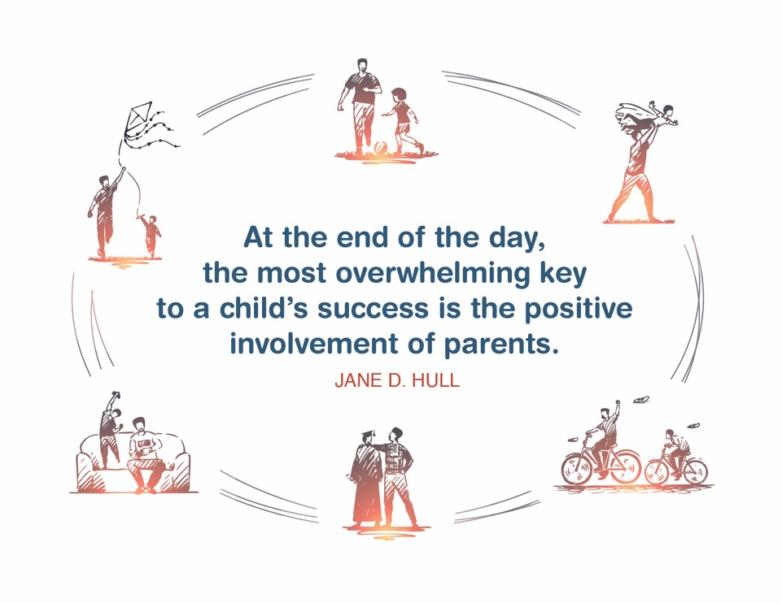
Place holder for slide with Closing Quote
Notes:
FACILITATOR'S NOTE
The closing quote above and the paraphrase section below will be done only once per day, after the last theme presented for the day. If you are moving on to another theme invite them to take a break, stretch, or breathe before moving on to the next theme.
If closing for the day:
Thank everyone for attending and for their thoughtful participation and attention. Remind the participants that although this training may seem long, it is critical for them to gather the knowledge, attitude, and skills that are needed as they embark on this journey because they ultimately will play a huge role in the lives of children and families.
If in person, collect the name tents or have them tuck them into their Participant Resource Manual to bring back to the next class.
PARAPHRASE
Close out the day by covering the below topics:
Remind participants of the date/time for the next class and let participants know if there are any changes to the location.
Encourage participants to contact you (or other facilitators) if they have any questions or concerns.
Review the themes that will be covered during the next class.
If in person, remind participants to take their Participant Resource Manual with them and to bring them to the next session. If using a remote platform, remind participants to have the Participant Resource Manual available for the next class.
39

Slide 40
For more information, visit:
Notes:
40

Slide 41
This curriculum was funded by the Children’s Bureau, Administration on Children, Youth, and Families, Administration for Children and Families, US Department of Health & Human Services, under grant #90CO1132. The contents of this curriculum are solely the responsibility of the authors and do not necessarily represent the official views of the Children’s Bureau.

