Slide 1
PARENTING IN RACIALLY AND CULTURALLY DIVERSE FAMILIES
FACILITATOR CLASSROOM GUIDE
Modified January 2022
Notes:
PARENTING IN RACIALLY AND CULTURALLY DIVERSE FAMILIES
FACILITATOR CLASSROOM GUIDE
Modified January 2022

Slide 2
To prepare for the class
See Notes view
Notes:
To prepare for this class, you should:
Review the facilitator preparation information included in this Guide along with the handouts.
Review the Resources for this theme found on CapLEARN (https://learn.childwelfare.gov/) or NTDC website (https://ntdcportal.org/).
Develop an agenda that includes this theme and any other themes you will be conducting along with it during the class.
Ensure that participants have a copy of the Participant Resource Manual and that it is accessible to them. This Manual will be used during all themes and will have handouts needed by participants. Facilitators should have copies of the handouts for the theme available in case participants do not bring their Manual to class. If the theme is being taught on a remote platform, facilitators should have the handouts available so that they can share in the chat and/or email to participants who do not have their Manual.
Bring any materials you need for the activities.
Review any videos or other electronic media used in this theme, if any, and plan the mechanics of how you will present them. Media for this theme are listed in the Materials and Handouts slide. Review the instructions for each media clip (e.g., to pause or stop at a particular time stamp). The videos can be played in different ways, including:
Play them from a flash drive or the computer’s hard drive using a media player app
Link to them from CapLEARN or the NTDC website
Practice playing the media for the theme. Ensure that you have the files and apps you need, that your links and connections work, and that you know when to pause or stop the media clip if appropriate.
If training on a remote platform, make sure all participants have the link available to access the class and that you have all videos, PPT’s and handouts ready for use.
If training in person, ensure that a room is available and set up, with the following:
Enough tables and chairs for all participants
Projector and screen (check that it works with the computer you will be using)
Classroom-based activities have been adapted so that they can be done on a remote platform. Adaptations will be marked as follows so that they can be easily spotted throughout the Facilitator Classroom Guide: Adaptation for Remote Platform
PREPARATION

Slide 3
MATERIALS AND HANDOUTS
See Notes view
Notes:
FACILITATOR'S NOTE
Participants are expected to have the Participant Resource Manual available for every session.
MATERIALS NEEDED
You will need the following if conducting the session in the classroom:
A screen and projector (test before the session with the computer and cables you will use)
A flipchart or whiteboard and markers for several of the activities. A flipchart with a sticky backing on each sheet may be useful and will allow you to post completed flipchart sheets on the wall for reference.
Pre-prepare a flip chart/white board with the list of racial/ethnic groups for the Bead Activity
Name tent cards (use the name tent cards made during the Introduction and Welcome theme)
A large assortment of beads, with at least 8 different colors of beads
Bowls to hold the beads (at least 1 bowl per table). Before starting the class, put a mixture of the different colors of beads into each bowl.
At least one plastic cup per participant (along with some extras). For Facilitators, the cups should ideally be clear.
You will need the following if conducting the session via a remote platform:
In advance, send out colored beads to participants, or an instruction for them to gather 8 specified colors of markers or crayons
A clear cup/receptacle and beads for the facilitator to model the bead activity
Access to a strong internet connection
A back-up plan in the event your internet and/or computer do not work
A computer that has the ability to connect to a remote platform- Zoom is recommended
HANDOUTS
Have the following handouts accessible. Participants will have all handouts listed below in their Participant Resource Manual:
Handout #1: Terms We’ll Use
Handout #2: Recommendations for Parenting in Racially and Culturally Diverse Families
VIDEOS AND PODCASTS
Before the day you facilitate this class, decide how you will show/play the media items, review any specific instructions for the theme, and do a test drive. You may wish to set up the media to the start point. Unless indicated otherwise below, all videos and podcasts can be obtained on CapLEARN (https://learn.childwelfare.gov/) or NTDC website (https://ntdcportal.org/).
The following media will be used in this theme:
Being 12: Because I’m Latino, from The Critical Media Project, 2020 (4:21minutes)
White Privilege in Foster Care or Adoption with Beth Hall (1.46 minutes)
Transracial Adoption and the Black Lives Matter Movement- Webinar hosted by Spaulding for Children. This theme contains 3 short clips from the webinar (the 3 clips total approx. 4 minutes)
EVALUATION
There is a pre- and post-survey available for every theme. If the facilitator wants to use these evaluation tools, they will need to be downloaded from the NTDC website or CapLEARN and provided to participants. Participants will need to complete the pre-survey prior to the theme and the post-survey upon completion of the theme. If conducting the class on a remote platform, the facilitator will need to put the surveys into an online format such as survey monkey.
MATERIALS AND HANDOUTS

Slide 4
Theme and competencies
See Notes view
Notes:
FACILITATOR'S NOTE
Before beginning, review the theme and competencies. You will not read these aloud to participants. Participants can access all competencies in their Participant Resource Manual.
THEME AND COMPETENCIES
4

Slide 5
Suggested agenda
See Notes view
Notes:
FACILITATOR'S NOTE
This slide shows a suggested agenda and timing for this theme. Before the session, please review this agenda and incorporate it into your overall agenda for this and any other themes you are conducting along with it.
AGENDA
This theme is divided into six sections. This content is based on 1.5 hours of classroom material.
BEFORE YOU BEGIN THE CLASS
Before discussing the Color Wheel of Emotions and covering the content of this theme, you should do the following:
Make any announcements that are needed regarding the training, timing of training, or process to become a foster or adoptive parent.
Take out the Participant Resource Manual and direct participants to this theme in their Manual. Remind participants that the Competencies for today’s theme are in their Manual.
Review the agenda for the theme. Facilitators should add a slide to the PPT deck that includes the agenda so that they can review it with participants. Make sure to include start and end times and any breaks that will be taken during the session.
Encourage participants to be engaged and active learners.
Encourage participants to contact you in between classes with any questions and/or concerns. (Prior to class, list the name(s) of the facilitators on the board with contact information.)
Remind participants to put out their name tents (these can either be made by the participants during the first class or the agency can print out name tents and provide them to the participants at the first class). If conducting the class on a remote platform, remind participants to type their first and last names in their screen box.
SUGGESTED AGENDA

Slide 6
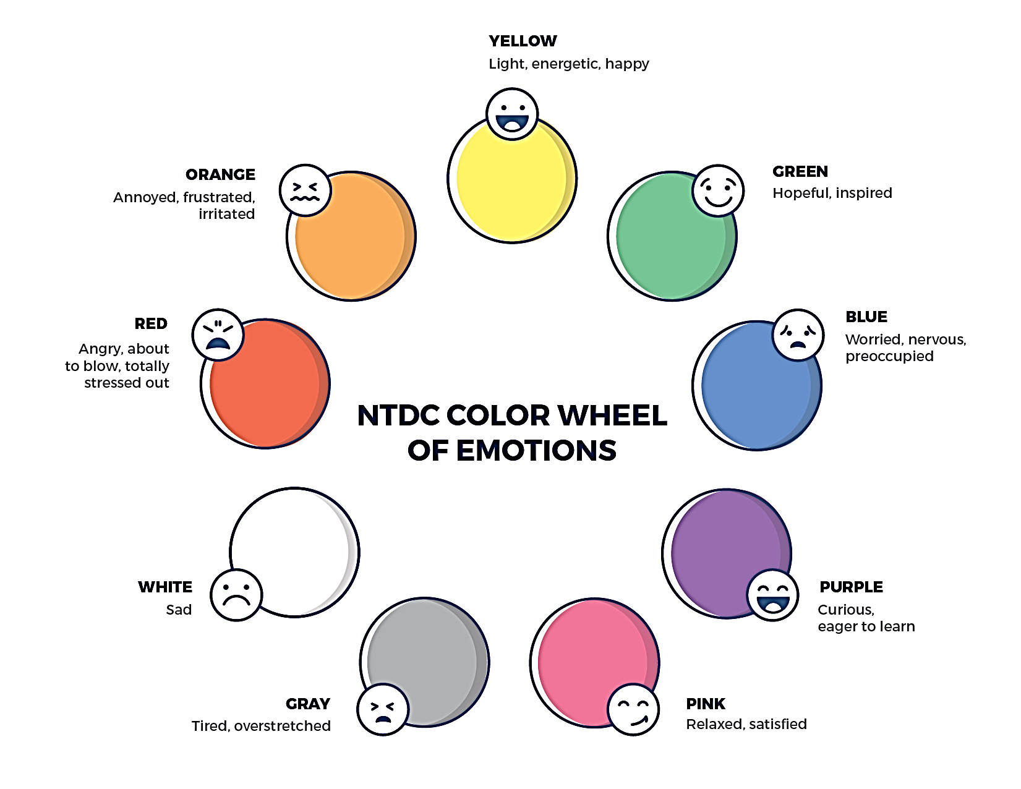
Welcome to the national training and Development Curriculum for foster and adoptive parents
Notes:
FACILITATOR'S NOTE
Have this slide showing onscreen as participants assemble for the first class of the day. As participants come in, welcome them back and ask them to take a few minutes to do a self-check using the Color Wheel. NOTE: The Color Wheel should only be done one time per day; before the first theme of the day. If combining several themes together on one day, facilitate the Color Wheel at the beginning of the first class of the day as participants are coming into the room.
SAY
Welcome back. We are so glad that you have taken time out of your day to join us for another exciting learning opportunity. As you recall, tuning in to how you’re doing on a daily basis may not be something everyone here is used to, but this type of regular self-check is critical for parents who are adopting or fostering children who may have experienced trauma, separation, or loss, as it will be helpful to become and stay aware of your own state of mind. It may seem like a simple exercise but be assured that knowing how we’re doing on any given day strengthens our ability to know when and how we need to get support and/or need a different balance. Doing this type of check in will also help us to teach and/or model this skill for children! Please take a moment to look at the color wheel and jot down on paper the color(s) that you are currently feeling.
DO
Wait a little while to give participants time to complete the Color Wheel.
SAY
Now that everybody has had the opportunity to do a quick check in, would someone like to share what color(s) they landed on today for the Color Wheel?
DO
Call on someone who volunteers to share their color(s). If a challenging emotion or feeling is shared, thank the person and acknowledge their courage in sharing, pause for a moment, encourage everyone to take a deep breath, and transition to beginning the theme.

Slide 7
PARENTING IN RACIALLY AND CULTURALLY DIVERSE FAMILIES
Modified January 2022
Notes:
FACILITATOR'S NOTE
Show this slide briefly just before you start the class.
SAY
Let’s get started! Welcome to the Parenting in Racially and Culturally Diverse Families theme.
7

Slide 8
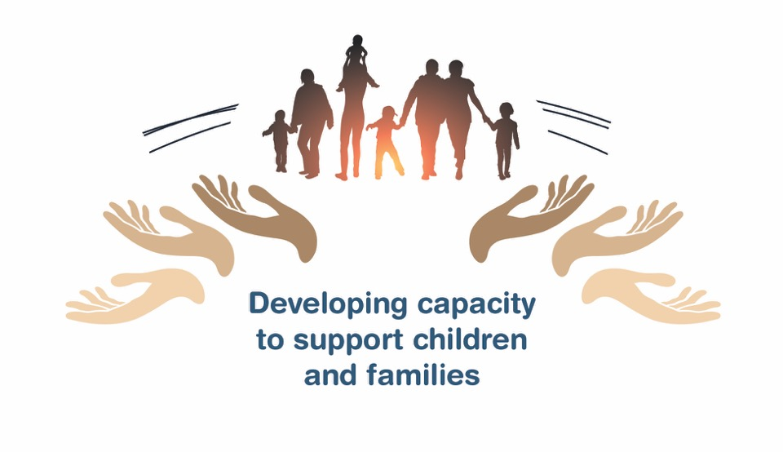
Place holder for slide with opening Quote
Notes:
FACILITATOR'S NOTE
The opening quote slide should only be used for the first theme of the day. If combining several themes together on one day, the opening quote slide would only be shown after the Color Wheel at the beginning of the first theme. It is important to always emphasize with this slide that this type of parenting involves lifelong learning and it will be critical for families to be invested in their own learning before and after a child is placed in their home.
PARAPHRASE
We are excited to share this lesson with all of you today. We are going to start with the Parenting in Racially and Culturally Diverse Families theme. As the slide states, this information will help to develop your capacity to support children and families. This type of parenting will require continuous learning. So, let’s dive in and see what important information we have to share with you today.
8

Slide 9
SECTION 1:
INTRODUCTION: PARENTING IN RACIALLY AND CULTURALLY DIVERSE FAMILIES
Notes:
FACILITATOR’S NOTE
Allow 15 minutes for this section.
PARAPHRASE
While not all of you will go on to adopt, it is helpful to be aware that nearly half of all children who are adopted are placed with families whose cultures or races are different than their own. That means that for many of you who foster and/or adopt, you will be parenting a child of a different race or culture than yours.
The majority of children being raised in racially and culturally diverse families are children of color being raised by white parents.
Race and culture are not always comfortable for people to discuss. You may already be feeling uncomfortable now and that is ok! But these realities are why we’re going to be talking about this topic today.
For those who chose not to parent in racially and culturally diverse families, that is ok too. It may not be the right choice for everyone, and it is wise to know about your family.
No matter your plans, we ask that you listen with an open mind, and stay engaged to consider how anything we discuss can impact your experience of fostering or adopting.
We’ll start by acknowledging that parenting in racially and culturally diverse families will require more than love. Today we’ll be discussing specific skills that parents will need to best meet children’s needs in racially and culturally diverse families. For example, research tells us that children in racially and culturally diverse families can later have difficulty defining their own cultural and racial identities, so they will need extra support from their parents to do this. Another example might be teaching children what to do when people make obvious or not so obvious insensitive or racist remarks. Knowing how to respond to this is not a natural skill, it needs to be learned.

Slide 10
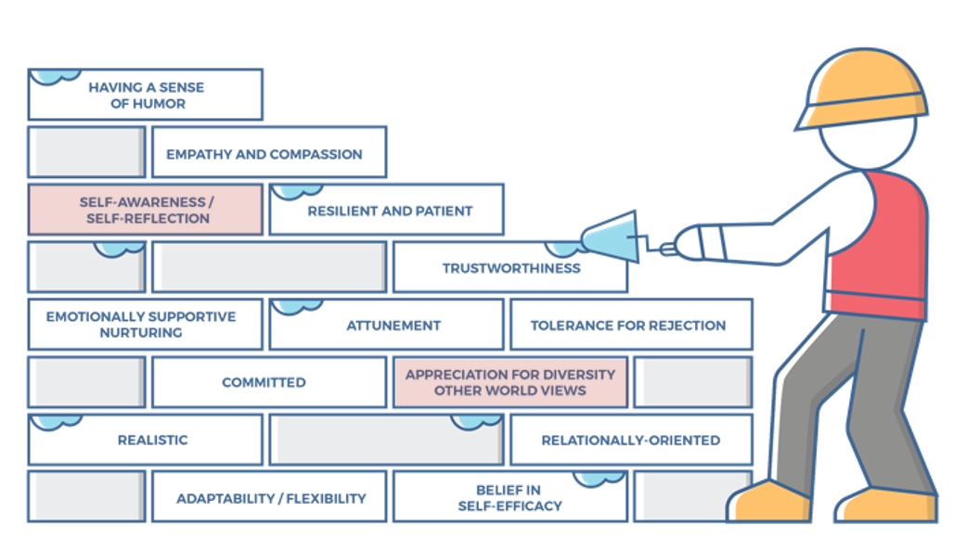
Characteristics of successful foster and adoptive parents
10
Notes:
FACILITATOR'S NOTE
This slide is shown at the start of each theme. Although the graphic will remain the same, the bricks that are colored in red will change based on the characteristics that will be touched upon in this theme. The characteristics were obtained from review of literature, stakeholder interviews, and review of existing curricula. We want families to become very acquainted with these characteristics throughout the training. It is important to note that in addition to the characteristics that are highlighted in red, there may be additional characteristics that are touched upon during the theme. Facilitators should try to connect these characteristics to the content they are sharing throughout the training. Remind participants that their Participant Resource Manual contains the definitions for these characteristics.
SAY
Before we get into the content, let’s look at the 14 characteristics of successful foster and adoptive parents. When you took your self-assessment, you were asked about these characteristics.

Slide 11
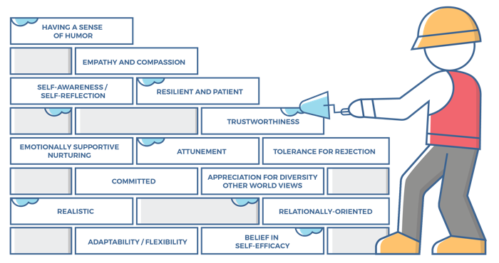
Characteristics for
Parenting in Racially and Culturally Diverse Families, 1 of 2
Self-Awareness/Self-Reflection:
Parents can identify why they have responded to a child in a certain way.
Parents can identify what was good, bad, and different about the way they were raised, while adjusting their own parenting to meet a child’s needs.
Parents can identify and forgive themselves for having negative feelings towards a child, moving from disappointment to acceptance.
Parents know their own history of experiencing loss and being hurt, and can identify how they might bring that into their parenting in negative ways if they are not careful.
Notes:
SAY
The Parenting in Racially and Culturally Diverse Families theme will cover the following characteristics:
Self-Awareness/Self-Reflection
Appreciation for Diversity/Other World Views
Take a moment to think back to how you assessed yourself with these characteristics. It is important as you start this journey to assess your characteristics as they are qualities that can strengthen your ability to successfully parent a child who is in foster care or has been adopted.

Slide 12
Characteristics for
Parenting in Racially and Culturally Diverse Families, 2 of 2
Appreciation for Diversity/Other World Views:
Parents understand and have a sense of respect for a child who brings a different set of values with them.
Parents can reconcile that the child’s behaviors and values may not align with their personal values and that this will feel uncomfortable and at times, feel wrong. Parents know that if not resolved/accepted, this can be a real source of discontent, tension, and conflict in the parenting of the child.
Notes:
SAY
Now that we have reviewed the definitions, why do you think these specific characteristics are important to understanding a child that you may foster or adopt?
Reinforce:
Self-awareness/Self-reflection:
How we talk and think about race and culture is influenced by our life experiences. It will be important for us to step outside our own beliefs to focus on the child’s experiences, needs and values.
Appreciation for Diversity/Other World Views:
Children who have experienced loss, separations and trauma have the critical need to develop healthy identities. When we value the views and experiences of the child and their family, we show the child that we really value who they are.
When we appreciate diversity rather than believing always that our way is the best way, we show children that we care for all parts of them. This encourages the development of pride about who they are and what they bring to the world.

Slide 13

Guess WHO?
Notes:
FACILITATOR’S NOTE
In this activity, participants will pair up and play the guess who game. They will take turns trying to identify one of the 12 images chosen by one of the pair. The person asking the questions will use only ‘Yes or No’ questions to try and identify who was chosen.
The activity is designed to demonstrate how avoidance of “noticing” and/or talking about race can be a significant barrier to authentic and supportive racially-conscious parenting. It is important to remember that how openly children talk about race will come largely from their parents model for them.
Validate any discomfort over labeling people or using binary or oversimplified categories but keep moving forward with the game.
To understand the game and its purpose, watch this video: https://hbr.org/video/2515962123001/the-costs-of-racial-color-blindness. (Note: video is not intended for participants.)
If you have a smaller group, you may choose to do this as a large group activity rather than pairing people up.
SAY
Now, let’s get into the “Guess Who?” game.
I’m going to ask you to pair up. Then, one person in each pair will choose one of these 12 photos of people, and their partner will try to figure out which photo it is by asking only ‘Yes or No’ questions. You’ll have 2 minutes to guess, and then you’ll switch roles. Then, we’ll have a quick group debrief.
DO
Break the group up into pairs.
Ask the groups to decide who will choose a photo first and who will guess first.
Remind the “chooser” to pick a photo.
Remind participants that the “guesser” can ask only ‘Yes or No’ questions.
Tell participants to start.
Circulate while participants work to give advice and encouragement and answer questions as needed.
Keep track of time.
Allow 2 minutes.
Have participants stop and switch roles.
Allow 2 minutes.
Bring the group back together.
Facilitate a discussion to process the activity, using the following questions:
What kinds of questions did you ask to distinguish different photos?
Did you ask about race? If so, how did you ask?
If not, why not?
Allow 4–6 minutes for the discussion; keep the overall activity within the 10 minutes allocated for it.
Adaptation for Remote Platform
Have the facilitator choose a person on the slide, but do not reveal the person you have chosen.
Use the chat box to have each participants ask you one ‘yes/no’ question each to guess who the selected person on the screen is.
Once all participants have asked their questions, stop the game and highlight any difficulty in pointing out the race of the person, with questions such as,
What kinds of questions did we ask to distinguish different photos?
Did you notice people talking about race? If so, how did they ask?
If not, why not?
PARAPHRASE
This game can be tough as you might have wanted to avoid making assumptions about people based on one photo. There are many good reasons to avoid labeling people or using binary or oversimplified categories. What we can learn from this game is how common it is for people to especially avoid asking questions about race as they try to narrow choices in the photos. This activity demonstrates what is often our discomfort and lack of skill in talking about race. When we do not talk openly about race, we can be sending a message to a child that we do not see their race or talk openly about race. While we might mean this with all the best intentions, the child may instead feel this avoidance means that others see only understand part of them and their experience. Because the reality is, the world is seeing their race.

Slide 14
SECTION 2:
BECOMING A RACIALLY AND CULTURALLY DIVERSE FAMILY
Notes:
FACILITATOR’S NOTE
Allow 20 minutes for this section.
PARAPHRASE
Trying to understand issues around race and culture gets complicated for children as they gain life experiences. Just think about how hard it can be for us adults! In a few minutes, we’re going to watch a video of children talking about their experiences and challenges as they try to make sense of it all.

Slide 15
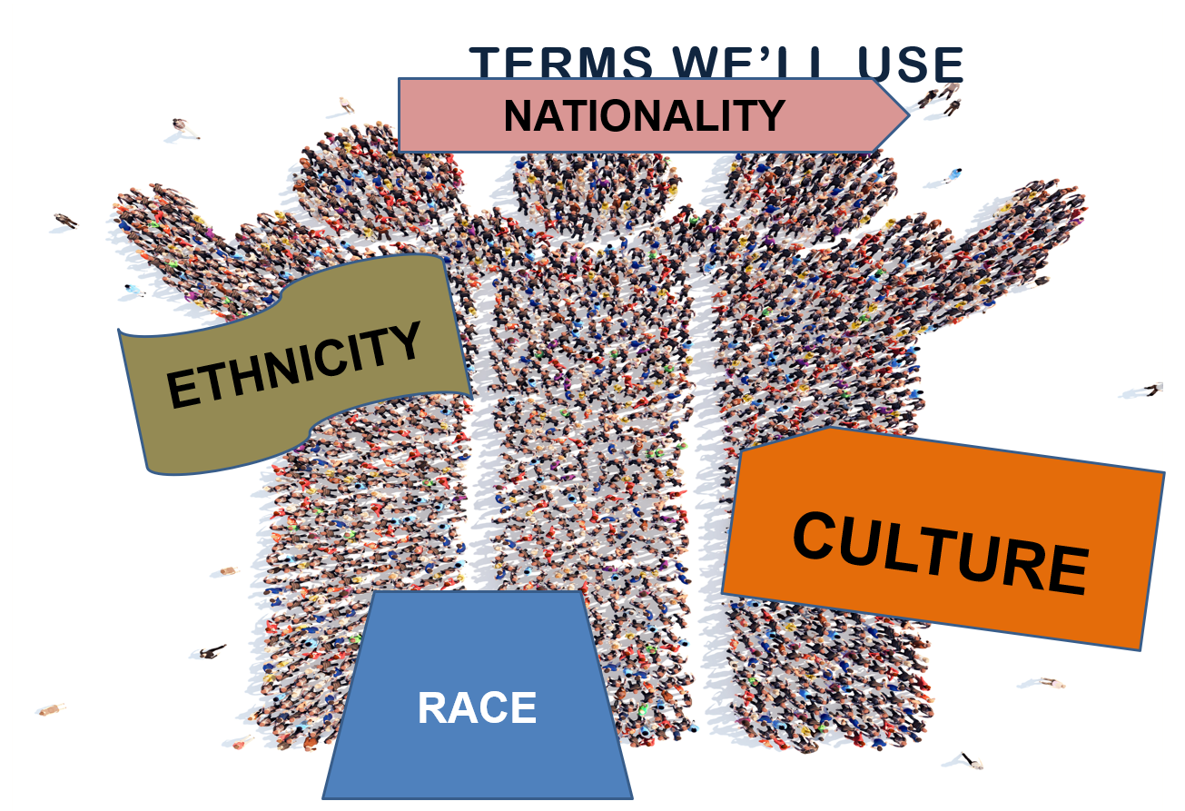
Terms we use
RACE
Notes:
PARAPHRASE
First let’s get on the same page with our language. As we’ve discussed before, language counts. Whether we mean to or not, our choice of words communicates certain viewpoints that we may have. This will make children keenly aware of where you stand and if you are open to talking about a particular topic, such as race.
As we saw in the Guess Who game, talking easily about race and culture is hard for most of us. On top of that, the words can get confusing, especially when their definitions overlap with one another, like race and ethnicity. Developing a vocabulary with some useful terms can help everyone communicate more clearly. There are a lot of different definitions out there, but here are the definitions we’ve chosen for today’s discussion. Let’s turn to Handout #1: Terms We’ll Use in your Participant Resource Manual.
PARAPHRASE
As you look this over, you might find words that you are familiar with and some that you are less familiar with. Either way, we can all get tripped up with these words. For instance, it is not unusual for people to use the word race when they actually mean culture or ethnicity, and vice versa. For example, some people use the word “Mexican” to refer to all people who come from Spanish-speaking countries, not just Mexico. Even when we do not make mistakes like this on purpose, it takes away from the diversity and pride that exists in those cultures and countries and can sometimes feel hurtful. So, it’s helpful to be thoughtful about using accurate words.

Slide 16

Being 12
Notes:
PARAPHRASE
There are so many different messages children learn from society and these messages will impact how they see and feel about themselves. It will also affect how they view their families, race and culture.
Let’s listen to some children now about their first-hand experiences. The clip we’re about to watch is called “Being 12: Because I’m Latino” and is taken from a series called Being 12: The Year that Everything Changes, that was filmed with real middle school students in New York by the Critical Media Project.
DO
Play the video. It will take about 5 minutes.
SAY
You just heard some of the types of experiences children are grappling with these days, whether we adults realize it or not. Let’s imagine that each of these children in the clip are in foster care or were adopted as we discuss the video.
DO
Lead a processing of the video with the sample questions below.
Refer to the children and the experiences they describe in the video to personalize the discussion.
ASK
How might children think or feel as a result of experiences like having to pay up front in a restaurant, being followed while trying on clothes, or trying to make sense of racist remarks?
Reinforce: sad, angry, unsettled, disgusted, confused, worried, less than/worthless
Do you think their parents know they are having these experiences, and should they know?
Reinforce: Yes, parents should know because children will need help making sense of
these experiences. They may also need help in figuring out how to respond in these
situations.
How do you think parents could best support children with these thoughts, feelings and experiences?
Reinforce responses that:
Validate the feelings of the child
Open the discussion with the child
Acknowledge realities in the world, including racism and discrimination, etc.
Acknowledge that the child’s experience of the world may be different from that of the parents
Suggest having relationships with other people who may have had similar experiences and/or of a similar race/culture to the child
Have awareness this is not a “one and done” kind of conversation, they occur over a lifetime.
These experiences complicate a child’s developing identity. It gets even more confusing when they have backgrounds of separations and trauma. Addressing sensitive topic areas that include and go beyond race will be a critical skill for a parent who is fostering or adopting. For example, while we won’t directly be talking about Sexual Development and Identity in class today, you may find that some of the information we discuss is useful to developing open communication in that area of developing identity as well. More information can be found on that topic in our Right-Time themes.

Slide 17
opportunities in parent-child
Conversations
To connect
To enhance the
child’s self-worth
To help the child
understand
themselves and
their story
To help the child develop a sense of belonging
Notes:
PARAPHRASE
Every time a parent talks with a child, it is an opportunity to connect with them, improve how the child thinks and feels about themselves, and to help a child who has lost so much have a sense of belonging. Children will need their parents’ understanding in conversations so they can really feel heard. As we think about the children we just saw in the video, let’s think about their parents and caregivers for a moment.
How might the parent’s own background, experiences, race, culture or privileges affect how they have these important conversations with the children? If the child and parent do not have the same life experiences, race, culture, or privileges, there can be a disconnect in their conversations because their view of the world may be so different. Let’s talk about privilege specifically for a moment because this is not always visible. Examples of privilege might be having access to a quality education, a solid income, the right to vote, a community of support, or a place to call home. When we adults understand what privileges we have, it allows us to become aware of what children do or do not have. This self-awareness (characteristic) will make our conversations with children much more valuable to really see things from their perspective and address the kinds of issues we just heard in the video.

Slide 18
White Privilege in Foster Care and Adoption
Notes:
FACILITATOR’S NOTE
This video may not pertain to everybody in the class; however, it is an important subject that we wanted to ensure was included for those parents who are white and may ultimately care for a child from a different race or culture. Talk with your co-facilitator in advance about who is the best person to discuss this subject matter, it can be a sensitive area. It may also be useful to educate yourself further on why it can be challenging so that you can develop comfort and to acknowledge it in class.*
PARAPHRASE
To help us understand more, we’re now going to watch a video with Beth Hall, a white parent who has raised two children of color and founded the organization PACT, an Adoption Alliance, for families who are parenting in racially and culturally diverse families. She will be talking about one area of privilege that is important for white parents who will be fostering or adopting children of color to consider. It is called white privilege. White privilege has to do with recognizing that as white person parenting children of color, your experiences in the world are different from theirs. That’s why this is important to learn about and understand.
While this clip may make you feel a bit uncomfortable, try to listen with an open mind about how to apply this concept. For those of you who have had fewer privileges, or who do not have this one, maybe this video will help you think about how you can offer wisdom or even mentoring to others about the experience of having less privilege or opportunities. Or, if you are not a white parent and the children you will be parenting could be white, maybe it will spark thoughts for you about how you can have conversations with them about a privilege you don’t share.
DO
Play the video. It will run approximately 2 minutes.
ASK
Thinking back to the children’s video, can you name some examples of white privilege you heard them describe? Take a few responses.
How do you think the information learned in these two video clips can be helpful to people who plan to foster or adopt children of color? Reinforce:
To open conversations with children
To help adults see them things from a child’s perspective
To realize that when children are in the world, they may be seen differently and have a very different experience than their families
To help support children and families with education and tools
To troubleshoot or advocate when necessary
PARAPHRASE
Once you recognize the privileges your family has, such as white privilege for those of you impacted by it, it is important to have open conversations about it and to understand that children you are parenting need to have tools to protect themselves in a world likely to discriminate against them because of their race or culture. The videos we just saw highlighted that white privilege, for example, is an area where white parents of children of color will need to help children recognize and learn how to guard against discrimination. This is not the same for parents of color who likely learned about this and taught their children through lived experience. For parents of color who are comfortable with it, you could choose to play an important role supporting parents who are racially or culturally diverse from their children of color.
*REFERENCE: DiAngelo, R. (2018). Why It’s So Hard For White People to Talk About Racism. Beacon Press.

Slide 19

More than meets the eye: intersecting identities
Notes:
PARAPHRASE
A complication in thinking about race and culture is that people don’t often fit into only one category. For example, some of the children you may care for will be of mixed race. As you heard in the children’s video, this can be confusing to them because the world often wants to treat them as either/or. This can also be true for culture, where a child may see themselves as bicultural or of two cultures, where for example they speak two languages. If the world around them only speaks one language, they may feel like a part of them is missing. Another area where things get confusing can be skin color. A child may be identified one way from their looks on the outside, but they could feel much more connected to a different identity, such as race or culture or religion, on the inside.
Another area that could be affected is how we view behavior, which can be understood differently depending on culture. For example, if a child comes from a culture where eye contact with an adult is considered disrespectful and the parents who are fostering or adopting insist on eye contact, they might consider the child rude or disrespectful. When the behavior is seen though through the lens of the child or family’s cultural experiences, the behavior can now be understood.
Rather than making assumptions, take the time to learn about the child and their family. We are all made up of more than meets the eye.
If your family’s race or culture is different than the child’s, or you only share part of a child’s race or culture, you are parenting in a racially and culturally diverse family. It will be important to learn about all the races and cultures of the child as well.
As we’ve noticed since we started with the Guess Who activity, talking about race or culture may not be comfortable or familiar. That’s ok. Let’s stick with it so we can practice the important parenting skill of keeping conversations open even in uncomfortable or tough moments. Doing this may also have the added plus of bringing you and the child closer.

Slide 20
SECTION 3:
PROMOTING POSITIVE RACIAL AND CULTURAL IDENTITY
Notes:
FACILITATOR’S NOTE
Allow 20 minutes for this section.
PARAPHRASE
Becoming a multiracial or multicultural family will be a journey that changes families. This will include leaving behind old beliefs like love is enough or that everyone should be color blind. Because as you heard in the video, this thinking will not meet children’s needs for education and support around their race and culture.
In racially and culturally diverse families, an opportunity and challenge that parents will face is how to support the identity needs of their children. This is true no matter what age their children were when they came to live with them.
Because their racial and cultural identities are different from each other, and parents who are fostering or adopting will have their own cultural values guiding their own behaviors and beliefs, this is not as simple as it may seem.
The task will be how the culture and/or race of the family and the child can work in harmony, rather than one taking priority over the other. This supportive approach benefits the child, rather than the child experiencing more loss and shame.

Slide 21

Challenges to Identity, 1 of 2
Notes:
PARAPHRASE
A complication to a child’s developing identity exists when the world views the child differently than how they see themselves. This can get confusing to children yet is not uncommon when they are raised in families with different racial or cultural backgrounds. For example, a child of color who is raised in a white family and community, could actually believe themselves to be white. As one child of color once said to her mother when she was little “ Mommy, when am I going to turn white and look like you?”
If the parent does not know how to respond to such questions, there may be no validation or explanation for the child. As a result, the child may be left feeling like there is something not quite right about them. When a child feels disconnected like this, it can have negative implications for their future mental health.
An outcome that is particularly concerning for children being raised in racially and culturally diverse families is called internalized racism. It develops very quietly so it is important that we draw attention to it.
Internalized racism occurs when a child takes in and believes negative societal beliefs and stereotypes about their race. The child and parents may not even realize it’s happening. One example might be around the concept of beauty. For example, think about what effect it might have on an African American child if they only see commercials of children or dolls with blond hair? Also, what message does it send to the child if every professional the child interacts with (teachers, nurses, doctors, dentists, etc.) is white?
FACILIATOR NOTE
These are rhetorical questions, there is no need to solicit answers and do not take much time here if someone chooses to answer. Simply validate answers.

Slide 22

The importance of combatting internalized racism
Notes:
PARAPHRASE
Parents will want to be aware that these kinds of messages can cause a developing child to believe that they have “defects” or that some of their traits are “unacceptable”. This further breaks down their self worth, already a vulnerability for children who have experienced separations, loss and trauma. When concerns like this are not recognized and counter-acted over time, children may end up wanting to distance themselves from their own birth racial, ethnic groups, and cultures. It is unfortunate when this happens because they miss the opportunity to draw strength and pride from their racial and ethnic roots. Instead, as they get older, they could end up feeling self hatred or like they are “less than”.
This is where you come in. An important skill for parents who have a racially and culturally diverse family is to understand what internalized racism is, how it happens and how to combat it. It’s important that parents take a pro-active approach when we see or hear negative messages about the child’s race or culture, and let the child know that we noticed the message and did not like it. If we don’t, we miss the opportunity to counter the message for the child. Noticing and talking with the child when these kind of conflictual or negative messages come up in day-to-day life and in less obvious places like television shows, social media, movies and advertising will help you counter negative messages, and actively work to make sure the child is getting the benefits of positive messages about their race and culture.

Slide 23

Challenges to Identity, 2 of 2
Notes:
PARAPHRASE
Noticing how others view your family or the child will be another important skill to develop for parents in racially and culturally diverse families. The reality is that people most often see differences first. For example, think about how it may be for a child when they introduce their parents for the first time, and no one looks anything alike. While you may be fully comfortable with the family you create, others may not be. You may think that focusing on differences rather than on what people have in common is not helpful. You may even want to tell the child it doesn’t matter. But that will not address the child’s discomfort and need for protection and support. Families who have been down this road before, like Beth Hall’s, teach us how important it is to pay attention to interactions with other people to best protect the wellbeing of the child.
Let’s hear some real-life scenarios now. I’d like you to listen to them from the viewpoint of a child. Think about what the child might be feeling and needing from their parents in these situations.
FACILITATOR NOTE
These scenarios are intended to be thought provoking, but not to spark major discussion. Do not focus on serious problem solving, quickly validate responses and move to the next scenario. There are 6 scenarios listed. Facilitators can select the scenarios (select 2 or 3 depending on time) that they think are most relevant to their participants.
Scenario #1:
SAY
A white family who is fostering a child of color enters a restaurant where every other person is white. People begin to stare at the child and a few start to whisper.
ASK
What do you think the child saw or experienced in this situation?
Reinforce: Difference, embarrassment, loneliness, shame
What should the family see?
Reinforce: The need for children go to places and have daily activities with others who look like them. Being the ‘only’ anything is hard on people.
Scenario #2:
SAY
A white parent who has adopted a child of color is approached by a white stranger. The stranger asks if she can hug the child because his looks are so unusual and so cute. The parent says ok.
ASK
What do you think the child saw or experienced in this situation?
Reinforce: Difference, confusion, anger, awkwardness. or mixed feelings (i.e., maybe they don’t want to hug a stranger but could feel they’re special)
What should the family see?
Reinforce:
The child might not want to hug a stranger.
The stranger’s feelings should not be prioritized over the child’s feelings.
These interactions can be alienating or like there’s something weird or wrong about the child.
Scenario #3:
SAY
You have relatives over for a holiday and they say the following to the whole group in front of the child you are fostering: “Of course Marta likes rice and beans, all Hispanics eat rice and beans.”
ASK
What do you think the child saw or experienced in this situation?
Reinforce: Difference, embarrassment, shame, anger
What should the family see?
Reinforce:
Stereotypes that might hurt the child.
The child feeling like her culture is being attacked.
The child feeling like she is different than others in the room.
Scenario #4:
SAY
You go to your friend’s house for dinner, and they say to the child you are fostering, “Ethan, it is so odd that you don’t eat pork. The rest of us are eating pork for dinner, I am not sure what you will eat tonight.”
ASK
What do you think the child saw or experienced in this situation?
Reinforce: Difference, embarrassment, scared of being hungry, pushed to change his ways, shame
What does the family need to see?
Reinforce:
The need to protect the child’s right to eat food that aligns with his culture.
The need to ensure the child has food options to eat no matter where he goes.
The need to honor the child’s identity.
Scenario #5:
SAY
Relatives are at your home watching TV with your family and an aunt says to the whole group in front of the child you are fostering who has been open about being LGBTQ+, “This program should not be allowed to air. It is just shameful to show two women who are together. What has this world become?”
ASK
What do you think the child saw or experienced in this situation?
Reinforce: Difference, embarrassment, shame, anger, not feeling respected for who they are
What does the family need to see?
Reinforce:
These interactions can be alienating or like there’s something weird or wrong about the child.
The need to be able to express who they are and to be proud of their identity.
The need to honor the child’s identity.
Scenario #6:
SAY
Your family and friends are singing Christmas carols. Mustafa has just been placed in your home and is Muslim. Your nephew turns to Mustafa and says, “Why are you not singing Mustafa, everybody knows this song.”
ASK
What do you think the child saw or experienced in this situation?
Reinforce: Difference, embarrassment, shame, anger, loneliness
What does the family need to see?
Reinforce:
These interactions can be alienating or like there’s something weird or wrong about the child.
The need to ask about and include the child’s own traditions into what the family is doing.
The need to educate family members on the importance of honoring the child’s religion.
The need to honor the child’s identity.

Slide 24
The best defense is a good offense
1. Notice
2. Discuss
3. Strategize
4. Check-in
Notes:
ASK
What do you think the child needs from their parents in these kinds of situations we just discussed?
Reinforce:
To know that their feelings are prioritized in these situations
Help in learning how to manage situations like this on their own in the future.
The child may need adults to get involved to troubleshoot.
Adults need to be proactive and think in advance about possible situations that could occur and how to handle them.
PARAPHRASE
At minimum, these situations are awkward for the child, and they have the potential to be quite painful, but your family will not always be able to avoid them. Instead realize that the best defense is a good offense. Think of possible situations and strategize with your child in advance rather than sugar coating or denying they will happen. By being proactive, we will help the child not be blind-sided by a situation. Children need the help of adults to make sense of these experiences and come up with responses that allow them to feel stronger, not weaker about being part of your family.
Parents will need to develop the skill of noticing when race or cultural considerations are coming up around the child, whether with strangers or even with extended family members. Rather than waiting for the child to bring up these incidents, it’s best when parents take the lead by noticing them, be the one to start discussions with the child, and later to check in. As the child gets older, it will be helpful to find others with racial and cultural experiences similar to the child to add to these discussions. These conversations are important because they will allow the child to learn how to manage these situations on their own as they get older.
Race, racism, prejudice, and white privilege are important to think about as you make decisions about embracing a child of a different race and culture into your home and as you determine which adults will be in the inner circle of your parenting experience. By being proactive about this in advance and tuning in whenever unexpected encounters happen along the way, you will be creating a protective buffer for the child. This will be a powerful antidote for a child whose needs were left unsupported in the past.

Slide 25

The Importance of Attention to Race and Racism
Notes:
PARAPHRASE
As we’ve been discussing today, race and culture are important parts of a child’s identity that can help them feel proud of who they are and give them a strong sense of belonging. But when others insult their race or culture, it often has the opposite effect on them, so it is important that we pay attention to these.
Others may cut children down for their race or culture, or other parts of their identity such as being in foster care or adopted, or their sexual identity or expression. These insults occur in obvious and not so obvious ways. The examples we used earlier are known as “microaggressions.” Microaggressions are common daily occurrences that insult others with words, behaviors, or something in the environment like a sign or symbol. They could also be slights or attitudes that show negative judgement. You heard examples of microaggressions and racism in the video we saw of children earlier, like the girl who was followed into the dressing room because they thought she was stealing, or the family that had to pay up front before eating at a restaurant. Other common occurrences of racism for children of color are being treated unfairly in disciplinary situations or being blamed when something has gone wrong. Another time racism might occur is when a child is old enough to date, yet other parents don’t allow their children to date them because of their race. The reality is that children of color will likely experience some form of racism while you are parenting them, and it can be unhealthy or unsafe if they do not have tools to address racism when it is directed at them.
Before we talk about how to address this, we also need to acknowledge that these incidents may not happen just with strangers. Our own family members may be the ones who are making inappropriate or racist remarks, even if they’re subtle. Some of us could even be the ones who unintentionally say harmful things about race or culture or some other form of the child’s identity. Intentional or not, it is hurtful to a child and their developing identity.
We all make mistakes, and this is an opportunity for all of us to grow. It might be helpful to start paying attention to how you speak about or interact with people from backgrounds that are different from yours. You can even ask children to let you know if they think you are accidentally doing or saying anything that could appear racist. This is not to be “politically correct” about your language, it is about how the child feels and what they learn through you about themselves. While doing things like this may seem awkward at first, it could create even more open and meaningful conversations with children in the long run.

Slide 26
Combatting racism:
The job of parents
Acknowledge it is
happening
Validate the child’s
feelings about it
Help the child
understand what’s
happening and why
Make sure the child
knows that there’s
nothing wrong with
them
Be a part of the solution
Notes:
PARAPHRASE
Open communication about race and racism is critically important to parenting. One of the most vital and supportive skills in racially and culturally diverse parenting is for parents to frequently, effectively and honestly communicate about race and racism. Parents in racially and culturally diverse families will need to be comfortable talking about these incidents, the impact of them, and to be an advocate and ally for their children. Not acknowledging differences in race or culture, and/or telling the child that we are all the same, closes down rather than opens up these conversations and minimizes the impact. Yet, these discussions are some of the best opportunities to understand what the child might be confused about, and to strengthen their understanding and perception of all parts of their identity.
Reinforce the child’s value and worth. Expose them to the richness of their racial and cultural history. Teach the skills necessary when they are faced with questions about their race or culture, or discrimination. Children need to be told outright that there is nothing wrong with them. Show them your family is part of the solution to end racism and discrimination. It is critical for children to feel that as a multiracial family, “we are all in this together.” When parents do all these things on a regular basis, they are preparing children to deal with racism, combatting internalized racism, and helping children develop healthy identities.
ASK
Why do you think the impact of racism and discrimination is even more challenging for children who have experienced separations, loss and/or trauma?
DO
Take a few quick responses if anyone wants to comment.
SAY
Children who have experienced separations, loss, and trauma desperately need to feel a sense of belonging and self-worth. When they can feel good about, draw strength from, and be proud of who they are inside and out, it is healing and helps them to be more resilient in weathering life's storms.
For parents, this journey will take active and purposeful parenting skills. It will require work, self-reflection, and a willingness to learn new strategies to do what is needed to build the child’s positive racial and cultural identity.

Slide 27
SECTION 4:
STRENGTH IN DIVERSITY
Notes:
FACILITATOR’S NOTE
Allow 15 minutes for this section.
PARAPHRASE
As we’ve been discussing today, our world is complicated. Building a supportive environment around a child is one of the best ways to combat the challenges that they might experience or be confused by. We are going to do an activity in a moment and then talk about some concrete strategies to create the strongest environment for racially and culturally diverse families.

Slide 28

How Diverse is Your World?
Notes:
FACILITATOR’S NOTE
In this activity, you will read phrases describing people in participants’ lives. Participants will select different colored beads to represent each of the people in their life and drop the beads into a cup. At the end, participants will have a visual representation of the diversity in their lives.
For the activity, it helps if facilitators can use clear cups to use themselves as an example of being open and able to talk about this subject. It is important to convey that this activity is not meant to shame anyone but is to help build awareness of who participants interact with on a daily basis, and then to think about the impact this could have on a child of a different race or ethnicity moving into the home.
PARAPHRASE
When people have experience with other races and cultures, it greatly helps in parenting children of diverse racial or cultural backgrounds.
In this next activity, we will use these colored beads to help you visually see the types of people you encounter in your daily life. This activity is meant to build awareness of who you interact with regularly. There is no right or wrong here. It will help everyone think about what a child of a different race or ethnicity would see and experience if they move into your home.
DO
As you introduce the activity, set out the bowls of beads for the activity (one per table, so all participants can reach a bowl) and give each participant one of the cups.

Slide 29
Let’s choose the Beads we’ll use
Racial/Ethnic Groups
African-American/Black or Brown
Arab/Middle Eastern
Latino/Hispanic Americans
Multi-Racial/Other
American Indian/Alaska Native/Indigenous
European Americans or White Americans
Asian/Pacific Islander/Asian American
ad ColorBlueBleue
Notes:
FACILITATOR’S NOTE
You will need to be prepared to write in the color of beads that represent each racial/ethnic group as the volunteer chooses each bead. Decide how you will be conducting this activity before you begin-writing on a flipchart/white board or writing onto the slide. If you are using a flip chart/white board, it would be advisable to prepare it in advance with the words on the slide to move this step along more quickly by simply writing in each bead color as it is chosen. Alternately, you could write the bead color directly onto the slide as each is chosen. Leave this list accessible for all to see until all steps of this activity are complete. Feel free to revise questions with language to resonate with your group.
PARAPHRASE
To do this activity, we will choose 8 colors to represent each of these race/ethnicities. Can I have a volunteer to choose a bead color for each?
DO
Have a volunteer come to the front to randomly choose a bead to represent each racial/ethnic group.
Call out each of the racial/ethnic groups on the list one at a time and have the volunteer choose a bead to represent it. There will be 8 total.
Each time the volunteer chooses a bead, write the color that will represent each of the racial/ethnic groups onto a white board/flip chart or directly into the slide. Be sure all can see it clearly.
Read each of the following statements. Pause briefly between statements to allow participants to choose the appropriate bead and drop it into their cup. Note that the participants can pick one bead (more if they choose) for each phrase unless it is worded otherwise (i.e., for children you can pick more than one).
Don’t let participants obsess about the details.
Listed below are suggested phrases to use, but facilitators can add or replace with phrases that are more applicable to participants in the class.
Adaptation for Remote Platform
The facilitator will model with a clear cup and beads on screen for this activity.
Volunteers can be used to randomly select colors for all to see and/or to write bead color selections into the chat.
If beads can be sent to participants in advance, the activity would follow as written.
If participants have not been sent beads in advance, they can be sent an instruction to collect colored markers or crayons in 8 colors. These will be used to substitute the same 8 bead colors the facilitator uses. In this option, a piece of paper will be needed to substitute for the cup. Participants will draw one colored line or shape on their paper to represent each bead being dropped, and by the end, the paper will be filled with the variety of colors that represent the diversity in their lives.
PARAPHRASE
For this activity, I will read a series of phrases about different people that may be in your life. After each statement, please pick the bead/color that best represents the person’s race or ethnicity and drop it into your cup. If a phrase does not apply to you, just skip it. When we are finished, you will each have a visual picture of the diversity in your world.
1. Select a bead that most closely represents your race/ethnicity.
2. Select a bead that most closely represents the race of your significant other.
3. If you have children, select beads that most closely represent each of your children.
4. Select a bead that most closely represents your children’s friends.
5. Select a bead that represents the race/ethnicity of your closest friend.
6. If I worship, the race of the people with whom I worship are mostly…
7. My neighbors (at home) on either side of my house are…
8. My doctor is…
9. My dentist is…
10. My boss is…
11. My co-workers are mostly…
12. The people in my favorite TV show are mostly…
13. The person whom I most admire or who has had the greatest impact on my life is…
14. The people in my favorite music group or band are mostly…

Slide 30
How Diverse is Your World, continued
Why is it important for those who parent children who are racially and ethnically different from them to work with and live with a variety of people that are different from you?
Notes:
PARAPHRASE
Your cup shows how you experience the world every day. The more colorful your cup is, the more diverse your experiences. There is no right or wrong with how anyone’s cup looks. But if a child of a different race or ethnicity moves into your home, you will need to think about how to support the child’s racial identity. Diversifying your family’s world is one important way to accomplish this.
ASK
Why would it be helpful for those who parent children who are racially and culturally different from them to live around and work in diverse communities?
Options may include:
It broadens one’s perspective
It creates diversity for children
It creates a richer environment
It allows children to see themselves reflected in others (role models, mentors, etc.)
It enhances culturally humility
It normalizes diversity
It allows us to see our blind spots
PARAPHRASE
Now that you have looked at the diversity in your own world, think about the diversity in the lives of the children and families with whom you will interact when a child is placed in your home. Consider how much your own universe helps you to understand diversity and whether or not you want to learn more.
We encourage parents to really consider how their family’s communities and social worlds may be affirming or may be uncomfortable, or even hostile, particularly around race and ethnicity of the child. Think about who you invite into your home. Do those close to you reflect the race, ethnicity, or culture of the children you plan to foster or adopt or can you consider adding more diversity to your social circle? Let’s remember that appreciation for diversity and other world views has been identified as an important characteristic of successful foster and adoptive homes. That is especially true for racially and culturally diverse families.

Slide 31
SECTION 5:
EFFECTIVE PARENTING CHOICES IN RACIALLY AND CULTURALLY DIVERSE FAMILIES
Notes:
FACILITATOR’S NOTE
Allow 15 minutes for this section.
PARAPHRASE
Put simply, the main goal for parents who are fostering or adopting is to raise a child to be healthy and to feel whole. When parenting in racially and culturally diverse families, there are additional parenting tasks to meet that goal.
Remember the situation we talked about earlier with the family who went into a restaurant and the child was the only person of color? Think about what you might do if you were the parent in that situation. What might you need to do or be willing to change in your world to avoid situations like that? For example, would you change where you eat, shop or take vacations?
These daily choices matter. We’re now going to spend some time thinking about choices that can help children in racially and culturally diverse families feel healthy and whole.

Slide 32

Let’s listen to the experts
Transracial Adoption and Black Lives Matter Movement
Webinar conducted by Spaulding for Children
2020
Notes:
PARAPHRASE
We are now going to listen to some audio clips from a webinar done in 2020 by Spaulding for Children called, “Transracial Adoption and Black Lives Matter Movement”. You will hear three clips from adults who were all adopted into racially and culturally diverse families when they were young children. Their parents are all white. Marcus is African American. April and Alexis are both bi-racial, African American and white. Their life-long experiences will help to guide our discussion on daily choices you can take to effectively parent children of diverse backgrounds.
As you hear their stories, I’d like you to especially listen for what it sounds like they needed when they were children. Take out a piece of paper to jot those things down as you hear them, and we’ll discuss them after we listen.

Slide 33

April Dinwoodie
Notes:
DO
Play audio podcast clip Transracial Adoption and the Black Lives Matter Movement that begins with a clip from April Dinwoodie. The podcast can be found on CapLEARN or the NTDC website. April’s clip is approx. one-minute, total run time of 3 clips together is approx. 4 minutes.
Pause the audio podcast after April’s clip to advance to the next slide.
April Dinwoodie
April is a Black-Bi-racial/transracially-adopted person, nationally recognized thought leader on non-traditional and multiracial families, and a race and culture competency coach. After years of corporate communications work, April pivoted to non-profits, spending several years as the Chief Executive of the Donaldson Adoption Institute, a research, education, and advocacy organization.

Slide 34

Marcus schmidt
Notes:
DO
Continue playing the podcast with the clip from Marcus. Marcus’s clip is approx. 1.5 minutes, total run time of 3 clips together is approx. 4 minutes.
Pause the podcast after Marcus’s clip to advance to the next slide.
Marcus Schmidt
Mr. Schmidt, originally born in Silver Springs, MD, was adopted by a family in California where he primarily grew up before relocating to the East coast for college. After college, Marcus reconnected with his biological family and found his experience valuable in helping younger adoptees process their experiences.

Slide 35
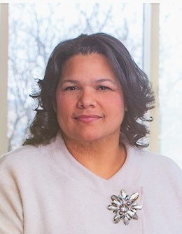
Alexis Oberdorfer
Notes:
DO
Continue playing the podcast with the clip that features Alexis. Alexis’s clip is approx. one-minute, total run time of 3 clips together is approx. 4 minutes.
Alexis Oberdorfer
Alexis was adopted by a white family as a young child, and is now a parent of three children, two of whom are adopted. She has worked in child welfare for over 25 years. She joined Children’s Home in 2008 and now serves as the President of Children’s Home and as an Associate Vice President of Adoption for Lutheran Social Services of Minnesota where she oversees their adoption programs and brings deep leadership experience.

Slide 36

36
WHAT DID YOU HEAR?
Notes:
PARAPHRASE
These speakers have a lot to share, and you can find the full podcast in our resources. Their experience growing up in racially and culturally diverse families can teach us so much, both in what was helpful that their parents did and what they needed more of when they were children.
ASK
What kinds of things did you hear they needed when they were growing up/what kinds of things did you jot down?
Reinforce responses like:
Parents need skill, not just will
Parents need to make efforts with consistency, over time, this is not a one and done
Children benefit greatly by being regularly exposed to people that look and sound like them, especially role models
Parents will not be able to provide all that a child of a different race or culture needs on their own
Who and what children are surrounded with matters
Using a color-blind approach will not be helpful to children-talking about race and culture shows parents understand their child’s experiences and needs
PARAPHRASE
As you listened, I’m wondering if anyone was thinking that parents who foster or adopt children in racially and culturally diverse families may not have the experience to teach the child all they need to know? That’s ok, you do not need to have all the answers. Children can also learn from others who do have the experience and/or are of the same race or culture if the child can spend time enough time with them. Know that being with others that are like the child also can reduce a sense of feeling different and isolated or alone.

Slide 37

Reflection/ relevance
Recommendations for Parents
Circle the one that would be the easiest for you to do.
Put an ‘X’ next to the hardest one for you.
Think or write about why.
Answer these questions in your Participant Resource Manual.
Notes:
FACILITATOR’S NOTE
You will use Handout #2: Recommendations for Parenting in Racially and Culturally Diverse Families that lists things you can do on a regular basis.
DO
Invite participants to take a moment to look over the handout or go around the room with one or more volunteers reading if you have time.
PARAPHRASE
While it might not always be easy, it’s so important to think through what we do and do not feel comfortable doing as parents and why. You might remember that self-awareness /self-reflection is a key characteristic for effective parenting in racially and culturally diverse families. When we do this, we can grow in the areas we need to meet children’s needs, such as reaching out to others from the child’s race or culture to more easily accomplish some of these. You are not alone, and this kind of parenting is easiest and best done with the support of others.
FACILITATOR’S NOTE
If there is time, conduct this exercise in class and allow for discussion of questions. If not, remind participants to do this at home in their Participant Resource Resource Manual.
PARAPHRASE
We have learned a lot today about parenting in racially and culturally diverse families. Now, you can reflect on what you’ve learned. Using Handout #2: Recommendations for Parenting in Racially and Culturally Diverse Families in your Participant Resource Manual, circle those suggestions that you think would be easiest to you to do and put an x by those that seem harder. Then. reflect on why this might be so.
37

Slide 38
SECTION 6:
WRAP-UP
Notes:
FACILITATOR’S NOTE
Allow 5 minutes for this section.
PARAPHRASE
We will wrap up by reflecting on what we’ve discussed during this class by reviewing a few key takeaways.
Children’s identities, and feelings about their identities, are highly impacted by their environments and the culture of their families.
When parents foster or adopt in racially and culturally diverse families, they need to exercise additional skills to enhance children’s sense of self-worth and belonging.
There are concrete choices parents can make to more effectively parent in racially and culturally diverse families. For example, people and influences from the children’s birth race and culture should be prominent and present in the child and family’s lives.
Parents who foster or adopt children of different races or cultures must become aware of and commit to having what may be difficult conversations about race and racism to support the child .
Parents must develop self-awareness of their own attitudes and feelings about other racial/cultural/ethnic groups (characteristic).

Slide 39

Lifelong learning
Notes:
PARAPHRASE
As you’ve heard a lot today, parenting in racially and culturally diverse families requires skills. While your love will be powerful, it does not meet all the extra needs for a child being raised in a racially and culturally diverse family. Education before, during and after a child is placed will be key for you. There is much reading, viewing and listening that you can do on race and culture. Just be mindful about where you get your information, making sure that it is accurate. Is it possible some of the places you get your information may not be accurate.
This theme has several resources that will help you continue learn more about parenting in racially and culturally diverse parenting. For example, you can listen to a full podcast with Beth Hall, adoptive mother and the CEO of PACT, an Adoption Alliance. You can find all these resources on the NTDC website or in CapLEARN.
As you move about the world, consider where else and from whom you can learn. You may be surprised at where or who you learn from the most, including from the child! So, keep your mind and heart open. and remind yourself that while there is nothing to lose by the child embracing their race and culture, there is so much to gain.

Slide 40
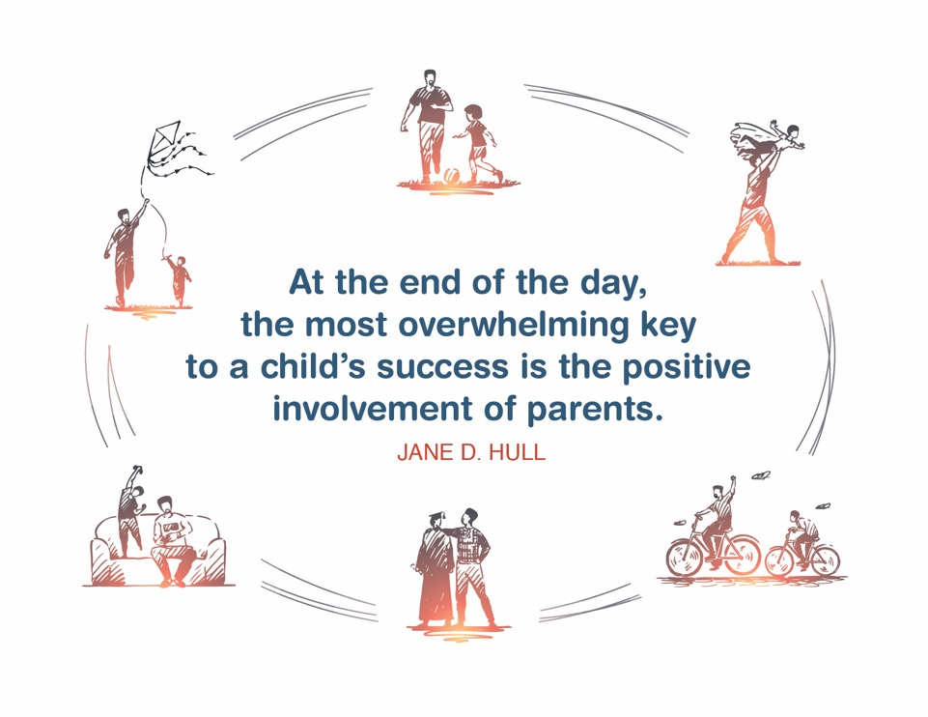
Place holder for slide with Closing Quote
Notes:
FACILITATOR'S NOTE
The closing quote above and the paraphrase section below will be done only once per day, after the last theme presented for the day. If you are moving on to another theme invite them to take a break, stretch, or breathe, before moving on to the next theme.
If closing for the day:
Thank everyone for attending and for their thoughtful participation and attention. Remind the participants that although this training may seem long, it is critical for them to gather the knowledge, attitude, and skills that are needed as they embark on this journey because they ultimately will play a huge role in the lives of children and families.
If in person, collect the name tents or have them tuck them into their Participant Resource Manual to bring back to the next class.
PARAPHRASE
Close out the day by covering the below topics:
Remind participants of the date/time for the next class and let participants know if there are any changes to the location.
Encourage participants to contact you (or other facilitators) if they have any questions or concerns.
Review the themes that will be covered during the next class.
If in person, remind participants to take their Participant Resource Manual with them and to bring them to the next session. If using a remote platform, remind participants to have the Participant Resource Manual available for the next class.
40

Slide 41
For more information, visit:
Notes:
41

Slide 42
.
This curriculum was funded by the Children’s Bureau, Administration on Children, Youth, and Families, Administration for Children and Families, US Department of Health & Human Services, under grant #90CO1132. The contents of this curriculum are solely the responsibility of the authors and do not necessarily represent the official views of the Children’s Bureau.

