Slide 1
TRAUMA-INFORMED PARENTING
FACILITATOR CLASSROOM GUIDE
Modified January 2022
Notes:
TRAUMA-INFORMED PARENTING
FACILITATOR CLASSROOM GUIDE
Modified January 2022

Slide 2
To Prepare for the Class
See Notes view
Notes:
To prepare for this class, you should:
Review the facilitator preparation information included in this Guide along with the handouts.
Review the Resources for this theme found on CapLEARN (https://learn.childwelfare.gov/) or NTDC website (https://ntdcportal.org/).
Develop an agenda that includes this theme and any other themes you will be conducting along with it during the class.
Ensure that participants have a copy of the Participant Resource Manual. This Manual will be used during all themes and will include the handouts needed by participants. Facilitators should have copies of the handouts for the theme available in case participants do not bring their Manual to class. If the theme is being taught on a remote platform, facilitators should have the handouts available so that they can share in the chat and/or email to participants who do not have their Manual.
Bring any materials you need for the activities.
Review any videos or other electronic media used in this theme, if any, and plan the mechanics of how you will present them. Media for this theme are listed in the Materials and Handouts slide. Review the instructions for each media clip (e.g., to pause or stop at a particular time stamp). The videos can be played in different ways, including:
Play them from a flash drive or the computer’s hard drive using a media player app
Link to them from CapLEARN or the NTDC website
Please note that all clips from Instant Family movie must be played directly from the Instant Family DVD or the movie can be streamed using the code provided in the DVD case. It is also available on some TV and Video streaming services (i.e., Prime Video- Amazon.com)
Practice playing the media for the theme. Ensure that you have the files and apps you need, that your links and connections work, and that you know when to pause or stop the media clip if appropriate.
If training on a remote platform, make sure all participants have the link available to access the class and that you have all videos, PPT’s and handouts ready for use.
If training in person, ensure that a room is available and set up, with the following:
Enough tables and chairs for all participants
Projector and screen (check that it works with the computer you will be using)
Classroom activities have been adapted so that they can be done on a remote platform. Remote adaptations are marked as follows so that they can be easily spotted in the Facilitator Classroom Guide: Adaptation for Remote Platform
PREPARATION

Slide 3
MATERIALS AND HANDOUTS
See Notes view
Notes:
FACILITATOR’S NOTE
Participants are expected to have the Participant Resource Manual available for every session.
MATERIALS NEEDED
You will need the following if conducting the session in the classroom:
A screen and projector (test before the session with the computer and cables you will use)
A flipchart or whiteboard and markers for several of the activities. A flipchart with a sticky backing on each sheet may be useful and will allow you to post completed flipchart sheets on the wall for reference.
Name tent cards (use the name tent cards made during the Introduction and Welcome theme)
You will need the following if conducting the session via a remote platform:
Access to a strong internet connection.
A back-up plan in the event your internet and/or computer do not work.
A computer that has the ability to connect to a remote platform- Zoom is recommended.
HANDOUTS
Have the following handouts accessible. Participants will have all handouts listed below in their Participant Resource Manual.
Handout #1: The Three R’s- Reaching the Learning Brain by Beacon House
VIDEOS AND PODCASTS
Before the day you facilitate this class, decide how you will show/play the media items, review any specific instructions for the theme, and do a test drive. You may wish to set up the media to the start point. Videos can be found on the NTDC website or CapLEARN. (https://learn.childwelfare.gov/) or NTDC website (https://ntdcportal.org/).
The following media will be used in this theme:
Podcast: Trauma Informed Parenting by Bruce Perry
Podcast: The Emotional Container in Real Life by Diane Lanni
Instant Family Clip
Two short NTDC videos: Living Room Scenes 1 and 2
EVALUATION
There is a pre- and post-survey available for every theme. If the facilitator wants to use these evaluation tools, they will need to be downloaded from the NTDC website or CapLEARN and provided to participants. Participants will need to complete the pre-survey prior to the theme and the post-survey upon completion of the theme. If conducting the class on a remote platform, the facilitator will need to put the surveys into an online format such as survey monkey.
MATERIALS AND HANDOUTS

Slide 4
Theme and competencies
See Notes view
Notes:
FACILITATOR'S NOTE
Prior to the session, review the theme and competencies. You will not read these aloud to participants. Participants can access all competencies in their Participant Resource Manual.
THEME AND COMPETENCIES
4

Slide 5
Suggested agenda
See Notes view
Notes:
FACILITATOR'S NOTE
This notes page shows a suggested agenda and timing for this theme. Before the session, please review this agenda and incorporate it into your overall agenda for this and any other themes you are conducting along with it.
AGENDA
This theme is divided into four sections. This content is based on 2 hours of classroom material.
BEFORE YOU BEGIN THE CLASS
Before discussing the Color Wheel of Emotions and covering the content of this theme, you should do the following:
Make any announcements that are needed regarding the training, timing of training, or process to become a foster or adoptive parent.
Take out the Participant Resource Manual and direct participants to this theme in their Manual. Remind participants that the Competencies for today’s theme are in their Manual.
Review the agenda for the theme. Facilitators should add a slide to the PPT deck that includes the agenda so that they can review it with participants. Make sure to include start and end times and any breaks that will be taken during the session.
Encourage participants to be engaged and active learners.
Encourage participants to contact you in between classes with any questions and/or concerns. (Prior to class, list the name(s) of the facilitators on the board with contact information.)
Remind participants to put out their name tents (these can either be made by the participants during the first class or the agency can print out name tents and provide them to the participants at the first class). If conducting the class on a remote platform, remind participants to type their first and last names in their screen box.
SUGGESTED AGENDA

Slide 6
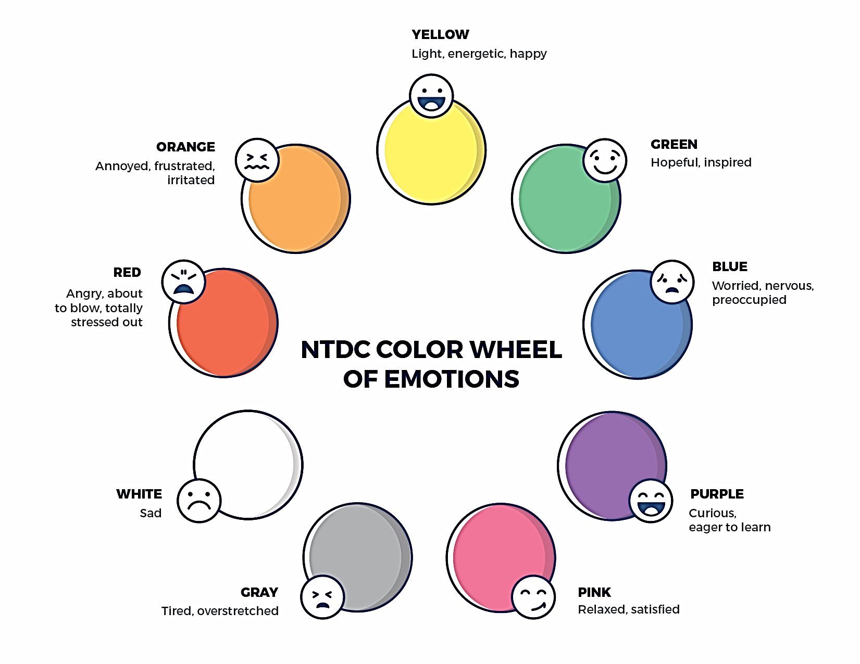
Welcome to the national training and Development Curriculum for foster and ADOPTIVE PARENTS adoptive parents
Notes:
FACILITATOR'S NOTE
Have this slide showing onscreen as participants assemble for the first class of the day. As participants come in, welcome them back and ask them to take a few minutes to do a self-check using the Color Wheel. NOTE: The Color Wheel should only be done one time per day; before the first theme of the day. If combining several themes together on one day, facilitate the Color Wheel at the beginning of the first class of the day as participants are coming into the room.
SAY
Welcome back. We are so glad that you have taken time out of your day to join us for another exciting learning opportunity. As you recall, tuning in to how you’re doing on a daily basis may not be something everyone here is used to, but this type of regular self-check is critical for parents who are adopting or fostering children who may have experienced trauma, separation, or loss, as it will be helpful to become and stay aware of your own state of mind. It may seem like a simple exercise but be assured that knowing how we’re doing on any given day strengthens our ability to know when and how we need to get support and/or need a different balance. Doing this type of check in will also help us to teach and/or model this skill for children! Please take a moment to look at the color wheel and jot down on paper the color(s) that you are currently feeling.
DO
Wait a little while to give participants time to complete the Color Wheel.
SAY
Now that everybody has had the opportunity to do a quick check in, would someone like to share what color(s) they landed on today for the Color Wheel?
DO
Call on someone who volunteers to share their color(s). If a challenging emotion or feeling is shared, thank the person and acknowledge their courage in sharing, pause for a moment, encourage everyone to take a deep breath, and transition to beginning the theme.

Slide 7
TRAUMA-INFORMED PARENTING
Modified January 2022
Notes:
FACILITATOR'S NOTE
Show this slide briefly just before you start the class.
SAY
Let’s get started! Welcome to the Trauma-informed Parenting theme.
7

Slide 8
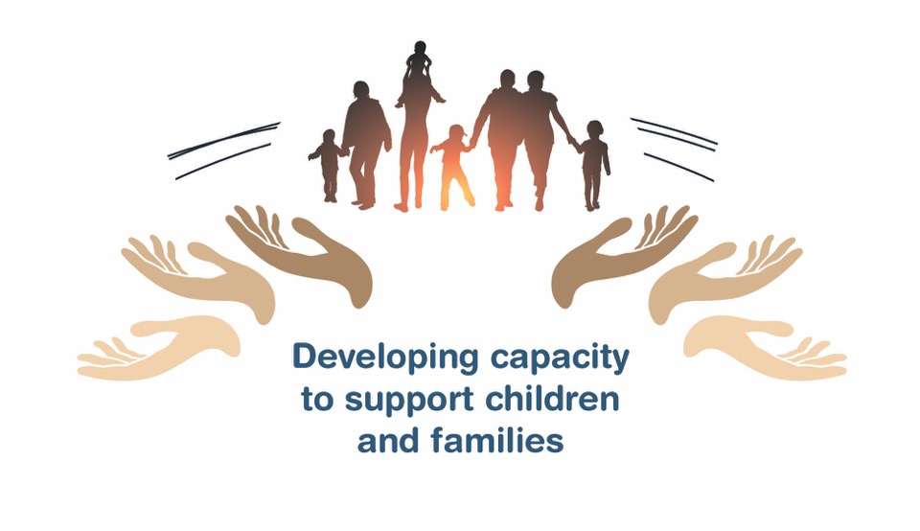
Place holder for slide with opening Quote
Notes:
FACILITATOR'S NOTE
The opening quote slide should only be used for the first theme of the day. If combining several themes together on one day, the opening quote slide would only be shown after the Color Wheel at the beginning of the first theme. It is important to always emphasize with this slide that this type of parenting involves lifelong learning and it will be critical for families to be invested in their own learning before and after a child is placed in their home.
PARAPHRASE
We are excited to share this lesson with all of you today. We are going to start with Trauma-informed Parenting. As the slide states, this information will help to develop your capacity to support children and families. Learning to parent in trauma informed ways is important when parenting children who are fostered and/or adopted. So, let’s dive in and see what important information we have to share with you today.
8

Slide 9
SECTION 1:
INTRODUCTION: TRAUMA-INFORMED PARENTING
Notes:
FACILITATOR’S NOTE
This section will take approximately 30 minutes.
PARAPHRASE
Listed below are the main topics that we will cover during this theme:
Children who have experienced trauma may have triggers that set off challenging behaviors. They need support from healthy adults to work through these challenges successfully.
Knowing and using the Three R’s (Regulate, Relate, and Reason) can be helpful when parenting a child who has experienced trauma.
When a child is triggered, the child’s intense emotion and challenging behaviors may trigger the parent as well. It is important for the parent to be aware of their own triggers and to regulate their own emotions and responses. This emotional co-regulation will help calm the child and de-escalate challenging situations.
It’s important to remember that parenting will bring successes as well as challenges. You will need to plan for the challenges and celebrate the successes!

Slide 10
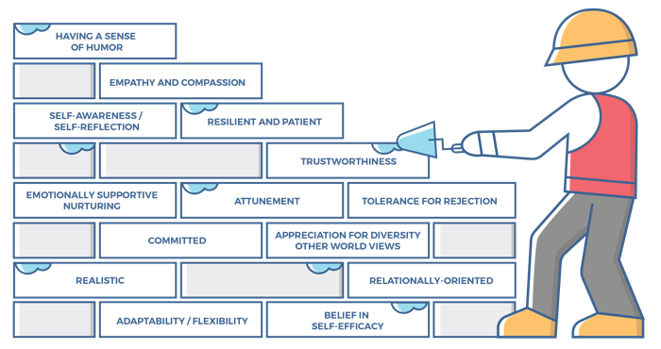
Characteristics of successful foster and adoptive parents
10
Notes:
FACILITATOR'S NOTE
This slide is shown at the start of each theme. Although the graphic will remain the same, the bricks that are colored in red will change based on the characteristics that will be touched upon in this theme. The characteristics were obtained from review of literature, stakeholder interviews, and review of existing curricula. We want families to become very acquainted with these characteristics throughout the training. It is important to note that in addition to the characteristics that are highlighted in red, there may be additional characteristics that are touched upon during the theme. Facilitators should try to connect these characteristics to the information they are sharing throughout the training. Remind participants that their Participant Resource Manual contains the definitions for these characteristics.
SAY
Before we get into the content lets look at the 14 characteristics of successful foster and adoptive parents. When you took your self-assessment, you were asked about these characteristics.

Slide 11
Characteristics for Trauma- Informed Parenting, 1 of 2
Self-awareness/Self-reflection:
Parents can identify why they have responded to a child in a certain way.
Parents can identify what was good, bad, and different about the way they were raised, while adjusting their own parenting to meet a child’s needs.
Parents can identify and forgive themselves for having negative feelings towards a child, moving from disappointment to acceptance.
Parents are aware of their own history of experiencing loss and being hurt and can identify how this history can negatively impact their parenting if they are not careful.
Trustworthiness:
Parents know that creating an environment of trust is the role of the parent.
Parents know that trust is based on understanding the importance of honesty, consistency, routines, and rituals, and they can implement these qualities/strategies in the home.
Parents are careful in what is promised to a child so that the parents can keep their word and meet the expectations they have set.
.
Notes:
SAY
The Trauma-Informed Parenting theme will cover the following characteristics:
Self-awareness/Self-reflection
Trustworthiness
Resilient and Patient
Tolerance for Rejection
Take a moment to think back to the report that you received after taking the self-assessment and how you assessed yourself with these characteristics. It is important as you start this journey to assess your characteristics as they are qualities that can strengthen your ability to successfully parent a child who is in foster care or has been adopted.

Slide 12
Characteristics for Trauma-Informed Parenting, 2 of 2
Resilient and Patient:
Parents see their role as helping a child achieve success in small steps, beginning with measurable, daily tasks.
Parents do not dwell on past mistakes or focus on the future in ways that pressure themselves or the child.
Parents celebrate small successes, teaching the child to appreciate the accumulative effect of each effort.
Parents have an ability to wait for answers /solutions without giving up.
Parents can withstand the child’s “testing” behaviors including hurtful, angry, or rejecting comments and actions.
Tolerance for Rejection:
Parents do not take hurtful comments or behaviors directed at them by the child personally.
Parents acknowledge that the rewards of parenting are not always immediate.
Parents provide a loving, nurturing environment to a child without receiving acknowledgment, gratitude, or reciprocal love.
Notes:
ASK
Now that we have reviewed the definitions, why do you think these specific characteristics are important to understanding a child that you may foster or adopt?
Reinforce with Participants:
Self-awareness/Self-reflection
Children who have a history of trauma and loss often exhibit behaviors that can easily trigger adult caretakers. Good self-awareness helps parents who foster or adopt not respond to the child with their own fight, flight, or freeze responses, but instead respond in ways that can help the child calm down and learn better ways to cope with their feelings.
Trustworthiness
Children who have experienced trauma and loss have often lost their trust in caretakers. By interacting with the child in honest and consistent ways, and by establishing predictable routines, and rituals, parents who foster or adopt can work to build trust with the child.
Resilient and Patient
Parenting a child who has experienced trauma and loss is often challenging, but by being able to see and celebrate small successes, the parent can help the child grow and heal.
Tolerance for Rejection
It’s not unusual for a child who has been hurt by experiencing trauma and loss to lash out with hurtful comments or behaviors with caretakers. The ability to not take this personally and to continue to provide a loving and nurturing environment offers the best opportunity to help the child grow and heal.

Slide 13

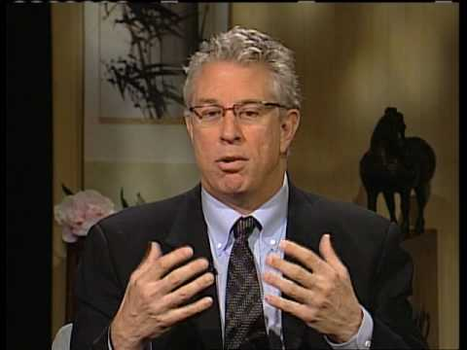
Guest: Bruce Perry, M.D.
Host: April Dinwoodie
PODCAST: TRAUMA-INFORMED PARENTING
Notes:
FACILITATOR'S NOTE
Listen to NTDC Podcast by Dr. Bruce Perry on Trauma-Informed Parenting (approximately 20 minutes) which can be obtained from the NTDC website or CapLEARN. Instruct participants to write down 3 points from Dr. Perry as they listen.
ASK
What points did you write down? (Have a few participants share).
PARAPHRASE
Reinforce the following points:
When a child is dysregulated (upset, angry, having or about to have a meltdown), Dr. Perry suggests that there are steps to reaching the child’s “thinking” brain (the Three R’s). First, we have to help a child Regulate (calm), then we help a child Relate (feel connected with us), and only then can we help the child Reason (think about what is happening and perhaps learn from it).
In order to be supportive when children are acting out, parents need to be aware of their own emotions.
Co-regulation acknowledges that it isn't just the child who needs to calm down. The parent and child's emotional responses both affect each other.
Children can recover and become more resilient. Children will develop at their own rate but, with care and support, they can begin to learn and grow.
We will talk more about the Three R’s in our next section.

Slide 14
SECTION 2:
SAFETY, SUPPORT, AND THE
THREE R’s
Notes:
FACILITATOR’S NOTE
This section will take approximately 40 minutes.
PARAPHRASE
In this section, we’ll discuss the need that all children, especially children who have experienced trauma, have for safety and support. Then we’ll discuss the Three R’s - Regulate, Relate, and Reason - as a tool to handle challenging behaviors while strengthening your relationship with the child. Finally, we’ll work through several case studies and examples.

Slide 15

Trauma and Parenting
Notes:
PARAPHRASE
Every child is unique, and every parent is unique. There is no one magic lesson on Trauma-Informed Parenting that will apply to everyone.
However, there are some general principles that can be helpful. As children develop, you can anticipate that they will go through the same stages and challenges (e.g., walking; toilet training; starting school; puberty; adolescent risk-taking), although they will often do it at different times and in different ways. These developmental stages are covered in the Child Development theme.
Because children do not all experience the same adversities or have the same supports available to them, no two children will have the same response. In general, you can anticipate that children who have experienced trauma may have some difficulty with developmental and emotional issues, including attachment. Children can have overdeveloped ways of responding to fear, moving quickly into fight/flight/freeze behaviors. While fight/flight/freeze responses are natural and helpful human responses to danger, children who have experienced trauma often overuse them, as they may often feel a sense of threat or danger.

Slide 16
TWO Key CONCEPTS
SAFETY
SUPPORT
Notes:
PARAPHRASE
There are some things you can do as a parent to help minimize these trauma reactions. Two key concepts are safety and support. We will talk about these concepts and some possible responses today. The Creating a Stable, Nurturing, and Safe Home Environment theme addresses additional helpful parenting responses.

Slide 17

Safety and Support, 1 of 2
SAFETY
Children need a space where:
They are safe.
They feel safe.
Schedules, rituals, and routines can help.
SUPPORT
Notes:
PARAPHRASE
When children do not feel safe, their arousal levels go up. and traumatic responses may kick in (overused fight, flight or freeze responses). Children need to know and feel that there is a safe place where they can go. It is important that parents who are fostering or adopting understand that there can be a difference between physical safety and felt safety for a child. A child who has experienced trauma may have trouble feeling safe in most places. Even when we cannot see any apparent danger, the child who has experienced the world as a dangerous place will carry this fear and worry with them. It may take more time and support for a traumatized child to have felt safety in certain situations, and their behavior will reflect their fear until felt safety has been experienced by the child. Felt safety can be developed when a caring adult modifies the child’s environment and learns how to respond in a way that helps the child feel safe. To do this, parents who are fostering or adopting will need to continuously show trustworthiness to the child (characteristic). This will entail doing what you say, keeping your promises, and being predictable.
Home should be a safe place - a place where children will not be harmed or be at risk of injury from others The home should be a place the child feels comfortable to be themselves and know that they will receive support, acceptance, and consistent care. Ideally, there will be several spaces in children's daily lives where they feel safe (such as their school, faith-based or other community spaces, relatives, or trusted friend or neighbors); however, when a child comes into a new situation, such as a new home or school, it will take time for the child to feel safe.
Modifying the child’s environment to help a child feel safe in the home:
Schedules can help a child feel safe. Consistency and predictability help a child feel safe. Anxiety sets in when a child is faced with uncertainty. The schedule should be shared with the child and if age appropriate, written out and placed where it is accessible to all.
As part of safety and scheduling, rituals and routines can help children feel safe as well. Having a routine way to get ready in the morning, (i.e., laying out clothes the night before, breakfast routines) and at bedtime (i.e., talking about tomorrow's schedule, reading a book before bedtime, saying prayers before lights out) allows the child to know what to expect, increasing their felt safety.

Slide 18
Safety and Support, 2 of 2
SAFETY
To handle adversity, children need a supporting relationship with a healthy adult.
SUPPORT
Notes:
PARAPHRASE
Despite a parent's best attempts, life will never go perfectly. Upsetting things will happen.
The most important factor in a child’s ability to tolerate adversity is having a supportive relationship with a healthy adult. This is particularly necessary for children who have experienced separation, loss, and trauma.
Ideally, the child should feel that the parent who is fostering or adopting them is a someone the child can turn to for support. It Is also important to find other safe, supportive adults that are available in places where the parent is not present (teacher, coach, neighbor, etc.).

Slide 19



NOT Punishment
Notes:
PARAPHRASE
When a traumatic response is triggered, the child may become overwhelmed and not able to think clearly. The child may engage in overdeveloped fight/flight/freeze behaviors. An adult who responds to this traumatic reaction by yelling at the child or immediately punishing the child will not help that child calm down and, in fact, may drive the child to overreact even more, making the situation worse.
For children who have experienced trauma, separation, or loss, punishment will likely escalate a situation, not solve it. These children will need help regulating before you can have any conversation or put in a consequence. In these situations, parents who are fostering or adopting need to regulate themselves, try to identify what might have caused the behavior, and help the child to regulate or calm.

Slide 20

Example
Notes:
PARAPHRASE
For example, let's assume a parent who is fostering or adopting gets up in the middle of a winter night and checks on a sleeping child who has kicked off their covers. As the parent is pulling the covers back up, the child wakes up. This child, who has a history of being sexually abused at night, now screams and hits the parent.
The parent, who has done nothing wrong, should not let the child continue to hit. But yelling at this child or punishing this child will not calm the child down. Nor will it help the child get back to sleep.
FACILITATOR’S NOTE
An example of how to handle this in an appropriate manner is described is included in the discussion on slides 22-24.

Slide 21
The Three R’s, 1 of 4
Reason
We can support the child to reflect, learn, remember, articulate and become self-assured.
3rd
2nd
Relate
We must relate and connect with the child through an attuned and sensitive relationship
1st
Regulate
We must help the child to regulate and calm their fight/flight/freeze responses.
Notes:
DO
Have participants look at the Handout #1 for this theme in their Participant Resource Manual.
PARAPHRASE
A better approach is a trauma-informed response that incorporates safety and support. This trauma-informed response uses the Three R’s: Regulate, Relate, and Reason. You heard Dr. Perry mention these in his podcast. Let’s look at Handout #1, The Three R’s - Reaching the Learning Brain, by Beacon House, that can be found in your Participant Resource Manual.
Dr. Perry spoke about the child who is dysregulated and needs help in calming down (Regulating). Then, the parent needs to connect with the child (Relate) enough for the child to start to feel safe again. Finally, the adult and child can talk and figure out how to move forward (Reason). In this way, a parent can help a child and set limits without being punitive.
Let’s take a closer look at each of these three steps.

Slide 22
The Three R’s, 2 of 4
Reason
We can support the child to reflect, learn, remember, articulate and become self-assured.
3rd
2nd
Relate
We must relate and connect with the child through an attuned and sensitive relationship
1st
Regulate
We must help the child to regulate and calm their fight/flight/freeze responses.
Notes:
PARAPHRASE
When a child who has experienced trauma is triggered (responding to something with a fight, flight or freeze response), their whole body is reacting, and they are in survival mode. As discussed in the Trauma-related Behaviors theme, the brain stem controls heart rate, blood pressure, and breathing, and all these can change when a child experiences a trauma trigger or feels fearful.
The child will not be able to have a rational discussion when their body is experiencing these physical reactions. This is what Dr. Perry described this as the reacting part of the brain, and that is what the child is responding to at that point. The first step that we must take is to help the child calm down (Regulate).
In the example where the child awakens and starts hitting the parent, the parent might step back out of range to stop the hitting, while assuring the child they are safe and encouraging the child to take some deep breaths; or count to ten.
Once the child has calmed, we then want to Relate.

Slide 23
The Three R’s, 3 of 4
Reason
We can support the child to reflect, learn, remember, articulate and become self-assured.
3rd
2nd
Relate
We must relate and connect with the child through an attuned and sensitive relationship
1st
Regulate
We must help the child to regulate and calm their fight/flight/freeze responses.
Notes:
PARAPHRASE
It is important now for the parent to emotionally reconnect with the child and try to understand what upset the child. This support engages the emotional part of brain that Dr. Perry referred to.
In the example about the child screaming and hitting the parent, the parent might acknowledge that the child was startled and apologize, even though the parent’s actions were well-intended. The parent can remind the child of where they are, who is in the room, and reassure them that they are safe. The parent needs to continue to reassure the child they are in a safe place and to focus on how the child is feeling (e.g., scared, anxious, angry, sad). In doing this, the parent needs to be aware of their tone, volume and proximity, making sure they are calming.

Slide 24
The Three R’s, 4 of 4
Reason
We can support the child to reflect, learn, remember, articulate and become self-assured.
3rd
2nd
Relate
We must relate and connect with the child through an attuned and sensitive relationship
1st
Regulate
We must help the child to regulate and calm their fight/flight/freeze responses.
Notes:
PARAPHRASE
Once the parent has helped the child regulate their behaviors and has emotionally reconnected with the calmed child, then they can talk about what happened and develop a plan to address the issues.
In the example, once the child is calmer and listening to the parent, the parent can explain why they were in the room. The parent can focus on soothing the child and getting them back to sleep. The next morning, they might talk about how to handle this situation in the future so that the child is not cold at night.
These discussions engage the highest level of brain, or the thinking and learning brain, and can happen only after the child has been calmed and emotionally engaged. This is why we work through the steps in order, Regulate first, then Relate, and finally Reason.
PARAPHRASE
Now, let’s do a few activities to help you develop your skills in using the Three R’s.

Slide 25
Enhancing Your Toolbox
Case Study
A 7-year-old child comes in dysregulated (angry, crying, and yelling) after playing outside with friends.
How can you use the first 2 steps of the Three R’s (Regulate, Relate)?
Notes:
FACILITATOR’S NOTE
In this activity, participants will work in small groups to think about ways to use the first 2 steps of the Three R’s with a 7-year-old child who comes in from playing with friends dysregulated. The group will share their ideas and responses and then consider how parents in that situation would feel. Each group will then do a brief report out on how they would engage with the child to help them move through the following steps: 1) Regulate 2) Relate.
Adaptation for Remote Platform: This activity can be modified for a remote platform by using the break-out rooms function in zoom to create small groups after the facilitator reads the case scenario. Or the activity can be done as a whole group activity with members using the chat function or sharing aloud how they would help a child 1) Regulate 2) Relate.
PARAPHRASE
Our first activity is a case study. I will read you the short scenario.
SAY
Imagine you are parenting a 7-year-old child who comes in after playing outside with some neighborhood friends, slams the door shut, and yells at the parent saying, “I hate this place and I hate you.” The child was crying as they came in.
ASK
First, how might the parent feel after this happens?
SAY
Now, I will break you into small groups to come up with a way you, as parents, could use the first 2 steps of the Three R’s. Remember - first, you need to Regulate (help the child calm down), then Relate (help the child feel connected with the parent).
You’ll have about 5 minutes, and then we’ll talk as a group to share some of your ideas.
DO
Circulate while participants work to provide encouragement and advice and to answer questions as needed.
At 4 minutes, give a 1-minute warning.
At 5 minutes, call the group back together.
ASK
Can I have a few volunteers to share their ideas with the full group?
PARAPHRASE
Thank you! That was a lot of great ideas, and a great job thinking about how a parent could help comfort a child who was overwhelmed and upset over an encounter with friends.

Slide 26

Option 1: Instant Family clip
Notes:
FACILITATOR’S NOTE
For the next activity, facilitators can choose one of 2 activities. In the first option, you will show and discuss a clip from the Instant Family. For the second option, you will engage the class in discussing a case scenario: A Field Trip to the Zoo. If you choose option 2, skip this slide and proceed to the next. Select only one of these activities as time will not permit you to do both.
If you chose option 1:
In this activity, you will show a clip from Instant Family and facilitate full-group discussion after watching the clip.
PARAPHRASE
Even when we try hard to understand the child and their past, we can’t always be aware of what might trigger a trauma reaction. We will watch a clip from Instant Family to illustrate an example for us to discuss.
DO
Show clip from Instant Family. Clips can be accessed by forwarding directly to the timestamps listed below and/or by clicking on the movie menu and forwarding to scenes, which will get facilitators closer to the timestamps. It is suggested that facilitators cue clips in advance to save time getting to precise timestamps. This clip from Instant Family (mom combing the daughter’s hair through the apology), lasts approximately 12 minutes. This scene can be found on the DVD scenes 10 and 11 (starting at scene 10) 1:01:28 thru (scene 11) 1:10:42.
PARAPHRASE
This is an example of not knowing when a trauma reaction has been triggered. Here, the new parent is being supportive. This would usually be a moment of bonding and attachment. However, for a traumatized child, starting to feel close to another adult may trigger a warning not to trust that adult and risk getting hurt again. It is important that the parent who fosters or adopts be able to tolerate rejection and understand what is underneath the rejection for the child (characteristic). It can also conflict with the child's feelings of attachment to their parent, making the child feel disloyal. Thus, a child's initial positive emotional experience can end up generating grief, loneliness, and other complicated emotions in that same child.
ASK
How do you think the mother feels in clip shown? What does this bring up for her?
What does the dad do to help Regulate and Relate to the child?
What did you think of this delayed explanation and apology?
Did it seem sincere?
Why didn't the daughter say all of this sooner?
Before we get into the next section, let’s take a 10-minute break.

Slide 27

Option 2: Role Play –
A Field Trip To the ZOO
Notes:
FACILITATOR’S NOTE:
This activity should only be done if not using Option 1.
In this activity, a facilitator will read a short case scenario for the group about a conversation between a 10-year-old and a parent. The child has a strong reaction to something the parent says about going to the zoo as part of a class field trip. The parent does not know that the reason the child is upset is that the child went to the zoo last year and got separated from the group and was very scared. When the teacher found the child, the teacher was angry, and the child got into trouble.
The scenario will be used to help the class to come up with reasons why the child may have reacted so strongly to the news about the field trip.
The last step will be for the group the think about the last step of the Three R’s, and how they could help the calmed child Reason.
SAY:
I am going to read a short scenario between a parent and child, and then we will put our heads together to try to figure out what could possibly be going on for the child.
DO:
Read the Scenario: A 10-year-old child has recently been placed in the home. The parent receives information from the child’s teacher that the child’s class will be going on a field trip to the zoo. The parent already knows that the child likes animals, so the parent says with enthusiasm to the child, “Hey, I’ve got some exciting news for you. Next week, your class will go on a field trip to the zoo!” The parent is surprised when the he begins to cry and shouts, “I hate the zoo! You can’t make me go on that stupid trip!”
PARAPHRASE
At this point, the parent is totally confused. It’s easy to understand why. The parent really thought they were sharing news that would be fun and exciting for the child.
DO
Facilitate a discussion around the following questions:
What are some possible reasons why the child might have responded in this way?
Would it help if the parent begins to scold the child for yelling and being rude? [Note: This would probably not help. It might escalate the child more or make the child more distant from the parent, because scolding does not attend to child’s real worry and feelings].
PARAPHRASE
The parent recognized that there must be something “underneath” the child’s behavior. The parent does not scold but calmly begins to help the child calm down (Regulate) and feel more connected with the parent (Relate). The child then shared the story of going to the zoo last year with his previous class/school, and that he got lost from the group during the trip, and this was really scary. When their teacher found him, the teacher was angry, and the child got into trouble.
If the parent had not dug into the reasons for the child’s yelling, and instead responded only to the child’s yelling or told the child to stop being silly, the parent would never have learned what the triggered the child’s behavior. The parent would have missed the opportunity to help the child feel safer (Regulate and Relate) and then work together to come up with possible solutions (Reason).
ASK
Can anyone in the group think of any examples of things that may help the child feel safer about the trip? By talking with the child about possible solutions, and including the child’s ideas, the parent will be helping the child achieve the last step of the Three R’s- Reasoning.
DO
Facilitate a discussion, asking group members to think of suggestions that might be helpful for the child. Examples of ideas that might help (if not mentioned by group):
Parent could ask the child what might help them feel safer if they go on the trip and offer some of their own ideas.
Parent could volunteer to be a chaperone.
Develop a safety plan with the child in case he ever gets lost again.
PARAPHRASE
We’ve learned a lot about how to address behaviors that may result from a child’s traumatic experience by providing safety and support and using the Three R’s. In the next section, we’ll go deeper into the emotions that may arise in this process.
Before we get into the next section, let’s take a 10-minute break.

Slide 28
BREAK
10 minutes
Notes:
FACILITATOR'S NOTE
Allow for a 10-minute break.
28

Slide 29
SECTION 3:
EMOTIONAL CO-REGULATION
Notes:
FACILITATOR’S NOTE
This section will take approximately 35 minutes.
PARAPHRASE
One important thing to realize is that the parent’s responses and the child’s responses interact. If the parent escalates by getting angry, the child may also escalate more, and the emotional intensity will increase. If the parent stays calm, it will help calm the child, and the emotional intensity will decrease. This is called emotional co-regulation, which is what we will be working on in this section.

Slide 30

Triggers and Emotional Intensity
Notes:
PARAPHRASE
As we discussed earlier, we know that a supportive relationship with a healthy adult is essential for a traumatized child. But we also know that it can be very hard for the child to feel close and connected, especially to somebody in a parent role.
Often, children who have experienced trauma will push back against a caring parent, not trusting their intentions and are fearful of closeness. Sometimes an older child distancing from a parent will be an attempt at developmental adolescent independence; other times, it may be due to the child's past, with the child assuming the parent is like previous adults who have let them down or hurt them in some way; or the child may be trying to get the parent to reject the child as other adults have done, proving the new parent can't be trusted either.
This can get emotionally intense. Children may become angry with the parent and defy the rules, falsely accuse a parent, or escalate into fight/flight/freeze behaviors. The characteristics of being resilient/patient and able to tolerate rejection are critical for the parent who is fostering or adopting to stay committed and invested in the child (characteristics).

Slide 31
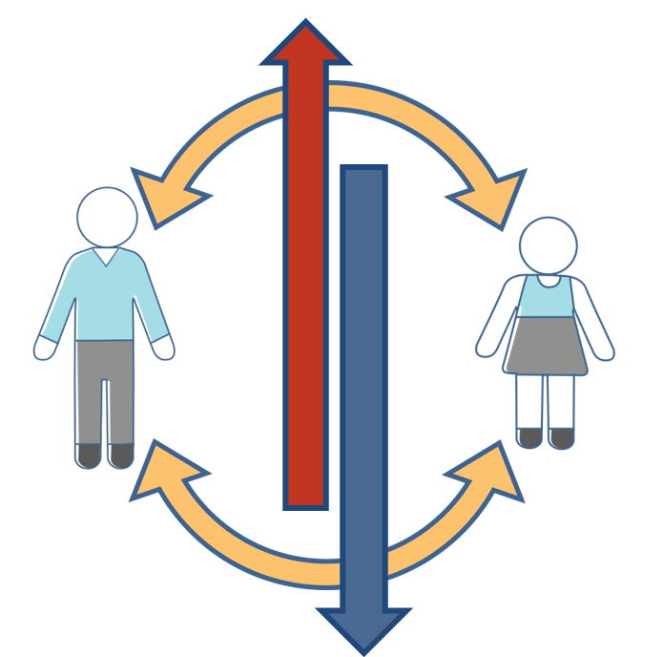
Emotional Co-Regulation
The PARENT'S response and the CHILD'S response interact, either to calm or increase the emotional intensity.
31
Notes:
PARAPHRASE
Successfully navigating these intense "emotional punches" requires emotional co-regulation. As we have discussed, the parent’s response and child’s response interact, either to calm or increase the emotional intensity. If the parent can remain calm during these emotionally intense situations, that will help the child begin to calm down as well. If, instead, the parent gets angry or upset, the child will escalate. Thus, the parent needs to remain calm and in control. The child will work hard to push a parent's “buttons,” trying to get the parent more upset and divert the conversation away from the child's inappropriate behaviors. Parents need to manage their own range of emotions, avoid reactive behaviors and, instead, increase their empathy.
All of this will require a great deal of self-awareness (characteristic). An adult who is getting more upset will not be able to calm a child. It is important to remember that the concerning behaviors, which are inappropriate now, are often behaviors that helped the child survive in previous threatening situations.

Slide 32
Podcast-The Emotional Container In Real Life
NCTSN* Resource Parent Curriculum Podcast
Host: Resource Parent- Diane Lanni
Notes:
FACILITATOR'S NOTE
Listen to the podcast by Diane Lanni on Trauma-Informed Parenting (3 minutes and 21 seconds) which can be obtained from the NTDC website or CapLEARN. Instruct participants to listen to how Diane Lanni helps her son Regulate or calm down? (This podcast can also be found on the National Child Traumatic Stress Network website.)
ASK
What did you hear going on in this podcast?
How did Diane Lanni help her son calm down through co-regulation? (She remains calm and supportive during the call. She understands what’s behind her son’s behavior and what has been triggered for him- fear of abandonment.
What do you think would have happened if Diane also “lost her cool” in response to her son’s behavior?

Slide 33

Reflection/
RElevance
Notes:
FACILITATOR'S NOTE
If time permits do this reflection in class. If time is short, ask participants to do on their own at home. This activity should take approximately 5 minutes.
SAY
Now, we’ll take a few minutes to reflect on what we’ve learned in this theme.
Now, please open your Participant Resource Manual for this theme. Think about Diane Lanni and her son. Now, think about a child having a meltdown, yelling at you and calling you names.
Please write your thoughts regarding the following questions in your Participant Resource Manual.
How do you think it would feel to you?
What might be your first reaction?
How would you get yourself ready to help the child co-regulate?
What support might you need?
33

Slide 34
Adults can Also be Triggered
Notes:
PARAPHRASE
An adult can go through the same calm to alarm stages as the child. Remember, it’s natural for all of us to respond to threat with a fight, flight, or freeze response. First, it is essential for parents to be able to recognize what emotional state they are in. Then, the parent can calm down, become more attuned to the child, and help that child become more regulated.
In these instances, parents may want to use the Three R’s to help calm themselves first.
ASK
How can the parent help themselves Regulate (calm), Relate (feel connected), and Reason (problem-solve)?
PARAPHRASE
Parents need to understand that progress is not always linear. A child may be doing well for a long time and then slip back into older, less healthy behaviors when retriggered. The parents need to recognize the developmental level of the child's response, be patient, and work through these tough times.
Next, we’ll watch a video that demonstrates two different ways of responding to when a child is upset and directly challenges the parents.

Slide 35
Video: Living Room scenes 1 and 2
Notes:
FACILITATOR’S NOTE
The facilitator will show two videos. (Show one and then have discussion, and then you will show the other followed by discussion.) In the videos, actors demonstrate a parent responding to a fourteen-year-old who breaks a vase. The child lies about breaking it and then angrily lists things that the parent has been doing wrong. After viewing the clip, facilitate a full-group discussion about the situation.
Allow 10 minutes for the video and discussion.
DO
Show the first short NTDC video clip (Living Room Scene 1) from the NTDC website or CapLEARN.
Facilitate a discussion around these questions:
How do you describe the child’s reaction to breaking the vase?
Look for answers such as: The child responds that they didn’t do it and becomes emotionally upset and defensive, the child immediately begins to blame the parent.
Why do you think the child responds this way?
Look for answers such as: the child may have experienced harsh discipline or abuse, so they are very fearful and go into “fight” response.
What is the parent’s reaction?
PARAPHRASE
Now we will watch the second video clip. Pay close attention to how the parent’s reaction affects the child’s reaction.
DO
Show the second short NTDC video clip (Living Room Scene 2) found on the NTDC website or CapLEARN.
.
Facilitate a discussion around these questions:
Eventually, what does the parent do that that helps child calm down?
How do you think the parent’s response helped the child become Regulated and then be able to Relate and Reason?
Let’s also remember that some children will react to fear with more of a flight-or-freeze response, such as running away or withdrawing. They too will need help in feeling safe. They will need your help to Regulate (calm down and feel safe enough not to run or withdraw), Relate, and Reason about a problem.

Slide 36

CELEBRATE SUCCESSES
Notes:
PARAPHRASE
While children who have experience trauma can present with challenging behaviors, parents who are fostering and adopting need to celebrate the successes. This will mean learning to celebrate small successes. Parents need to be flexible in their thinking and to redefine their expectations and their idea of success. Something, such as a child coming home from school one day without a negative comment about their behavior could truly be a success and should be celebrated. Find and focus on the positive accomplishments of the child.
Families can do this by:
Having lots of private celebrations for the child’s achievements that might embarrass the child if known publicly (e.g., passing a test in a subject they were failing or talking out a disagreement rather than becoming aggressive).
Setting small goals for the family and then recognizing the achievement of these goals.
Celebrating birthdays, anniversaries, and holidays.
Supporting one another after difficulties - take a night off.
Rewarding positive behaviors of the child and parents.
Finding fun activities the parents and child can share in and enjoy together.
DO
Facilitate a brief discussion of ways to celebrate the child’s successes.
PARAPHRASE
We’re almost finished. Let’s wrap up.

Slide 37
SECTION 4:
WRAP-UP
Notes:
FACILITATOR’S NOTE
This section will take approximately 5 minutes.
SAY
Now, it’s time to wrap up. Before we do, I want to briefly highlight the key points from this theme:
In parenting a child who has experienced trauma, keep in mind the importance of a child feeling safe and supported and that co-regulation will be more helpful to the child than punishment.
Intervening with a child who has experienced trauma and is upset includes helping the child calm (Regulate), then reestablish your supportive relationship with the child (Relate) and helping the child to Reason through the issue (Three R’s).
To help a child who has experienced trauma, a parent must be able self-regulate. This can be challenging when the parent feels the child is intentionally provoking the parent. (Remember the Three R’s for the parent as well.)
A child who has experienced trauma can recover but it will take time and patience.

Slide 38

LIFELONG Learning
Notes:
SAY
It is critical that as you go through this journey, you continue to enhance your knowledge and skills. It is important that you continue your own learning by taking advantage of resources that are available to you. This theme has numerous resources that will help you continue to learn more about this topic. For example, you can find a video created by Dr. Bruce Perry called Sequential Engagement to hear more about the importance of the Three R’s when fostering or adopting a child with a history of trauma. You can find the resources on the NTDC website or in CapLEARN.

Slide 39
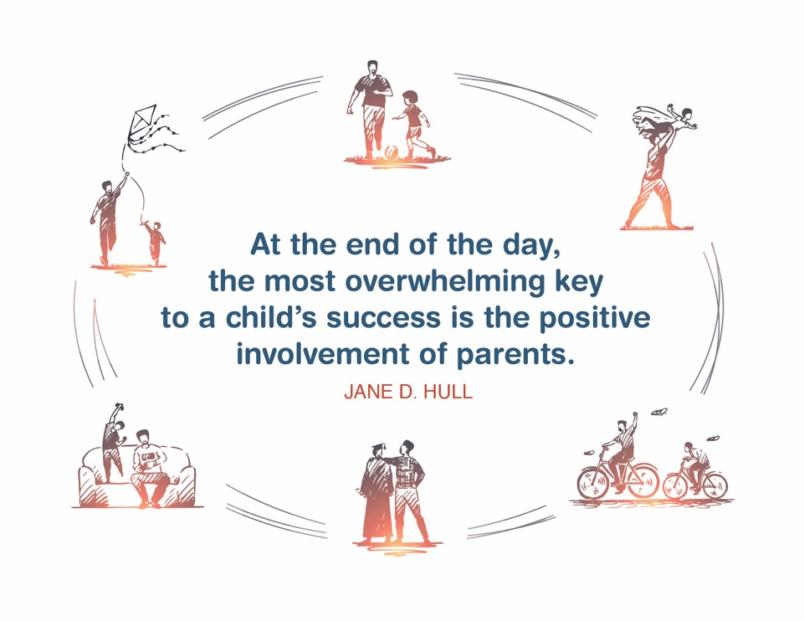
Place holder for slide with Closing Quote
Notes:
FACILITATOR'S NOTE
The closing quote above and the paraphrase section below will be done only once per day, after the last theme presented for the day. If you are moving on to another theme invite them to take a break, stretch, or breathe, before moving on to the next theme.
If closing for the day:
Thank everyone for attending and for their thoughtful participation and attention. Remind the participants that although this training may seem long, it is critical for them to gather the knowledge, attitude, and skills that are needed as they embark on this journey because they ultimately will play a huge role in the lives of children and families.
If in person, collect the name tents or have them tuck them into their Participant Resource Manual to bring back to the next class.
PARAPHRASE
Close out the day by covering the below topics:
Remind participants of the date/time for the next class and let participants know if there are any changes to the location.
Encourage participants to contact you (or other facilitators) if they have any questions or concerns.
Review the themes that will be covered during the next class.
If in person, remind participants to take their Participant Resource Manual with them and to bring them to the next session. If using a remote platform, remind participants to have the Participant Resource Manual available for the next class.
39

Slide 40
For more information, visit:
Notes:
40

Slide 41
.
This curriculum was funded by the Children’s Bureau, Administration on Children, Youth, and Families, Administration for Children and Families, US Department of Health & Human Services, under grant #90CO1132. The contents of this curriculum are solely the responsibility of the authors and do not necessarily represent the official views of the Children’s Bureau.

