Slide 1
TRAUMA-RELATED BEHAVIORS
FACILITATOR CLASSROOM GUIDE
Modified January 2022
Notes:
TRAUMA-RELATED BEHAVIORS
FACILITATOR CLASSROOM GUIDE
January 2022

Slide 2
To prepare for the class
See Notes view
Notes:
To prepare for this class, you should:
Review the facilitator preparation information included in this Guide along with the handouts.
Review the Resources for this theme found on CapLEARN (https://learn.childwelfare.gov/) or NTDC website (https://ntdcportal.org/).
Develop an agenda that includes this theme and any other themes you will be conducting along with it during the class.
Ensure that participants have a copy of the Participant Resource Manual. This Manual will be used during all themes and will include the handouts needed by participants. Facilitators should have copies of the handouts for the theme available in case participants do not bring their Manual to class. If the theme is being taught on a remote platform, facilitators should have the handouts available so that they can share in the chat and/or email to participants who do not have their Manual.
Bring any materials you need for the activities.
Review any videos or other electronic media used in this theme, if any, and plan the mechanics of how you will present them. Media for this theme are listed in the Materials and Handouts slide. Review the instructions for each media clip (e.g., to pause or stop at a particular time stamp). The videos can be played in different ways, including:
Play them from a flash drive or the computer’s hard drive using a media player app
Link to them from CapLEARN or the NTDC website.
Please note that all clips from Instant Family movie must be played directly from the Instant Family DVD or the movie can be streamed using the code provided in the DVD case. It is also available on some TV and Video streaming services (i.e., Prime Video- Amazon.com).
Practice playing the media for the theme. Ensure that you have the files and apps you need, that your links and connections work, and that you know when to pause or stop the media clip if appropriate.
If training on a remote platform, make sure all participants have the link available to access the class and that you have all videos, PPT’s and handouts ready for use.
If training in person, ensure that a room is available and set up, with the following:
Enough tables and chairs for all participants
Projector and screen (check that it works with the computer you will be using)
Classroom activities have been adapted so that they can be done on a remote platform. Adaptations will be marked as follows so that they can be easily spotted throughout the Facilitator Classroom Guide: Adaptation for Remote Platform
PREPARATION

Slide 3
MATERIALS AND HANDOUTS
See Notes view
Notes:
FACILITATOR'S NOTE
Participants are expected to have the Participant Resource Manual available for every session.
MATERIALS NEEDED
You will need the following if conducting the session in the classroom:
A screen and projector (test before the session with the computer and cables you will use)
A flipchart or whiteboard and markers for several of the activities. A flipchart with a sticky backing on each sheet may be useful and will allow you to post completed flipchart sheets on the wall for reference.
Name tent cards (use the name tent cards made during the Introduction and Welcome theme)
You will need the following if conducting the session via a remote platform:
Access to a strong internet connection
A back-up plan in the event your internet and/or computer do not work
A computer that has the ability to connect to a remote platform- Zoom is recommended
HANDOUTS
Have the following handouts accessible. Participants will have all handouts listed below in their Participant Resource Manual:
Handout #1: Identifying States
Handout #2: Holiday Dinner Scene (Option 2 if not showing the Instant Family clip)
Handout #3: Predictable Escalating and De-escalating Behaviors Chart
VIDEOS AND PODCASTS
Before the day when you will facilitate this class, decide how you will show/play the media items, review any specific instructions for the theme, and do a test drive. You may wish to set up the media to the start point. Unless indicated otherwise below, all videos and podcasts can be obtained on CapLEARN (https://learn.childwelfare.gov/) or NTDC website (https://ntdcportal.org/).
The following media will be used for this theme:
Brain Basics (2:34 minutes)
State Dependent Functioning (6:11 minutes)
Instant Family video clip (separate DVD)- time stamps to scene found on slide 28
EVALUATION
There is a pre- and post-survey available for every theme. If the facilitator wants to use these evaluation tools, they will need to be downloaded from the NTDC website or CapLEARN and provided to participants. Participants will need to complete the pre-survey prior to the theme and the post-survey upon completion of the theme. If conducting the class on a remote platform, the facilitator will need to put the surveys into an online format such as survey monkey.
MATERIALS AND HANDOUTS

Slide 4
Theme and competencies
See Notes view
Notes:
FACILITATOR'S NOTE
Before beginning, review the theme and competencies. You will not read these aloud to participants. Participants can access all competencies in their Participant Resource Manual.
THEME AND COMPETENCIES
4

Slide 5
Suggested agenda
See Notes view
Notes:
FACILITATOR'S NOTE
This notes page shows a suggested agenda and timing for this theme. Before the theme, please review this agenda and incorporate it into your overall agenda for this and any other themes you are conducting along with it.
AGENDA
This theme is divided into four sections. This content is based on 2 hours of classroom material (including a 10-minute break).
BEFORE YOU BEGIN THE CLASS
Before discussing the Color Wheel of Emotions and covering the content of this theme, you should do the following:
Make any announcements that are needed regarding the training, timing of training, or process to become a foster or adoptive parent.
Take out the Participant Resource Manual and direct participants to this theme in their Manual. Remind participants that the Competencies for today’s theme are in their Manual.
Review the agenda for the theme.
Encourage participants to be engaged and active learners.
Encourage participants to contact you in between classes with any questions and/or concerns. (Prior to class, list the name(s) of the facilitators on the board with contact information.)
Remind participants to put out their name tents.
SUGGESTED AGENDA

Slide 6
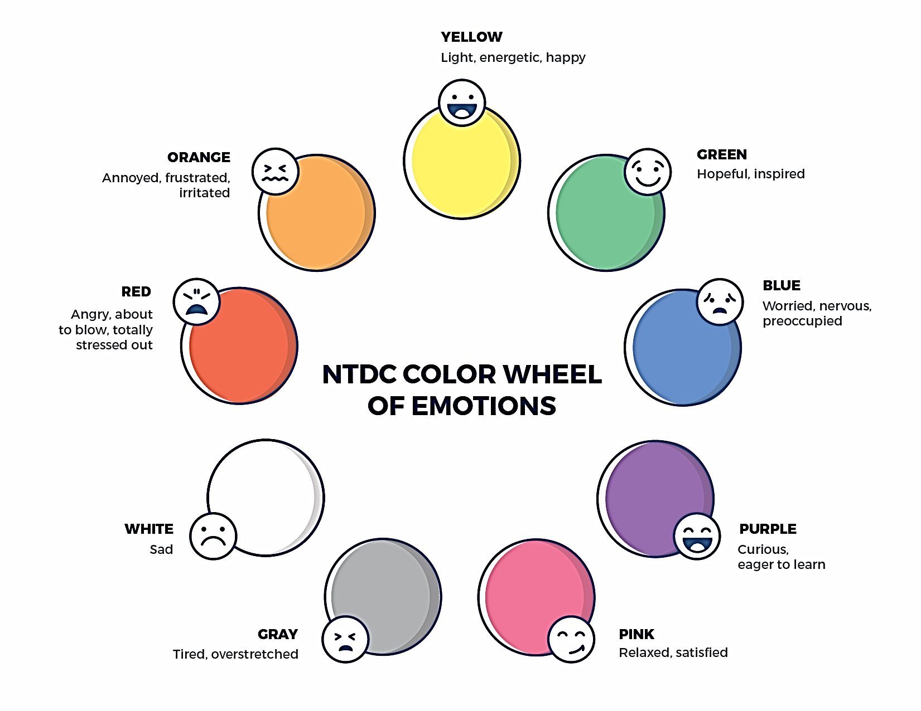
Welcome to the national training and Development Curriculum for foster and adoptive parents
Welcome to the national training and Development Curriculum for foster and adoptive parents
Notes:
FACILITATOR'S NOTE
Have this slide showing onscreen as participants assemble for the first class of the day. As participants come in, welcome them back and ask them to take a few minutes to do a self-check using the Color Wheel. NOTE: The Color Wheel should only be done one time per day; before the first theme of the day. If combining several themes together on one day, facilitate the Color Wheel at the beginning of the first class of the day as participants are coming into the room.
SAY
Welcome back. We are so glad that you have taken time out of your day to join us for another exciting learning opportunity. As you recall, tuning in to how you’re doing on a daily basis may not be something everyone here is used to, but this type of regular self-check is critical for parents who are adopting or fostering children who may have experienced trauma, separation, or loss, as it will be helpful to become and stay aware of your own state of mind. It may seem like a simple exercise but be assured that knowing how we’re doing on any given day strengthens our ability to know when and how we need to get support and/or need a different balance. Doing this type of check in will also help us to teach and/or model this skill for children! Please take a moment to look at the color wheel and jot down on paper the color(s) that you are currently feeling.
DO
Wait a little while to give participants time to complete the Color Wheel.
SAY
Now that everybody has had the opportunity to do a quick check in, would someone like to share what color(s) they landed on today for the Color Wheel?
DO
Call on someone who volunteers to share their color(s). If a challenging emotion or feeling is shared, thank the person and acknowledge their courage in sharing, pause for a moment, encourage everyone to take a deep breath, and transition to beginning the theme.

Slide 7
TRAUMA-RELATED BEHAVIORS
Modified January 2022
Notes:
FACILITATOR'S NOTE
Show this slide briefly just before you start the class.
SAY
Let’s get started! Welcome to the Trauma-related Behaviors theme.
7

Slide 8
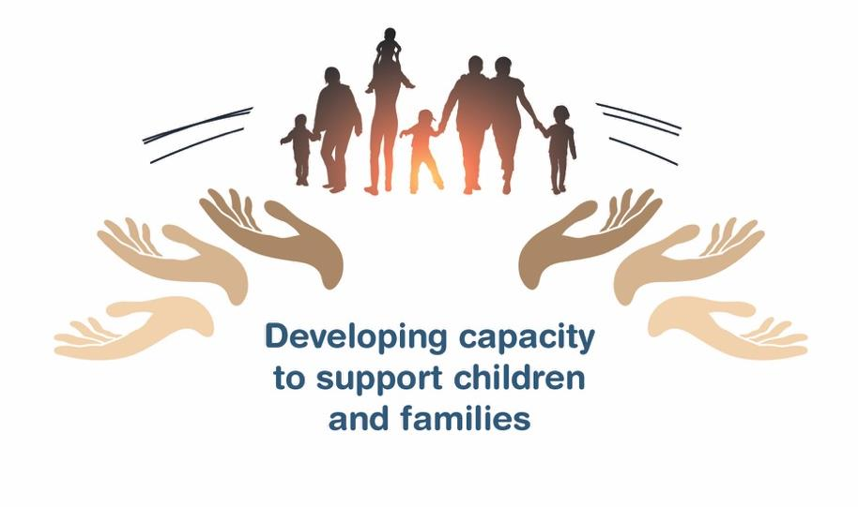
Place holder for slide with opening Quote
Notes:
FACILITATOR'S NOTE
The opening quote slide should only be used for the first theme of the day. If combining several themes together on one day, the opening quote slide would only be shown after the Color Wheel at the beginning of the first theme. It is important to always emphasize with this slide that this type of parenting involves lifelong learning and that it will be critical for families to be invested in their own learning before and after a child is placed in their home.
PARAPHRASE
We are excited to share this lesson with all of you today. We are going to start with the Trauma-related Behaviors theme. As the slide states, this information will help to develop your capacity to support children and families. This type of parenting will require continuous learning. So, let’s dive in and see what important information we have to share with you today.
8

Slide 9
SECTION 1:
INTRODUCTION: TRAUMA-RELATED BEHAVIORS
Notes:
PARAPHRASE
Today, we will be talking about the following:
When children experience separation, loss, and trauma, their brains often develop differently from children who feel safe and consistently cared for.
While the effects of trauma are different for each person, we know that the effects can be far-reaching and can influence every part of the brain, which in turn can impact how the body functions. Trauma can impact our physical health as well as complex brain functions like our ability to learn or how we form relationships.
Children’s responses when fearful or anxious are often rooted in survival instincts and that protected them when they felt unsafe. Children will need adult support to help them learn new ways of interacting now that they are safe.
Parents who are fostering or adopting can help children manage these behaviors and heal from their separation, loss, and trauma by co-regulating - staying calm to help the child learn how to become and stay calm.

Slide 10
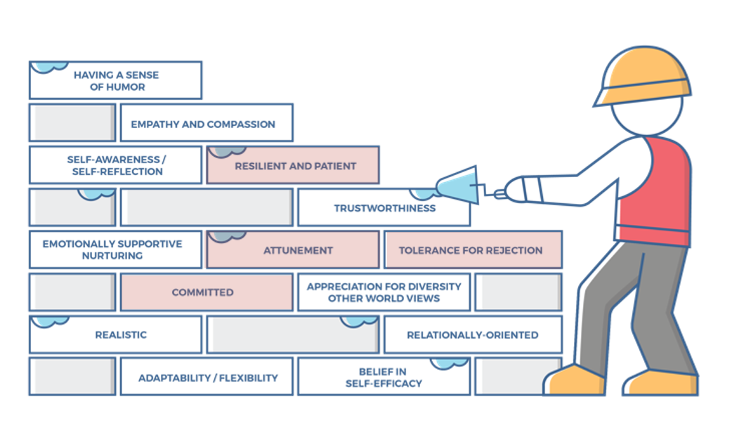
Characteristics of successful foster and adoptive parents
10
Notes:
FACILITATOR'S NOTE
This slide is shown at the start of each theme. Although the graphic will remain the same, the bricks that are colored in red will change based on the characteristics that will be touched upon in this theme. The characteristics were obtained from review of literature, stakeholder interviews, and review of existing curricula. We want families to become very acquainted with these characteristics throughout the training. It is important to note that in addition to the characteristics that are highlighted in red, there may be additional characteristics that are touched upon during the theme. Facilitators should try to connect these characteristics to the content they are sharing throughout the training. Remind participants that their Participant Resource Manual contains the definitions for these characteristics.
SAY
Before we get into the content lets look at the 14 characteristics of successful foster and adoptive parents. When you took your self-assessment, you were asked about these characteristics.

Slide 11
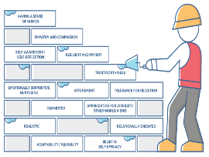
Characteristics for Trauma-Related Behavior, 1 of 2
Attunement:
Parents are aware of, understand, and are sensitive to the specific responses and needs of a child at any given time (despite the degree to which the child expresses or does not express these needs directly).
Parents are in tune with the child’s moods, levels of exhaustion, hunger, rhythms, responses, need for physical contact, affection, security, and stimulation, and use this understanding to build a trusting environment with the child.
Parents understand that they need to stay calm and regulated so that they can successfully help the child regulate their emotions.
Committed:
Parents are dedicated to a child, sticking with them no matter how difficult the journey.
Parents carefully and consciously consider the requirements of parenting a child and understand that it is not about fulfilling their own parental needs.
Parents recognize the role may not offer much validation or reinforcement of their skills and talents but are willing to commit to the long-term work of unconditional parenting and promoting the child’s well-being.
Parents believe in commitment and can persevere in the face of adversity.
Parents have a secure commitment to the child, knowing they are doing the right thing.
Notes:
SAY
The Trauma-related Behaviors theme will cover the following characteristics:
Attunement
Committed
Resilient and Patient
Tolerance for Rejection
Take a moment to think back to how you assessed yourself with these characteristics. It is important as you start this journey to assess your characteristics as they are qualities that can strengthen your ability to successfully parent a child who is in foster care or has been adopted.

Slide 12
Characteristics for Trauma-Related Behavior, 2 of 2
Resilient and Patient:
Parents see their role as helping a child achieve success in small steps, beginning with measurable, daily tasks.
Parents do not dwell on past mistakes or focus on the future in ways that pressure themselves or the child.
Parents celebrate small successes, teaching the child to appreciate the accumulative effect of each effort.
Parents have an ability to wait for answers /solutions without giving up.
Parents can withstand the child’s “testing” behaviors including hurtful, angry, or rejecting comments and actions.
Tolerance for Rejection
Parents don’t take hurtful comments or behaviors directed at them personally.
Parents acknowledge that the rewards of parenting are not always immediate.
Parents provide a loving, nurturing environment to a child without receiving acknowledgment, gratitude, or reciprocal love.
Notes:
ASK
Now that we have reviewed the definitions, why do you think these specific characteristics are important to a child who had experienced trauma?
Reinforce the following:
Attunement:
Children who have experienced trauma, are often quick to become dysregulated and they need caring adults who can stay calm so that they can help the child calm.
Being attuned to the child emotional needs (i.e., moods and feelings of security) and physical needs (i.e., hunger, levels of exhaustion) will help a parent respond positively to those needs and gradually build the child’s trust and sense of safety.
Being attuned means paying attention to more than words, there are many subtle clues that can help adults learn when a child is starting to go into survival mode.
Committed:
It takes a great deal of commitment from the parent to understand what the behaviors mean, rather than just reacting to the behaviors.
It can feel challenging to parent when children behaviors are difficult. Like all children, they need a safe, nurturing home environment with parents who are able to stay committed to meeting their needs and will hang in there while the child gradually develops trust. It will take time.
Resilient and Patient:
Caring, patient caregivers who have realistic expectations will be most successful with children who have experienced trauma.
It will be important to notice and celebrate the small steps of progress- each one matters, and they will be fuel to help you and the child keep going.
Tolerance for Rejection
At times, survival behaviors will look as though the child is rejecting the parent who is fostering or adopting them. As a result, parents will need to have tolerance for rejection and learn not to take things that the child does or says personally.
Children who have experienced trauma often are filled with guilt and shame and may feel unworthy of love and care. As a result, they may try to push you away with their words or behaviors. It is important not take these moments to heart as they are not about you and much more about their past experiences.

Slide 13
SECTION 2:
THE SCIENCE OF TRAUMA
Notes:
FACILITATOR’S NOTE
Allow 60 minutes for this section.
PARAPHRASE
To understand how trauma has impacted a developing child, we are going to take a deeper look at what goes on in the brain and body after a person has experienced trauma. This will help us to better understand what is going on underneath a child’s behaviors.

Slide 14

Brain Basics
Notes:
PARAPHRASE
Let’s watch this short video about the basics of how the brain works.
DO
Play the video Brain Basics (runtime: 2:34.) It can be found in CapLEARN (https://learn.childwelfare.gov/) or on the NTDC website (https://ntdcportal.org/)
ASK
How does understanding the hierarchy of the brain that Dr. Perry was talking about give you better insight into confusing or challenging behaviors of a child?
DO
Facilitate a discussion around participants’ answers to this question.
Reinforce answers like:
When children feel scared, they act in the present as if the trauma/abuse/loss is still occurring.
Children who have experienced trauma are not trying to misbehave, nor do they have complete control over their behavior until they feel safe enough to learn new patterns and skills.

Slide 15

Behavior and The Confused Brain
Notes:
PARAPHRASE
Behaviors of children who have experienced loss and trauma are often perplexing to adults. As you heard in the video, the brain of the child is processing the present as if it were the past. The child is frequently not responding from the higher levels, or “smart part” of the brain and rather is acting, interacting, and reacting from the more primitive, lower parts of the brain, which do not have the ability to reason like we might expect. What makes this especially hard to for us to keep in mind is that the brain is invisible to us from the outside. We are often looking at a child whose face or words do not tell us that their brain is functioning in a very underdeveloped way in these moments. Parenting a child who has experienced trauma and loss requires the parent to be attuned to the child’s level of functioning. It takes a great deal of commitment from the parent to understand what is beneath the behaviors versus just reacting to the behaviors (characteristics).

Slide 16

State-Dependent Functioning
A small sampling of emotional states
Notes:
PARAPHRASE
Let’s talk for a moment about the concept of “states.” Understanding ‘state-dependent’ functioning is the key to understanding many trauma-related behaviors.
ASK
Can anybody give a definition for the “state” of a person? Here’s a hint, it is not the same as a “trait.”
DO
Facilitate a brief discussion.
If needed, repeat the question “What is a state?”
If nobody has an answer - or if nobody gets the right answer after a few tries, give or reinforce the answer below.
States are temporary behaviors or feelings that depend on the person’s situation at a point in time, like being tired, hungry, irritable, etc.
FACILITATOR’S NOTE
Unlike states, traits are stable characteristics about the person that tend to show through in most situations over time, i.e., intelligent, outgoing, witty, etc.
PARAPHRASE
States will not always be present; they pass. And that’s a good thing! For example - when a person is irritable from not eating or sleeping! But, as we heard in that last video, when children have experienced trauma and loss, their brains have been taught that they are in a state of distress regularly because their needs so rarely got met. And, their behaviors show it.

Slide 17
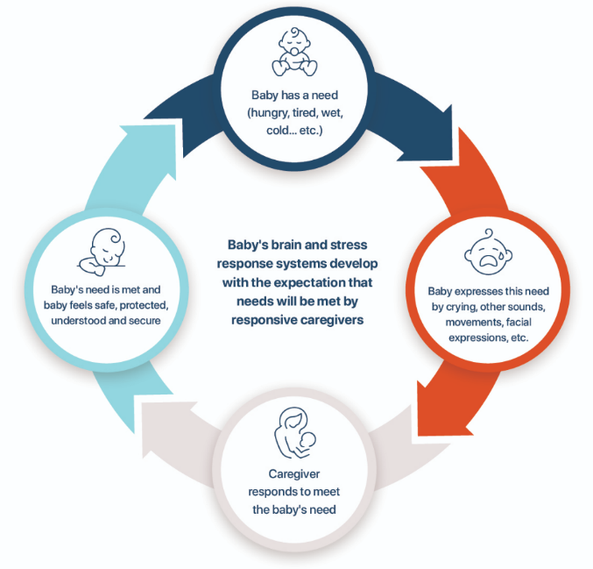
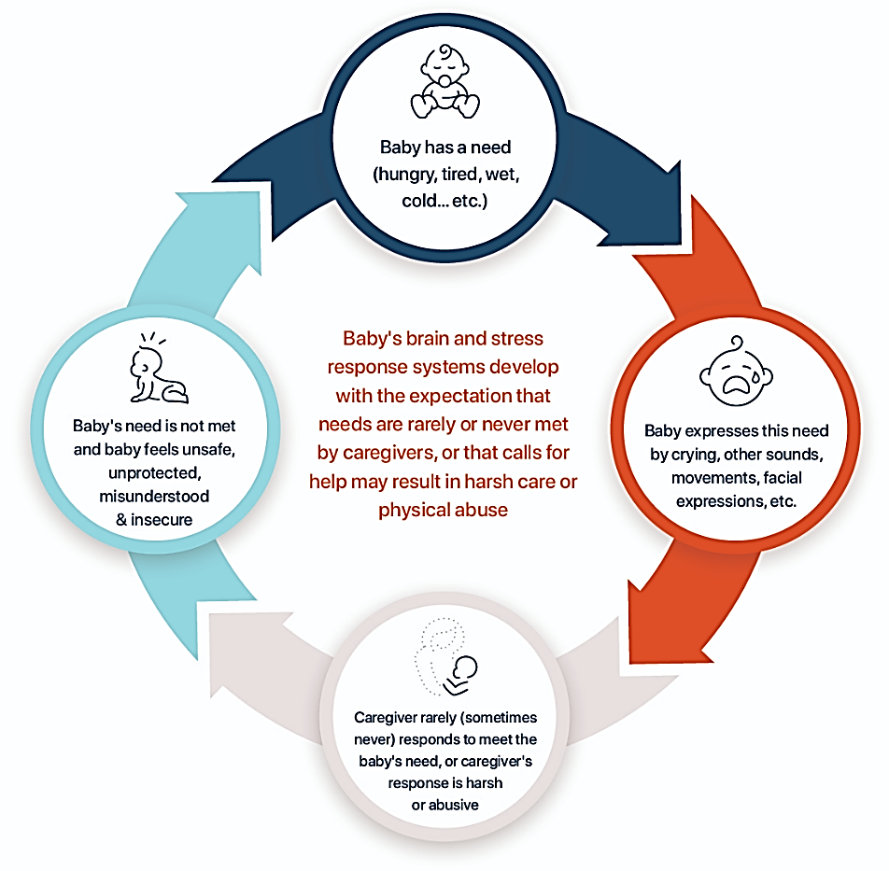
Cycle Of Attachment
Healthy
Disrupted
Notes:
PARAPHRASE
This is the cycle of attachment from the Attachment theme. Rather than learning how to relax from their caregiver as other children learn to do, children who have experienced trauma and separations learned distress from their caregiver not coming to meet their needs for perhaps hurting them when they did come. And this teaches the child’s brain a fearful, defensive, survival mode as a starting place, rather than a moment they’re just passing through.
This is different than a child who developed more typically - a child whose brain and body learned that distressful moments happen and then they will be able to relax again when they pass. So, fast forward a few years and a child with a more typical background may experience minor stress and not be too bothered by it, or they will get over it quickly.
Let’s watch another video clip with Dr. Perry to learn more about the brain functioning behind states.

Slide 18
State Dependent functioning
Notes:
DO
Play the video: State-Dependent Functioning (runtime 6:11). It can be found in CapLEARN (https://learn.childwelfare.gov/) or on the NTDC website (https://ntdcportal.org/).
ASK
What did Dr. Perry mean when he said that when people are stressed, there will be a ‘state-dependent’ shift in the parts of the brain that are ‘in control’ of our functioning?
DO
Break down the video by highlighting the following points as participants make them. If they do not make these points, be sure to reframe or state them.
For all of us, the more stress we experience, the harder it is for us to stay in the smart part of our brains.
This is especially hard for children because the higher and more thoughtful parts of their brain are not fully developed due to their age.
Children who have experienced trauma and loss often have even greater difficulty than other children because rather than their brain power going toward maturing, their brain power was going towards defending itself for survival. So, they are playing serious catch-up.
The behaviors of children who have experienced trauma are largely out of their control even though it may not look like it. They are not manipulating or planning to misbehave, they are reacting to what feels like scary situations with survival behaviors. At times, these survival behaviors will look as they are rejecting the parent who is fostering or adopting them. As a result, parents will need to have tolerance for rejection and learn not to take things that the child does or says personally (characteristic).
Hopefully, as adults, we have learned to regroup pretty quickly from stressful times and get back into the smart part of our brain, but it still takes a lot of practice for us all!

Slide 19
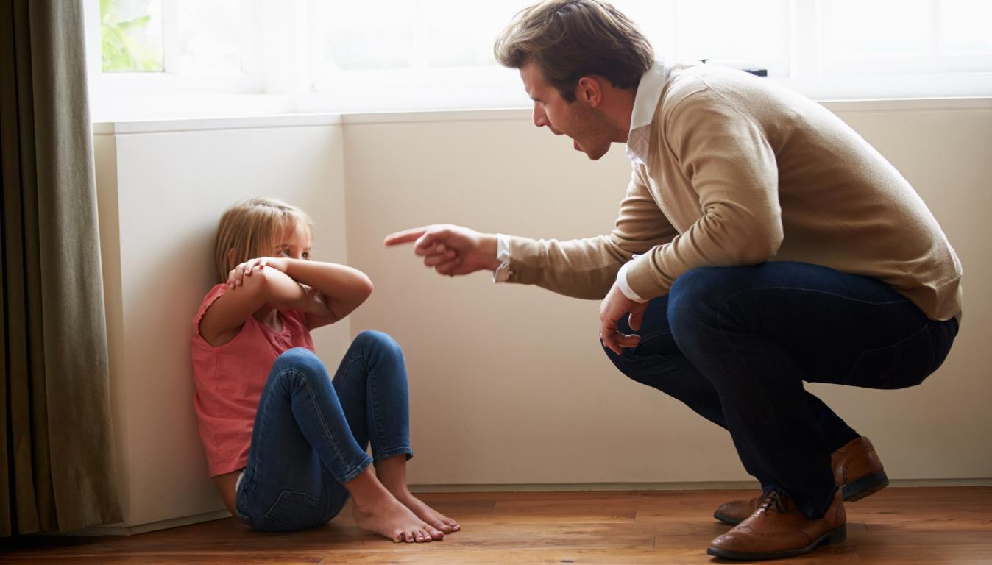
Brain Basics
Stress, Trauma, and Relationships
Notes:
PARAPHRASE
Because of the way trauma impacts the brains and bodies of children, it will almost definitely affect relationships with family members and the child’s ability to develop friendships.
ASK
If others don’t understand that this is what’s actually going on in the child’s brain, how might it impact their relationships with you, peers, others when the child overreacts?
DO
Facilitate a short discussion by taking a few thoughts/examples.
Highlight examples from participant responses that demonstrate “misunderstandings” and “landmines,” as in the video.
Reinforce that a child’s misreading of a person’s facial expressions, body language, intentions, etc., can lead to overreactions (like fighting, blowing up, shutting down, etc.).
PARAPHRASE
If the caregiver, teacher, or other adult working with the child does not understand what’s going on in the child’s brain, they might take it personally, respond with punishment or disconnecting from the child.
For those that are more understanding and continue to work with the child, it can get frustrating after a while because the misunderstandings can lead to a lack of trust from the child, even though the other person is doing and saying all the right things.
Children can remain in survival mode much longer than you might expect until their brains can truly learn a new pattern of acting, interacting, and reacting. That’s where you’ll come in as they’ll learn it best from you!
We know that this is a lot of information to take in. It’s a lot to get! To help, we’re going to ask a few true/false questions about long-term trauma and its effect on behaviors to make sure we’re all on the same page.

Slide 20
The Science of Trauma:
First two Questions
True or False?
Fear and threat change the way we think, feel, and behave.
True or False?
A child who has experienced trauma and loss will need understanding and support to learn how not to react as if the past is present.
Notes:
FACILITATOR’S NOTE
In this short activity, you will present two True/False questions. For each question, you will ask participants to answer, and then present the correct answer.
Move rapidly through each question, but pause if participants have questions or seem confused, reinforcing any areas of content that are necessary.
These questions are purposely designed so all of the answers are true. The goal of the activity to reinforce correct concepts rather than to quiz participants on their knowledge.
PARAPHRASE
I’m going to go through two true or false questions with you. And, in a few minutes we’ll do two more. I’ll read each question and ask you to choose your answer as a group.
DO
Read the first question. “True or False? Fear and threat change the way we think, feel, and behave.”
Call on a few people to answer and see whether the group can reach consensus.
PARAPHRASE
This is TRUE. Fear and threat do change the way we think, feel, and behave.
DO
Pause briefly for questions; answer them as appropriate.
Read next question “True or False? A child who has experienced trauma and loss will need understanding and support to learn how not to react as if the past is present.”
Call on a few people to answer and see whether the group can reach consensus.
PARAPHRASE
This is TRUE. A child who has experienced trauma and loss will need understanding and support to learn how not to react as if the past is present.
We’ll have two more questions in a moment, first let’s talk a little about adaptive responses.

Slide 21

ADAPTIVE RESPONSES
Hyperarousal
Extreme alertness and easily triggered fight-or-flight reaction, possibly when there is no actual danger.
Dissociation
Disconnecting from the here-and-now; retreating to an inner world that feels safe.
Notes:
PARAPHRASE
There are two major adaptive strategies that we use that work together to help us cope with stress, fear, and traumatic stress. The first is Hyperarousal. The second is Dissociation.
DO
Write “Hyperarousal” on the top left of a flipchart or whiteboard. Write “Dissociation” on the top right. You will add additional information to each column in the next slides.
PARAPHRASE
These are natural, biological responses that help to protect us. It is important to remember these responses come from the lower parts of our brain.
ASK
Is that the smart, thinking part of the brain, or the instinctive, reactive part of the brain?
DO
Reinforce that, in the moments when these responses are activated, they are coming from instinct, not logic or thinking.
PARAPHRASE
Let’s look at Hyperarousal responses first.

Slide 22
Hyperarousal
Extreme alertness and easily triggered fight-or-flight reaction, possibly when there is no actual danger.
Notes:
FACILTATOR’S NOTE
In this activity, you will facilitate brainstorming about hyperarousal behaviors.
Be sure to encourage and support participants as this material is complex.
PARAPHRASE
You may have heard about fight or flight. These reactions are forms of “hyperarousal,” which means things are revved up too hot and our brains and bodies will have to respond. So, we fight under stress, or sometimes, when things (or people) become too much for us, we run away from them. Is this the way any of you currently react or have reacted under extreme stress? It’s true for most of us. And the same is true for children who have experienced separations, trauma, and loss. The difference for them is that when a person has been exposed to extreme or ongoing distress, like physical or sexual abuse, or unpredictable and uncontrollable stress, like with poverty and community violence, the stress-response systems can become what’s called ‘sensitized.’ This means their brains may not be able to determine what an actual threat is and overreacts to things as if they are more threatening than they actually are.
ASK
What might hyperarousal behaviors look like for a child who has experienced separations, loss, and trauma?
DO
Ask participants to give examples.
Write responses in the first column under the word Hyperarousal. Reinforce responses or fill in behaviors like:
Extreme reactions, often from things that seem minor.
Hard time transitioning
“Melt downs”/getting “worked up” easily
Running away
Bursting away from interactions with others
Lashing out
Yelling
Encourage participants throughout this activity with statements like “Great, you’re definitely getting it!”
PARAPHRASE
Now, let’s look at the other side of the coin - Dissociation.

Slide 23
Dissociation
Disconnecting from the here-and-now; retreating to an inner world that feels safer.
Notes:
FACILTATOR’S NOTE
In this activity, you will facilitate brainstorming about behaviors associated with dissociation.
Be sure to encourage and support participants as this material is complex.
PARAPHRASE
Dissociation comes from the same instinctive part of the brain as hyperarousal, and it is also a response to detecting threat. So, the response is for protection and survival of the person like Hyperarousal, but it looks quite different on the outside.
The ‘flock’ response is the natural process of looking to others to help you figure out how to interpret a challenge. It helps us to maneuver our way through many situations where we are unsure. But, for children with backgrounds of separation, loss, and trauma, looking to others has not always kept them safe. It is not uncommon for children with these experiences to constantly keep watch over adults and their surroundings because they learned they had to, to keep themselves safe. When children are in your homes, you may notice this through facial expressions that show just how tuned in there are to other’s reactions, such as wide watchful eyes, or body language that could look stiff or turned inward. You may hear this reactions referred to as “hypervigilance.”
The next stage is for the body to move into fight or flight which we already talked about, but there are some circumstances where children who have experienced trauma were not able to fight or flee, such as if they would get hit for trying to defend themselves or were physically held down or were being sexually abused by a bigger person in their home. In circumstances like this where they could not get away or flee, another possibility would be for the brain itself to flee. This process is invisible on the outside and the person can look passive or even cooperative. This freeze response is a very common reaction for children who have experienced painful events because it protects them from absorbing the intensity of what was is happening to them.
When a person’s body is present, but their mind is not, it is known as Dissociation. Dissociation is a way of emotionally fleeing from the body and retreating to an inner world that feels safer. When a person is dissociating, they might experience feelings and interactions like they are watching themselves from above. On the outside, this kind of quiet withdrawal can be mistaken for compliance or typical shyness at first, but you will see it become problematic. Examples might be when a child does not follow directions because they haven’t been absorbing them, or not really feeling any emotions, which makes it hard to connect in meaningful interactions with others. It is in situations like these where they need us the most.
ASK
What do you think are some examples of behaviors of a child who has experienced separation, loss, and trauma while in a dissociated state?
DO
Ask participants to give examples.
Write responses in the second column under the word Dissociation. Reinforce responses or fill in behaviors like:
Tuning out/avoiding/withdrawing
Daydreaming
Physical complaints in their body like headaches and/or stomachaches
Not seeming to take in information
Staying away from people, in their room or the playground
Difficulty identifying or expressing feelings
Substance use/abuse
Self-harming behaviors such as “cutting”
ASK
As we were coming up with these examples of hyperarousal and dissociation, were any of you thinking of adults you know who also do some of these? Perhaps yourselves?
FACILITATOR NOTE
Pause here, but do not probe. This question is meant to get parents thinking, not to prompt a lengthy discussion. If anyone chooses to answer outloud, acknowledge any insight a person may show.
PARAPHRASE
Everything we’ve been discussing is true not just for children; it is true for all people. Any of us can potentially act in these ways! So, it’s important not just to identify these responses for children, but also for ourselves. We may have learned to manage these reactions better by adulthood, but they can be sparked when we ourselves are under stress or experiencing fear or distress. The experience of parenting traumatized children may in fact be one of those sparks. This makes it even more important to be aware of as the impact on children on this state will not be positive if both parent and child are reactive mode.
Now, let’s try to answer the second set of true/false questions.

Slide 24
The Science of Trauma: next two Questions
True or False?
Challenging behaviors from a child who has experienced trauma and loss were likely learned as adaptive strategies to cope or survive.
True or False?
“Fight,” “flight," “freeze,” and “flock” are normal responses to separation, loss, and trauma.
Notes:
DO
Read the question. “True or False? Challenging behaviors from a child who has experienced trauma and loss were likely learned as adaptive strategies to cope or survive.”
Call on a few people to answer and see whether the group can reach consensus.
PARAPHRASE
This is TRUE. Challenging behaviors from a child who has experienced trauma and loss were likely learned as adaptive strategies to cope or survive.
DO
Pause briefly for questions; answer them as appropriate.
Read the next question. “True or False? “Fight,” “flight," “freeze,” and “flock” are normal responses to separation, loss, and trauma.”
Call on a few people to answer and see whether the group can reach consensus.
PARAPHRASE
This is TRUE. “Fight,” “flight”, “freeze,” and “flock” are normal responses to separation, loss, and trauma.
ASK
Does anyone have any other questions or comments before we move on?
DO
Pause briefly for questions/comments; respond as appropriate.
PARAPHRASE
Now that we understand a bit about the brain science involved with trauma, we can practice translating what that looks like in behaviors on the outside. Soon, we’ll do an activity with that, and then we can get into how we might best interact to help children learn new patterns and have better relationships!

Slide 25
BREAK
10 minutes
Notes:
FACILITATOR'S NOTE
Allow for a 10-minute break.
25

Slide 26
SECTION 3:
IDENTIFYING STATES
Notes:
FACILITATOR’S NOTE
Allow 15 minutes for this section/activity.
PARAPHRASE
To understand how trauma has impacted a developing child, we are going to take a deeper look at what goes on in the brain and body after a person has experienced trauma. This will help us to better understand what is actually going on underneath a child’s behaviors.

Slide 27
Enhancing Your Toolbox
Identifying States
Instant Family clip
Notes:
FACILITATOR’S NOTE
Option 1: In this activity, you will show a clip from the Instant Family video. Participants will fill in the Identifying States handout, identifying the state of different characters during the clip. Allow some time for discussion, stressing points that help participants understand where and why characters become more escalated. You can also make the point out that the behaviors of different people can look different in each of the states (i.e., when in a fear-based state, Juan starts to cry, while Lizzie acts angry.)
Option 2: If you are not using the Instant Family video, move on to slide 29 for as an alternate activity,
PARAPHRASE
When noticed early, fear-based responses can be reduced. It’s helpful to be able to recognize the range of what these states look like. Let’s have a little fun going to the movies to practice. Many of you may have already seen the video Instant Family, but for those who haven’t, it’s about a family who came together through foster care and adoption. Although the movie is fiction, it is based on experiences that the director’s family had on their journey through foster care and ultimately adoption. Please turn to Handout #1: Identifying States in your Participant Resource Manual. We will watch a scene now while we do an exercise to identify the states of each of the characters in the scene. This will help us practice noticing when you or the children you are parenting are moving away from the ideal active, alert, engaged state.

Slide 28
Enhancing Your Toolbox
Identifying states, 1 of 2
Instant Family:
Christmas Dinner
Characters
Mom
Dad
Lizzie
Juan
Lita
Notes:
FACILITATOR’S NOTE
This slide is only used when the Instant Family clip is played.
PARAPHRASE:
In the scene we’re about to see, there are 5 characters: Mom, Dad, Lizzie the oldest, Juan the middle child, and Lita, the youngest. As you watch, put an “x” in the box for each character that you think best represents the state they are experiencing for most of the scene. Because states can change quickly, you may want to mark more than one box for a few of the characters.
DO
Show clip from Instant Family. The clip can be accessed by forwarding directly to the timestamp listed below and/or by clicking on the video menu and forwarding to the scene, which will get facilitator closer to the timestamp. It is suggested that the facilitator cue the clip in advance to save time getting to precise timestamp.
Scene-Christmas dinner. This scene can be found on the DVD scene 6 39:30 -41:12
Pause the video to allow the class to mark the boxes on the handout
Discuss choices as a group, emphasizing what shows escalation or de-escalation

Slide 29
Enhancing Your Toolbox
Identifying States
Christmas Dinner Scene
Notes:
FACILITATOR’S NOTE
Option 2: This activity is an alternate to watching the Instant Family video clip. Skip this slide if you have used the Instant Family clip.
After reading the scene summary on Handout #2: Christmas Dinner Scene, participants will fill in the Identifying States handout to determine the states of different characters in the story. Allow some time at the end for discussion to help participants understand the different states.
DO
Ask participants to turn to the following handouts in their Participant Resource Manual.
Handout #1: Identifying States
Handout #2: Christmas Dinner Scene
Let the class know that this scene is based on a scene for the Instant Family movie. Read, or ask for a volunteer reader to read Handout #2: Christmas Dinner Scene aloud.
PARAPHRASE`
When noticed early, fear-based threat responses can be greatly reduced. So, it’s helpful to be able to recognize the range of what these states look like.
While you listen, think about what state the children and the parents are in. Because states can change, you may choose to mark more than one box for each character.
Christmas Dinner Scene
Mom and Dad have prepared a lovely holiday dinner for the 3 children who have been newly placed in their home. It has been a nice day for all, but they have also discovered some cultural differences.
Lita, age 7, is used to having potato chips at every dinner and rejects the “nice meal”. Mom and Dad calmly tell the child that tonight there will be no chips. Lita begins to demand potato chips and older sister Lizzie attempts to step in and firmly tell her to stop. Mom tells Lizzie she can handle it. Mom begins trying to convince Lita the dinner is really good. Lizzie says she was only trying to help, leans back in her chair and focuses on eating her food (while really watching everything going on). Lita begins to scream and demand the chips. Dad steps in and tells Mom it doesn’t look like Lita is getting on board with the plan. Juan sits quietly watching.
As Mom increasingly insists that Lita eat her dinner, Lita screams louder, throws food. and leaves the table. Juan accidentally knocks over his glass of milk, breaking it and begins apologizing repeatedly. As food flies, a candle is knocked over and a small fire starts on the table. Dad attempts to put the fire out and Juan cries quietly. Lizzies asks if she can take over now and Dad tells Mom it’s time to let Lizzie step in. Lizzie then firmly takes Lita’s hands and gives her specific directions in Spanish, their native language. She then leads Juan and Lita out of the room to get cleaned up and tells Mom and Dad that kids should not be given drinks in glass cups.

Slide 30
Enhancing Your Toolbox
Identifying states, 2 of 2
 | High Arousal | Moderate/ on the way to Arousal | Active, Alert, Engaged | Disengaged/ pulling away | Shut Down
Mom | X | X
Dad |  | X | X
Lita | X
Lizzie |  | X | X | X
Juan |  | X | X | X
Notes:
FACILITATOR’S NOTE
This slide is used for both options.
PARAPHRASE
This table shows the range of possible answers about the character’s states. The arrows show changing states that may have shifted during the clip. Look it over for a moment and see how it compares to what you were thinking.
DO
Wait for a minute or so for participants to review the table and compare their results.
Facilitate a brief discussion to process the video and expand on nuances that help participants understand what states look like in behavior, such as pointing out body language and tone of voice for any given character.
Highlight any responses that show characters moving between states, such as:
Lizzie’s is quick to respond with anger then withdraws emotionally as she is not allowed to help, and her sister’s behavior escalates. This withdrawal is a survival strategy that actually works in the end because she understood what her sister needed.
Juan’s has extreme changes from watchful to scared and apologetic back to watchful. Highlight the trauma over-response he has to breaking his glass.
Mom making a choice not to listen when other people (such as Dad or Lizzie) tried to help allows us to see that she is not operating in the smart part of her brain. In the end, she is deflated because she has been ineffective.
PARAPHRASE
Paying attention to behaviors, which can sometimes be very subtle, allow us to see into the inner world of a child. When we can tune in to children’s needs early, we can cut off extreme hyperarousal or dissociation and are much more likely to avoid the situation turning serious. How you react is so important we’re going to spend the rest of our time talking about that today and will talk more about it in the Trauma Informed Parenting theme.

Slide 31
SECTION 4:
THE HEALING POWER OF RELATIONSHIPS
Notes:
FACILITATOR’S NOTE
Allow 20 minutes for this section.
PARAPHRASE
True healing can begin for children when parents tune-in to their children’s needs while putting their needs aside. Children need support from their parents and caregivers in many ways. One important way to help a child is to focus in on your relationship with the child.

Slide 32

Co-Regulation
Notes:
PARAPHRASE
Co-regulation occurs when a person is able to calm because someone else soothes them. It is what babies learn from their earliest caregivers. As was covered in the Attachment theme, people often think co-regulation is something only infants and young children need, but children who have experienced separations, loss, and trauma have not yet learned the skill of self-regulating and calming down on their own. The process of learning how to self-regulate will develop over time through repeated experiences with parents teaching the child how to calm. And, just as it happens with babies, learning how to be calm and self-regulate will not come from parents’ words, but by the way they interact with their child.

Slide 33
Predictable BEHAVIORS
DE-ESCALATING
ESCALATING
PARENT CHILD
Calm, predictable, clear, listening, empathetic, reassuring, reflective
PARENT CHILD
Loud, showing frustration, yelling, too close, using threats, giving ultimatums
Notes:
PARAPHRASE
Getting wound up and escalating is contagious. Remember how when a domino goes down, the rest of them go down as well? This is true here; the more escalated the parent, the longer the child stays escalated. We know that what will shut a child’s thinking brain down and put them in survival mode is another person in escalation mode. This can be communicated in words, tone of voice, or body language. As we’ve talked about, children who have experienced trauma, separation, or loss are very attuned to everything beyond words, so even if you are saying the right things, but your body language, like facial expression or tone of voice says something else, they will be much more likely to tune into your body language (characteristic).
The good news is that calming down is contagious as well. That’s why sometimes it matters less what we say in a stressful or sad situation, and more that we are present or just listen or sit calmly and kindly with someone. Let’s turn to Handout #3: Predictable Escalating and De-escalating Behaviors Chart in our Participant Resource Manual. As you will see from the handout and our conversation on co-regulation, what will quiet the fear and help a child feel safe enough to begin to use the smart part of their brain, is another person using the smart part of their own brain! That’s why they need caring, tuned in parents.
This handout was created by Dr. Bruce Perry. There’s a lot of information on this here, so let’s focus on two rows, the Predictable De-Escalating Behaviors and Predictable Escalating Behaviors. These two rows describe how children and parents get wound up and also how they are able to wind down.
As you look this over, what do you notice about the important impact that the parent’s behavior has on the child’s behavior?
DO
Pause for a few minutes for participants to look over the chart.
Reinforce: The adult’s responses seem to directly affect the child’s behavior. When the adult has calming behaviors, the child can calm. When the adult’s behavior escalates, so does the child’s behavior.
PARAPHRASE
Let’s think a little more about how we as parents or caregivers can help a child move from one state to the other. It might make more sense with an example. Imagine that you just heard a crash from another room. When you investigate, you find a child who has just broken a window and is standing there, looking at the broken pieces with a worried expression.
ASK
Looking at the top row of the chart of adaptive responses, does anyone want to take a guess about which adaptive response the child might be having and/or what state they could be experiencing at a moment like this?
DO
Call on a few participants to get their answers.
NOTE: The child is probably in the ALARM state and the adaptive response is FREEZE. FEAR/FLIGHT and ALERT/FLOCK are also reasonable responses.
PARAPHRASE
Let’s assume the child’s adaptive response is the Freeze state. Now look at the Predictable De-Escalating Behaviors and Predictable Escalating Behaviors rows in the FREEZE column.
The de-escalating behaviors section lists things you as the parent or caregiver can do that will predictably calm and regulate the child and move the child to the ALERT or CALM states. On the other hand, the escalating behaviors section lists things you might do that will predictably make the child more upset and move them to the FEAR or TERROR states.
ASK
What emotional state do we want the child to be in so that we can deal with the problem?
DO
Call on a few participants to get their answers.
NOTE: We want to regulate the child by moving them to the ALERT or CALM state. Going in the other direction will escalate the situation and make it harder for the child to use the thinking parts of their brain.
ASK
Based on this chart, what are some actions we as parents could take to regulate the child?
DO
Call on a few participants to get their answers.
NOTE: The actions are listed in the Predictable De-escalating Behaviors section, i.e.:
“Invited” touch.
Quiet melodic words.
Singing, humming.
Music.
ASK
Based on this chart, what actions should we avoid because they would probably escalate the situation?
DO
Call on a few participants to get their answers.
NOTE: The actions are listed in the Predictable Escalating Behaviors section, i.e.:
Raised voice.
Raised hand.
Shaking finger.
Tone of voice, yelling, threats.
Chaotic milieu.
ASK
As you look over the whole chart, what do you notice children need most from their parent when they need help to wind down? Is it lecturing or being sent away for a time out? Is it a raised voice or hand?
DO
Facilitate a short discussion by prompting a few participants to share their thoughts/answers to the question.
Reinforce: Children need their parent/caregiver to remain with them, and most of all, to remain calm themselves and to help them become regulated. It is not about using lots of words or lecturing.

Slide 34

The power of A parent’s Reaction
Notes:
PARAPHRASE
It may not come naturally at first, but people who are parenting children who have experienced separation, grief and loss have tremendous power when they can teach children this skill.
To be able to tune in to children and meet their needs, the parent will need to put their own feelings and preoccupations aside. Yet, this is easier said than done when a child looks like they’re misbehaving. Just imagine what that mom felt like in the Christmas dinner scene! How many of us would get hooked into that same power struggle?
While any of us might have this reaction, the reality is our own feelings, history and values will have a lot to do with how we react. Any or all of that can come to the surface when a child is expressing the kind of behaviors we were talking about earlier, like yelling or running away. Those moments are not usually when adults feel like coming in closer and responding calmly!
At times, survival behaviors will look as if the child is rejecting the parent who is fostering or adopting them. As a result, parents will need to have tolerance for rejection and learn not to take things that the child does or says personally (characteristic).
ASK
Even if the child is dysregulated or rejecting, what do you think they need the most? Reinforce: the parent to come in closer and respond calmly.
Why is this so critical?
Reinforce:
What is likely happening in these moments, is the child is going into survival mode.
The sooner caregivers come in closer to help the child feel safe, the more the child will be able to learn over time that it’s ok to let their guard down and start to trust.
When we do this over and over and over again, the child’s brain eventually learns a new pattern. Once their brain learn this new pattern, it will move out of fearful, survival mode more easily and stay in the higher, thinking parts of the brain more often.
This is a critical turning point, because once we can decrease their need for survival behaviors, children can start to think before they act on their own.
This skill can take a lot of practice for parents too, so we’re going to be talking much more about this in the Trauma Informed Parenting theme.

Slide 35

Reflection/ relevance
When you’re stressed, think about what adaptive responses you use and why you may have developed them.
What regulating or calming activities do you use?
How might your responses play out when interacting with a dysregulated child?
Notes:
PARAPHRASE
Use your Participant Resource Manual to answer the following questions:
When you are highly distressed or threatened, do you tend to use more hyperarousal strategies (do you get confrontational, agitated, and angry with conflict/frustration/stress) or dissociative strategies (do you avoid and shut down with conflict), or some of both?
What do you think sparked you to develop these strategies?
Based on what you have been learning, identify a list of regulating or calming activities that you use or can use. (What makes you feel better when you are upset?)
Reflect on how your responses to distress may play out when interacting with a dysregulated child.
Parenting a child with the needs we have been talking about will require the best of you. Maybe you’ve started to think about how draining this type of parenting can be. It will take a great deal of resilience and patience with yourself and with the child (characteristic).
When you feel drained, it will be critical that you take care of yourself so that you are able to provide the nurturing and regulation the child needs, even in challenging situations. It is also important to understand the impact of your interactions on the child- including their ability to regulate, their ability to learn new patterns of handling stressful situations, and their likelihood of becoming escalated. So, we’ll focus more on the parent’s role and positive strategies to use in the Trauma-informed Parenting theme.
35

Slide 36
SECTION 5:
WRAP-UP
Notes:
FACILITATOR'S NOTE
Allow 5 minutes for this section.
PARAPHRASE
Now, it’s time to wrap up. Before we do, I want to briefly highlight the key points from this theme:
Each person is impacted uniquely from trauma.
The effects of trauma can influence every part of the brain, including how we interact in relationships.
Adults should be prepared for children who have experienced separation, loss, and trauma to be impacted in the way they think, feel, and behave. This is an adaptive, biological response that produces adaptive strategies that can be experienced as challenging behaviors.
There are two major adaptive strategies to perceived threat: Hyperarousal (the “fight or flight” response) and Dissociation (“freeze” response) that work together to help us all cope with stress, distress, and traumatic stress.
These adaptive strategies are interactive, and their sensitivity can be modified; increased by chaotic, unpredictable, or severe stress and distress; decreased by opportunities for moderate, predictable stress.
Emotions can be contagious, and self-regulation for parents is valuable.
Parenting a child who has experienced trauma and/or loss will require: 1) resilience and patience, 2) attunement, 3) tolerance for rejection and 4) commitment

Slide 37

LIFELONG Learning
Notes:
SAY
It is critical that as you go through this journey, you continue to enhance your knowledge and skills. It is important that you continue your own learning by taking advantage of resources that are available to you. This theme has numerous resources that will help you continue to learn more about this topic that can be found on the NTDC website or in CapLEARN.
Excellent resource for this theme are a podcast with Dr. Bruce Perry and two videos called Developmental disruptions and the 3E’s that help us to better understand trauma.

Slide 38
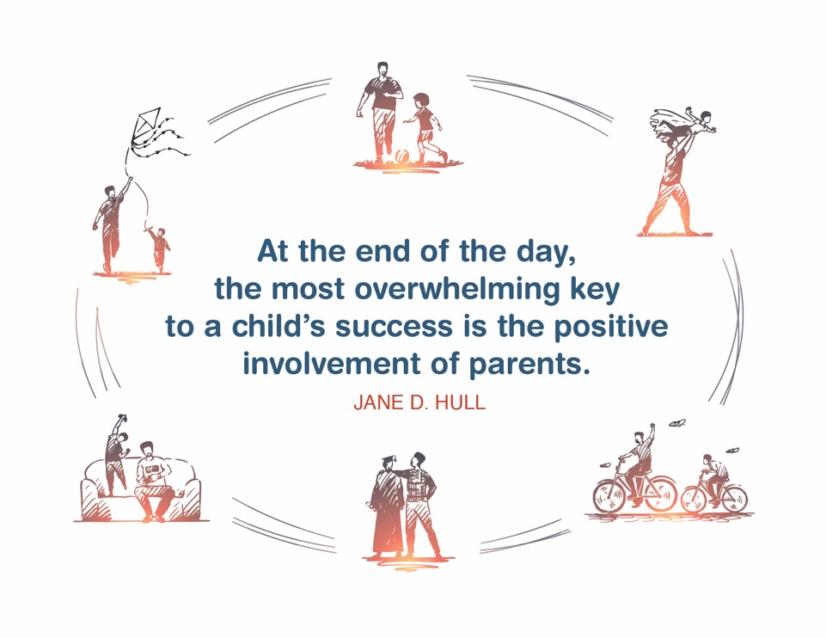
Place holder for slide with Closing Quote
Notes:
FACILITATOR'S NOTE
The closing quote above and the paraphrase section below will be done only once per day, after the last theme presented. If you are moving on to another theme, invite them to take a break, stretch, or breathe, before moving on to the next theme.
If closing for the day:
Thank everyone for attending and for their thoughtful participation and attention. Remind the participants that although this training may seem long, it is critical for them to gather the knowledge, attitude, and skills that are needed as they embark on this journey because they ultimately will play a huge role in the lives of children and families.
If in person, collect the name tents or have them tuck them into their Participant Resource Manual to bring back to the next class.
PARAPHRASE
Close out the day by covering the below topics:
Remind participants of the date/time for the next class and let participants know if there are any changes to the location.
Encourage participants to contact you (or other facilitators) if they have any questions or concerns.
Review the themes that will be covered during the next class.
If in person, remind participants to take their Participant Resource Manual with them and to bring them to the next session. If using a remote platform, remind participants to have the Participant Resource Manual available for the next class.
38

Slide 39
For more information, visit:
Notes:
39

Slide 40
.
This curriculum was funded by the Children’s Bureau, Administration on Children, Youth, and Families, Administration for Children and Families, US Department of Health and Human Services, under grant #90CO1132. The contents of this curriculum are solely the responsibility of the authors and do not necessarily represent the official views of the Children’s Bureau.

Slide 41
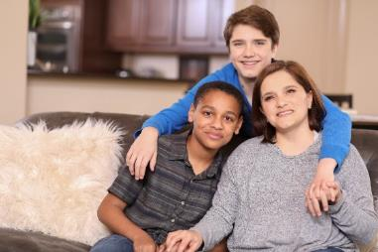

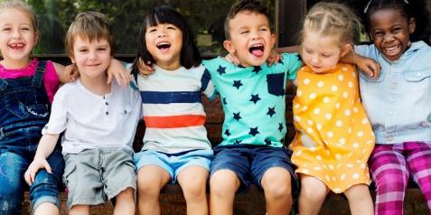


Protecting Foster Youth
from secondhand smoke exposure
Missouri Resource Provider Required Training

Slide 42

Protecting Foster Youth from Secondhand Smoke Exposure
Review the information on each slide, including any video content.
IMPORTANT: The final slide of this presentation includes your certificate of completion. Print a copy of your certificate (or save as a PDF) and present to your resource development worker to verify completion of this training module.
42

Slide 43

RSMo 210.109 (5)
Missouri law tasks the Children’s Division with placing youth, who are in the division’s care and custody, in homes that:
  Safeguard and promote their present – and continuing – good health
  Will not commit any act – or engage in any conduct – that would be injurious to the child’s health
43

Slide 44
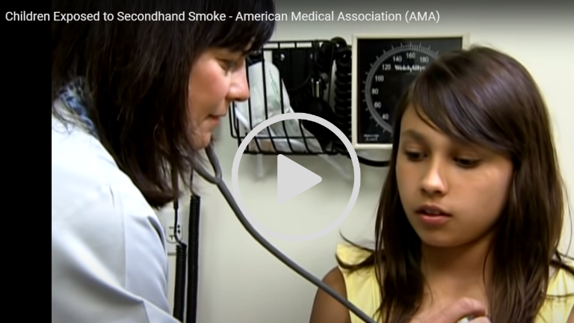
Children Exposed to Secondhand Smoke
American Medical Association (AMA)
The following video, created by the Medical Association, describes the dangerous effects secondhand smoke has on children.
44

Slide 45
The Dangerous Effects of Secondhand Smoke
Exposure to secondhand smoke has been linked to the following health conditions for children:
Sudden Infant Death Syndrome (SIDS)
Respiratory Infections, such as bronchitis and pneumonia
Ear infections
Chronic cough
Tooth decay
Long term effects including:
Poor lung development (meaning their lungs never develop to their full potential)
Lung cancer
Heart disease
Cataracts
45

Slide 46
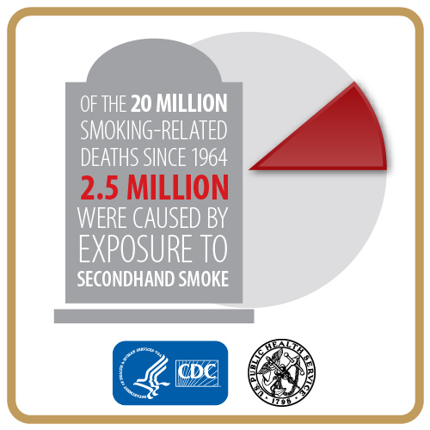
Health Effects of Secondhand Smoke
Approximately one half of American children between the ages of 3 and 18 are victims of secondhand smoke. Please read the information found in the Health Effects of Secondhand Smoke, produced by the Centers for Disease Control and Prevention (CDC).
46

Slide 47
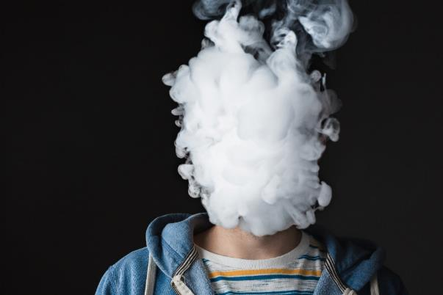
The Dangers of Secondhand Smoke
Secondhand smoke exposure is especially harmful to children, as their lungs are still developing.
Read more about the dangers of secondhand smoke exposure at healthychildren.org.
47

Slide 48
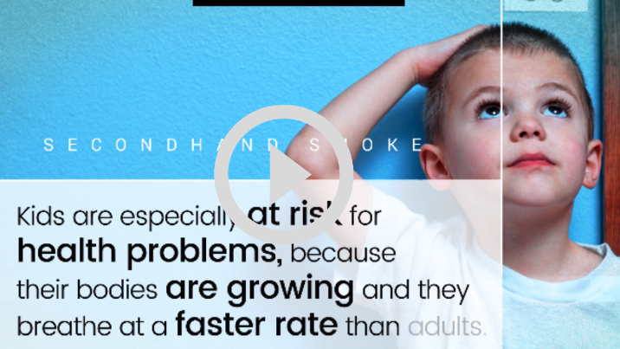
The Dangers of Secondhand Smoke
“Kids are especially at risk for heath problems, because their bodies are growing and they breathe at a faster rate than adults.”
Watch this short WebMD video to learn about the dangers of secondhand smoke.
48

Slide 49
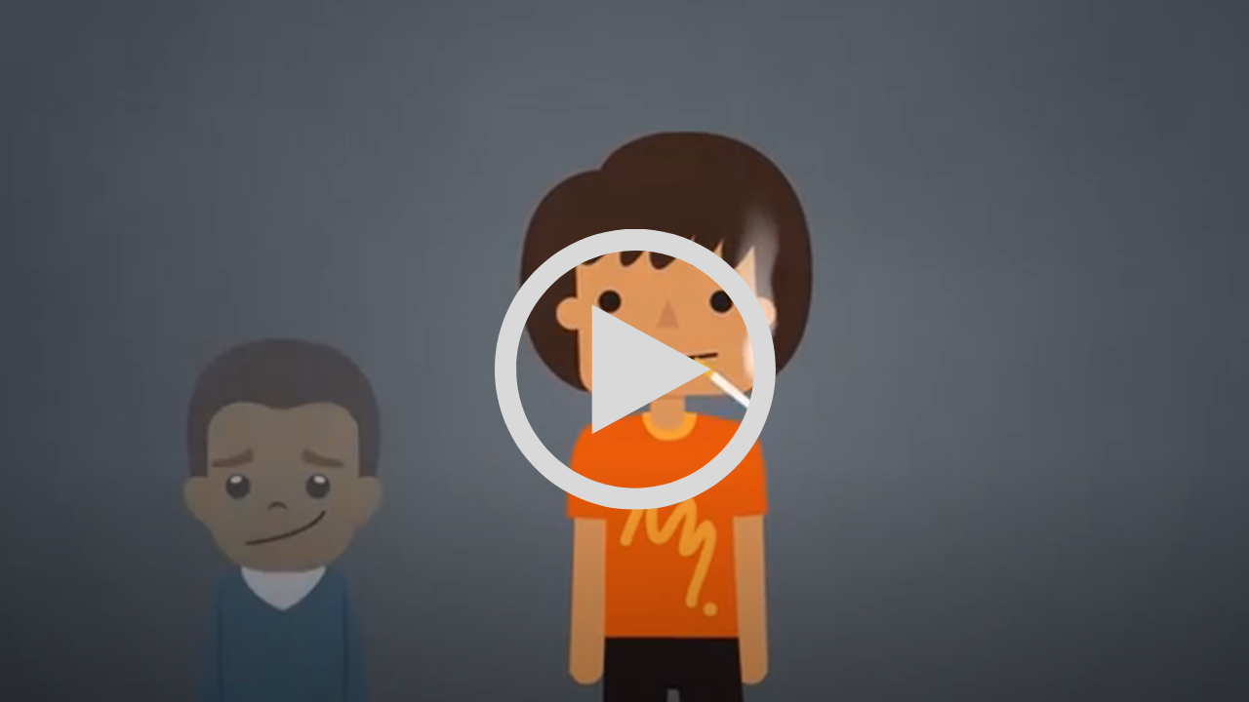
Secondhand Smoke in our Homes and Vehicles
Secondhand smoke isn’t just the cigarette smoke in the air. Watch this video about how smoke is absorbed in furniture, walls, and clothing.
49

Slide 50
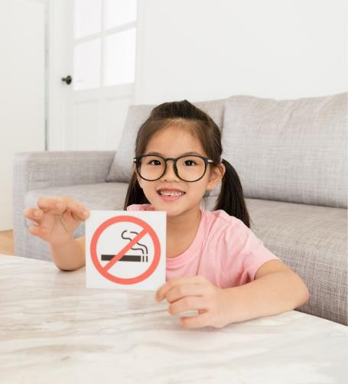
The Importance of Smoke-Free Homes and Cars
Secondhand smoke is not the only concern for children. Smoke residue from tobacco products lingers in homes and cars, long after someone smokes. Simply opening a window or running a fan cannot eliminate exposure. Smoke that remains in the air and settles on surfaces is ingested by children, and causes:
Ear infections
Bronchitis
Pneumonia
Sudden Infant Death Syndrome
50

Slide 51


Tips for a Smoke-Free Home
Never smoke inside you home, even when it is cold outside
Smoking indoors one time is enough to contaminate the rest of the house, even if you’re in a room with the doors closed
Create a comfortable place to smoke outside
Keep an umbrella near the door to reinforce going outside to smoke, even when the weather is bad
Let guests know that your house is smoke-free and show them the outdoor smoking area
Consider posting a sign to remind visitors that there is no smoking in your house
51

Slide 52

Tips for a Smoke-Free Car
Never smoke in a car that transports children (even if the windows are open, smoking in your car once, can fill the seats and other materials with toxins)
Remind passengers not to smoke in your car
Try to time your smoking to coincide with times when you know you will outside of the car
Fill your car’s ashtray with change, so you aren’t tempted to use it for ash
Leave a cellphone charger plugged into the car’s adapter outlet, so you aren’t tempted to use it as a lighter
Keep a jacket/umbrella in the car to use in case you need to stop and smoke when the weather is bad
Store your cigarettes in an out-of-reach area while you drive
52

Slide 53
Resources
American Academy of Pediatrics. The Dangers of Secondhand Smoke. 10 May 2017. www.healthychildren.org/English/health-issues/conditions/tobacco/Pages/Dangers-of-Secondhand- Smoke.aspx
American Medical Association. “Children Exposed to Secondhand Smoke.” YouTube, uploaded by AMA, 14 October 2010, www.youtube.com/watch?v=raYlnhksw5I
Centers for Disease Control and Prevention. Health Effects of Secondhand Smoke. 27 February 2020,
www.cdc.gov/tobacco/data_statistics/fact_sheets/secondhand_smoke/health_effects/index.htm
Centers for Disease Control and Prevention. Smoking Cessation: A Report of the Surgeon General. 10 December 2020. www.cdc.gov/tobacco/data_statistics/sgr/2020-smoking-cessation/index.html
Centers for Disease Control and Prevention. Extinguishing the Tobacco Epidemic in Missouri. 21 April 2020. www.cdc.gov/tobacco/about/osh/state-fact-sheets/missouri/
53

Slide 54
Resources
Family Health Network. “Secondhand Smoke.” YouTube, uploaded by Family Health Network 5 August 2019.
www.youtube.com/watch?v=8GdunZYw74s
Kids Health. “Thirdhand Smoke.” YouTube, uploaded by Nemours KidsHealth 2 March 2015.
www.youtube.com/watch?v=eAXpYhGeRFE
Missouri Department of Health and Senior Services. Tobacco Use Prevention and Control.
https://health.mo.gov/living/wellness/tobacco/smokingandtobacco/tobaccocontrol.php
Missouri Government, Missouri Revisor of Statutes. Statute 210.109. Title XII Public Health and Welfare, 28 August 2020. Revisor of Missouri, https://revisor.mo.gov/main/OneSection.aspx?section=210.109
Missouri Group Against Smoking Pollution. About MoGASP. 2017. https://mogasp.wordpress.com/about/
Kids Health. “Thirdhand Smoke.” YouTube, uploaded by Nemours KidsHealth 2 March 2015.
www.youtube.com/watch?v=eAXpYhGeRFE
54

Slide 55
Resources
United States Environmental Protection Agency. “Secondhand Smoke and Smoke-free Homes.” Indoor Air Quality. 25 September 2020. www.epa.gov/indoor-air-quality-iaq/
United States Department of Health and Human Services. SmokeFree.gov. National Institute of Health.
https://smokefree.gov/
WebMD. “The Risks of Secondhand Smoke.” Lung and Respiratory Health. 22 January 2019.
www.webmd.com/lung/video/video-secondhand-smoke
55

Slide 56
Protecting Foster Youth from Secondhand Smoke Exposure
I read all the document links and watched all the video links.
I understand the dangers of exposure to secondhand smoke.
_______________________ ___________
signature date

