Slide 1
Long-Term Care
Professor Timothy McBride
Brown School
Washington University in St. Louis
July 2016

Slide 2
Longevity: A two-edged sword!!
At birth:
Life expectancy for women = 81.2
Life expectancy for men = 76.0
The average Missourian will live about a year less.
At age 65 (Missouri):
Life expectancy for women = 84.6
Life expectancy for men = 82.1
Living longer makes it more likely that you or your spouse or partner will, at some point, need services that could be paid for by long term care insurance.

Slide 3
Demographics of LTC Recipients
Majority of LTC recipients live in the community
Among the LTC recipients who receive care in their own home…
74% live in the home with spouses or other family members
Half have household income of less than 200% of the federal poverty limit
Minority representation higher among LTC recipients
92% receive some help with ADLs from an unpaid helper (informal caregiver)
Source: Kaye, H. S., Harrington, C., & LaPlante, M. P. (2010).

Slide 4
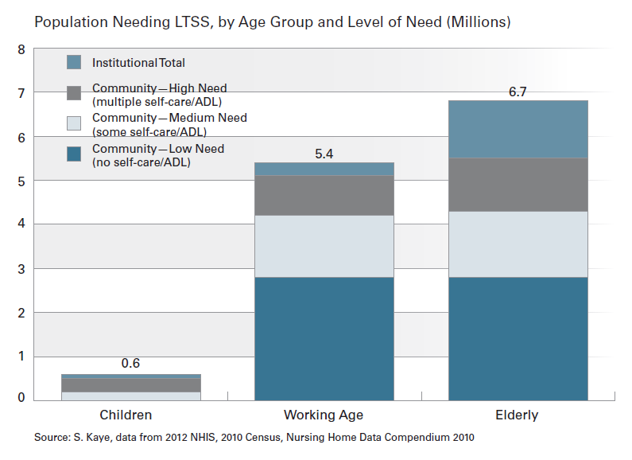

Slide 5
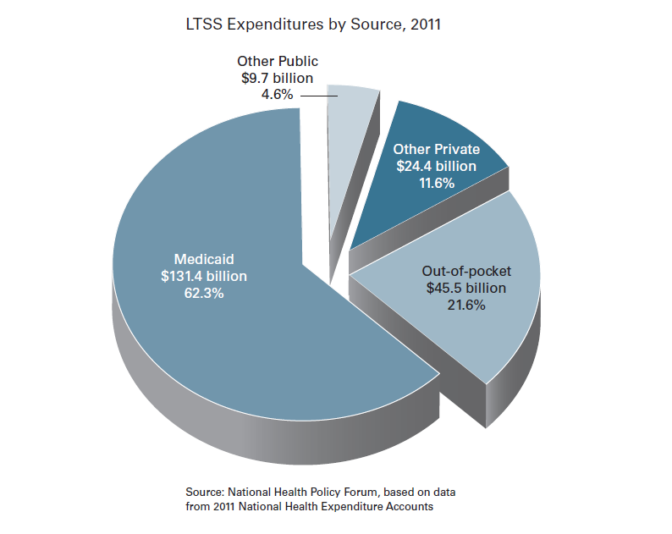

Slide 6
Medicaid Acute and Long-Term Services and Supports Spending Per Enrollee, by Beneficiary Population, FY 2010
$16,240
$12,958
$3,615
$10,037
$2,359
$3,025
$9,344
$2,296
$63
$3,012
$12
$6,203
Total:
32.5M
18.0M
6.3M
9.7M
NOTE: Spending per enrollee figures are for all Medicaid enrollees, not just long-term services and supports users. Expenditures may not sum to total due to rounding. SOURCE: KCMU and Urban Institute estimates based on data from FY 2010 Medicaid Statistical Information System (MSIS) and Centers for Medicare & Medicaid Services (CMS)-64 reports. Because 2010 data were unavailable, 2009 MSIS data were used for CO, ID, MO, NC, and WV, and then adjusted to 2010 CMS-64 spending levels.
Notes:
Comment/Question:

Slide 7
Projections of the Future

Slide 8
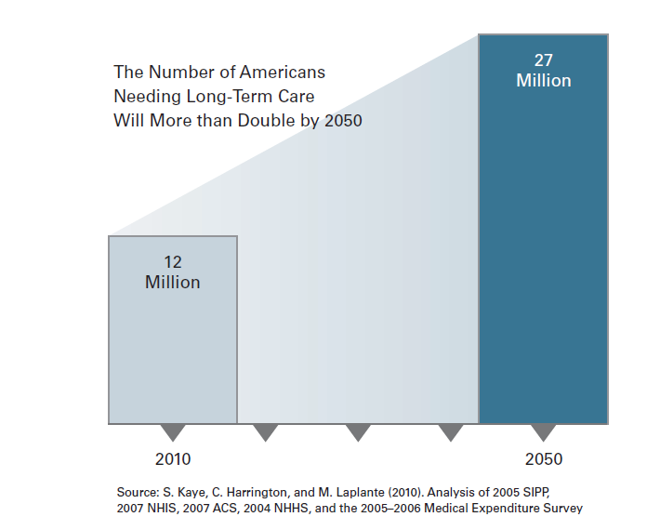

Slide 9
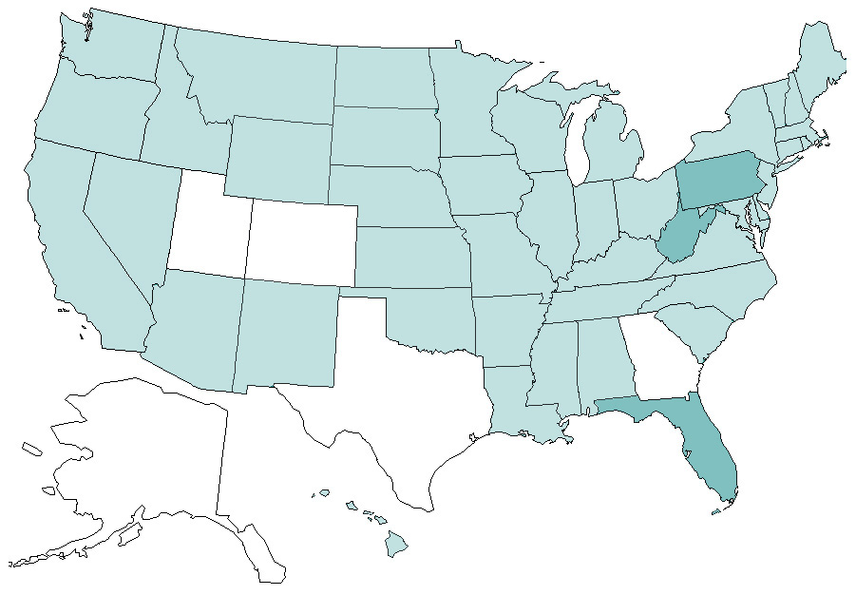
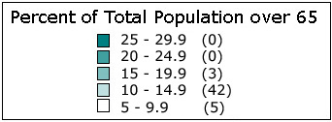
The Graying of America Percent of Total U.S. Population over 65 in 2000
Source of data: U.S. Census Bureau, State Interim Projections by Age and Sex: 2004-2030, 2005.
Notes:
Source of data: U.S. Census Bureau, State Interim Population Projections by Age and Sex: 2004-2030, Table B1: The total population by selected age groups. http://www.census.gov/population/www/projections/projectionsagesex.html.
Last updated October 2006.

Slide 10
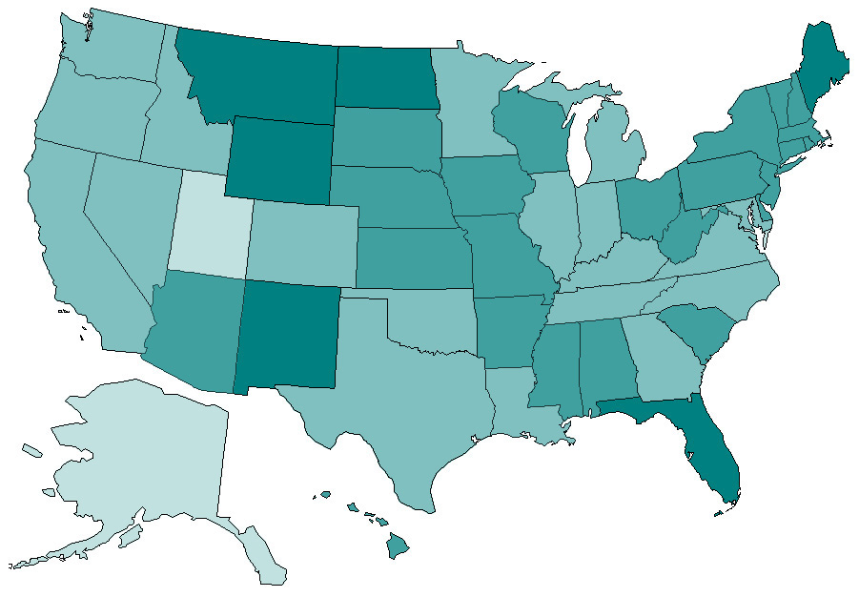
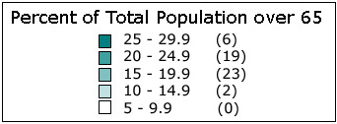
The Graying of America Percent of Total U.S. Population over 65 in 2030 A “Nation of Floridas”
Source of data: U.S. Census Bureau, State Interim Projections by Age and Sex: 2004-2030, 2005.
Notes:
Source of data: U.S. Census Bureau, State Interim Population Projections by Age and Sex: 2004-2030, Table B1: The total population by selected age groups. http://www.census.gov/population/www/projections/projectionsagesex.html.
Last updated October 2006.

Slide 11
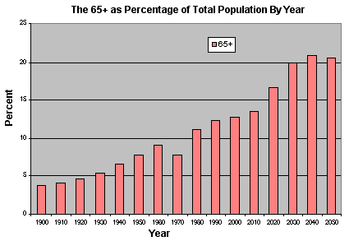
Aging of America

Slide 12
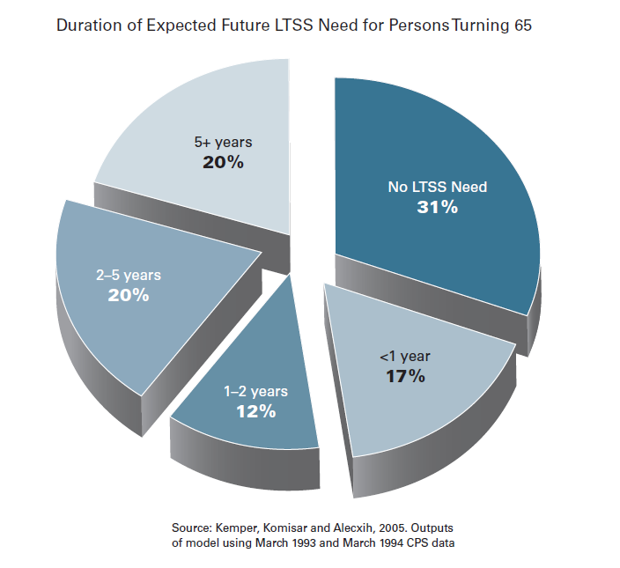
Two-thirds of Americans ages 40 and older say they have done little or no planning for LTSS
In 2005, only 1/3 of seniors had non-housing financial assets equal to the cost of a year in a nursing home

Slide 13
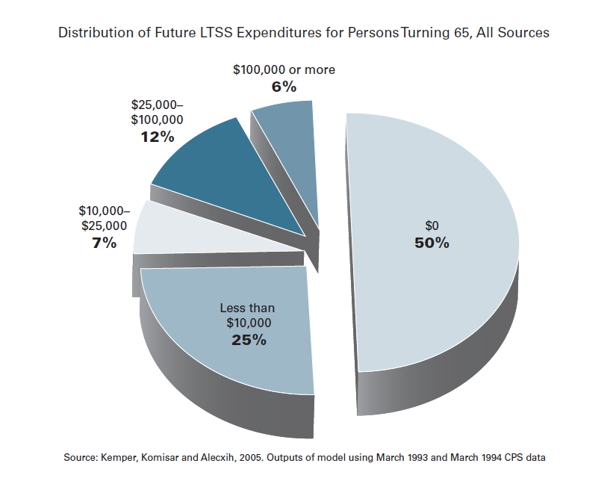
Expected value of all paid LTSS for a person turning 65 in 2005 is $47,000
Notes:
Only 10% of Americans 50 and older have LT care insurance. Check states that have Partnership for Long Term Care plans (45 states?). Life Care Annuity is another option.

Slide 14
Service Use Projections, 2000-2020
Nursing Homes
Grow from 2.4 to 3.7 million users (54% growth)
Alternative Residential Care
0.8 to 1.4 million (75% growth)
Skilled Home Care
2.5 to 3.2 million (28% growth)
Personal Care
3.2 to 4.2 million (31% growth)
[Exhibit 11; Appendix G, Table 1]

Slide 15
How we pay for LT Care
Using personal funds – typically used first until funds run out
Current income from wages, Social Security, or retirement income
Reverse mortgage
Single premium life insurance
Long Term care insurance – only about 10% of LT care recipients have this coverage
Medicare
Part B will cover some home health if part of plan certified by physician
only provides short term percentage of LT care (does not include custodial care)
Medicare covers 100% cost for first 100 days
Provides 80% costs for next 80 days
Provides no reimbursement for subsequent
Medicaid – once income eligibility is met, pays for most of the cost of LT care

Slide 16
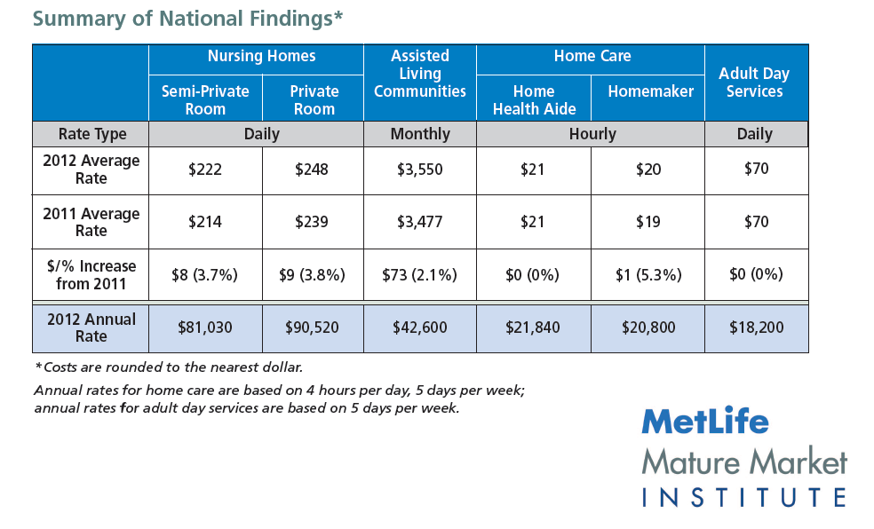
LTSS Costs, 2012

Slide 17
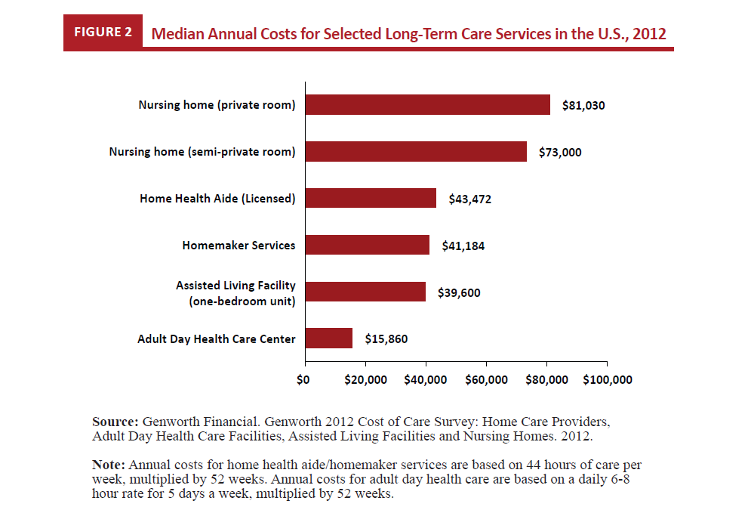

Slide 18
Annual Median LTC Costs, Missouri
Source: http://longtermcare.gov/cost-of-care-results/?state=US-MO

Slide 19
Projected Long-Term Care Expenditures, 2000-2040
Source: CBO (1999)

Slide 20
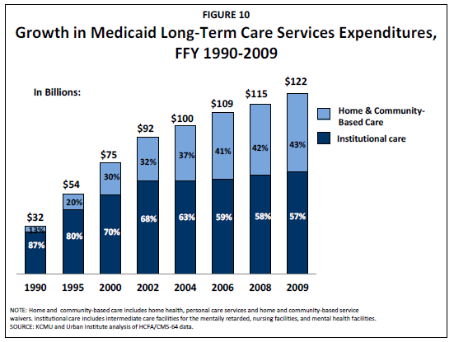

Slide 21
Conclusions
Currently, there is no national system of long-term care insurance – individuals must first rely on their own resources and then primarily on Medicaid
Families play a critical role in provision of care and financing home care and nursing home
Medicaid is the primary payer for long-term care services – particularly nursing home care
Private sector options are still limited and often costly
The demand for long-term care will continue to grow -- the ACA, particularly the HCBS expansions, could make a huge difference

