Slide 1

Division of
Developmental Disabilities

Slide 2
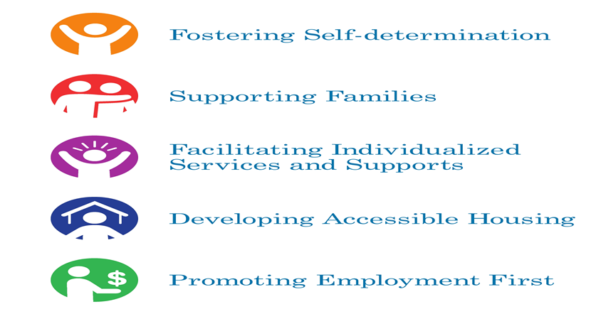





DD Mission

Slide 3
A Brief History of DD
Started with Institutions
  Called schools or homes for the “feebleminded” or “mental deficiencies”; allowed segregation in an institution.
Individuals integrated into classrooms
Development of Group Homes in the Community
Development of new residential options under waiver
Funding of in-home services to avoid residential options

Slide 4
Habilitation Centers-
State Operated Programs

Slide 5
State Operated Programs
4 Habilitation Center Programs
  Bellefontaine Habilitation Center
  St. Louis Developmental Disabilities Treatment Centers
  Southeast MO Residential Services
  Higginsville Habilitation Center
3 Community Waiver Home Programs
  Southeast MO Residential Community Services
  Southwest Community Services
  Northwest Community Services
Budget

Slide 6
MO DDD At-A-Glance
Residential Services
Fast Facts/Fiscal year 2015
Behavioral Services
3,216
new individuals became
eligible for services.
Day Activities
Employment Supports
Respite Services
Personal Assistance
Home Modifications
In Fiscal Year 2015, DDD served approximately 34,119 individuals.
13,885 individuals were served in the DDD Medicaid waiver.
2,523 individuals were served in the Partnership for Hope Waiver.
320 individuals were served in the Missouri Children’s Developmental Disabilities (MOCDD) Waiver or Sarah Jian Lopez Waiver.
8,363 individuals were served in the Comprehensive Waiver.
1,942 individuals were served in the Community Waiver.
142 individuals were served in the Autism Waiver.
380 individuals were served in State Operated Habilitation Centers.
215 individuals were served in State Operated Community Waiver Homes.
20,234 individuals received case management services.

Slide 7
Glossary of Terms
Medicaid Waivers
  CMS and state partnerships that allow states the opportunity to test new or existing ways to deliver and pay for health care services. There are four types of waivers, DDD only uses the 1915(c) home and community-based waiver.
1915 (c) Home and Community-Based Services (HCBS) Waiver
  Allows states to deliver long-term care services in home and community settings rather than institutional settings like nursing homes and ICF/ID.
Intermediate Care Facilities for Individuals with Intellectual Disability (ICF/ID)
  An optional Medicaid benefit that enables states to provide comprehensive and individualized health care and rehabilitation services to individuals to promote their functional status and independence. ICF/ID is only available for individuals in need of, and receiving active treatment.
Notes:
Angie

Slide 8
Glossary
Person-Centered Service Plan
  Document developed by the individual and their identified planning team, managed by a support coordinator, that reflects the services and supports that are important for the individual to meet their assessed functional needs, as well as what is important to the individual with regard to preferences for the delivery of such services and supports.
Conflict-Free
  “Providers of HCBS for the individual, or those who have an interest in or are employed by a provider of HCBS for the individual must not provide case management or develop the person-centered service plan, except when the State demonstrates that the only willing and qualified entity to provide case management and/or develop person-centered service plans in a geographic area also provides HCBS.”
  – 42 C.F.R. 441.301(1)(vi)(Contents of request for a waiver)
Notes:
Angie

Slide 9
Glossary of Terms
SB40 Board
  SB40 (1969) allowed counties to pass a tax on personal property to support services for individuals with a developmental disability. Tax dollars generated are managed by a nine member public board in the county. 85 counties and the City of St. Louis have SB 40 Boards.
Individualized Supported Living (ISL)
  Services designed to serve one to four individuals located in a residential, single-family neighborhood. A supervisor coordinates all individuals’ care, staff schedules, and community integration. Individuals living in ISL homes are provided up to 24 hours per day support based upon the needs of the individual(s) living in the home.
Setting
  The location where the Home and Community Based Service is being provided.
Notes:
Angie

Slide 10
What is a
developmental disability?
Autism, Down Syndrome, Genetic Disorder, Cerebral Palsy, Intellectual Disability
Attributable to a mental or physical impairment
Manifested before 22
Likely to continue indefinitely
Substantial Functional Limitations
Notes:
Vicki

Slide 11
Getting Through the Door For
Services
Regional Office connection
Application to determine if developmentally disabled.
Assessment with:
  Adults - Missouri Critical Adaptive Behaviors Inventory (MOCABI,) or
  Children - Vineland Adaptive Behavior Scales, 2nd Ed.

Slide 13
Enrolled in the Division
What does this mean?
Assignment of Support Coordinator
Development of Individual Support Plan
Services tied to support need, not diagnosis
Not an entitlement
Eligibility for Division services provides limited range of benefits, compared to eligibility for Medicaid Waiver services
Notes:
Vicki

Slide 14

Eligibility and need
DD enrollment/Waiver enrollment in the waiver door
Are you DD eligible?
What is your level of need?
Are you eligible for Medicaid Services?
What level of residential care do you need?
Do you need in-home supports or residential?

Slide 15
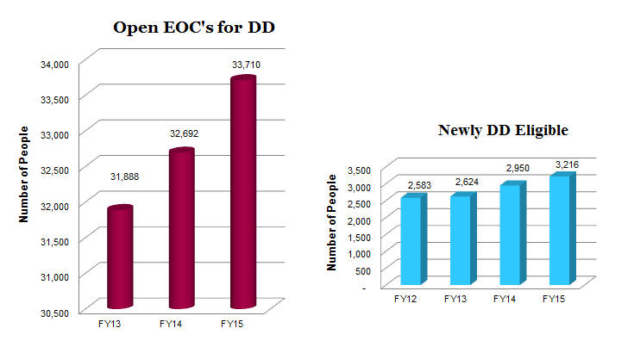
By the Numbers

Slide 16
Division Funded Services
Waivers
Be eligible for MO Division of Developmental Disabilities
Be MO HealthNet (Medicaid) eligible as determined by Department of Social Services, Family Support Division
Evaluation of Need for ICF/ID Level of Care (LOC):
  Meet the federal definition of developmental disability (three substantial functional limitations), and
  Have active habilitation needs, and
  There is reasonable indication that the individual has needs that could be met with ICF/ID services unless provided Home and Community Based Services under the Waiver
ICF/ID LOC determined initially and at least every 365 days from the initial date
Notes:
Melissa

Slide 17


State Plan
MO HealthNet Services
Before waiver services are authorized, first must ensure that state plan
MO HealthNet services are accessed when those services can meet the individual’s need.
        Examples of State Plan services:
          Doctor’s Office visits
          Durable medical equipment
          Personal care
          Pharmacy
          Hospital
          Home health care, etc.

Slide 18
Waiver Services

Slide 19
Priority of Need
When the Division of Developmental Disabilities is unable to serve all eligible individuals with the funds available through the appropriations process, the Division uses a Priority of Need (PON) assessment to determine the order in which Individual Support Plans will be funded.
This action is taken in accordance with 9 CSR45-2.015.

Slide 20
In-Home Waitlist Update
Total: 165

Slide 21
MO Waivers
Administered by DMH/DD
Comprehensive Waiver
MO Waiver for Children with Developmental Disabilities (“Lopez” Waiver/AKA MOCDDS)
Community Support Waiver
Waiver for Children with
Autism Spectrum Disorders
Partnership for Hope Waiver
1988
1995
2003
2009
2010
Notes:
Melissa

Slide 22
Comprehensive Waiver
Comprehensive Waiver
Began in 1988
28 services included; No cap
Only waiver that includes residential services (ISL, Group Homes, Shared Living)
Number currently served: 8,350
Up to 8,782 persons can be served in this waiver per fiscal year
Meet ICF/ID Level of Care
Notes:
Melissa

Slide 23
Missouri Children with Developmental Disabilities Waiver
Also called Lopez Waiver
Began in 1995
14 services included; No cap
For children up to age 18
Ineligible for MO HealthNet due to the deeming of parental income and resources. Enables children to qualify for MO HealthNet disregarding parental income and resources
Child lives with family
Has a permanent and total disability
Meet ICF/ID Level of Care
Up to 366 persons can be served per waiver year
Number currently served: 320
Notes:
Melissa

Slide 24
Autism Waiver
Autism Waiver
Began in 2009
13 services included; $22,000 cap
Serves persons between the ages of 3 and 18
Have a diagnosis of Autism Spectrum Disorder as defined in the most recent edition of the Diagnostic and Statistics Manual of Mental Disorders, American Psychiatric Association.*
Meet ICF/ID Level of Care
Up to 175 persons can be served per waiver year
Number currently served: 142
*Includes Autistic Disorder, Asperger’s Syndrome; Pervasive Developmental Disorder,
Not otherwise specified; Childhood Disintegrative Disorder; and Rett Syndrome
Notes:
Melissa

Slide 25
Community Support Waiver
Community Support Waiver
Began in 2003
27 services included – same as Comprehensive Waiver but no residential services
No age limit
Meet ICF/ID Level of Care
Has an individual cost limit of $28,000/year (exception to cost limit can be granted on case-by-case basis)
Up to 2,254 persons can be served per waiver year
Number currently served: 1,937

Slide 26
Partnership for Hope Waiver
Partnership for Hope Waiver
Began October 2010
Includes 20 services
Available in the 103 counties participating, plus City of St. Louis
Annual cost cap of $12,000 (exception to cost limit can be granted on case-by-case basis up to $15,000)
Meet ICF/ID Level of Care
Serves up to 3,156 persons annually
Number currently served: 2,512
Notes:
Melissa

Slide 27
Laura’s Experience
https://youtu.be/lR6EcgX5k3k

Slide 28
Waiver Assurances
(Required by CMS)
Level of Care
Service Plans
Administrative Authority
Health and Welfare
Financial Accountability
1
2
3
4
5
Notes:
Shelly/Melissa

Slide 29
Home and Community
Based Services (HCBS)
Final Federal Rule
29
Notes:
Val

Slide 30
Home and Community Based
Services Final Rule
Final Rule Published January 2014 – Effective March 17, 2014
  Person Centered Service Plan
  Conflict Free
  Settings
Affects all DDD Waivers
States have until March 17, 2019 to achieve compliance with requirements for home and community-based settings in transition plans for existing programs.
Notes:
Angie

Slide 31
Final HCBS Rule Key
Provisions - Self Advocates
Individuals have the right to receive services in the community to the same degree as those not receiving HCB waiver services:
Individuals must be allowed to select the services they receive, where they live among available options, and the providers of those services.
Individuals have the freedom to control their own schedules, personal resources, and other aspects of their living arrangement.
Individuals must be treated with dignity and respect and be free from coercion or restraint.
I have a right to work. You should expect me to work.
Notes:
Cory

Slide 32
Transition Plan
State Level Remediation Actions such as:
New requirements promulgated in statute, licensing standards, and/or provider qualifications (RSMo, CSR, Provider Enrollment, Provider Contracts)
Revised service definitions and standards (Waiver Manual, Service Catalog)
Revised training requirements (Support Coordinator Manual, MELS)
Plans to relocate individuals to settings that are compliant with the regulation
Notes:
Angie

Slide 33


Provider Owned or Controlled
Residential Settings
Additional Requirements
Individuals have:
  privacy in their homes
  choice of roommates
  freedom to furnish and decorate their sleeping or living areas within the lease or other agreement
  freedom and support to control their schedules and activities and have access to food any time
  visitors at any time
Homes have lockable entrance doors, with the individual and appropriate staff having keys to doors as needed.
Setting is physically accessible to the individual.
Notes:
Leslie

Slide 34

Provider Owned or Controlled
Residential Settings
Additional Requirements
Specific unit/dwelling is owned, rented,
or occupied under legally enforceable agreement.
Same responsibilities/protections from eviction as all tenants under landlord tenant law of state, county, city or other designated entity.
If tenant laws do not apply, state ensures lease, residency agreement or other written agreement is in place providing protections to address eviction processes and appeals comparable to those provided under the jurisdiction’s landlord tenant law.
Notes:
Leslie

Slide 35





DDD Key Partners
DD Council
IHD (Institute for Human Development-UMKC)
MACDDS (MO Association of County Disability Services)
MARF (MO Association of Rehabilitation Facilities)
MO Autism Parent Advisory Committees
People First of Missouri
Providers (case management, residential,
day program, employment)
SB40Boards (aka County DD Boards)
The Arc of Missouri

Slide 36
Questions?

