Slide 1
SFY 2019 BUDGET UPDATE
MO HealthNet Oversight Committee
Presented by Tony Brite
Deputy Finance Director February 1, 2018

Slide 3
MHN Enrollment – Managed Care Penetration
3

Slide 4
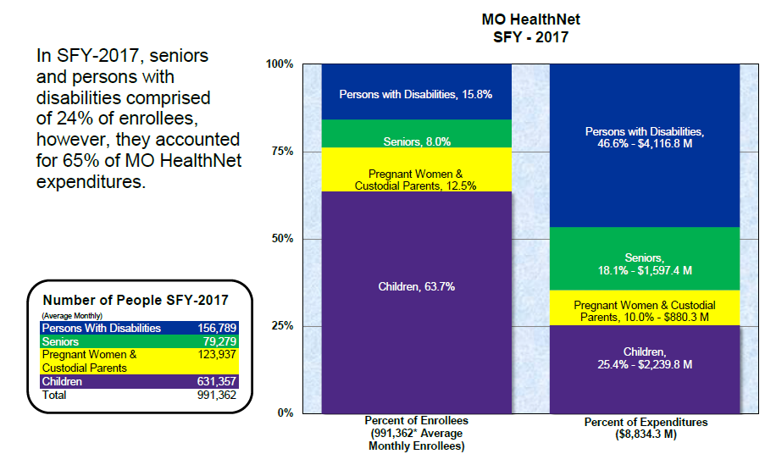
Medicaid Enrollees & Expenditures
4

Slide 5
SFY-2019 Governor’s Recomm 5 |  | ndatio Governo
 | (in millions) | Total | GR
SFY-2018 Supplemental Total MHD Program Supplemental: |  | $586.0 | $110.6
Pharmacy |  | $7.3 | $0.0
Physician |  | $138.0 | $44.8
Dental |  | $2.7 | $1.0
Nursing Facilities |  | $4.8 | $1.3
Nursing Facilities FRA |  | $6.9 | $0.0
Rehab & Specialty Services |  | $44.7 | $14.8
NEMT |  | $0.2 | $0.2
Hospital |  | $277.8 | $44.8
Show Me Healthy Babies |  | $14.4 | $3.6
FRA |  | $89.3 | $0.0
Total MHD Program Supplemental |  | $586.0 | $110.6
Medicare Parity for Maternal-Fetal Medicine (Managed Care) |  | $4.2 | $1.5
MHD DMH IGT Authority Supplemental |  | $233.4 | $0.0
e
n
r’s Rec

Slide 6
SFY-2019 Governor’s Recommendation
6
Governor’s Rec
Total GR
$7,624.9 $1,225.0
(in millions)
SFY-2019 Governor’s Core Budget
SFY-2019 Major Budget Items
Medicaid Cost to Continue
Cost to Continue based on SFY-2018 ongoing need as reflected in SFY-2017 supplemental. Physician, Dental, Nursing Facilities, NFFRA, Rehab & Specialty, Services, NEMT, Hospital Care, Show-Me Healthy Babies Hospital FRA, and IGT-Tier 1 Appropriations
$342.2
$81.8
$255.6
$0.0
DMH Intergovernmental Transfer:
Increased authority for the DMH Intergovernmental Transfer

Slide 7
SFY-2019 Governor’s Recommendation
7
Governor’s Rec
Total GR
(in millions)
SFY-2019 Major Budget Items
Health Insurer Fee
Reimbursements to Managed Care organizations for the federally mandated health insurer fee.
$63.1
$22.3
$58.5
$58.5
GR Pickups:
To replace one time funding from increased federal CHIP earnings, Healthy Families Trust Fund, Life Sciences Research Trust Fund, and Premium Fund: Pharmacy, Managed Care, and CHIP Medical Benefits Appropriations.

Slide 8
SFY-2019 Governor’s Recommendation
8
Governor’s Rec
Total GR
(in millions)
SFY-2019 Major Budget Items
FMAP
Increase Federal Fund authority to address the change in the Medicaid federal participation percentage (FMAP)
$56.6
$0.0
Pharmacy Specialty Increase
Funding for the ongoing inflation and utilization of specialty pharmaceuticals.
$55.2
$19.3
Pharmacy Non-Specialty Increase:
Funding for the ongoing inflation and utilization of non-specialty pharmaceuticals.
$0.0
$0.0

Slide 9
SFY-2019 Governor’s Recommendation
9
Governor’s Rec
Total GR
(in millions)
SFY-2019 Major Budget Items
Federally Required Actuarial Rate Increases:
Managed Care Actuarial Rate Increase
Funding for Managed Care medical, delivery and Neonatal Intensive Care Unit services to ensure that Managed Care payments are actuarially sound.
$37.3
$12.8
NEMT Actuarial Increase
Funding for NEMT rates to ensure payments are actuarially sound.
$2.2
$0.8
Hospice Rate Increase
Funding for annual hospice rate increase as established by Medicare. The MO HealthNet hospice rates are calculated based on the annual hospice rates established under Medicare.
$0.3
$0.1

Slide 10
SFY-2019 Governor’s Recommendation
10
Governor’s Rec
Total GR
(in millions)
SFY-2019 Major Budget Items
Managed Care Contracted Withhold Deferment
Funding needed for the amount of Managed Care withhold deferred in SFY18 associated with extending Managed Care regional coverage and increasing the Managed Care withhold from 2.5% to 5% in the Statewide Managed Care RFP.
$34.0
$11.7
HB 1565 Asset Limit Increase
Funding for additional individuals and couples who will become eligible for full Medicaid benefits as a result of HB 1565 (2016). The bill raises the MO HealthNet asset limits for MO HealthNet permanent and totally disabled claimants, MO HealthNet blind claimants, and MO HealthNet aged claimants from $2,000 to $3,000 for individuals and $4,000 to $6,000 for married couples in 2019.
$20.6
$3.2

Slide 11
SFY-2019 Governor’s Recommendation
11
Governor’s Rec
Total GR
(in millions)
SFY-2019 Major Budget Items
Advancing MMIS Technology
Funding Medicaid Management Information System (MMIS) system changes necessary for Medicaid reform; additional contracted pharmacy call center staff; additional state staffing (7 FTE) which will be designated to work on the procurement and system implementations; federal match rate changes on current contracts; and decreasing reliance on MMIS payments made from the MO HealthNet program lines.
$9.6
$6.6
Premium Payments Increase
Funding for the increase in Medicare Part A and Part B premiums.
$9.1
$3.0

Slide 12
SFY-2019 Governor’s Recommendation
12
Governor’s Rec
Total GR
(in millions)
SFY-2019 Major Budget Items
Health Home Expansion
Funding expansion of the Primary Care Health Home (PCHH) initiative in Missouri by up to 5,000 new participants.
$5.4
$0.7
Medicare Parity for Maternal-Fetal Medicine
Funding provides Medicare parity payments for primary care physicians relating to maternal-fetal medicine, neonatology, and pediatric cardiology.
$4.2
$1.5
Third Party Liability Contract Increase
Funding the cost of increased collections for the fee-for-service population.
$2.5
$0.0

Slide 13
SFY-2019 Governor’s Recommendation
13
Governor’s Rec
Total GR
(in millions)
SFY-2019 Major Budget Items
MMIS Contract Extension
Funding to extend contracts for development, operation, and support of the MO HealthNet technology infrastructure.
$1.3
$0.4
Electronic Visit Verification (EVV)
Funding to comply with the 21st Century CURES Act designed to improve the quality of care provided to individuals through enhanced quality control, through obtaining data for research and action, and is designed to strengthen mental health parity. Section 12006 of the CURES Act requires states to implement an Electronic Visit Verification (EVV) system for Personal Care services (PC) by 01/01/2019 and for Home Health Care Services (HH) by 01/01/2023. (Public Law 114-255).
$0.7
$0.1

Slide 14
SFY-2019 Governor’s Recommended Core Cuts
14
Governor’s Rec
Total GR
(in millions)
SFY-2019 Governor’s Recommended Core Cuts
Program Reductions due to lapse
$78.3
$21.9
Federal and Other Funds used as one-time fund sources in SFY18
$58.5
$0.0
Fee-For-Service Claims Run out from State Managed Care
$58.3
$20.7
FRA reduction in Managed Care, increased in Hospital section
$57.2
$0.0
FMAP
$56.6
$54.7
Reductions for Statewide Managed Care one-time costs
$40.5
$14.4
Senior Services Protection Fund
$11.0
$0.0
Reductions for Management of Pharmacy costs and rebate
$11.1
$3.9
SFY-2018 Governor Expenditure Restrictions Core Cuts
Reduction in Fee-For-Service rates, monitoring program and pager pilot program, elimination of CHAPS.
$4.6
$3.3

Slide 15
Revenue Update
15
SFY 2018 Consensus Revenue Estimate
▪ 3.8% Growth - $9,398B
SFY 2018 Revised Consensus Revenue Estimate
▪ 1.9% Growth - $9,188.9B
SFY 2019 Consensus Revenue Estimate
▪ 2.5% Growth - $9,418.2B
SFY 2018 Actual Revenue Growth - December Collections
Increased 4.13% for the year, from $4.26B to $4.44B
12

Slide 16
Provider Taxes
16
The Mo HealthNet provider taxes are used to draw down matching federal dollars which are used to pay program providers. Without these revenue sources in Fiscal Year 2018, Missouri would need to find approximately $1.379 billion of general revenue for the Medicaid program.
In FY 2017 MO HealthNet Providers paid over $1.435 billion in provider taxes. Using the standard Federal match rate, this earns $2.467 billion in federal funds and accounts for close to $3.902 billion in total MO HealthNet funding. All provider taxes must be reauthorized through state legislation.
Authorized Provider Taxes
Hospital (FRA)
Nursing Facility (NFFRA)
Pharmacy (PFRA)
Intermediate Care Facilities (ICF-IDD)
Ambulance (AFRA)
Managed Care
12

Slide 17
Provider Taxes
17
Hospital Tax (FRA)
Established 1992
This tax is assessed on net operating revenue of all hospitals in the state.
FY 2017 tax rate was 5.95% for July 1, 2016 through June 30, 2017
FY 2017 assessments: $1,124.1 million
FY 2018 tax rate was 5.70% for July 1, 2017 through September 30, 2017 and is 5.50% for October 1, 2017 through June 30, 2018; estimated assessment is $1,093.7 million; federal earnings $1,966.5 million
Participating providers: 142 (7 DMH and 135 non-DMH)
FRA proceeds support:
Hospital costs to care for the uninsured
Expanded coverage for children
Enhanced Medicaid rates for hospitals
Managed Care capitated payments
12

Slide 18
Provider Taxes
18
Nursing Facility Tax (NFFRA)
Established 1995
This tax is assessed on patient-days (occupancy tax) of all nursing homes in the state.
FY 2017 tax rate was $13.40 per patient day (rate effective beginning July 1, 2015)
FY 2017 assessments: $199.4 million
FY 2018 tax rate is $13.40 per patient day (no change in tax rate for SFY 2018); estimated assessment is $198.9 million; federal earnings $357.6 million
NFFRA proceeds support nursing facility rates.
Participating providers: 521
12

Slide 19
Provider Taxes
19
Pharmacy Tax (PFRA)
Established 2002
This tax is assessed on gross prescription receipts of all pharmacies in the state.
FY 2017 tax rate was 1.49% from July 1, 2016 to December 31, 2016 and 1.39% from January 1, 2017 to June 30, 2017.
FY 2017 assessments: $97.0 million
FY 2018 tax rate is 1.59%; estimated assessment is $110.3 million; federal earnings $124.7 million
Participating providers: 1,330
Pharmacy tax proceeds support:
Medicaid pharmacy program
Enhanced dispensing fees for Medicaid prescriptions
12

Slide 20
Provider Taxes
20
ICF-IID Provider Tax
Established 2009
This tax is assessed on 6 State Habilitation Centers and 7 Private Intermediate Care Facilities for Individuals with Intellectual Disabilities
FY 2017 tax rate is 5.95%
FY 2017 tax assessments: $5.3 million
FY 2018 tax rate is: 5.95%; estimated assessment is $6.0 million; federal earnings $4.4 million
The proceeds generated from this the tax on the private ICF-IIDs goes back to these entities in the form of a rate increase.
12

Slide 21
Provider Taxes
21
Ambulance Provider Tax
Authorized by the General Assembly in May 2009; Established October 2011
This tax is assessed on gross receipts of all ambulance providers
FY 2017 tax rate was 3.74% July 1, 2016 to September 30, 2016 and 4.44% from October 1, 2016 to June 30, 2017
FY 2017 assessments: $9.8 million
FY 2018 tax rate is 4.44% from July 1, 2017 to September 30, 2017 and 4.75% from October 1, 2017 to June 30, 2018
FY 2018 estimated assessments: $11.6 million; federal earnings $20.9 million
Ambulance provider tax proceeds support enhanced fees to ground ambulance service providers.
Participating providers: 201
12

Slide 22
Provider Taxes
22
Managed Care Tax
Established 2005
This tax will be assessed on gross receipts of all Medicaid managed care companies in the state. Since there was no change at the federal level the tax ended September 30, 2009.
FY 2010 tax rate was 5.49% (July 09- September 09); FY 2010 assessments: $22.5 million
Federal law authorized Missouri’s tax on Medicaid Managed Care companies through September 30, 2009.
12

