Slide 1
Rural Hospital Closures and the State of Rural Health
Timothy D. McBride, PhD
Brown School
Center for Health Economics and Policy
Washington University in St. Louis
RUPRI Center for Rural Health Policy Analysis
May 2018

Slide 2
Briefing
Excerpt from briefing given for Senate Finance staff, April 24, 2018
  Presenters:
    Mark Holmes and George Pink, UNC-Chapel Hill
    Keith Mueller, University of Iowa
    Tim McBride, Washington University in St. Louis
Focus primarily was on rural hospital closures
  Background
  Why are hospitals closing?
  Policy options?

Slide 3
Rural Hospital Closures

Slide 8
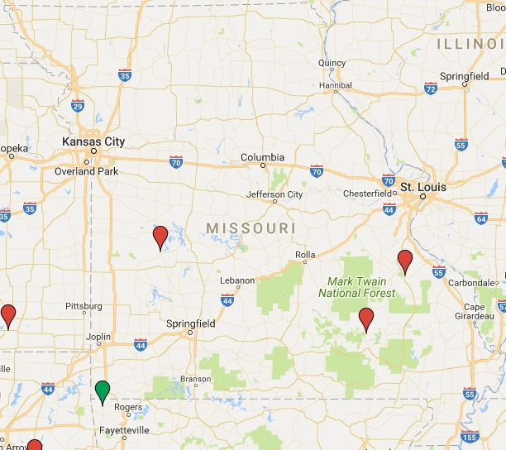
Missouri Rural Hospital Closures (since 2014)
Closures
    Twin Rivers Regional Medical Center, Kennett, MO in 2018 (116 beds)
    SoutheastHEALTH Center of Reynolds County, Ellington MO in 2016 (21 beds)
    Parkland Health Center, Farmington MO in 2015 (98 beds)
    Sac-Osage Hospital, Osceola MO in 2014 (47 beds)
In financial distress and close to closure
    Southeast Health Center Ripley County, Doniphan, MO (not yet announced, but expected soon unless a new buyer is located)
    Iron County Medical Center, Pilot Knob, MO (bankruptcy)

Slide 9
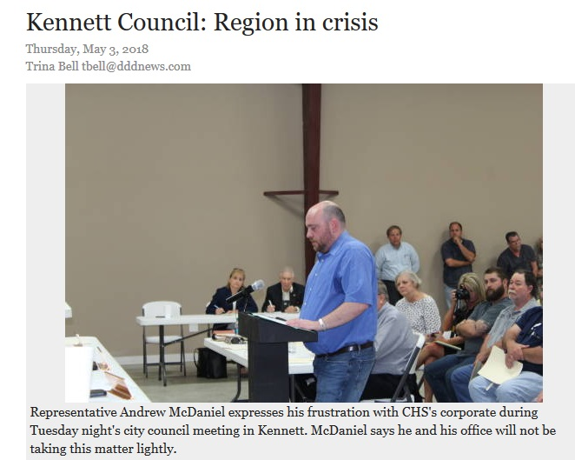
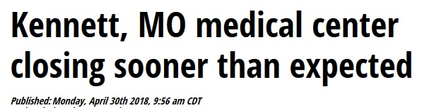
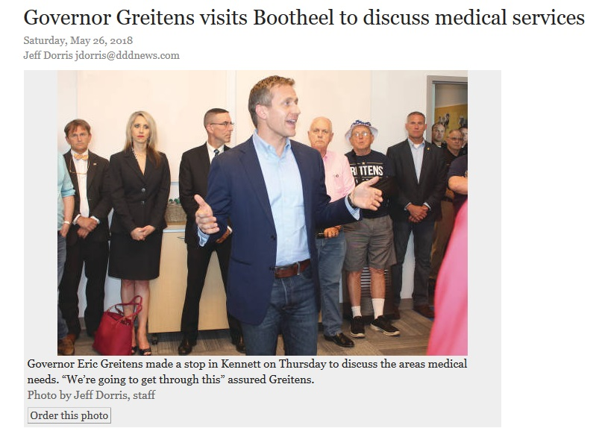
Missouri Rural Hospital Closures (since 2014)
Dr. Randall Williams: “I am surrounded by heroes in this room. This could have been a problem you run away from, so I just can’t thank you enough from the health care community for your vision and your willingness to take on this challenge…We’re working with county commissioners. We’re getting every resource. We are paving a way to make that happen.”

Slide 10
Financial distress
Causes of financial distress and closure are multi-facted and complex
Long-term unprofitability is a major cause
  Many factors go into contributing to long-term unprofitability
    Low volumes
    Market structure
    Population served (older, sicker, lower incomes)
    Service mix
    Workforce issues
    Technology challenges
    Policy challenges: lack of Medicaid expansion, low payment, Medicare payment changes
The South has the greatest number of rural hospitals at high risk of financial distress

Slide 14
Why are rural health systems stressed?

Slide 15
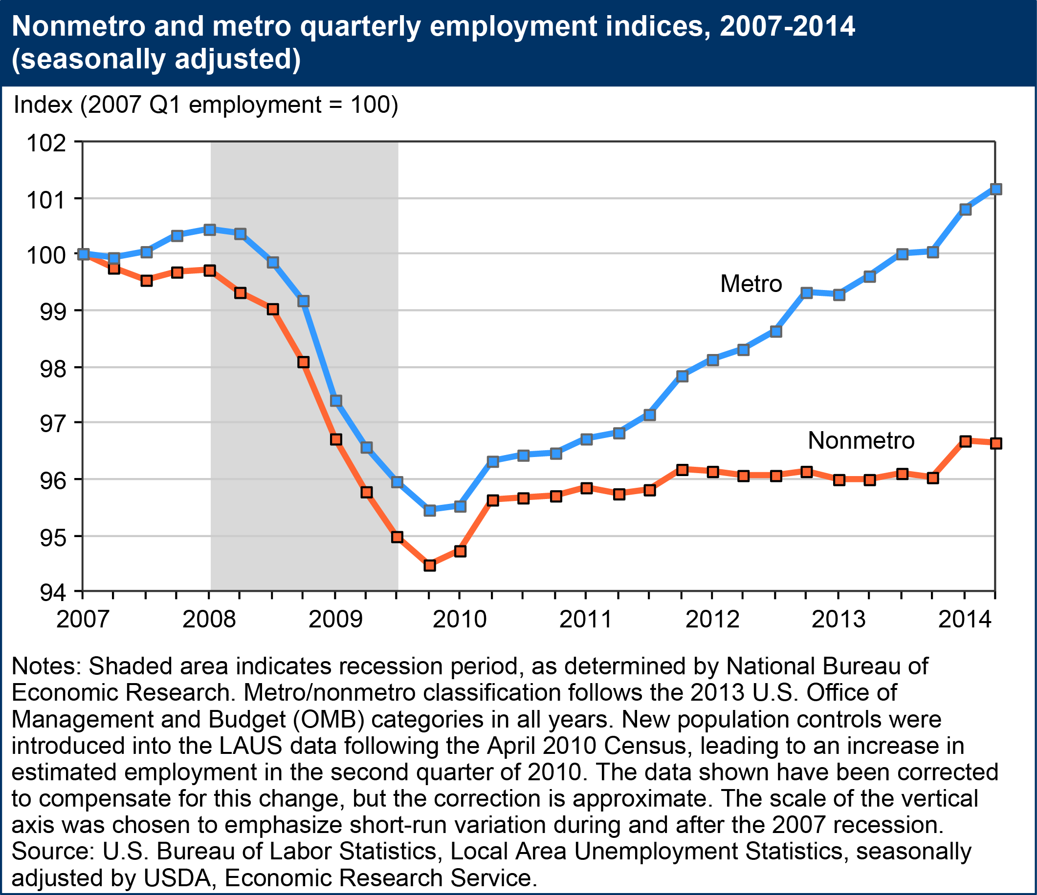
Nonmetro areas have NOT recovered to the employment levels they held prior to the Great Recession.
Metro areas had by mid 2013.

Slide 16
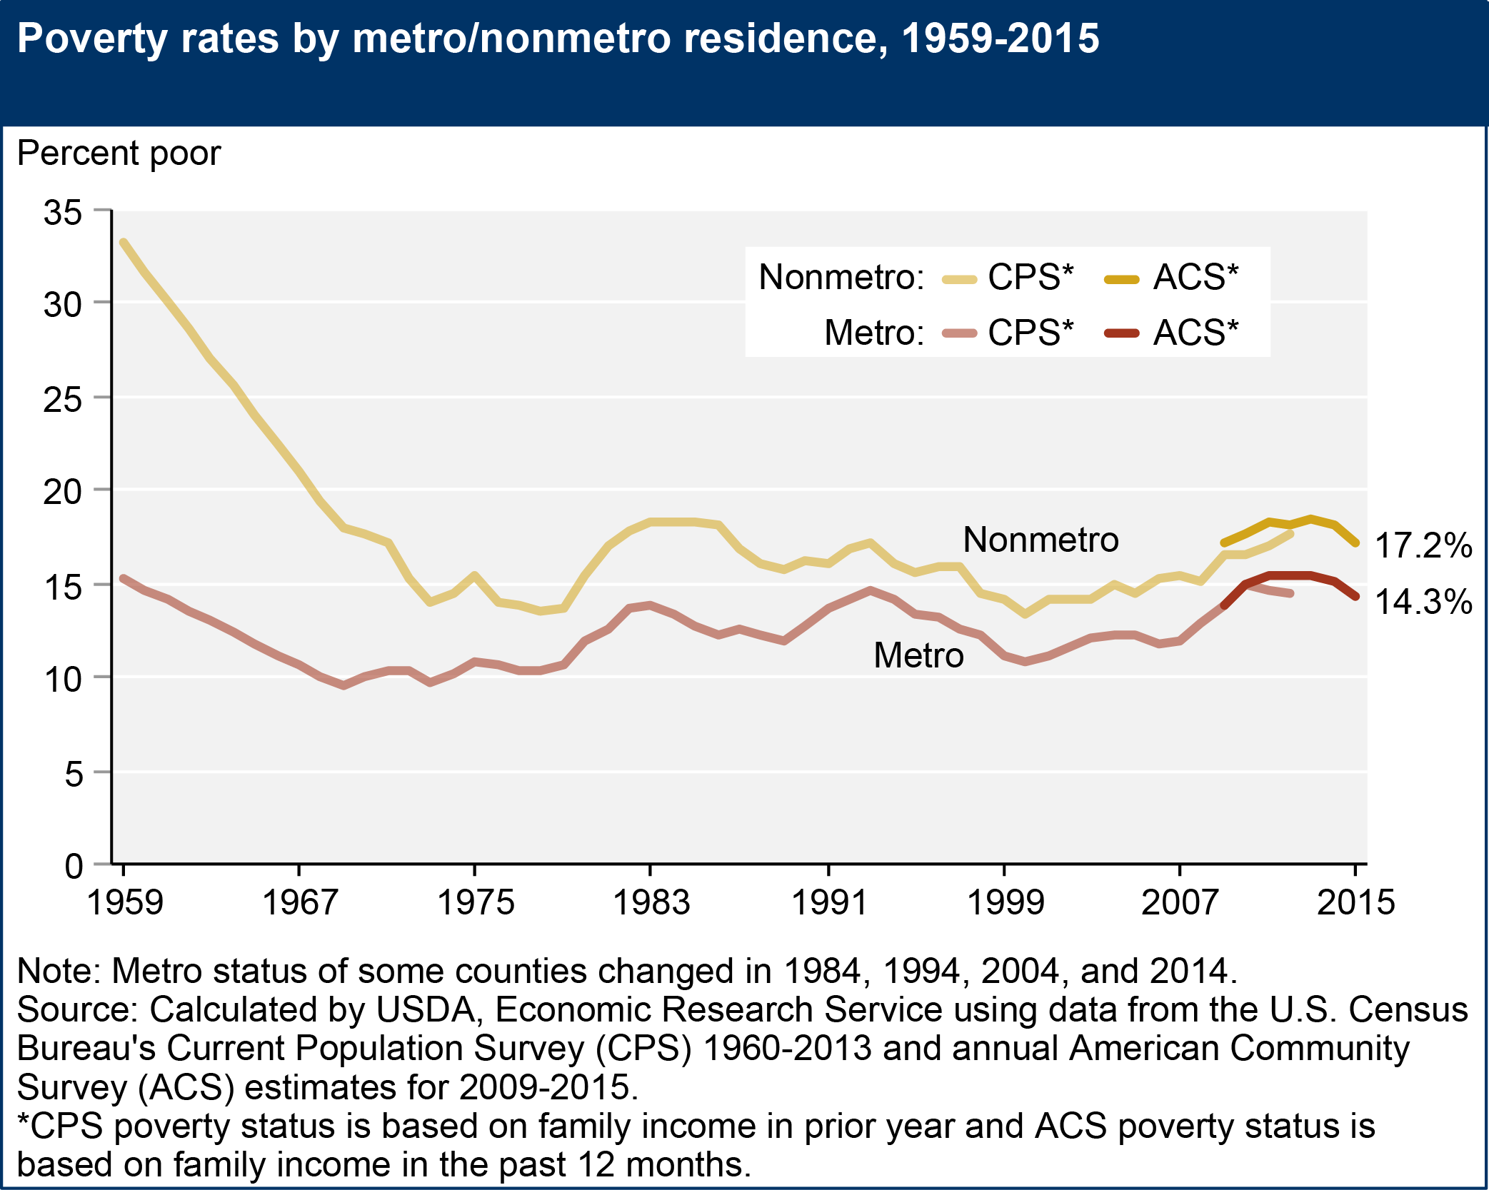
Though poverty rates fell significantly until the early 1970s, nonmetro poverty rates have always been higher than metro poverty rates.

Slide 17
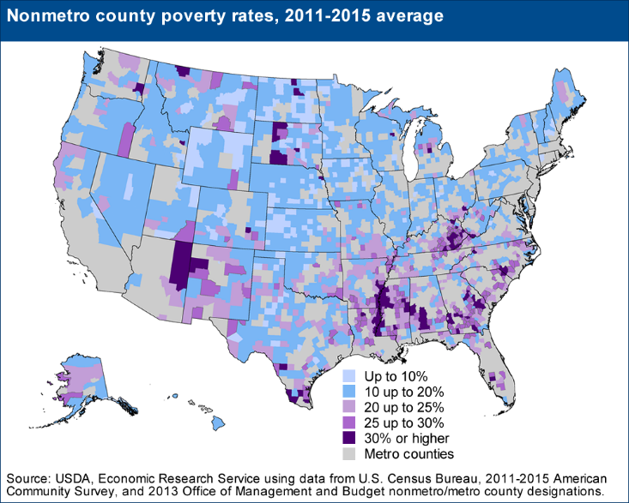
Some rural areas in the U.S. have significantly higher poverty rates; mostly in the rural South and Southwest, Appalachia.

Slide 18
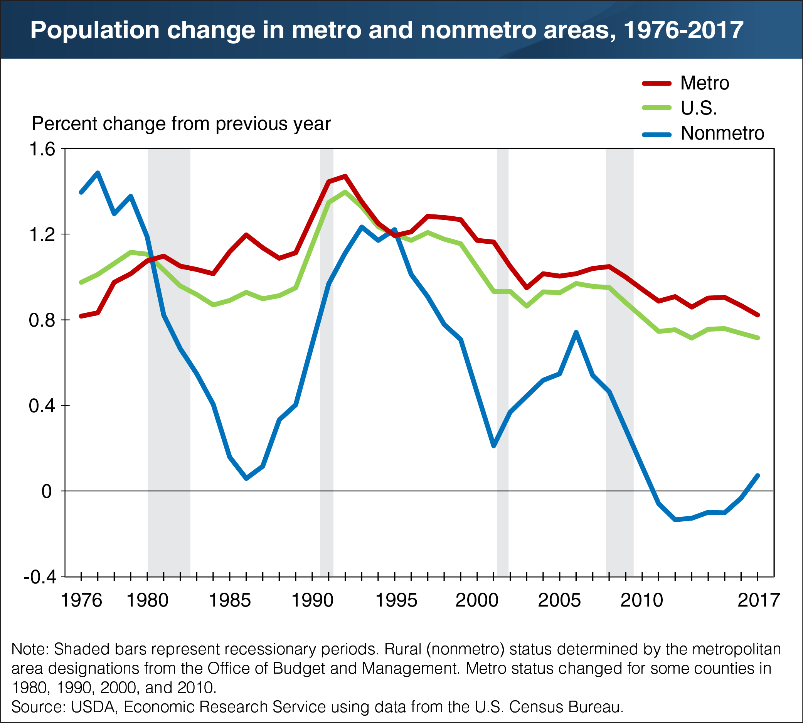
Since the 1980s, population growth has lagged in nonmetro areas as compared to metro areas.
Depopulation occurred after Great recession.

Slide 19
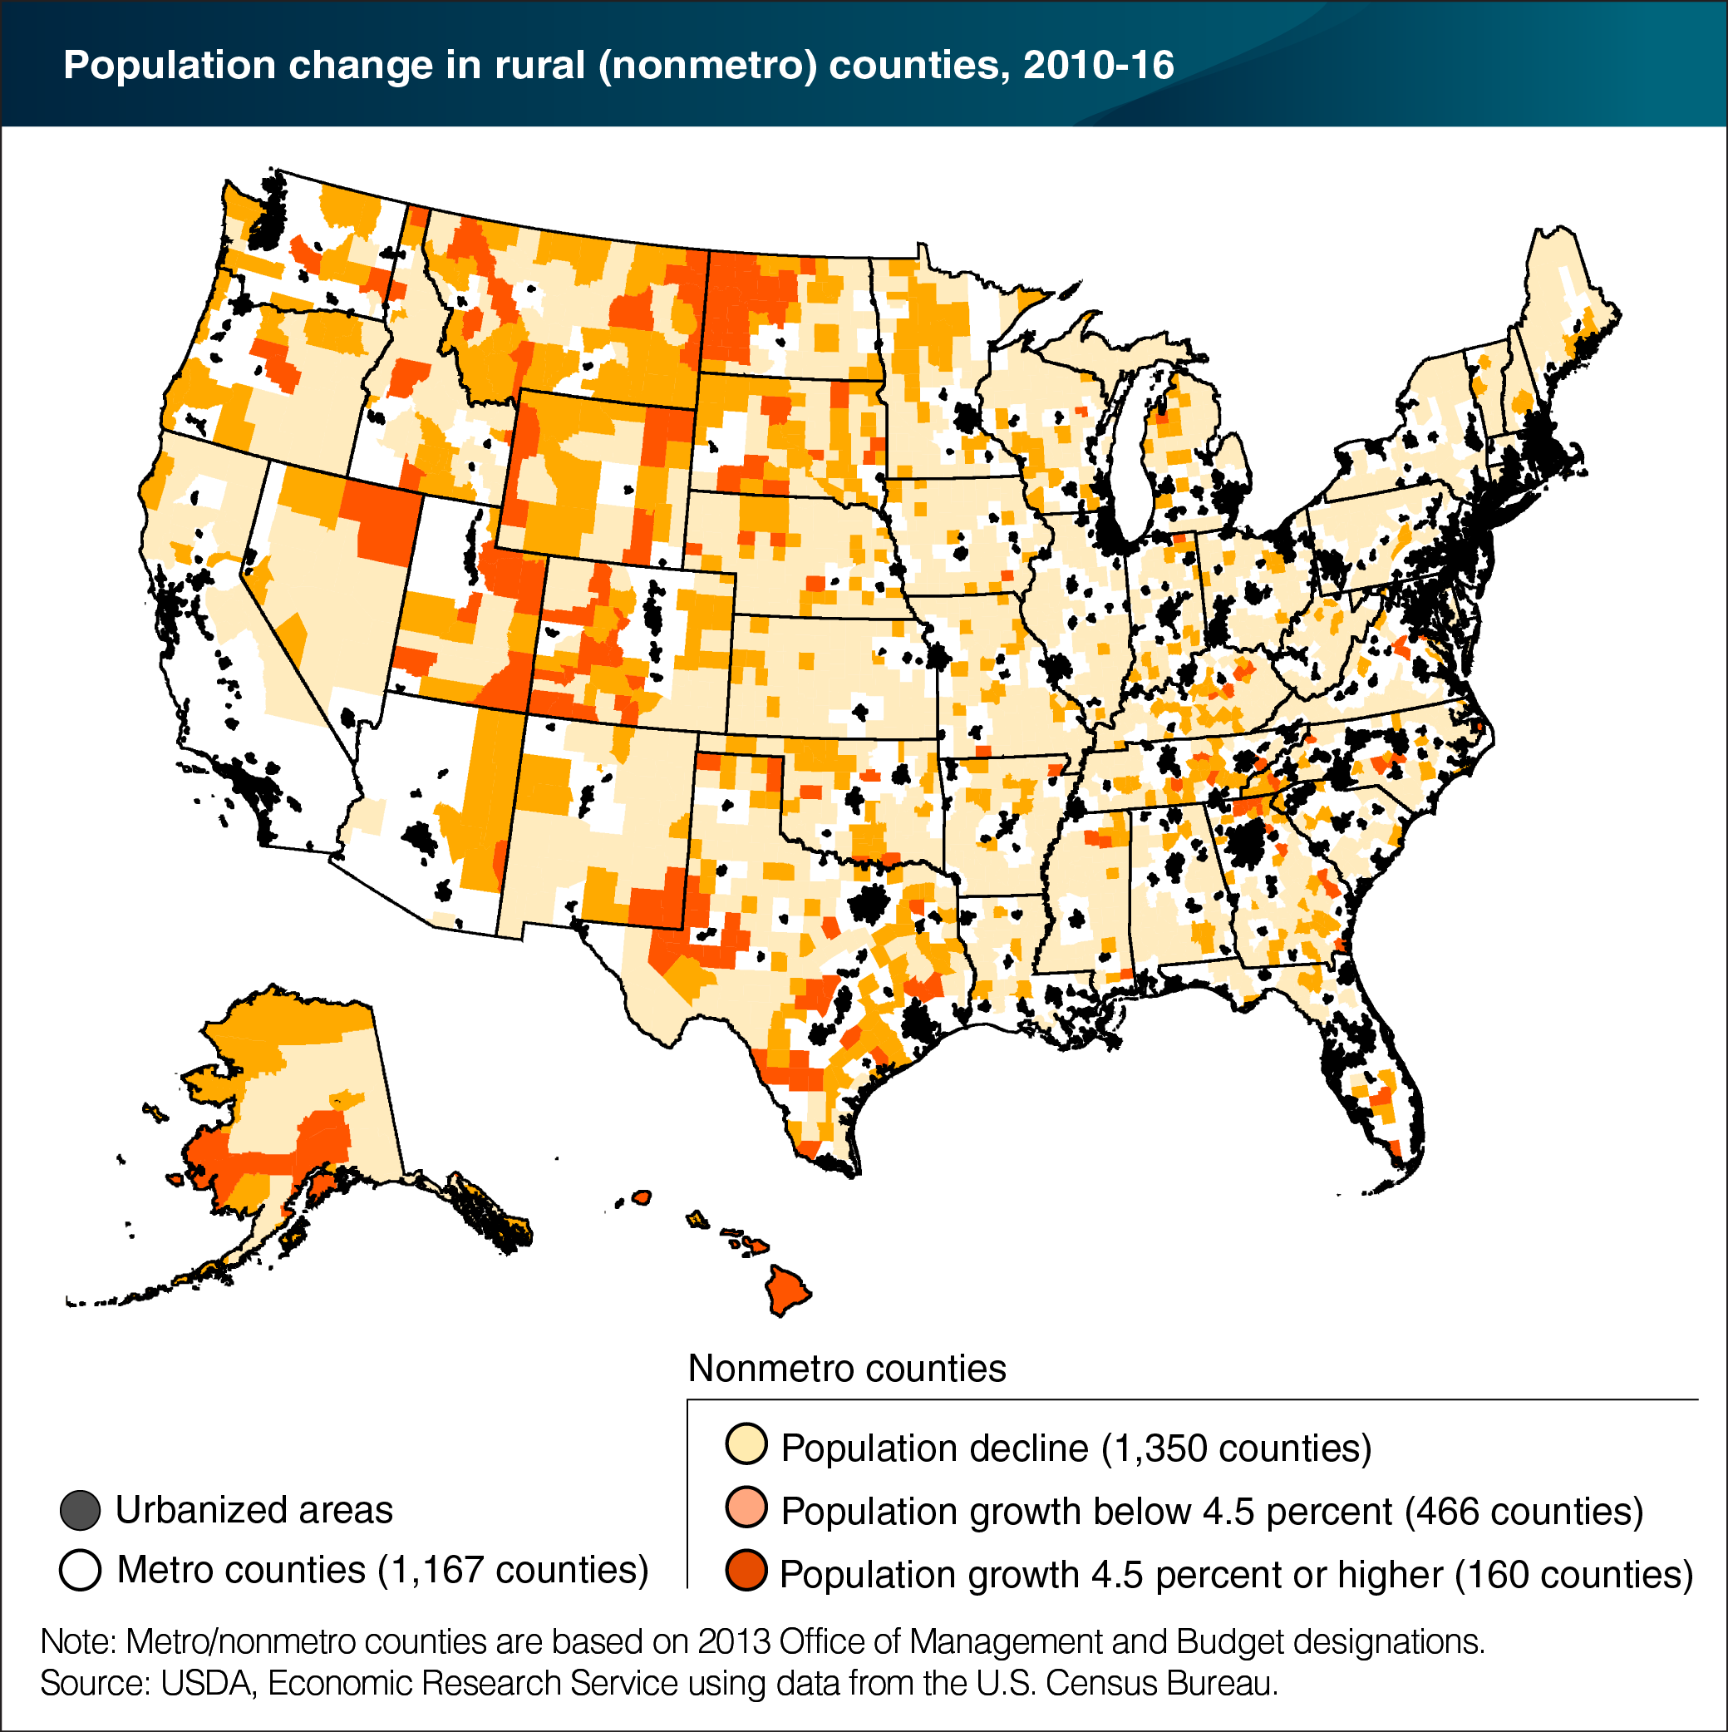
More than a third of the counties in the U.S. experienced population decline over the 2010-16 period.
Almost all nonmetro counties had population growth below 4.5%

Slide 20
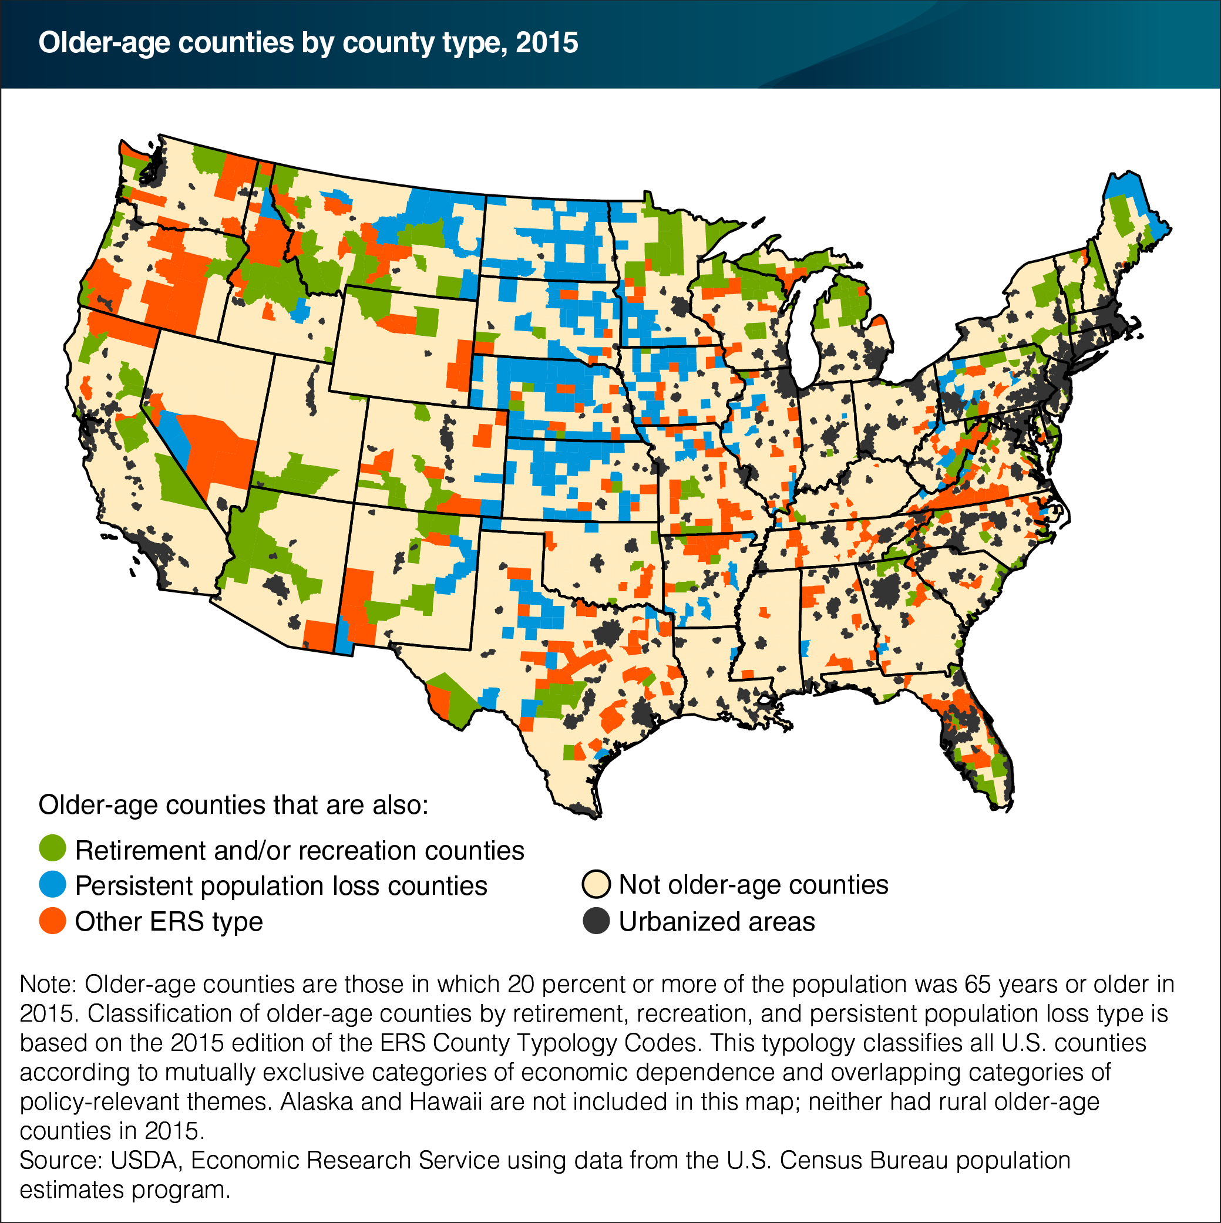
Median age:
Rural 43, Urban 36
% of population age 65+:
Rural 17.2%, Urban 12.8%
Aged population will double from 2000 to 2030!
Implications for Medicare&Medicaid
Map shows two reasons for this: migration to retirement/recreation counties, but also loss of population elsewhere.

Slide 21
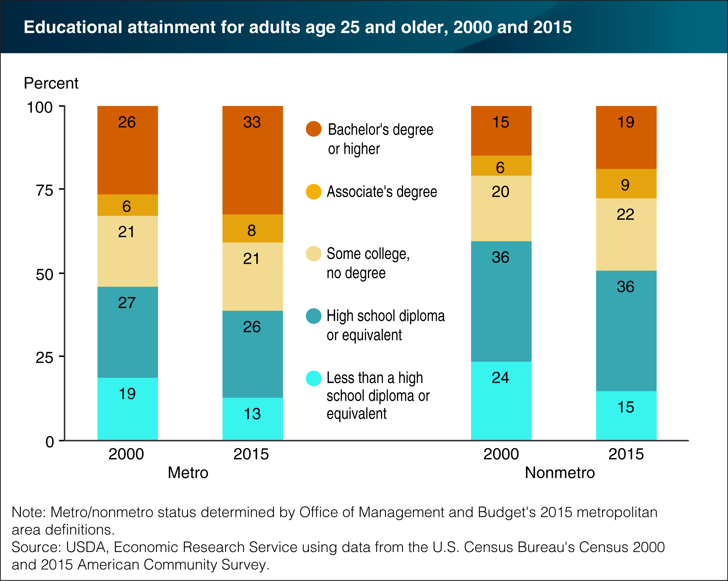
A lower proportion (28%<41%) have college education in rural America.
Implication for opportunities for skilled labor positions.

Slide 22
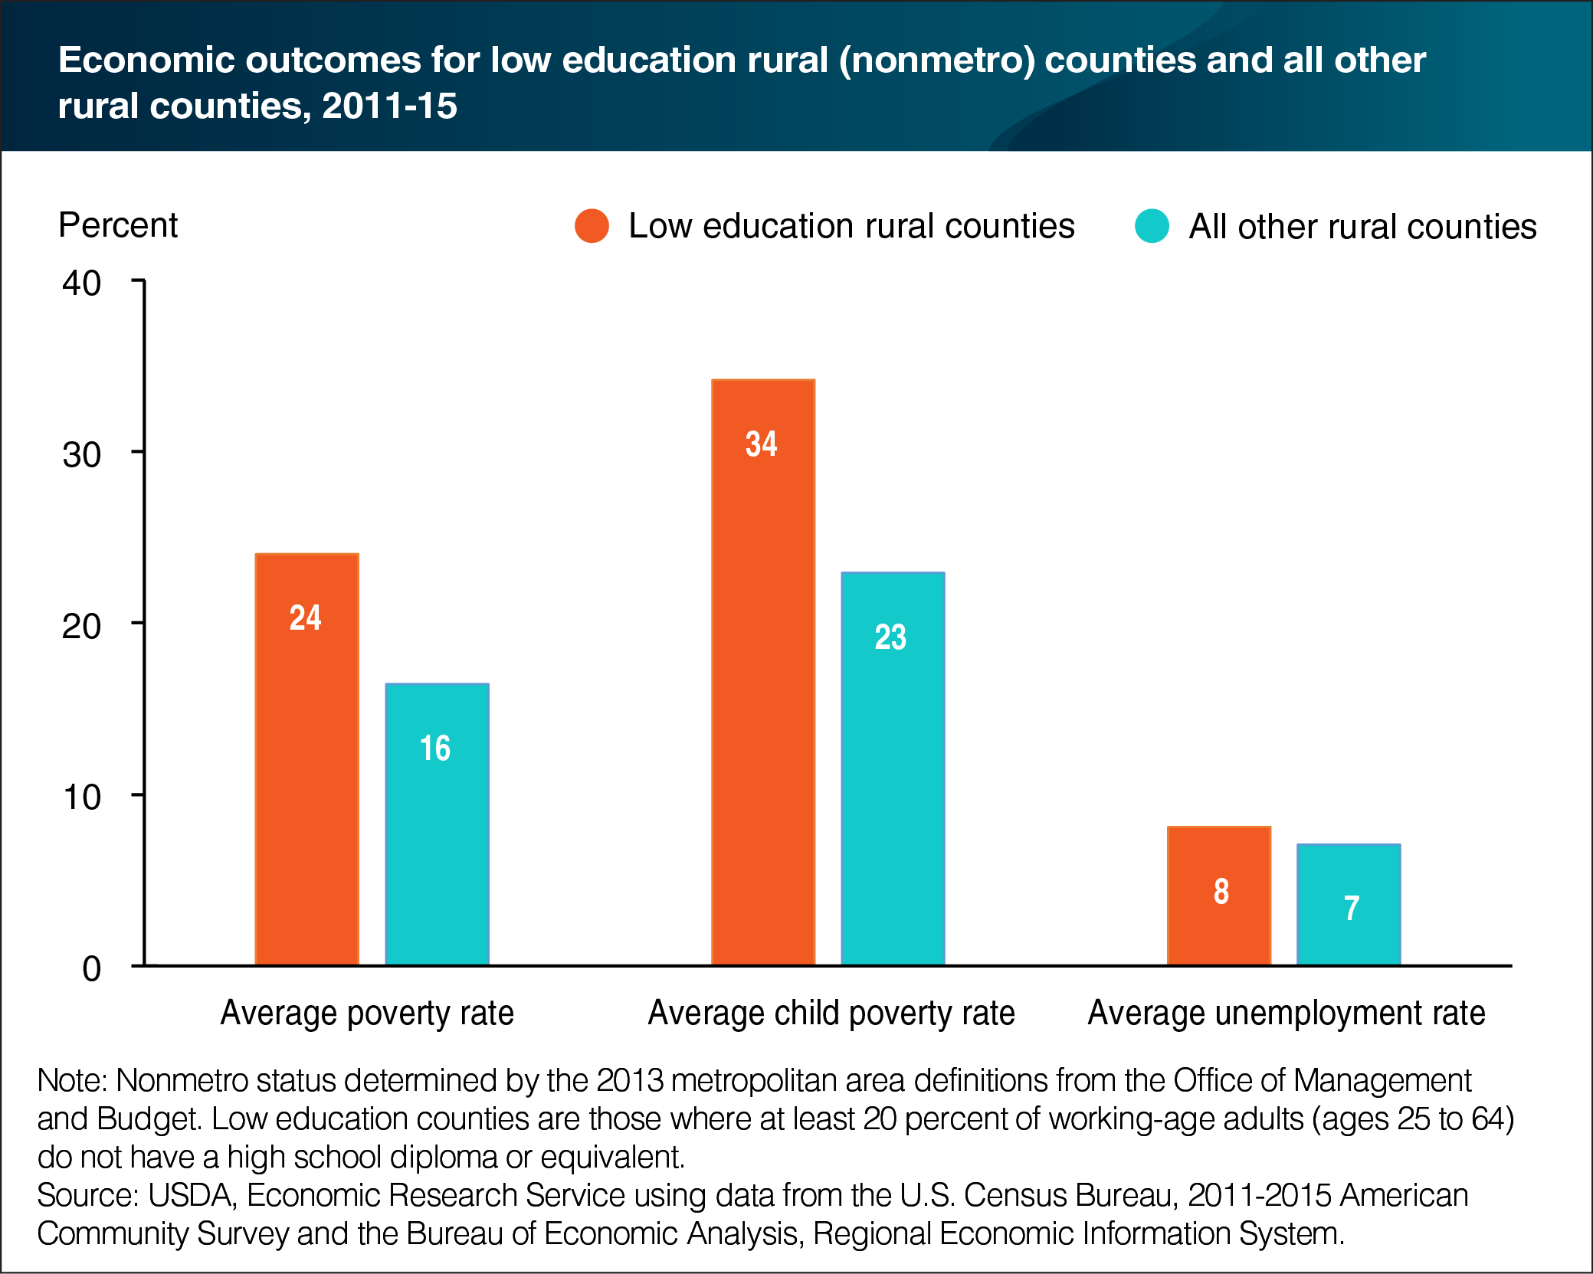

Slide 23
Change in Uninsured Rate in U.S., 2013-16
 | 2013 | 2016 | Change 2013-16
Nonmetro | 12.8% | 9.4% | -3.4%
Metro | 13.4% | 8.7% | -4.7%
All | 13.3% | 8.8% | -4.5%
SOURCE: Bureau of the Census, CPS ASEC, 2013-16.

Slide 24
Medicare Advantage Enrollment Growth
Continued steady growth in Medicare Advantage enrollment in rural and urban areas.
But rural enrollment has always lagged behind urban by about 10 percentage points.
Implications for rural provider payment.
Notes:
Or, even though they aren’t allowed to charge higher premiums for sicker populations, they can, in subsequent years, charge more in places where their own costs turn out to be higher – for whatver reason.

Slide 25
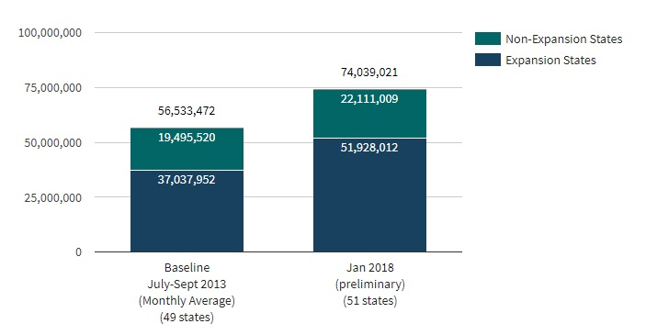
Medicaid Enrollment Growth
Medicaid and CHIP enrollment growth
38% growth in Medicaid Expansion States
12% growth in non-expansion states
29% growth overall in all states
Source: CMS, January 2018.
Notes:
Or, even though they aren’t allowed to charge higher premiums for sicker populations, they can, in subsequent years, charge more in places where their own costs turn out to be higher – for whatver reason.

Slide 26
More than 63% of rural hospital inpatient days paid by Medicare and Medicaid; 49% for urban hospitals.
SOURCE: Healthcare Management Partners, LLC, June 2017.

Slide 27
Key takeaways
Many rural hospital closures in recent years nationally
  And a number of other rural hospitals facing significant financial stress
  Missouri: four rural hospital closures since 2014
Causes of financial distress and closure are complex and the number of hospitals at risk of financial distress is growing
  Rural America has endured major shocks in the last few decades to its economy
  Like the rest of America, rural America is aging, but a faster rate
  Educational attainment levels are lower
  Payer mix
    Uninsured rates lower since 2013, but drop smaller in rural
    Medicaid coverage growing, Medicare Advantage growing (and Medicare)
    Lack of Medicaid expansion adding to financial stress in some states
    Marketplace enrollment lower in rural
    Overall: rural has higher proportion of funding covered by public funding

Slide 29


Contact Information
Timothy McBride tmcbride@wustl.edu

