Slide 1
State Student Aid Program Update
DSS Learning Lab
June 30, 2022

Slide 2
Agenda
State Student Aid Overview
Spotlight on:
Access Missouri
Fast Track
State Aid Program Highlights
Questions

Slide 3
State Student Aid Overview

Slide 4
In the 2021-2022 academic year
MDHEWD provided
approximately $139.5 M
to more than 58,900 students
through 10 programs

Slide 5
State Student Aid Overview
Gift Aid
Student does not have to repay
Scholarship: Based on academic merit
Grant: Based on need or special purpose
Loans
Student must repay, typically with interest
Federal
State
Private
FAFSA: Free Application for Federal Student Aid
Federal aid application (Pell, loans)
State aid application for some programs
Used to determine need/other eligibility criteria

Slide 6
State Student Aid Overview
Grant/Loan Conversion: Grant becomes a loan if specified criteria not met
Grant
Loan

Slide 7
State Student Aid Overview
General Eligibility Criteria
U.S. citizen/permanent resident
Some programs include those lawfully present in U.S.
Missouri resident
Undergraduate student attending a participating Missouri institution
Not be pursing a degree/certificate in theology or divinity
Some programs may not include all general criteria/ others may have additional criteria

Slide 8
State Student Aid Overview
Application: MDHEWD Student Portal/Estimate Eligibility tab
Deadline | Program(s)
February 1 | Access Missouri preferred (upcoming yr.), DCDE spring priority (current yr.)
April 1 | Access Missouri final (upcoming yr.), DCDE spring final (current yr.)
April 30 | Kids’ Chance (upcoming yr.)
May 1 | War Vet Renewal preferred (upcoming yr.)
June 1 | MUELP (upcoming yr.), Advanced Placement (current yr.)
June ACT test date immediately following high school graduation | Bright Flight (upcoming yr.)
October 1 | DCDE fall priority (current yr.)
December 1 | DCDE fall final (current yr.)
None | A+, Public Safety Officer, War Vet initial & renewals who didn’t meet 5/1
TBD | Fast Track

Slide 9
Spotlight on
Access Missouri

Slide 10
Access Missouri
Missouri’s primary need-based grant
Need based on Expected Family Contribution (EFC) from FAFSA
Awards designed to be simple, predictable and portable
 | Public 2-Year | Public 4-Year, State Tech, Private, Approved Virtual (WGU)
Statutory Maximum | $1,300 | $2,850
Statutory Minimum | $300 | $1,500

Slide 11
Access Missouri Awards
Annual maximums typically less than statutory
Awards based on:
Number of eligible students
Program appropriation
Structure
EFC/Type of Institution Matrix
EFCs in $500 ranges from $0-500 to $11,500-$12,000
Awards higher for students with lower EFCs

Slide 12
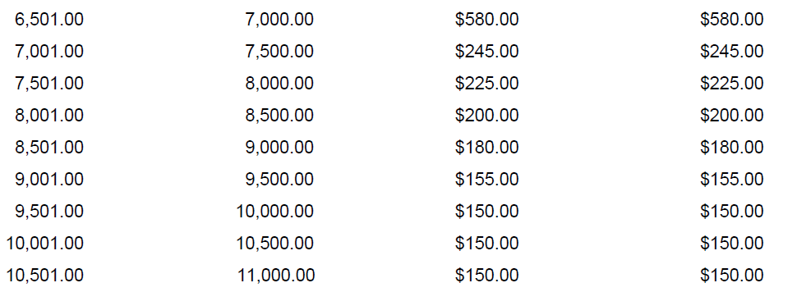
Access Missouri Awards

Slide 13
Access Missouri Eligibility
U.S. Citizen or permanent resident
Missouri resident
Full-time (12 hours), undergraduate student
Expected Family Contribution (EFC) of $12,000 or less
File the FAFSA
Feb. 1 preferred, April 1 final deadline. Actual award deadline can be set anywhere in between.
Corrections by July 31
2.5 cumulative GPA to renew

Slide 14
Access Missouri Eligibility
Eligibility expires on earliest of:
Receipt of the award for 10 semesters
Receipt of 1st bachelor’s degree
Completion of the required hours for a bachelor’s degree
Completion of 150 semester credit hours

Slide 15
Access Missouri
FY 2023
$9 M appropriation increase
Full funding at statutory maximum award levels and April 1 deadline

Slide 16
Spotlight on
Fast Track

Slide 17
Fast Track
Addresses state’s workforce needs
Targeted toward adults
Assistance in pursuing a certificate, degree, or industry recognized credential in a designated high need area
Need-based grant
AGI of $80,000 or less if married filing jointly
AGI of $40,000 or less for all other tax filing statuses

Slide 18
Fast Track
Prior to Aug. 28, 2022 grant could convert to loan if not a MO resident/employed in MO for 3 years after graduation
Grant
Loan

Slide 19
Fast Track
SB 672 effective August 28, 2022
All loan-related requirements eliminated
Recipients must still report 3 years of residency/employment
Program expanded to include additional eligible training providers and apprenticeships
Grant
Loan
Details coming soon

Slide 20
FY 2023 Fast Track Awards
Student Award:
Tuition and fees
Governmental sources of funding (state or federal non-loan)
Award
If calculated award is zero, student can receive lesser of remaining cost of attendance or $500
Apprentice Award:
Related educational costs (tools, uniforms, etc.)
Governmental sources of funding (state or federal non-loan)
Award

Slide 21
Fast Track
Level appropriation of $4.7 M for FY 2023
Expected to be sufficient but exact impact of expansion and removal of the loan requirements uncertain

Slide 22
State Aid Program Highlights

Slide 23
State Aid Program Highlights
A+
Scholarships to eligible graduates of A+ designated high school to attend a participating public community college or vocational/technical schools, or certain private two-year vocational/technical schools
Bright Flight
Merit-based scholarship encouraging top-ranked high school seniors to attend approved MO postsecondary schools with tiered awards
Top 3% = ACT 31 for 2022 seniors; ACT 32 for 2023+ seniors – up to $3,000 annually
Students must meet high school requirements and postsecondary renewal requirements
Top 4th & 5th percentiles = ACT 30 for 2022 seniors; ACT 31 for 2023+ seniors – up to $1,000 annually
Awards based on tuition and fees remaining after federal non-loan aid (Pell) is applied
FY 2023 will be first year top 4th & 5th percentiles (2018-2022 graduates) funded

Slide 24
State Aid Program Highlights
Scholarship to assist high school students cover tuition and fees for dual credit/dual enrollment courses
First implemented spring 2022; tied to A+; need-sensitive
MUELP
Scholarship to assist academically talented minority and underrepresented individuals pursuing a bachelor’s or master’s degree in an environmental course of study leading to employment in a field clearly environmentally-related
Awards selected by statutorily-defined selection committee
Dual Credit/
Enrollment
2022 legislative changes (SB 718) removed A+ tie; need-based effective 8/28/22
Award calculated by dividing appropriation among selected recipients

Slide 25
State Aid Program Highlights
Public Safety Officer Survivor
Grant providing tuition assistance to certain public employees and their families if the employee is killed or permanently and totally disabled in the line of duty
If child, available through semester of 24th birthday
Wartime Veteran’s Survivor
Grant for children/spouses of veterans whose deaths or injuries were a result of combat action or attributed to an illness contracted while serving in combat action, or who became 80% disabled as a result of injuries/accidents sustained in combat since 9/11/2001
If child, available through semester of 25th birthday
Statutorily limited to 25 recipients/year
Semester awards based on tuition/fees capped at UMC rate + 2,000 room & board allowance + actual book costs up to $500
Award capped at tuition for 12 hours and UMC tuition rate

Slide 26
State Aid Program Highlights
Kids’ Chance
Scholarship for children of workers/families receiving worker’s compensation for a serious injury or death that occurred on the job
Partnership with Kids’ Chance Inc. of Missouri
Advanced Placement Incentive Grant
One-time $500 grant encouraging high school students to take and score well on Advanced Placement tests in math and science
Award lesser of actual tuition/fees capped at UMC rate, or maximum award provided by Kids’ Chance Inc. of Missouri
Must achieve two scores of 3 or higher on math or science AP exams while at a Missouri public high school
Must also receive an Access Missouri or A+ award, or be eligible for a $0 award

Slide 27
Application
For most programs, application is on MDHEWD Student Portal/Estimate Eligibility tab
https://web.dhewd.mo.gov/studentportal/
Not required for Bright Flight or Access Missouri
Bright Flight eligibility based on ACT score received from ACT Inc.
Access Missouri eligibility is based on FAFSA received from U.S. Department of Education

Slide 28
State Aid Program Highlights
Visit https://dhewd.mo.gov/ppc/grants/ for more info
Individual pages for each program with eligibility, award, application and other information

Slide 29
Questions
DHEWD
By Phone:
(800) 473-6757 or (573) 751-2361
By Email:
info@dhewd.mo.gov
By Mail:
P.O. Box 1469
Jefferson City, MO 65102-1469
By Fax:
(573) 751-6635
Website:
www.dhewd.mo.gov
State Aid
Connie Bestgen, financial aid specialist
Connie.Bestgen@dhewd.mo.gov
(800) 473-6757, option 4 or (573) 751-1772
Amy Haller, financial aid specialist
Amy.Haller@dhewd.mo.gov
(573) 526-7958
Kelli Reed, senior associate
Kelli.Reed@dhewd.mo.gov
(573) 751-2444

