Slide 1


The Migrant & Immigrant Community Action (MICA) Project

Slide 2
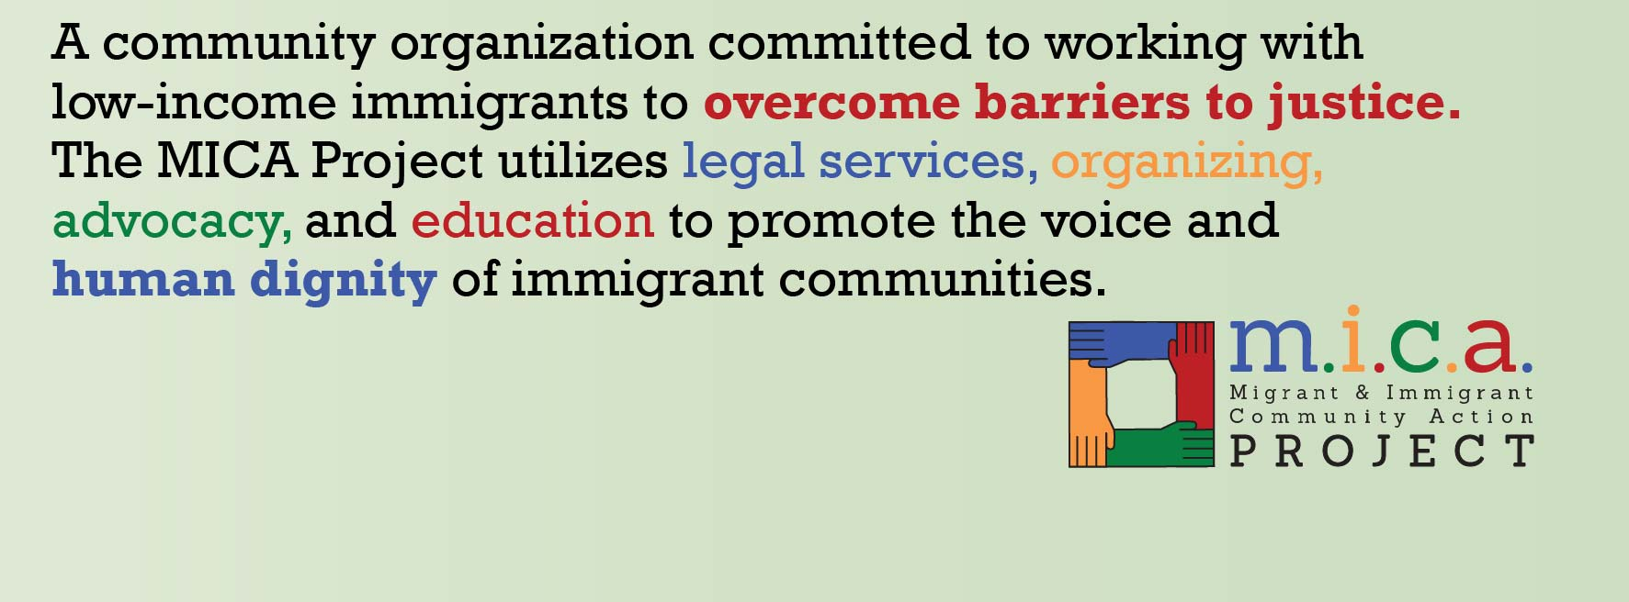
Who We Are:
Vision
We live in a safe and welcoming community for immigrants, demonstrating a shared understanding of the dignity and worth of all people.

Slide 3
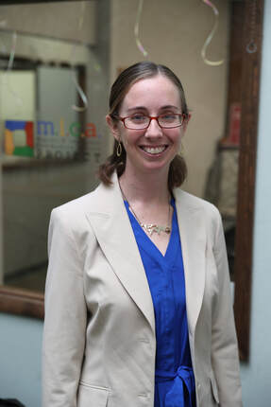
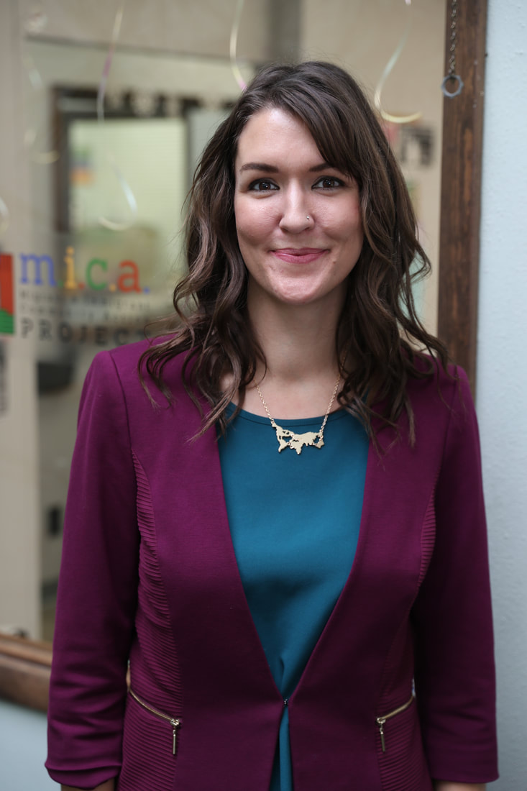
History
The MICA Project was founded in 2011 by law students Nicole Cortés and Jessica Mayo and began operations in 2012. Through their work in the nonprofit immigration field, they observed surplus need for low-cost immigration legal services.
They saw a need in the community that was not being met, and the lack of access to immigration legal services in the area led to open their own non-profit.
Since the organization's founding, the MICA Project has worked with hundreds of individuals and families in the St. Louis and Illinois region.

Slide 4
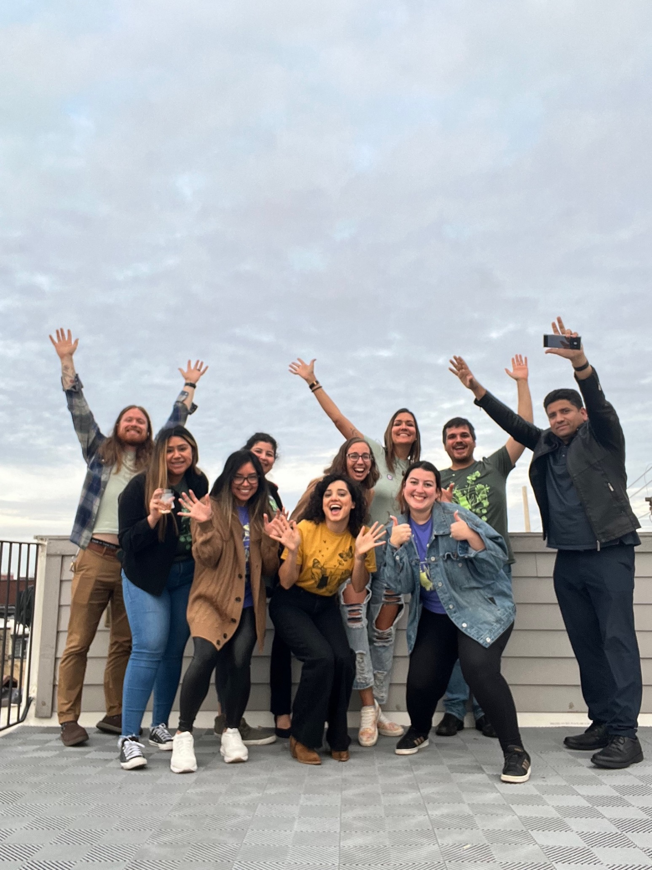
Our Growth
From those two young graduates in 2012, to a current staff of 16, the MICA Project has seen tremendous growth.
2022 was the perfect example of that
growth - MICA received funding to
expand its legal programming in rural
Illinois, to oversee the provision of
legal services for Afghan parolees in
eastern Missouri, and to expand the
Children's Immigrant Advocacy
Project.

Slide 5
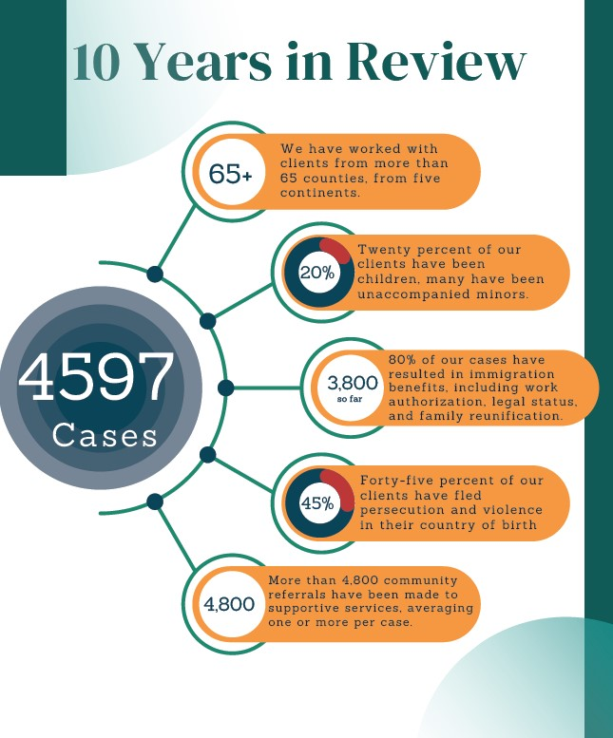

Slide 6
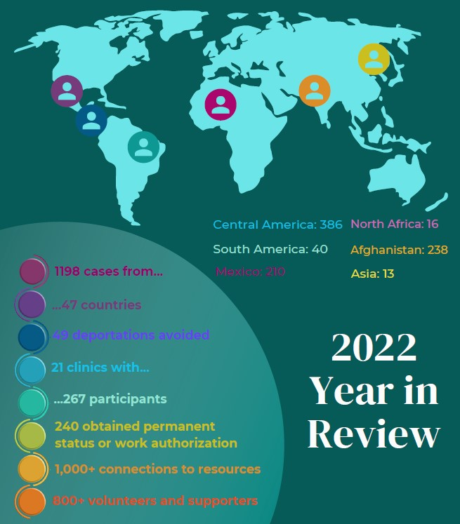

Slide 7

What types of legal cases do we take?

Slide 8
Affirmative Asylum
Defensive Asylum
U-Visas
T-Visas
VAWA (Violence Against Women Act)
DACA (Deferred Action for Childhood Arrivals)
SIJ (Special Immigrant Juveniles)
Adjustment of Status
Residency, Citizenship, Family Petition, Consular Processing
Pro se Clinics
Asylum & Work Permits

Slide 9
Client Support Services Department
Supporting and equipping clients as they navigate complex systems in the St. Louis region through case management, advocacy, and other support services
Our services include: interpretation, accompaniment, access to community resources, and emotional support, referrals to partners agencies

Slide 10
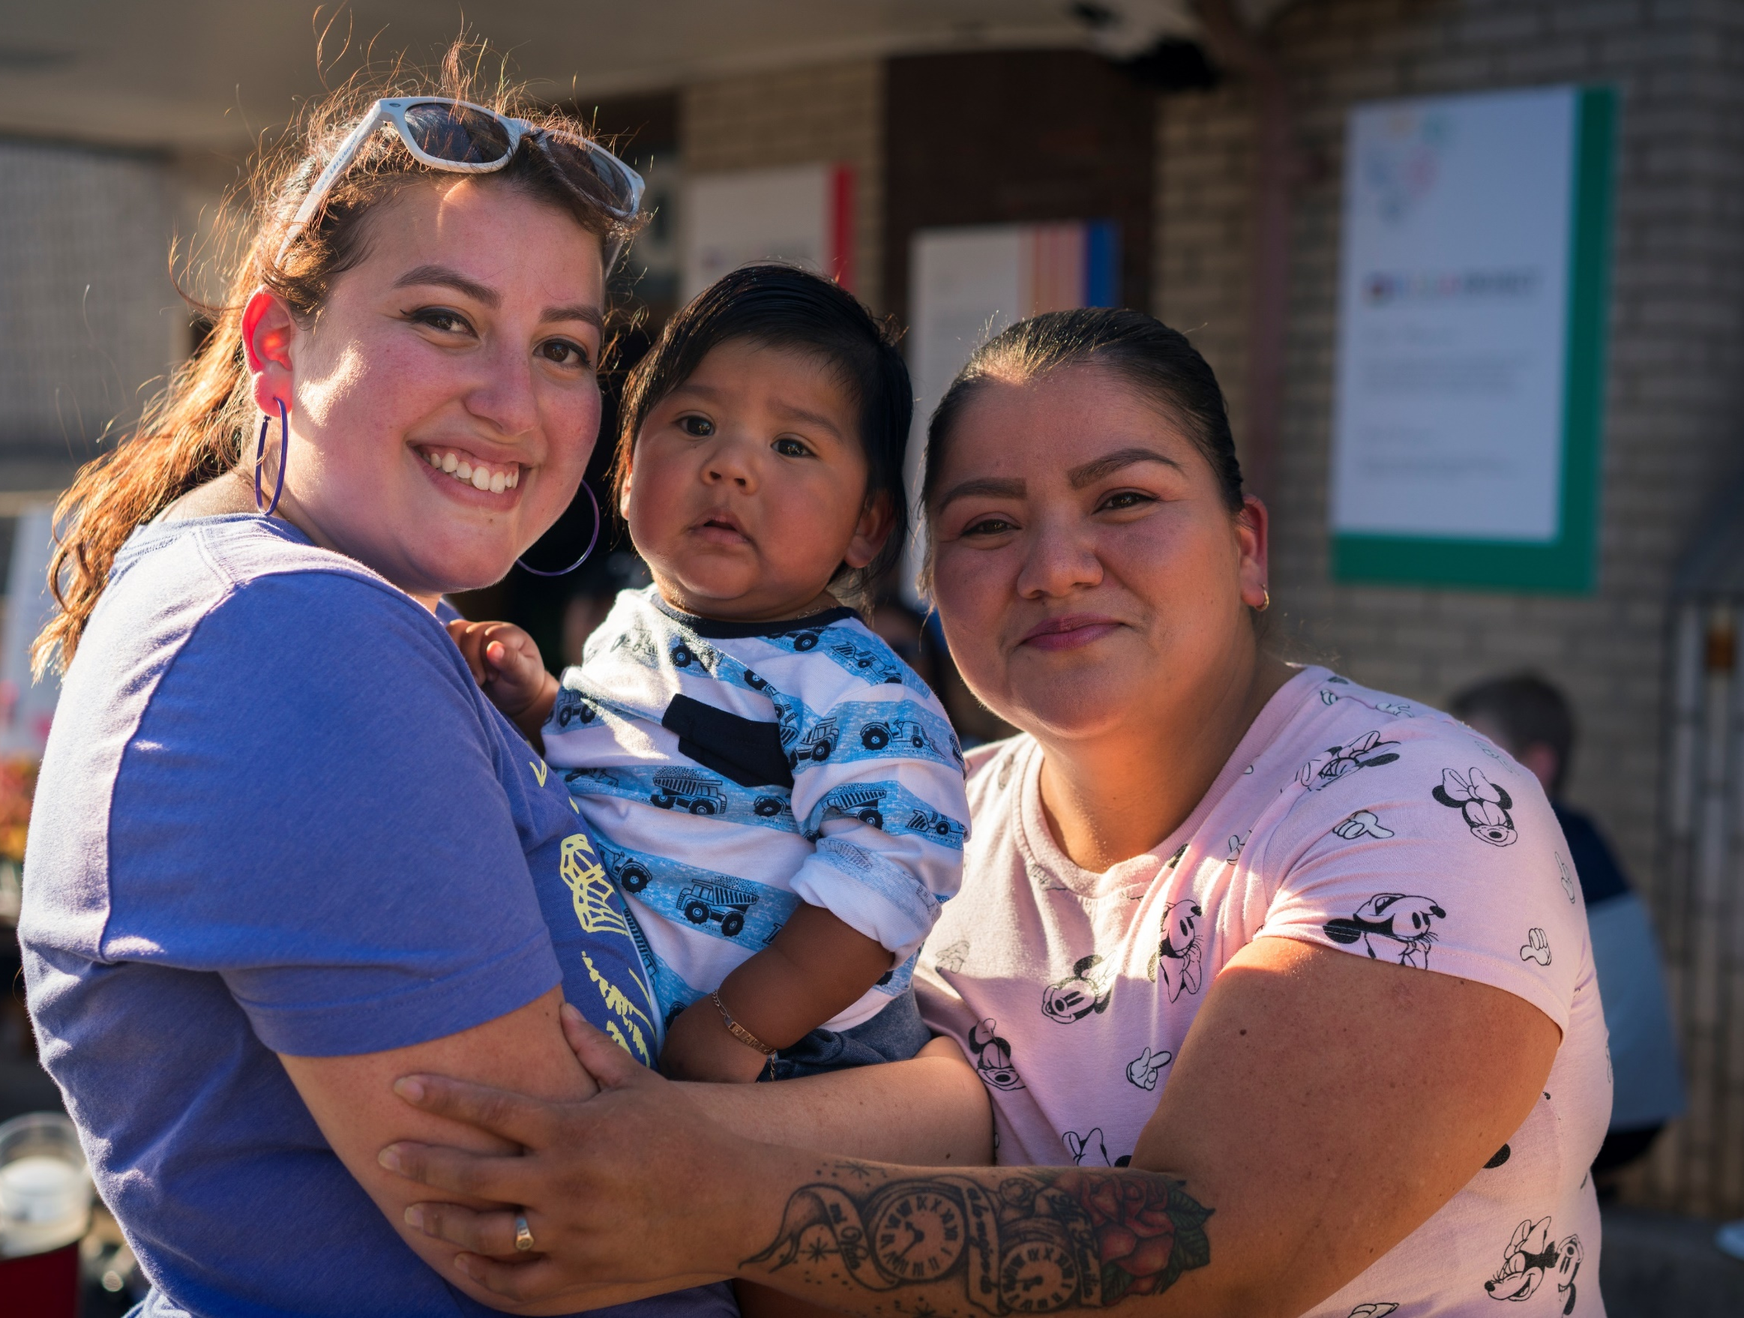
Most Common Services:
Public benefits applications
Hospital financial assistance applications
Obtaining ID
Connecting with community resources (mental health, food)
Accompaniment
Writing legal affidavits
Interpretation of forensic exams

Slide 11
Our department’s goals
Support clients throughout the duration of the legal case
Inform clients about existing community resources
Equip clients to navigate complex systems in St. Louis independently by the time their case is closed

Slide 12



We also work with community partners such as:

Slide 13
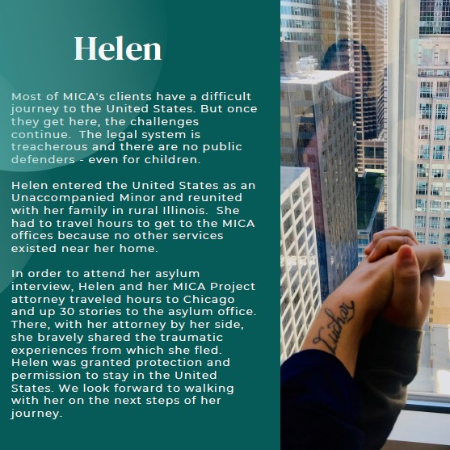
Client’s Story:

Slide 14

Questions?
MICA Project Intake Line:
314-995-6995 extension #2
Our intake line is ordinarily open the first Monday of each month
Contact Info:
carlosruizmartinez@mica-project.org
marianaleonpastore@mica-project.org
Website:
www.mica-project.org

