Slide 1

The Missouri Recovery Friendly Workplace Project April 27, 2023

Slide 2

Introductions
Dr. Doug Swanson
Field Specialist, Labor and Workforce Development
University of Missouri Extension
Ann McCauley, MEd
Director, Rural Opioids Technical Assistance Project
University of Missouri Extension
Notes:
.

Slide 3

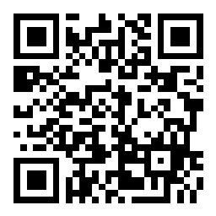
Vote at Slido.com with the code #1940271
Would you consider your place of employment recovery friendly for employees?

Slide 4
Learning Objectives
To increase your understanding of the Recovery Friendly Workplace Initiative in Missouri
Describe workforce trends and shortages and challenges employers face in today’s market
Learn current and future plans for the initiative in Missouri and how we can support businesses and Institutes of Higher Education (IHE) who are ready to create positive change, eliminate stigma, and support employees in recovery

Slide 5

REPORTS & PUBLICATIONS
In 2010, workers between the ages of 25 and 54 made up 40.2% of the population. In 2020, Millennials made up 37.5% of the workforce. Of all those aged 15 to 64, one-third are between the ages of 25 to 39.
In the next decade, there will be 50,000 more Missourians who turn 65 years old than graduate high school.
Source: Mark White, University of Missouri

Slide 6

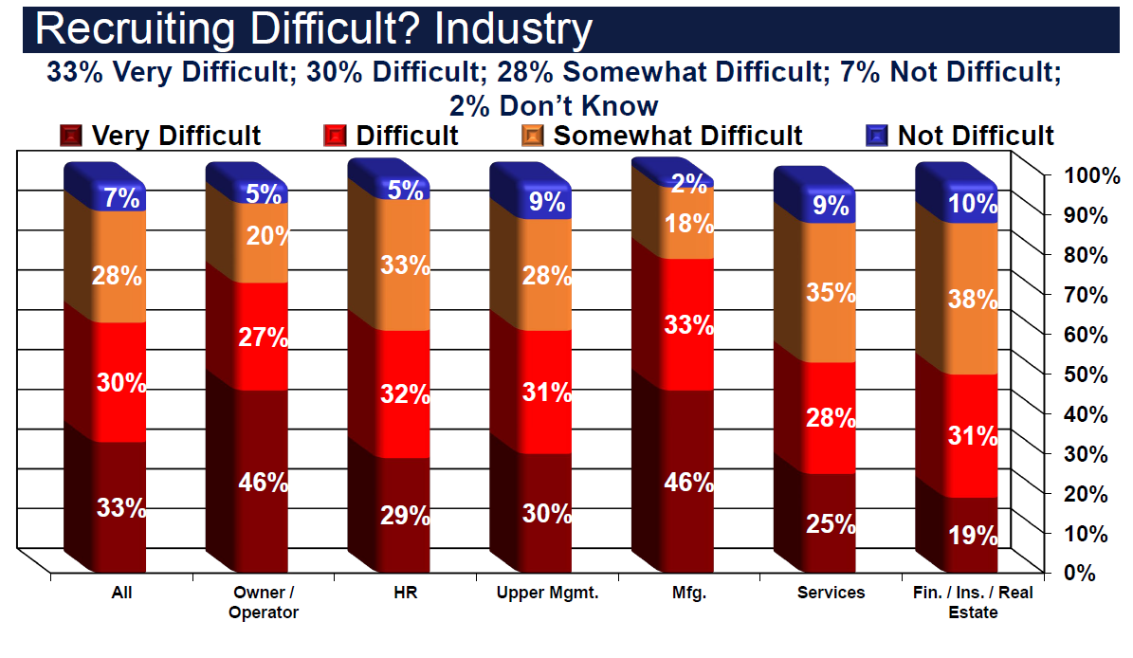

Slide 7
By Dec 31, 2029, 79 million Baby Boomers will be eligible to leave or will have left the workforce
That = 26% of the population
or
1 out of every 4 people
(based on Jan 1, 2010, population)
Source: Cohn, D’Vera and Paul Taylor. Baby Boomers Approach 65 - Glumly. Pew Research Center. December 29, 2010. https://www.pewresearch.org/social-trends/2010/12/20/baby-boomers-approach-65-glumly/
Notes:
Covid did not cause this shortage of workers!
Of the workers in the workforce when the first boomer became retirement eligible, over a quarter of them will be leaving the workforce by the end of 2029.
We have not had a replacement birth rate since 1973.
The past two years we have had the lowest immigration rate to the US in the nations history.
Changing this data points are policy changes above our paygrade, if you will.

Slide 8
Where Have All the Workers Gone?
11.4% of men between the ages of 25 and 54 are not in the workforce, because they are either not employed or not seeking work. Of the 11.4%, approximately 7,000,000 of them are not working.
The survey found that 47% of those individuals had taken pain medication within the last 24 hours.
Source: Krueger, Alan. October 4, 2016. Where Have All the Workers Gone? https://www.bostonfed.org/-/media/documents/economic/conf/great-recovery-2016/alan-b-krueger.pdf

Slide 9

Intended Outcomes for RFW MO Initiative
Between 2000 and 2016, the U.S. lost an estimated $37.8 billion in state and federal taxes due to eligible workers not in the workforce
Develop a framework and guidelines for training and technical assistance to businesses and IHE to be recognized as a Recovery Friendly Workplace (RFW)
Establish designation process for employers to become recovery friendly
Build capacity within Extension to address OUD/SUD and stigma within local communities on- and off-campus
Foster a workplace culture that promotes employee health, safety, and wellbeing through strategies that provide support for managers, employers, faculty, staff, and students in recovery
Source: Penn State University Study in Journal of Medical Care, 2019

Slide 10
In 2016, Missouri’s total economic cost of the opioid epidemic was $12.6 billion Opioid Use Disorder (OUD) and overdose deaths cost the state $34.5 million a day; $1.4 million an hour That’s 4.2% of the nearly $300 billion of the MO GDP
Source: HIDI HealthStat, January 2018

Slide 12


Slide 13
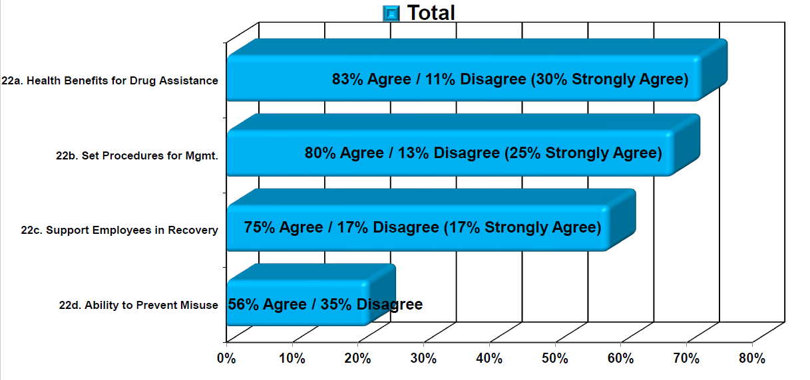
My Organization Has…?

Slide 14
Are You Aware of Your Employer’s Policy on Substance Use and / or Addiction?

Slide 15
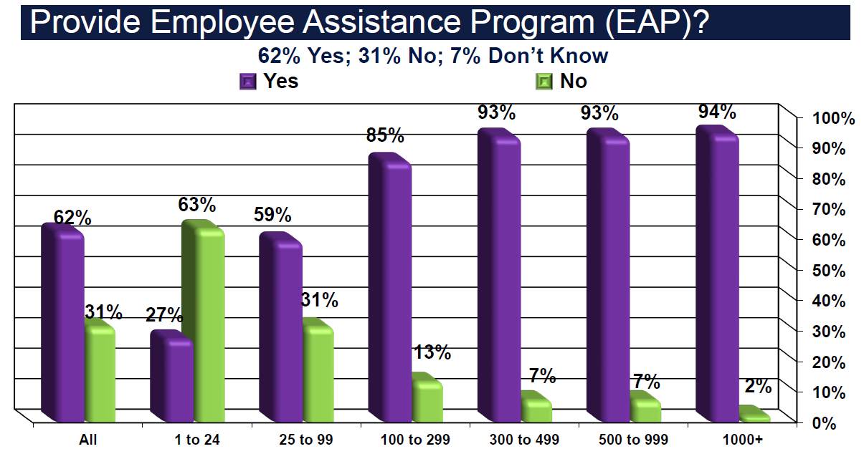

Slide 16
Notes:
When we asked if employers provided any recourses on SUD or addiction recovery, we saw those numbers trending downward.
Again, this may be an area where multi employers may be able to collaborate to provide benefits that help to provide stability in their workforce.

Slide 17
Vote at Slido.com with the code #1940271
What word should be included in a recovery friendly workplace?

Slide 18

What is a Recovery Friendly Workplace? What does Recovery Friendly mean?
A RFW is a business or academic institution that chooses to go above and beyond for its employees by creating a workplace culture that supports people in recovery from SUD, as well as those impacted by substance misuse.
When a recovery friendly environment is created, people in recovery and those impacted by SUD can thrive. A Recovery Friendly Workplace shines a light on employee health, wellness and safety, and demonstrates commitment to reducing stigma often associated with SUD.

Slide 19

Benefits of RFW
EMPLOYERS
EMPLOYEES
Improved health and wellness on campus
Faculty and staff retention
Reduced absenteeism
Improved productivity by giving faculty/staff the tools they need
Safe, positive workplace culture
Employee loyalty
Organizational commitment
Improved health and wellness
Reduced stigma
Improved communication
Supportive, safe environment
Motivation to succeed
Job satisfaction
Healthier workplace culture overall

Slide 20

Recovery is Resilience

Slide 21
Accomplishments RFW Education, Training and Resources
Series of livestream sessions
Economic Analysis
Community Conversations
Developed the RFW Designation Process
Trainings include Shatterproof, Recovery Ally and Naloxone/Narcan
Statewide Employer Survey/Employee Survey
Businesses Across the State Apply for Designation
Working with the state of Nebraska and University of Wisconsin as they develop their initiative
Recording Shared Stories/Penn State’s Story Powered Initiative
Sharing our Blog with Penn State
Employer Toolkit

Slide 22
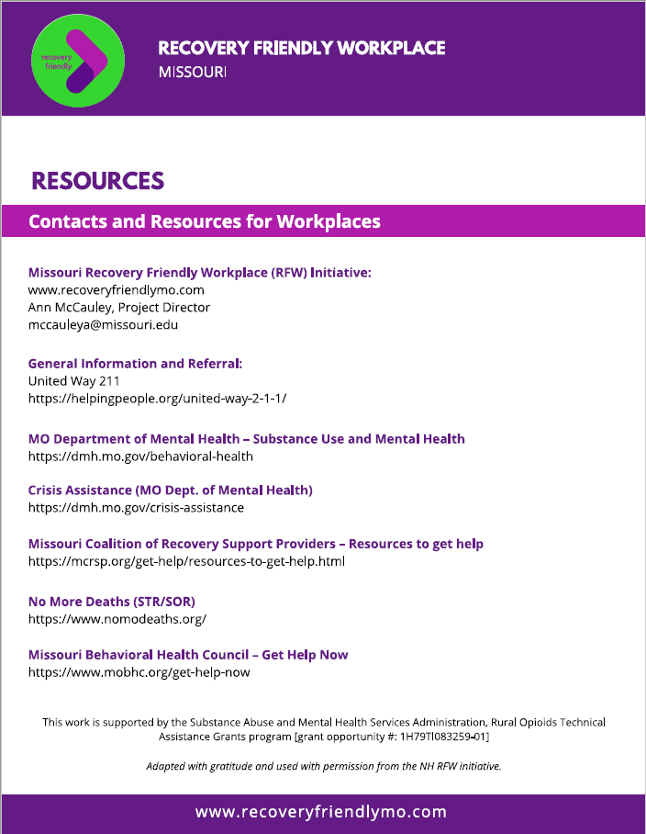
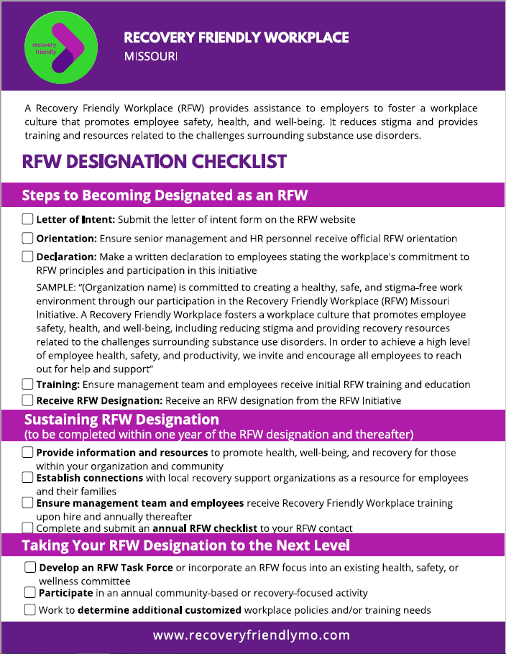
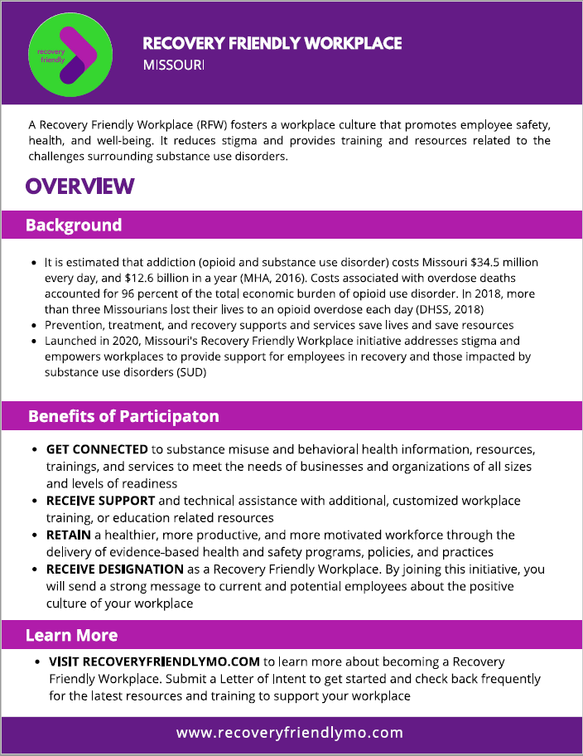
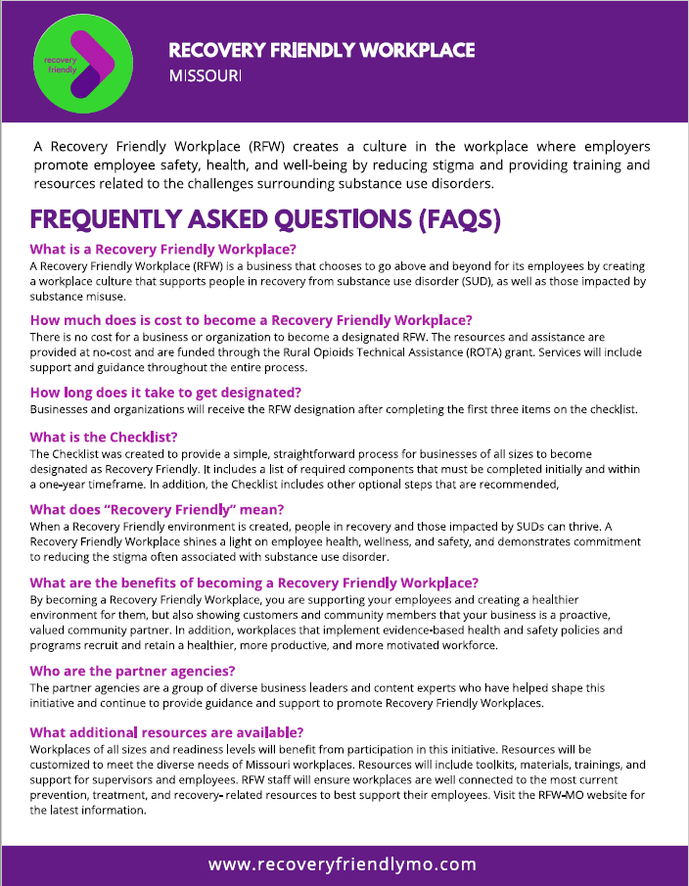
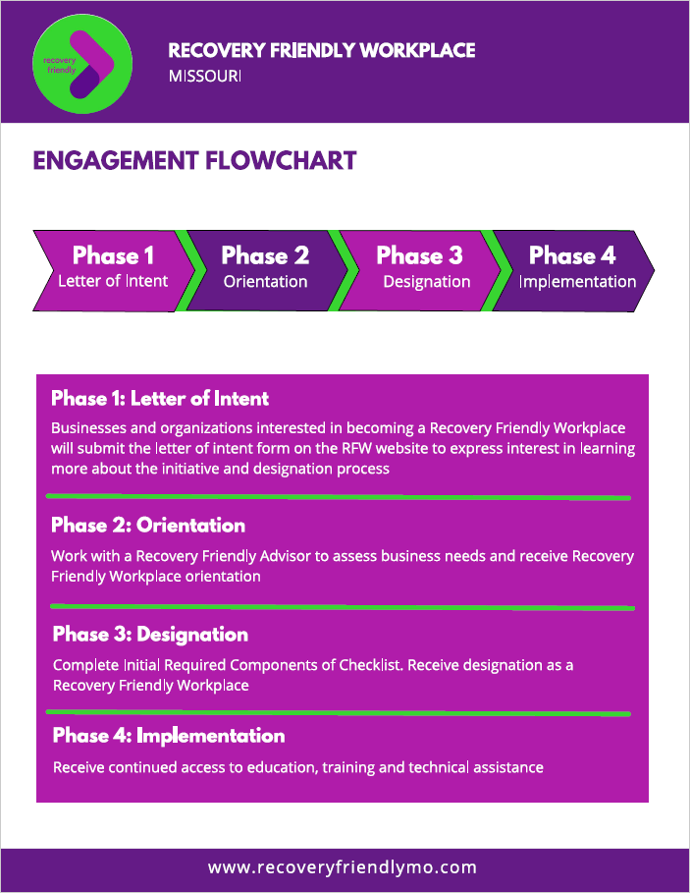
Recovery Friendly Designation Packet

Slide 23
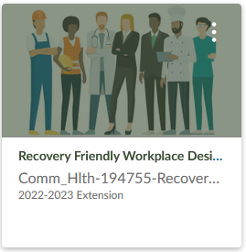
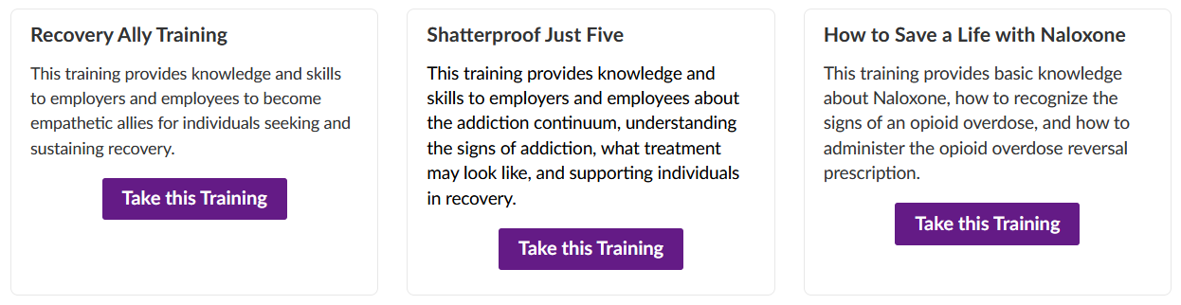
RFW Designation Online Trainings
3 engaging modules
Found on Canvas

Slide 24
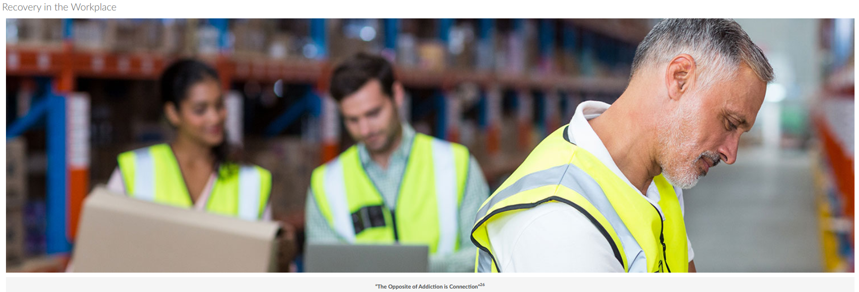
Recovery Ally Training
30 minutes
Content includes
Substance use disorders and recovery
Myths and stigma about substance use disorders
Using person first, recovery friendly language
How to support someone seeking, or already in, recovery
How to support employees with substance use disorder

Slide 25
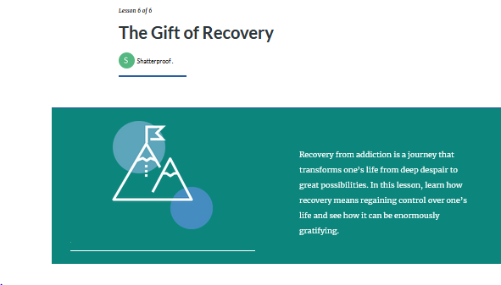
Shatterproof Training
Content includes
The Science of Addiction
Are You at Risk?
The Dangers of Opioids
Signs, Symptoms & Treatment of Addiction
How You Can Help
The Gift of Recovery

Slide 26
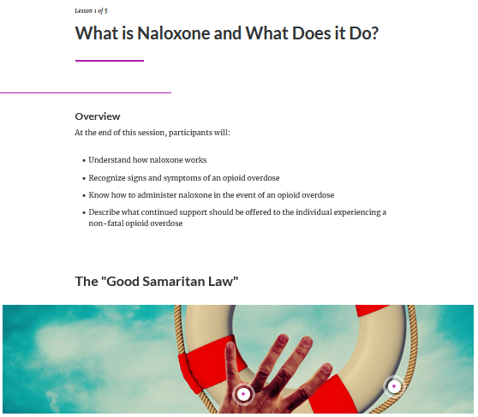
How to Save a Life with Naloxone Training
15 minutes
Content includes
What is Naloxone and What Does it Do?
Opioid Overdose & Steps for Care
Naloxone Administration
More About Naloxone
Summary

Slide 27
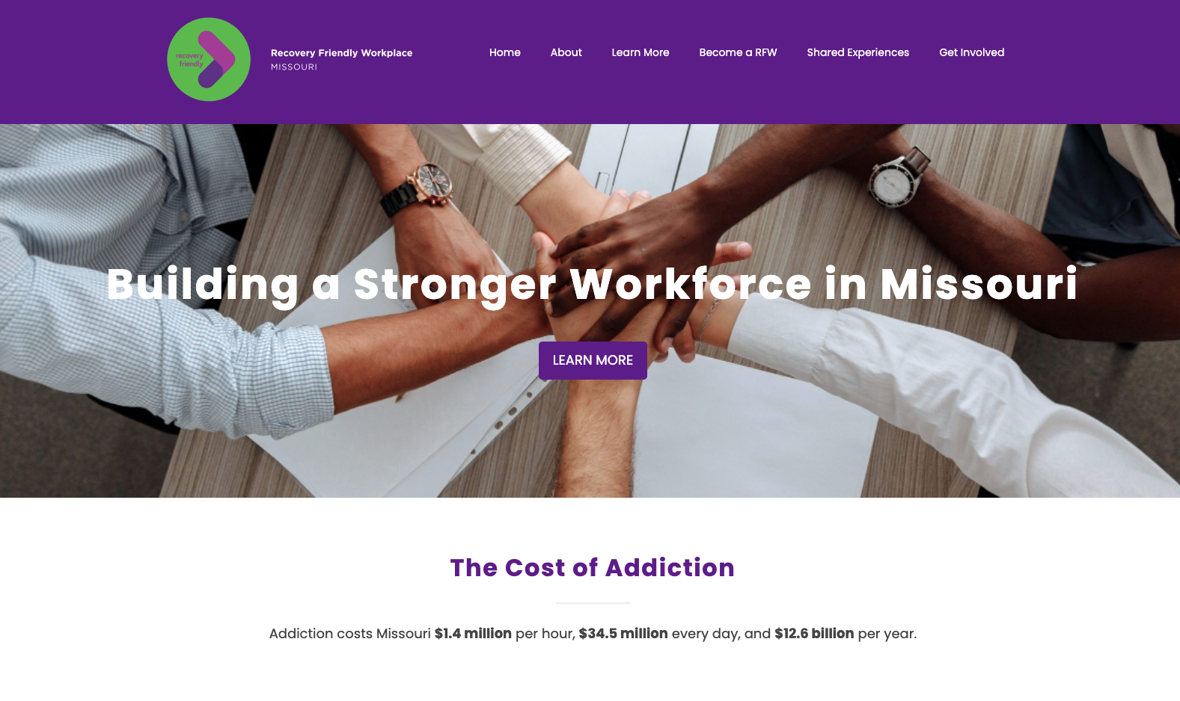
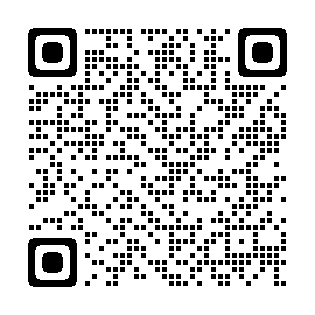
RFW Website
https://recoveryfriendlymo.com/

Slide 28
Businesses Designated as Recovery Friendly Workplaces in Missouri
Citizens Memorial Hospital; Bolivar A.M. Solutions, Jefferson City
Tower Rock Stone Company; ACE Pipe Company;
St. Genevieve Kansas City
CORE; Branson First Call; Kansas City
Buddeez Manufacturing; Union PreventEd, St. Louis

Slide 29
What’s on the Horizon
Complete Employee Surveys and tabulate data, draw comparisons to Employer Survey results
State-wide Advisory Committee convenes monthly
Statewide convening of stakeholders on University of Missouri campus in August
SUD/OUD education and training for Extension professionals and faculty to help build capacity for working in local communities
Expanding regional with ROTA-R
Presentations at local, state and national conferences
Contacting State Representatives and Senators to share initiative
Awarding Recovery Friendly Workplace Designations
Presentation on Recovery Ally Training for the University of Wisconsin
Offering Technical Assistance services

Slide 30
What Can You Do?
Contact us if you have a story to share
Let us know if your organization or business is hiring people in recovery
Sign up to attend our statewide convening
Become a partner
Be a Champion

Slide 31
Thank You
Ann McCauley, MEd
mccauleya@missouri.edu
Dr, Doug Swanson
swansondj@missouri.edu
recoveryfriendlymo.com
This work is supported by the Substance Abuse and Mental Health Services Administration, Rural Opioids Technical Assistance Grants program [grant opportunity #: 1H79TI083259-01]

